Slide 1


Linear modules basic training
Superior Clamping and Gripping

Slide 2
Linear modules overview
pneumatic |  | electric
 |  | Spindle/Belt/Rack |  | Linear direct drive
Components | Systems | Components | Systems | Components | Systems
LM | PPU-P | Alpha | LPE | LDK | PPU-E
CLM | LPP | Beta | RPE | LDH
KLM | DRL | Gamma |  | LDN
HLM |  | Delta |  | LDM
PMP |  | ELS |  | LDT
 |  |  |  | LDF
 |  |  |  | ELM
 |  |  |  | EPM
Produced in Huglfing at SCHUNK Montageautomation GmbH
100 % SCHUNK
Produced in St. Georgen at SCHUNK Electronic Solutions GmbH
100 % SCHUNK
Produced in Reutlingen at HSB-Automation GmbH
29 % SCHUNK
Produced in Hausen

Slide 3
Linear modules overview
pneumatic |  | electric
 |  | Spindle/Belt/Rack |  | Linear direct drive
Components | Systems | Components | Systems | Components | Systems
LM | PPU-P | Alpha | LPE | LDK | PPU-E
CLM | LPP | Beta | RPE | LDH
KLM | DRL | Gamma |  | LDN
HLM |  | Delta |  | LDM
PMP |  | ELS |  | LDT
 |  |  |  | LDF
 |  |  |  | ELM
 |  |  |  | EPM

Slide 4
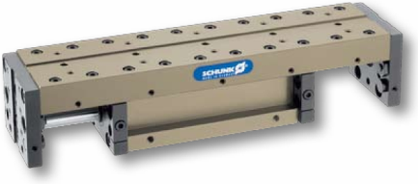
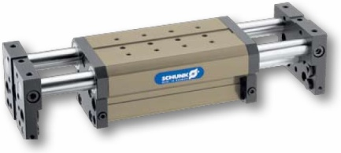
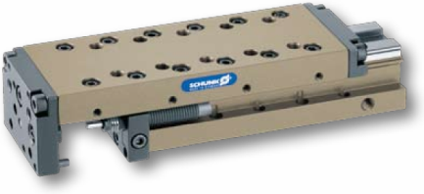
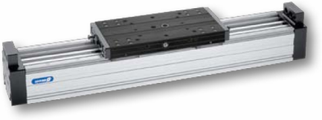
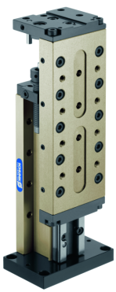
Pneumatic components
LM 25-300
KLM 25-300
CLM 08-200
PMP 16-25
HLM 25-200

Slide 5
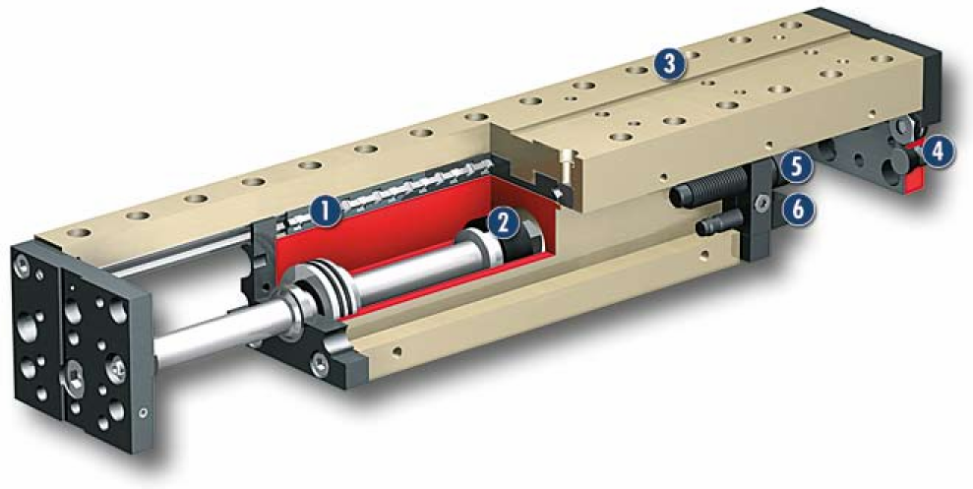
Pneumatic components
LM 25, 50, 100, 200, 300
5 sizes (67 N - 753 N)
strokes 25 - 450 mm
precise cross roller guidance (preloaded)
high stiffness by closed slider plate
possible adoption as slides or stroke modules
in the projection screen integrated dampers and proximity switches
several intermediate positions available – can be retrofitted
rod lock possible – can be retrofitted (from on size 50)
1
Crossed roller guide
2
Drive
3
Modular design hole pattern
4
Dampening adjustment
5
End position setting
6
Sensor system

Slide 6
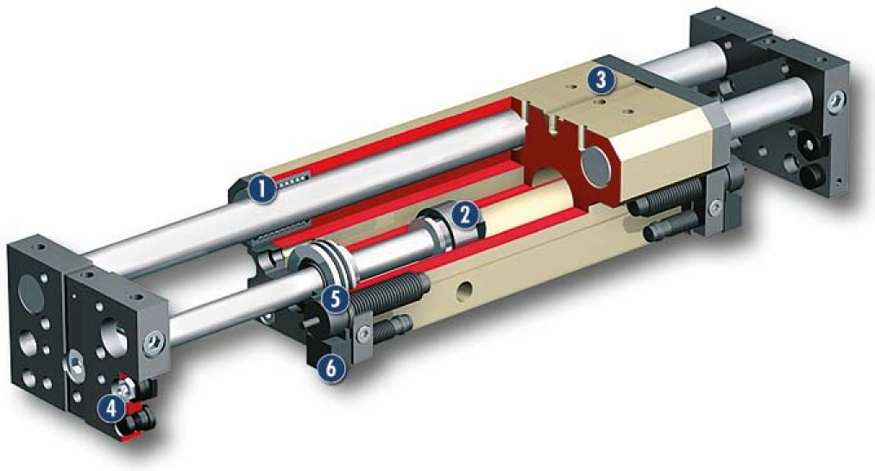
Pneumatic components
KLM 25, 50, 100, 300
4 sizes (67 N - 753 N)
strokes 25- 300 mm
free of play ball lining guidance system
cost-efficient alternative for the LM modules
protected guidance system by wipers
possible adoption as slides or stroke modules
in the projection screen integrated dampers and proximity switches
several intermediate positions available – can be retrofitted
rod lock possible – can be retrofitted (from on size 100)
1
Ball bushing guide
2
Drive
3
Modular design hole pattern
4
Dampening adjustment
5
End position setting
6
Sensor system

Slide 7
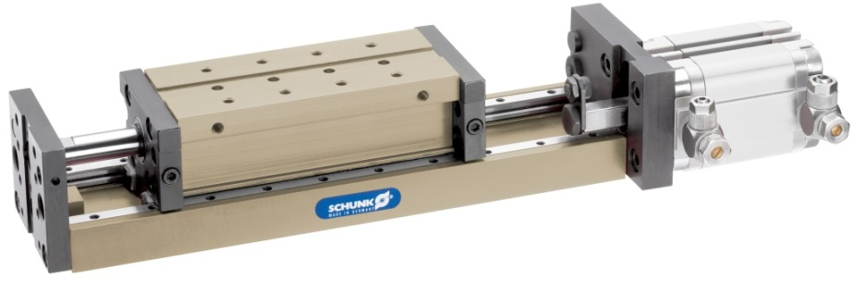
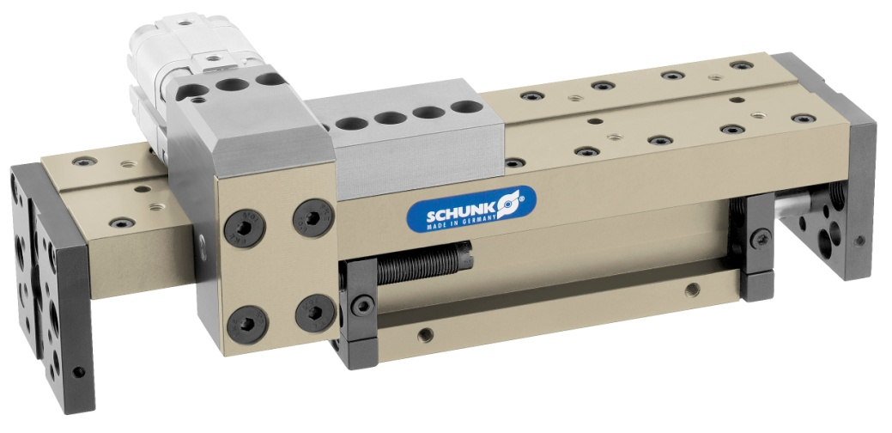
Pneumatic components
ZZA for all LM/KLM modules
up to two intermediate positions possible
intermediate position with
pneumatic cylinder
no swinging in the intermediate position
all operating circles allowed
LMZAW for LM 100/200/300
several intermediate positions possible
intermediate positions stepples adjustable
operating circle out of operating manual

Slide 8
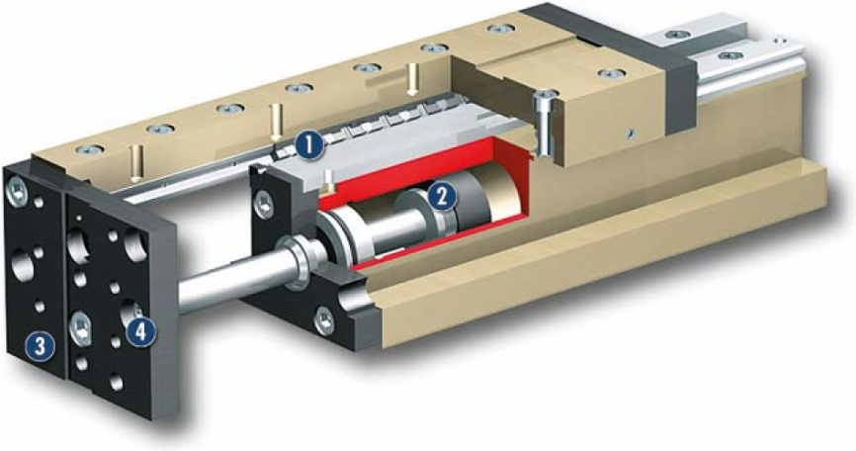
Pneumatic components
CLM 08, 10, 25, 50, 100, 200
6 sizes (30 N - 482 N)
strokes 14 - 150 mm
precise cross roller guidance
(preloaded)
compact length optimised design
protected guidance system by wipers
moving end plates or moving slider
in the projection screen integrated dampers and proximity switches
connection dimensions identical for LM and KLM linear modules (from on size 25)
rod lock possible – can be retrofitted (from on size 50)
1
Crossed roller guide
2
Drive
3
Modular design hole pattern
3
4
Dampening adjustment

Slide 9
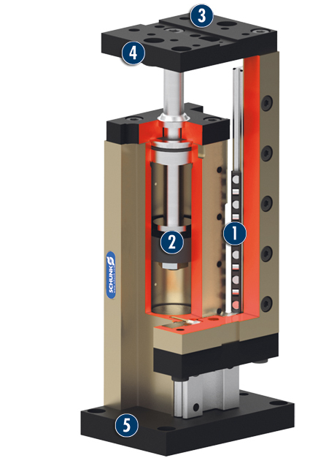
Pneumatic components
HLM 25, 50, 100, 200
4 sizes (30 N - 482 N)
strokes 25 - 150 mm
precise cross roller guidance (preloaded)
compact length optimised design
protected guidance system by wipers
in the projection screen integrated dampers and proximity switches
connection dimensions identical for LM, CLM and KLM linear modules
rod lock possible – can be retrofitted (from on size 50)
consists of CLM and base plate
1
Crossed roller guide
2
Drive
3
3
Modular design hole pattern
4
Dampening adjustment
5
Base plate

Slide 10
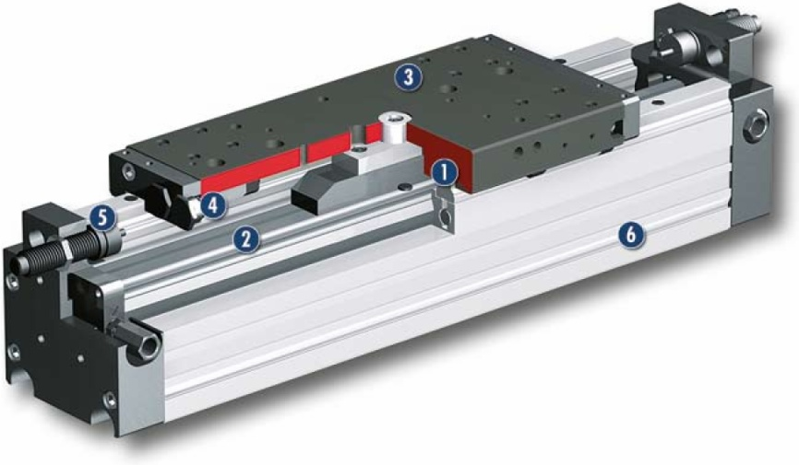
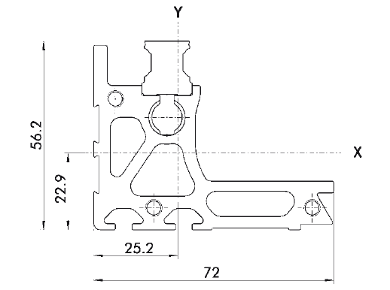
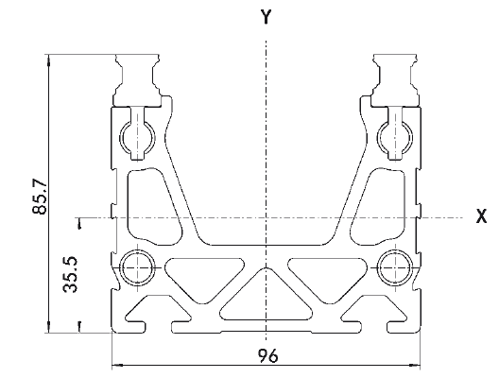
Pneumatic components
PMP 16, 25
2 sizes (100 N and 250 N)
strokes up to 2700 mm
profiled rail guidance
high degree of regidity thanks to special extruded profile
geometry
numerous options e.g.cable drag chain, bellow,
intermediate positions, etc.
1
Profiled rail guide
2
Drive
3
Modular design hole pattern
4
Dampening adjustment
5
End position setting
6
Profile
< profile PMP 16
profile PMP 25 >

Slide 11
Linear modules overview
pneumatic |  | electric
 |  | Spindle/Belt/Rack |  | Linear direct drive
Components | Systems | Components | Systems | Components | Systems
LM | PPU-P | Alpha | LPE | LDK | PPU-E
CLM | LPP | Beta | RPE | LDH
KLM | DRL | Gamma |  | LDN
HLM |  | Delta |  | LDM
PMP |  | ELS |  | LDT
 |  |  |  | LDF
 |  |  |  | ELM
 |  |  |  | EPM

Slide 12
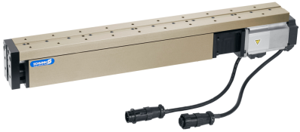
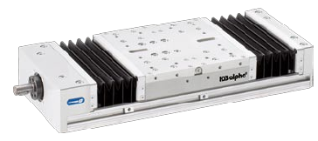
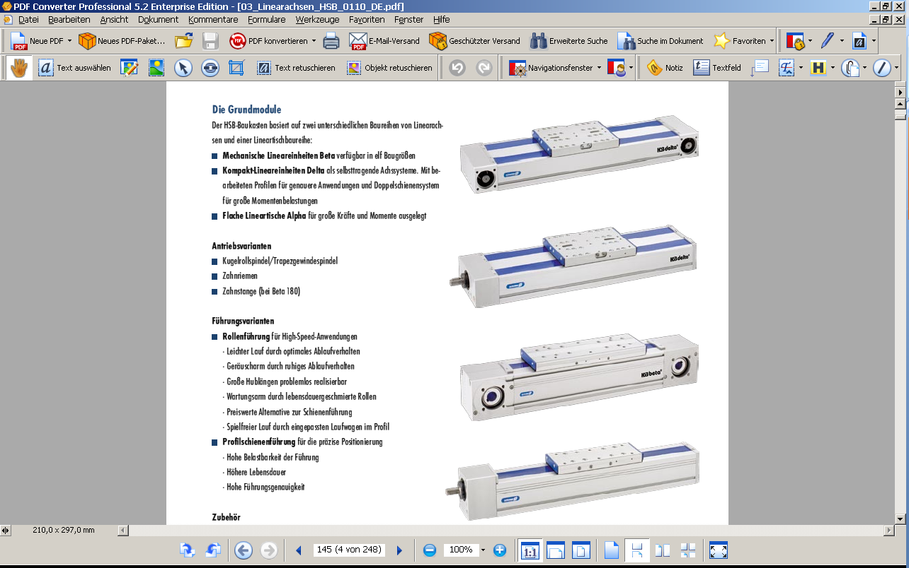
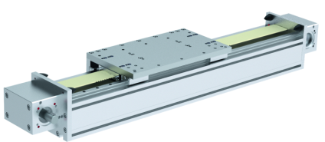
Electric components
Spindle/Belt/Rack driven axis
 | Spindle driven | Belt driven | Rack driven
ELS |  | - | -
Alpha |  | - | -
Beta |  |  | -
Gamma | - |  | Picture is missing
Delta |  |  | -

Slide 13
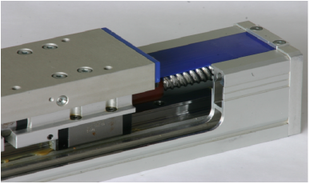
Function spindle driven axis

Slide 14
Function spindle driven axis
Typical design of a spindle driven axis
Pro:
High forces
Constant forces
Moderate costs
Con:
Large inteference contour
Many components
Lower stiffness
Low velocity
Short strokes
motor
coupling
spindle
slide
guidance
Spindle nut
Illustration with
mass – spring – backlash - model
motor
rotor
coupling
bearing
spindle
guidance
motor
stator
x
slide

Slide 15
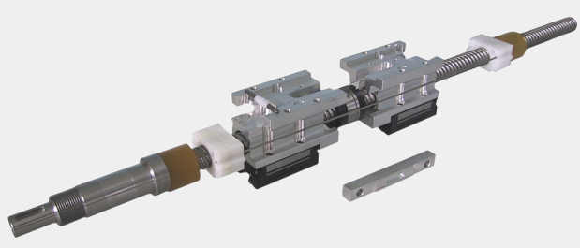
Function spindle driven axis
spindle support
internal damping
Spindle nut
wire for the spindle supports
glued spindle journal
guiding wagon

Slide 16
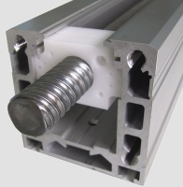
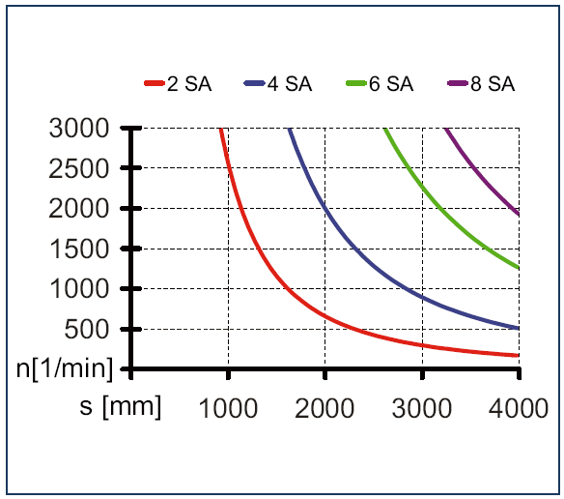
Function spindle driven axis
Tip:
A spindle driven axis can either use a ball bearing spindle or a trapezoid spindle
Attention - the axis will be longer when the spindle supports are used!
spindle support (3000 rpm !)
Repeat accuracy:
ball bearing spindle +/- 0.03 mm
trapezoid threaded spindle +/- 0.05 mm
Example: number of spindle supports

Slide 17
Function belt driven axis
Typical design of a belt driven axis
Pro:
Cost effective
High velocity
Contra:
Large inteference contour
Many components
Lower stiffness
Ideal for middle strokes
motor
slide
belt
gearbox
coupling
guidance
Illustration with
mass – spring – backlash - model
motor
rotor
gearbox
coupling
bearing
belt
guidance
x
slide

Slide 18
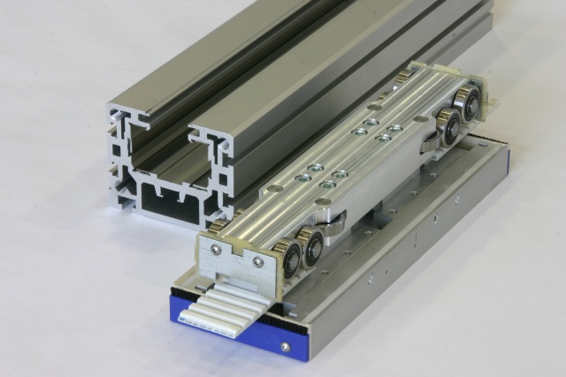
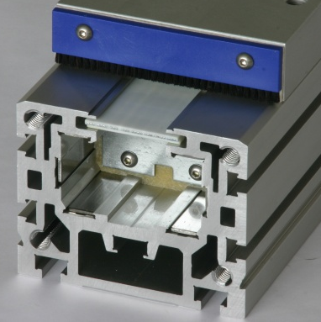
Function belt driven axis
Slot for belt

Slide 19
Function rack driven axis
Typical design of a rack driven axis
Pro:
Cost effective
High velocity
More than one slide on the same profile is possible
Fewer components
Robust
Contra:
Large inteference contour
Motor is always moved
Not as precise as spindle driven units
guidance
motor
coupling
slide
gearmox
rack
Illustration with
mass – spring – backlash - model
Motor
rotor
coupling
gearbox
rack
guidance
x
slide

Slide 20
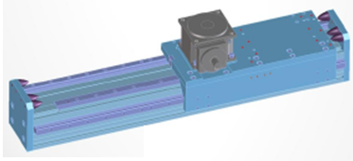
Function rack driven axis
Example of a rack drivenaxis

Slide 21
Characteristics of Guidance Types
Type of guidance | vmax amax | Friction | Precision | Load | Price level
Roller guidance
Ball bushing guidance
Profiled rail guidance
Sliding guide

Slide 22
Characteristics of Guidance Types
Roller guidance
Low noise due to roller movement
Long strokes easily possible
Low maintenance
Low costs compared to rail guidance
Profiled rail guidance
High load capacity of the guidance
Longer life time
High precision

Slide 23
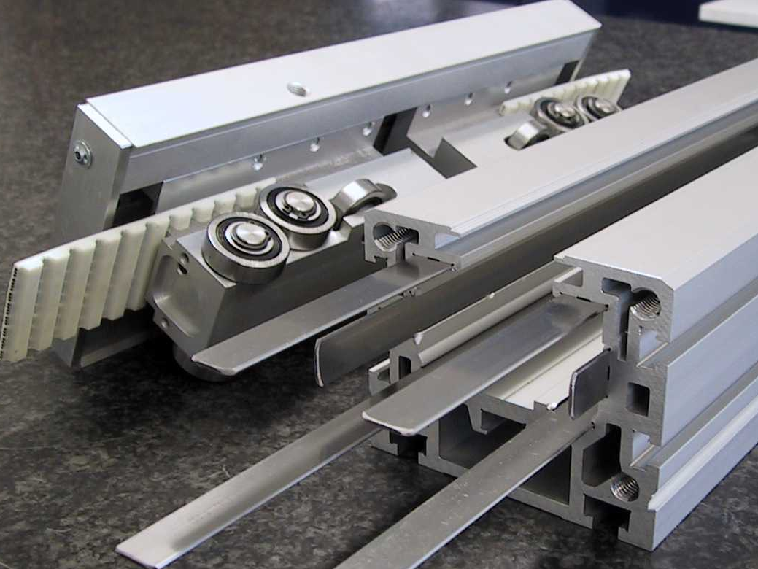
Characteristic of guidances
Rollers for forces from beneath
Rollers for lateral forces
Rollers for forces from above
Belts with steel cores
Six hardened precision steel strips

Slide 24
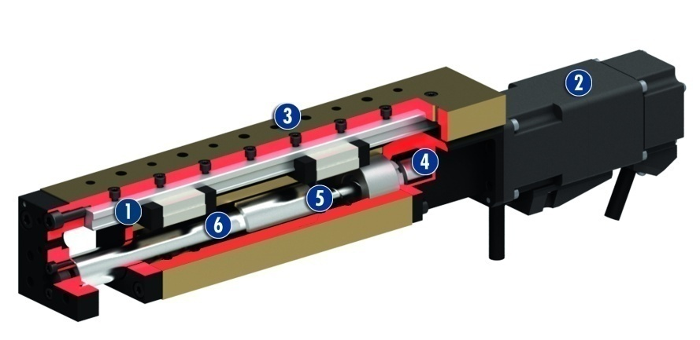
Electric component
Spindle driven
ELS 23, 37
1
Profiled rail guide
profiled rail guide
compact design
can be combined with pneumatic linear modules and/or linear motors as standard
driven by external motor: Standard: BoschRexroth MSM, other drives also possible
telescopic extension of the slide results in smaller space requirements
motor is always fixed, only slide moves. Low moving mass (compared to conventional spindle axes, e.g. HSB) → smaller drives can be used
thread and centering holes used for mounting instead of T-nuts. This makes for easier assembly and simple alignment of the axis or gripper → time savings
2
Drive
3
Modular design hole pattern
4
Ball screw nut
5
Spindle
6
Cover tube

Slide 25
Electric component
Spindle driven
Profile Overview
Beta 40, 50C, 60, 70C, 80, 100D, 110, 140, 140C, 165, 180, 180C
12 profile sizes
Rigidity hollow board profile
Max. stroke 7,640 mm
Driven by drive belt or spindle
Optionally profile rail guides or roller guides
Spindle supports can be added for high speed (only for a spindle axis)
Completely covered by a plastic band
Can be mounted via T-nuts or mounting blocks

Slide 26
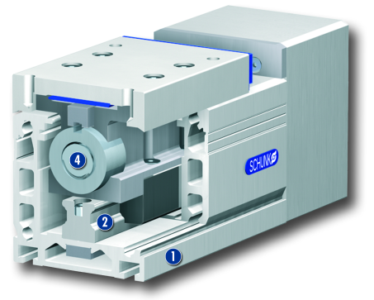
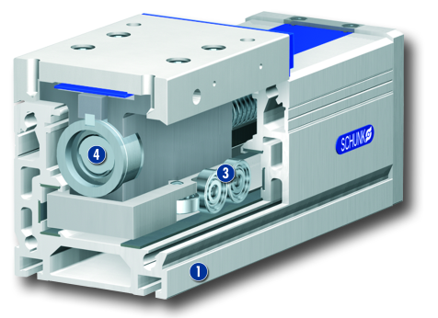
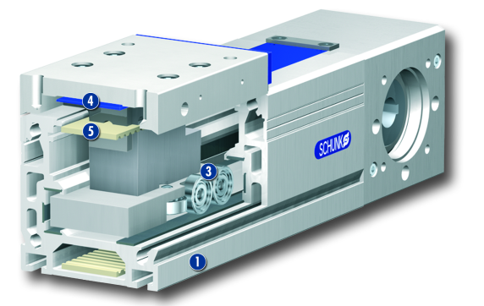
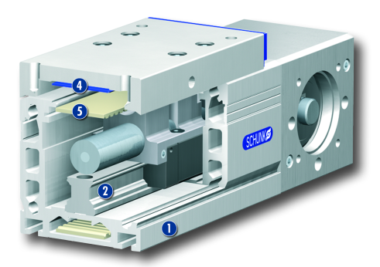
Electric component
Spindle driven
Beta Function sectional view
1
Profile
2
Rail guidance
3
Roller guidance
4
Spindle drive
5
Cover band
6
Toothed belt drive

Slide 27
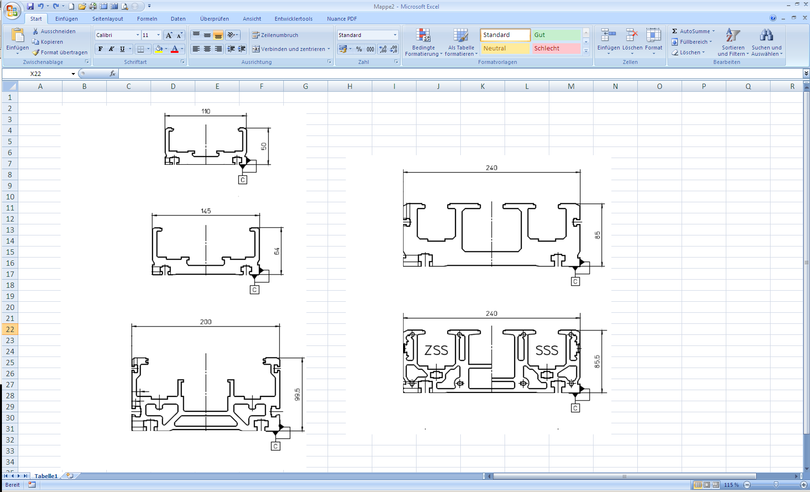
Electric component
Spindle driven
Profile Overview
Delta 90, 110, 145, 240, 240C
5 Profile sizes
Machined profile for higher precision
Driven by drive belt or spindle
double rail guide for high load capacity
Designed for high forces and moments
Spindle supports can be added for high speed (only for a spindle axis)
Completely covered by a plastic band
Can be mounted via T-nuts or mounting blocks

Slide 28
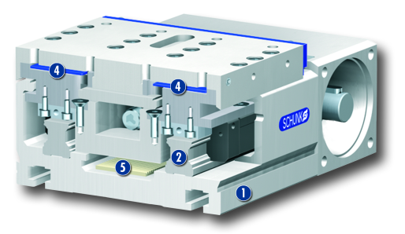
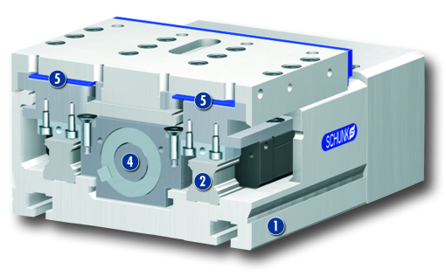
Electric component
Spindle driven/ belt drive
Delta Function sectional view
1
Profile
2
Rail Guidance
4
Cover band
5
Toothed belt drive
1
Profile
2
Rail Guidance
4
Spindle drive
5
Cover band

Slide 29
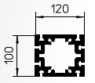
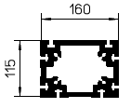
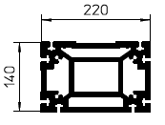
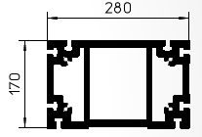
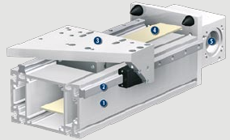
Electric component
Spindle driven/ belt drive
Overview profile
Gamma 120, 160, 220, 280
4 profile sizes
max. stroke 10,000 mm
closed basic profile for max. rigidity, no additional support needed
optional belt or rack drive
double rail guidance for high load capacity
Possible to have several , independent slides on a single profile
rail clamping elements for lowering block available
1
Profile
2
Rail Guidance
3
Slide
4
Toothed belt
5
Motor mount

Slide 30
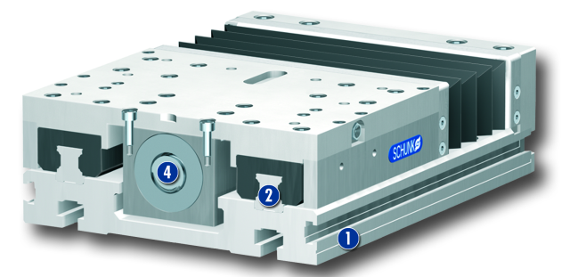
Electric component
Spindle driven
Alpha 15, 20, 30, 35
Overview profile
flat design for table mounting
ballscrew spindle drive
max. stroke 2,540 mm
double rail guide for high load capacity
completely covered by bellows
attachment either from the top or from the bottom screwed directly via T-nuts
1
Profil
2
Profilschienenführung
4
Spindelantrieb

Slide 31
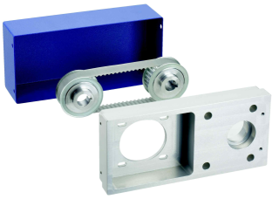
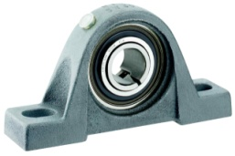

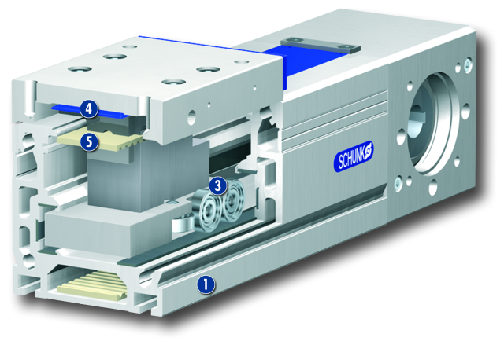
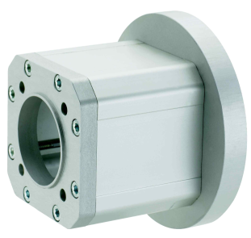
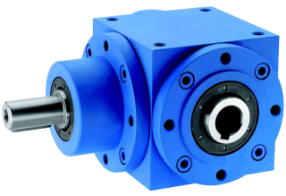
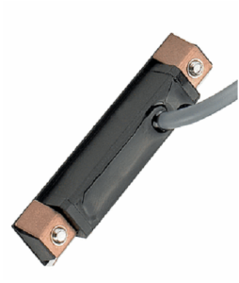
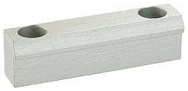
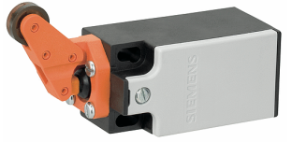
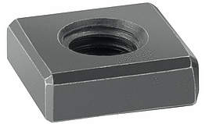
Accessories
Spindle driven/ belt drive
Synchronization shafts
Pedestal bearing
Belt drive
Flange
Bevel gear
Mech. roller switch
T-Nut
Mounting strip
Ind. proximity switch

Slide 32
Linear modules overview
pneumatic |  | electric
 |  | Spindle/Belt/Rack |  | Linear direct drive
Components | Systems | Components | Systems | Components | Systems
LM | PPU-P | Alpha | LPE | LDK | PPU-E
CLM | LPP | Beta | RPE | LDH
KLM | DRL | Gamma |  | LDN
HLM |  | Delta |  | LDM
PMP |  | ELS |  | LDT
 |  |  |  | LDF
 |  |  |  | ELM
 |  |  |  | EPM

Slide 33
Function linear motor
Pro:
Fewer components
high velocity
high stiffness
„unlimited“ stroke
Contra:
not very good at vertical applications
higher costs
measering system necessary
Typical design of a linear motor axis
slide
magnets
guidance
Motor coil
Illustration with
mass – spring – backlash - model
Direct drive:
High stiffness with small backlash is due to high dynamics and a high precision!
motor
coil
guidance
magnets
x= upper part

Slide 34
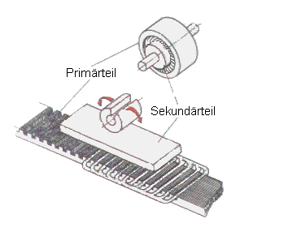


Function linear motor
N
S
S
N
N
S
S
N
N

Slide 35
Function linear motor
Commutation
Before the homing procedure of the linear axis the offset (or position) between the motor coils (primary part) to the permanent magnets (secondary part) has to be detected. That detection is necessary to supply the motor coil with the right amount of current so that the thermal load the the efficiency is optimal. That is called commutation.
Therefore there are different posibilities:
with a hall sensor
This is done by Hall-effect sensors integrated in the motor. They output sine and cosine signals. The controller calculates the position of the runner relative to a pair of magnets from these signals over a period (= 28.1 mm)
Standstill commutation
Here are some current impluses at a standstill used to detect the position of the cails relativly to the magnets.
„Wake and Shake“ Commutation
The primary part makes a small movement to detect the phase angle (Wake und Shake, W&S).

Slide 36

Function linear motor
Linear motor
Belt driven axis
Spindle driven axis

Slide 37
Electric components linear direct drive
End-/Reference switch
(not stringent necessary)
Motor cabel
Measuring system cable
Controller
Communication via different interfaces:
optional parallel interface, Profibus,
CanOpen, Sercos III, Ethercat, EtherNet/IP, PROFINET IO oder DeviceNet
IPC
SPS
CNC/NC

Slide 38

Linear direct drive LDN
+15% rated force compared to predecessor
(MLD …-N) in the same space
no Hall effect sensors, so fewer cables in the cable set
absolute stroke measuring system
multiple freely programmable slides on a profile guide enable unusual, compact and low-priced drive concepts
many different variants (longitudinal slides, supported version) available
with X-shaped profile for loads with highly dynamic requirements
optional holding brake available for applications
as a Z axis
  max. useful stroke: 2700 mm
  repeat accuracy: 0,01 mm

Slide 39

Linear direct drive LDN
Customer value/selling points
the absolute-value transducer means that commutation is only necessary during initial commissioning, after which the parameter is stored in the transducer
the absolute-value transducer means that no end or reference sensors are necessary. Cheaper and with less programming, as well as time savings during system start-up
higher operating speeds lead to reduced cycle times, they also lead to more cycles per unit of time, and they lead to more products produced per unit of time
1
Aluminium press-drawn section
2
Steel guide rails
3
Integriated secondary parts
4
Compact primary part slide
5
End plates
6
Motor plug

Slide 40

Linear direct drive LDM
+15% rated force compared to predecessor (MLD …-M) in the same space
no Hall effect sensors, so fewer cables in the cable set
absolute stroke measuring system
multiple freely programmable slides on a profile guide enable unusual, compact and low-priced drive concepts
many different variants (longitudinal slides, mechanically supported version) available
axis module with rigid double X-shaped profile for medium loads with highly dynamic requirements
optional holding brake available for applications as a Z axis
max. useful stroke: 2700 mm
  repeat accuracy: 0,01 mm

Slide 41

Linear direct drive LDM
Customer value/selling points
the absolute-value transducer means that commutation is only necessary during initial commissioning, after which the parameter is stored in the transducer
the absolute-value transducer means that no end or reference sensors are necessary. Cheaper and with less programming, as well as time savings during system start-up
higher operating speeds lead to reduced cycle times, they also lead to more cycles per unit of time, and they lead to more products produced per unit of time
1
Aluminium press-drawn section
2
Steel guide rails
3
Integriated secondary parts
4
Compact primary part slide
5
End plates
6
Motor plug

Slide 42

Linear direct drive LDT
+15% rated force compared to predecessor (MLD …-T) in the same space
no Hall effect sensors, so fewer cables in the cable set
absolute stroke measuring system
multiple freely programmable slides on a profile guide enable unusual, compact and low-priced drive concepts
Many different variants (longitudinal slides, mechanically supported version) available
axis module with rigid triple X-shaped profile for high loads with highly dynamic requirements
optional holding brake available for applications
as a Z axis
  max. useful stroke : 2700 mm
  repeat accuracy : 0,01 mm

Slide 43

Linear direct drive LDT
Customer value/selling points
the absolute-value transducer means that commutation is only necessary during initial commissioning, after which the parameter is stored in the transducer
the absolute-value transducer means that no end or reference sensors are necessary. Cheaper and with less programming, as well as time savings during system start-up
higher operating speeds lead to reduced cycle times, they also lead to more cycles per unit of time, and they lead to more products produced per unit of time
1
Aluminium press-drawn section
2
Steel guide rails
3
Integriated secondary parts
4
Compact primary part slide
5
End plates
6
Motor plug

Slide 44

Linear direct drive LDK
+15% rated force compared to predecessor (MLD 100/200-K) in the same space
no Hall effect sensors, so fewer cables in the cable set
absolute stroke measuring system
compact and light short-stroke module for small loads that have to be moved exceptionally dynamically in the Z axis
optional holding brake available for applications as a Z axis
many different variants (longitudinal slides, supported version) available
  max. useful stroke: 400 mm
  repeat accuracy: 0.01 mm

Slide 45

Linear direct drive LDK
Customer value/selling points
the absolute-value transducer means that commutation is only necessary during initial commissioning, after which the parameter is stored in the transducer
the absolute-value transducer means that no end or reference sensors are necessary. Cheaper and with less programming, as well as time savings during system start-up
higher operating speeds lead to reduced cycle times, they also lead to more cycles per unit of time, and they lead to more products produced per unit of time
1
Holding break
2
Steel guide rails
3
Integriated secondary parts
4
Compact primary part slide
5
End plates
6
Motor plug

Slide 46

Linear direct drive LDH
+15% rated force compared to predecessor (MLD 50-K), i.e. more powerful motors in the same space
no Hall effect sensors, so fewer cables in the cable set
absolute stroke measuring system
no mechanical play between the drive elements, enabling highly precise positioning
compact and light short-stroke module for small loads that have to be moved exceptionally dynamically in the Z axis
optional holding brake available for applications as a Z axis
  max. useful stroke: 200 mm
  repeat accuracy : 0,01 mm

Slide 47

Linear direct drive LDH
Customer value/selling points
the absolute-value transducer means that commutation is only necessary during initial commissioning, after which the parameter is stored in the transducer
the absolute-value transducer means that no end or reference sensors are necessary. Cheaper and with less programming, as well as time savings during system start-up
higher operating speeds lead to reduced cycle times, they also lead to more cycles per unit of time, and they lead to more products produced per unit of time
1
Holding break
2
Steel guide rails
3
Integriated secondary parts
4
Compact primary part slide
5
End plates
6
Motor plug

Slide 48

Linear direct drive LDF
+15% rated force compared to predecessor, i.e more powerful motors in the same space
no Hall effect sensors, so fewer cables in the cable set
absolute stroke measuring system
multiple freely programmable slides on a profile guide enable unusual, compact and low-priced drive concepts.
many different variants (longitudinal slides, mechanically supported version) available
axis module in extremely flat design (height: 66 mm) for loads with highly dynamic requirements
optional holding brake available
max. useful stroke: 3700 mm
  repeat accuracy: 0,01 mm

Slide 49

Linear direct drive LDF
Customer value/selling points
the absolute-value transducer means that commutation is only necessary during initial commissioning, after which the parameter is stored in the transducer
the absolute-value transducer means that no end or reference sensors are necessary. Cheaper and with less programming, as well as time savings during system start-up
higher operating speeds lead to reduced cycle times, they also lead to more cycles per unit of time, and they lead to more products produced per unit of time
1
Aluminium press-drawn section
2
Spring steel guide rails
3
Integriated secondary parts
4
Compact primary part slide
5
End plates
6
Motor plug

Slide 50
Why use roller guides in the linear motors?
Advantages of roller guides in linear motors:
- They are adequate for handling tasks
- Suitable for high acceleration / speed
- Distorting profile
- Guide rollers are in an X-shape and far from one anotherarranged
- A closed carriage can be used
Info:
With short strokes high speed can not be reached. This is why the PPU-E uses a rail guide.

Slide 51

Linear modules overview
ELM 23, 37
2 sizes (60 N and 160 N)
strokes 70 – 260 mm
profiled rail guide
integrated motor in the axis
integrated measuring system and temperature monitoring
controlling by I/O’s or fieldbus system
compatible with all PLC‘s
weight compensation, external stroke measuring and
rod lock available – can be retrofitted
1
Profiled rail guide
2
Drive
3
Modular design hole pattern
4
Runner
5
Base body

Slide 52

Linear modules overview
EPM 37, 48
2 sizes (160 N and 580 N)
strokes up to 1380 mm
design based on the PMP modules
motors Linmot
integrated motor in the axis
integrated measuring system and temperature monitoring
controlling by I/O’s or fieldbussystem
compatible with all PLC‘s
external stroke measuring system and cable drag chain possible
1
Profiled rail guide
2
Drive
3
Modular design hole pattern
4
Runner
5
Profile

Slide 53
Linear modules overview
pneumatic |  | electric
 |  | Spindle/Belt/Rack |  | Linear direct drive
Components | Systems | Components | Systems | Components | Systems
LM | PPU-P | Alpha | LPE | LDK | PPU-E
CLM | LPP | Beta | RPE | LDH
KLM | DRL | Gamma |  | LDN
HLM |  | Delta |  | LDM
PMP |  | ELS |  | LDT
 |  |  |  | LDF
 |  |  |  | ELM
 |  |  |  | EPM

Slide 54

Modulare Pick & Place unit
LM/CLM
Your added value
• modular design for more individuality and cost effectiveness
• high-quality components for a long life and process reliability
• can be delivered pre-configured or pre-mounted, for fast use
• efficient due to easy operation, maintenance and repair
Your advantage
with two intermediate positions, the modular pneumatic units
are the optimal solutions for a low investment – ideal for point-to-point handling tasks with the same pick and place height and for the assembly of parts which are always identical.
Fließtext Folie/Continuous text of the Slide

Slide 55
Modular Pick & Place unit
Control
Standard pneumatic valves
Field of application
Combination of two single components from the SCHUNK modular assembly system for the Pick & Place unit. Ideal for point-to-point handling tasks with the same pick and place height or for the assembly of parts which are always identical.
Technical data
Number of sizes | Flexible
Repeat accuracy / axis | ± 0.01 mm
Horizontal stroke | max. 450 mm
Vertical stroke | max. 450 mm
Max. payload | 15 kg
Max. picks per minute | 45*

Slide 56

Modulare Pick & Place unit
ELM/ELM
Your added value
• high repeat accuracy of ± 0.05 mm and high speed
due to the linear direct drive
• more flexibility due to individual definition and control of
stroke and driving forces
• maintenance-free due to linear direct drive
• modular design for more individuality and cost effectiveness
• pre-configured or mounted, for fast use
Your advantage
The free programmability of the strokes and driving forces.
They give you freedom for a broad range of applications.

Slide 57
Modulare Pick & Place unit
Control
Drive controller: Linmot
Interfaces: Sercos III, EtherNet/IP, EtherCAT, ProfiNet, ProfibusDP, PowerLink, CANopen
Field of application
Combination of two single components from the SCHUNK modular assembly system for the
Pick & Place unit. Very compact for applications with high requirements for flexibility and dynamics.
Technical data
Number of sizes | Flexible
Repeat accuracy / axis | 0.05 mm
Horizontal stroke | max. 260 mm
Vertical stroke | max. 260 mm
Max. payload | 5 kg
Max. picks per minute | 70*

Slide 58

Modulare Pick & Place unit
LDN/LDK
Your added value
powerful modules in the same space
no reference runs and drives and controls
fewer cables in the cable set, less wearing parts
high durability and reliability of the system
provides a high-precision positioning
shortest positioning and position stability
minimized interference contours and space requirements
delivering exceptional, compact and cheap-drive concepts
the optimum axis for each application

Slide 59
Modulare Pick & Place unit
Control
Drive controller: Bosch-Rexroth***
Interfaces: Sercos III, Multi-Ethernet
(Sercos III, Profinet IO, EtherNet/IP, EtherCat), Profibus
Field of application
Combination of two single components from the SCHUNK modular assembly system for the
Pick & Place unit. For applications with high
requirements for precision, flexibility and dynamics.
Technical data
Number of sizes | Flexible
Repeat accuracy / axis | 0.01 mm
Horizontal stroke | max. 500 mm
Vertical stroke | max. 400 mm
Max. payload | 6 kg
Max. picks per minute | 85*

Slide 60

Pick & Place unit PPU-P
PPU- P
Your added value
• higher system productivity due to 30% shorter cycle times of only 0.63 s*
• more flexibility due to compensation of different pick and place heights
• easy integration in processes due to integrated tolerance compensation
• easy commissioning due to Plug&Play functionality
• full compatibility with modules for modular assembly automation
Your advantage
The ideal solution when high cycle rates are required – without
conversion to mechatronic solutions.

Slide 61

Pick & Place unit PPU-P
Control
VCU (valve control unit) or standard pneumatic valves
Field of application
Extremely compact 2-axis unit for fast execution
of a typical Pick & Place movement.
For fast and precise transfer of workpieces
in high-speed assembly.
Technical data
Number of sizes | 2
Repeat accuracy / axis | ± 0.01 mm
Horizontal stroke | 145 mm | 210 mm
Vertical stroke | 45 mm | 60 mm
Max. payload | 1 kg | 3 kg
Max. picks per minute | 95* | 75**

Slide 62

Pneumatic Lifting-Swivel Unit DRL
DRL
Your added value
• Higher cycle rates involve lower cycle times and considerably higher productivity
• Translation and rotation in a single unit. Therefore replacing individual rotary
and Pick & Place Units.
• Highly flexible control meaning it can be directly stopped over the picking or
drop- off location to remain out of the working area resulting in an overall
increase of process reliability.
• The swiveling stroke per side is adjustable by ±2°, and the tolerances of the picking and
drop-off positions can be compensated.
• The vertical strokes per side can be adjusted independently from each other and can vary
by 10 mm: Various picking and placing positions are possible.
• Fully integrated into the GEMOTEC modular system. Therefore maximum flexibility/
modularity are achieved.
• Implement and turning in a very compact design with a high clock rate

Slide 63

Pneumatische Hub-Dreheinheit DRL
Technische Daten
Number of sizes | 1
Repeat ability per axis | 0.01 mm
Max. permitted mass moment of inertia | 0.03 kgm²
Vertical stroke | 40 mm
Max. payload | 3 kg
Max. Picks per minute | 75
Rotation angle | 90° | 180°
1
Housing
2
Drive, turning
3
Driving Cylinder vertical
4
End position damping
5
Curved Rolller
6
Attachment connection

Slide 64


Pick & Place unit PPU-E
PPU- E
Your added value
• higher system productivity due to minimal cycle times of an
incredible 0.54 s*
• reliable processes due to excellent repeat accuracy of 0.01 mm
• minimized energy costs due to consistently lightweight design
• higher system availability due to elimination of moving
motor cables
• broad spectrum of different requirements due to six standard
modular devices
Your advantage
The compact unit is the ultimate solution for high-speed
assembly tasks. Its regulation of forces also makes it perfect
for use in joining processes, pressing, and measuring forces.

Slide 65

Pick & Place unit PPU-E
Control
Controller: Bosch-Rexroth, Siemens
Interfaces: Sercos III, Multi-Ethernet (Sercos III, Profinet IO, EtherNet/IP, EtherCat), Profibus
Field of application
Extremely compact 2-axis unit for fast execution
of a typical Pick & Place movement.
For fast and precise transfer of workpieces
in high-speed assembly.
Technische Daten
Number of sizes | 3
Repeat accuracy / axis | 0.01 mm
Horizontal stroke | 150 mm | 270 mm | 280 mm
Vertical stroke | 60 mm | 100 mm | 150 mm
Max. payload | 1,5 kg | 3 kg | 5 kg
Max. picks per minute | 100* | 110* | 80**

Slide 66
Linear modules overview
pneumatic |  | electric
 |  | Spindle/Belt/Rack |  | Linear direct drive
Components | Systems | Components | Systems | Components | Systems
LM | PPU-P | Alpha | LPE | LDK | PPU-E
CLM | LPP | Beta | RPE | LDH
KLM | DRL | Gamma |  | LDN
HLM |  | Delta |  | LDM
PMP |  | ELS |  | LDT
 |  |  |  | LDF
 |  |  |  | ELM
 |  |  |  | EPM

Slide 67

Line Gantry Pneumatic LPP
LPP
Your advantage:
The defined traverse paths result from shopfloor reality.
You benefit from proven linear modules from SCHUNK.
Sensors and shock absorbers are pre-assembled on the units,
which are then ready for operation. Cable tracks are integrated
in the range of products for vertical strokes of 125 mm and longer. A separate hose or cables guide is usually not needed for shorter strokes. Two working positions can be approached with the LP line gantries. The pillar assembly system is available in two heights.

Slide 68

Line Gantry Pneumatic LPP
Ideal application examples:
Pick & place applications, loading and unloading of conveyor belts,
pallets and machines, assembly automation, small part handling,
simple handling tasks, etc.

Slide 69

Line Gantry Pneumatic LPE
LPE
Your advantage:
Any positions can be programmed and reached as required.
The electric line gantries are available in two payload categories.
They consist of high-quality linear axes with sturdy toothed belt drive
and a precision profiled rail guide for optimum running smoothness.
High-performance servo drives with absolute-value transducersensure
a high repeat accuracy.
All units are pre-assembled in assembly groups that are ready for use.

Slide 70

Line Gantry Pneumatic LPE
Ideal application examples:
Handling and assembly technology, measurement and testing technology,
component marking and identification, component assembly and
final inspection in microelectronics, medical/surgical equipment etc.

Slide 71

Line Gantry Electric RPE
RPE
Your advantage:
Maximum flexibility – any positions can be programmed and
Reached in three dimensions.
The electric line gantries are available in two payload categories.
They consist of two high-quality linear axes with sturdy toothed belt
drive and a precision profiled rail guide for optimum running smoothness.
A vertical axis with spindle drive meets the high precision and
driving force demands. High-performance servo drives with direct
stroke measuring system ensure a high repeat accuracy.
All units are pre-assembled in assembly groups that are ready for use.

Slide 72

Line Gantry Electric RPE
Ideal application examples:
Handling and assembly technology, measurement and testing technology,
component marking and identification, component assembly and
final inspection in microelectronics, medical/surgical equipment etc.

