Slide 1

Product presentation
PPU-E
Pick & place modules

Slide 2
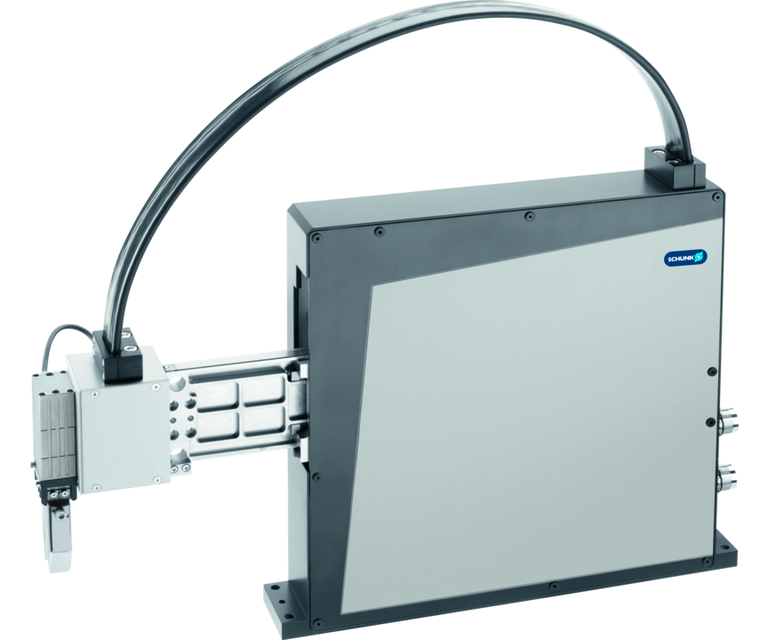
Pick & place modules
Compact 2-axis unit for a faster, flexible running of any curve on one plane
The fastest Pick & Place unit on the market.
110 picks per minute

Slide 3

Flexible. Fast. Precise.
New sizes PPU-E 25 and 40
New hybrid cable (flat ribbon), integrated air lines, electric and bus lines. Modular design, easily exchangeable
Absolute stroke measuring system
Improved maintenance, easy access to greasing areas, automatic lubrication optional
Variable application options via the adapter to the modular SCHUNK assembly system

Slide 4
Principle of function
Functional description
The pick & place module is actuated via two fixed linear motors (primary parts). The secondary parts (magnets) are fixed for the Z-axis on the slide, and for the Y-axis on the cantilever arm. Both axes can be actuated and controlled independently of one another.
1
cantilever arm
2
Linear motor for vertical axis
3
Linear motor for horizontal axis
4
Distributor box
5
Hybrid cable
6
Pneumatic holding brake

Slide 5
Advantages – Your benefits
No moving motors - no moving motor cables - no cable break high reliability and life time of the system
Short cycle time therefore a high productivity is achieved
Both axes can be controlled and adjusted independent from each other for maximum flexibility in applications
Integration of micro valves possible at a low assembly and installation work
Manifold options for perfect optimization to your case of application (integrated valves, C-axis)
Additionally with electrical C-axis for one more degree of freedom at each application
Adapter from the modular system for numerous standard combinations with products of the modular assembly automation
All the connections can be reached via the backpanel for comfortable commissioning and maintenance
Optionally certified safety devices according to SIL2/PLd with the HIPERFACE® and DRIVE-CliQ interfaces for applications with high standards in the area of machine safety

Slide 6
Technical data
Technical data overview
Size | stroke horizontal [Y-axis] | stroke vertical [Z-axis] | Max. driving force [Y axis] | Max. driving force [Z axis] | Nominal force [Y-axis] | Nominal force [Z-axis] | Max. load capacity | Weight
 | [mm] | [mm] | [N] | [N] | [N] | [N] | [kg] | [kg]
15 | 150 | 60 | 180 | 540 | 65 | 200 | 1.5 | 17 .. 20
30 | 270 | 100 | 400 | 550 | 150 | 195 | 3 | 22 .. 27.6
50 | 280 | 150 | 400 | 1200 | 160 | 525 | 5 | 35 .. 38.9

