Slide 1

Product presentation
RST-D
Ring indexing table

Slide 2
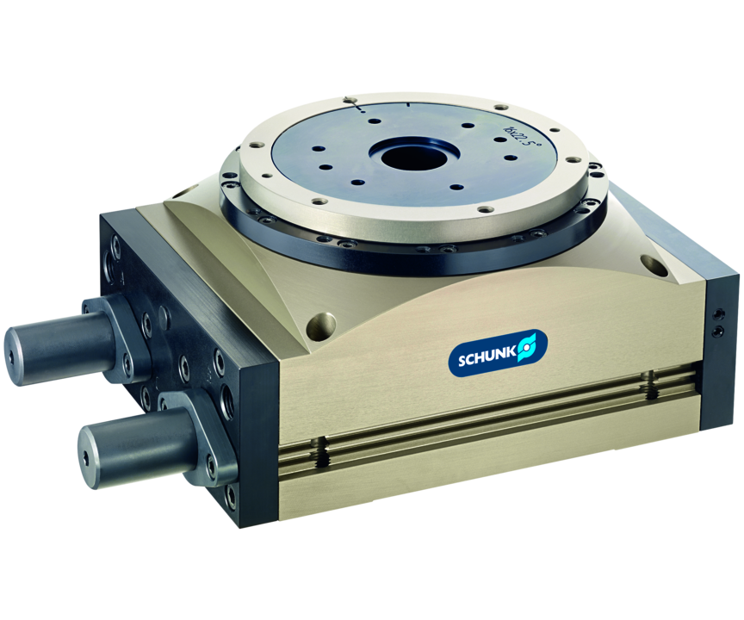
Ring indexing table
Ring indexing unit for endlessly turning with an angle of rotation up to 90° per cycle.
The most compact pneumatic ring indexing table for high performance assembly.
Three times higher power density than comparable ring indexing tables

Slide 3

Endlessly turning. Strong. Robust.

Slide 4
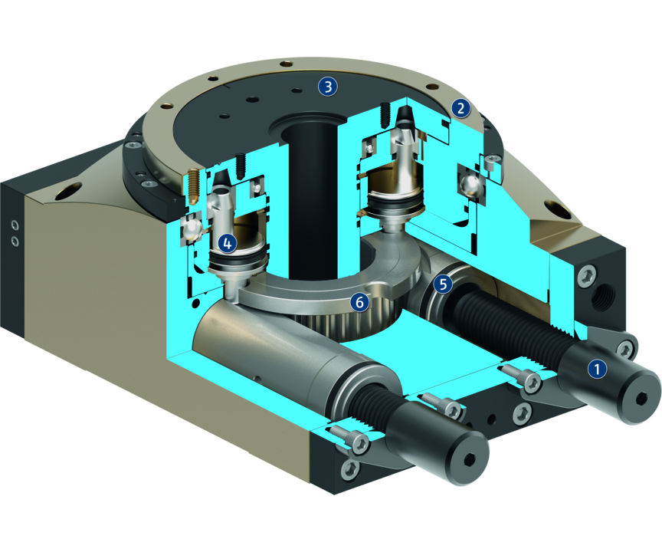
Principle of function
Functional description
After pressure actuation of the faces, the driving piston linearly moves into the bore, and turns the cycle ring via a laterally attached gear.
After actuation of the locking piston it is indexed, and releases the driving piston for return stroke.
1
Damping
2
Drive ring
3
Fixed center part with center bore
4
Locking mechanism
5
Drive
6
driver

Slide 5
Advantages – Your benefits
Right, left, and alternating operation are possible with this actuator total flexibility for your application
High damper performance due to the use of hydraulic shock absorbers suitable for the use of large rotary tables
Large, fixed center part for simple addition of further components
Two locking pins therefore the locking of the drive ring has no backlash
All adjustments and air connections are located on one side for easy commissioning
Center bore for media feed-through for supply of additional components

Slide 6
Technical data
Technical data overview
Size | Angle of rotation | Torque | Weight | Repeat accuracy
 | [°] | [Nm] | [kg] | [°]
60 | 30 .. 90 | 3.1 | 1 | 0.09
87 | 30 .. 90 | 7.9 | 2.9 | 0.06
134 | 22.5 .. 90 | 29.3 | 8.3 | 0.04

