Slide 1

Product presentation
NSR-A
Quick change system

Slide 2
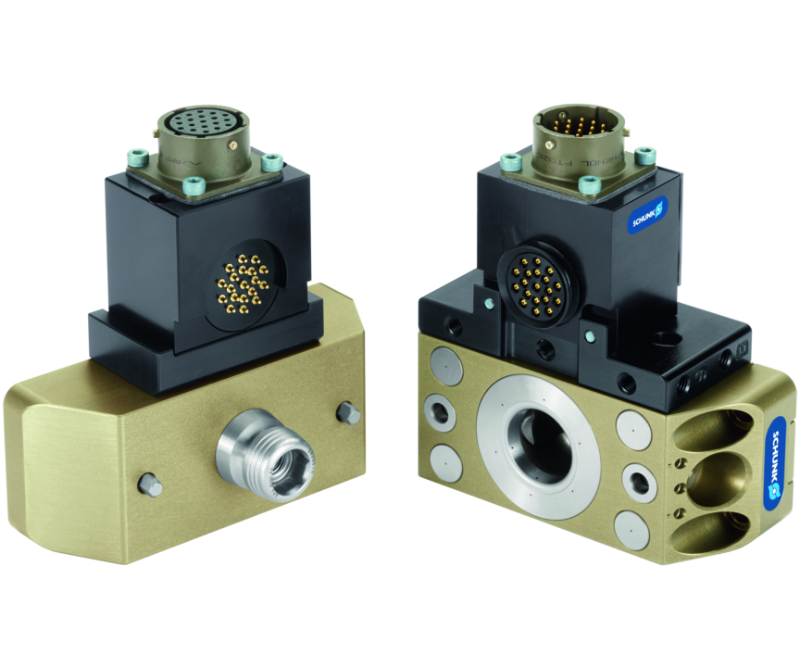
Quick change system
Pneumatic pallet change system with patented locking system.
Robot coupling for automated pallet handling – process-reliable, precise, space-saving.
4,000 Nm maximum moments

Slide 3

Compact. Loadable. Precise.

Slide 4
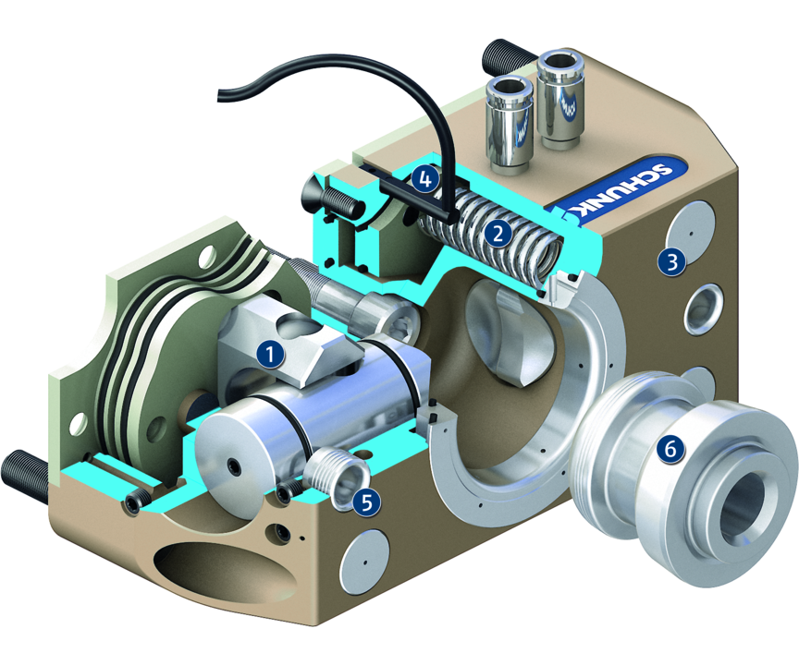
Principle of function
Functional description
The pallet-change system (NSR-A) consists of a change head (NSR-A) and a clamping pin (NSR-SPA). The NSR-A is mounted onto the robot, and couples the NSR-SPA mounted onto the tool. A pneumatically driven locking piston with its patented design, ensures a secure connection. After coupling, pneumatic and electric feed-throughs supply the end effector.
1
Locking mechanism
2
Pressure springs
3
Housing
4
Piston stroke monitoring
5
Anti-twist protection
6
Conical clamping pin

Slide 5
Advantages – Your benefits
Time saving through automatic pallet changing
Very compact design for space-saving exchange and direct coupling on the machine table
Form-fit, patented locking system with self-retention and high locking force
All functional components made from hardened steel for high mechanical resilience of the changing system
Integrated piston stroke monitoring and tool presence sensing for condition monitoring
Wide product line of electric and fluid modules for universal energy transmission possibilities

Slide 6
Technical data
Technical data overview
Size | Version | Max. distance when locking | Weight | Piston stroke monitoring | Locking force
 |  | [mm] | [kg] |  | [N]
100 | Angled .. Straight | 1 | 0.34 .. 0.4 | optional | 4000
160 | Angled .. Straight | 1 | 0.9 .. 1.6 | optional | 15000

