Slide 1

Product presentation
MPG-plus
Miniature parallel gripper

Slide 2
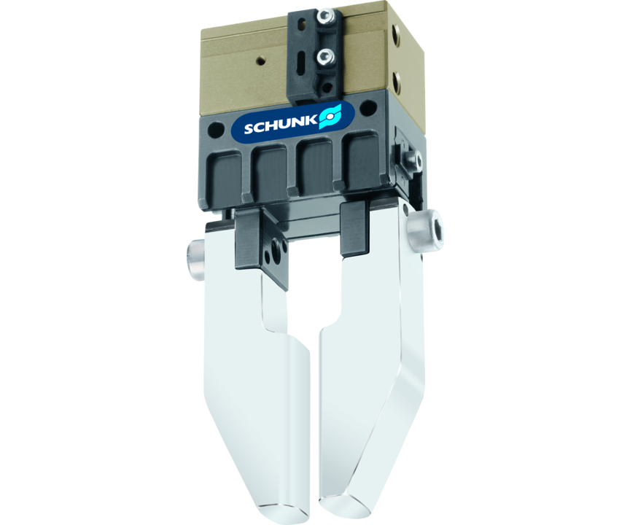
Miniature parallel gripper
2-finger parallel gripper with smooth roller guides of the base jaws
The most powerful pneumatic miniature parallel gripper on the market
25% higher gripping force

Slide 3

Powerful. Fast. Long fingers.
New precision version P for maximum accuracy within the gripping process
Convenient jaw quick-change system
Compact, weight-reduced gripper for small components, ideal for handling and assembly applications
Robust junction roller guide for use with longer gripper fingers

Slide 4
Principle of function
Functional description
The oval piston is moved up or down by compressed air.
The angled active surfaces of the wedge-hook produce a synchronized, parallel jaw motion.
1
Base Jaw
2
Wedge-hook design
3
Cross roller guidance
4
Sensor system
5
Oval piston drive
6
Housing

Slide 5
Advantages – Your benefits
Cross roller guidance for precise gripping through due to a scope-free base jaw guidance
Base jaws guided on double roller bearings ensuring low friction and smoothly running
Optimized basic load rating suitable for using long gripper fingers
Drive concept oval piston for maximum gripping forces
Monitoring with electronic magnetic switches for a maximized process reliability
Mounting from two sides in four screw directions for universal and flexible gripper assembly
Air supply via hose-free direct connection or screw connections for flexible pressure supply in all automated systems
Compact dimensions for minimal interfering contours in handling

Slide 6
Technical data
Technical data overview
Size | Stroke per jaw | Closing force | Opening force | Recommended workpiece weight | Weight | Max. permissible finger length
 | [mm] | [N] | [N] | [kg] | [kg] | [mm]
10 | 1 | 9 | 7 | 0.05 | 0.01 | 10
12 | 1.2 | 10 | 8 | 0.05 | 0.01 | 12
16 | 1.5 | 29 .. 37 | 25 .. 32 | 0.14 | 0.022 .. 0.025 | 20
20 | 2 | 34 .. 42 | 30 .. 37 | 0.17 | 0.035 .. 0.042 | 25
25 | 3 | 38 .. 48 | 32 .. 41 | 0.19 | 0.06 .. 0.11 | 32
32 | 4 | 80 .. 105 | 70 .. 90 | 0.43 | 0.1 .. 0.19 | 40
40 | 6 | 135 .. 170 | 110 .. 135 | 0.7 | 0.18 .. 0.33 | 50
50 | 8 | 215 .. 265 | 195 .. 230 | 1.05 | 0.31 .. 0.38 | 64
64 | 10 | 300 .. 370 | 280 .. 335 | 1.25 | 0.53 .. 0.63 | 80

