Slide 1

Product presentation
JGP
Universal gripper

Slide 2
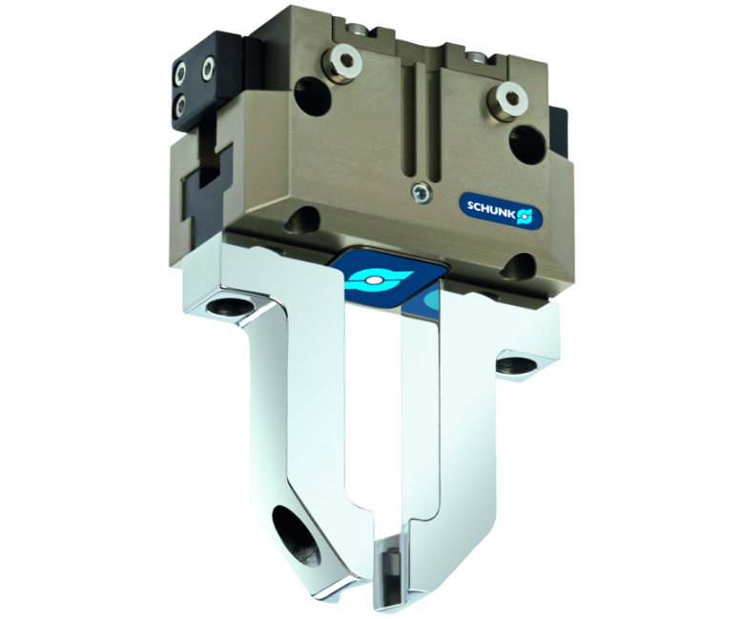
Universal gripper
Universal 2-finger parallel gripper of the compact class with T-slot guidance and best cost-performance ratio

Slide 3

Loadable. Reliable. Compact.

Slide 4
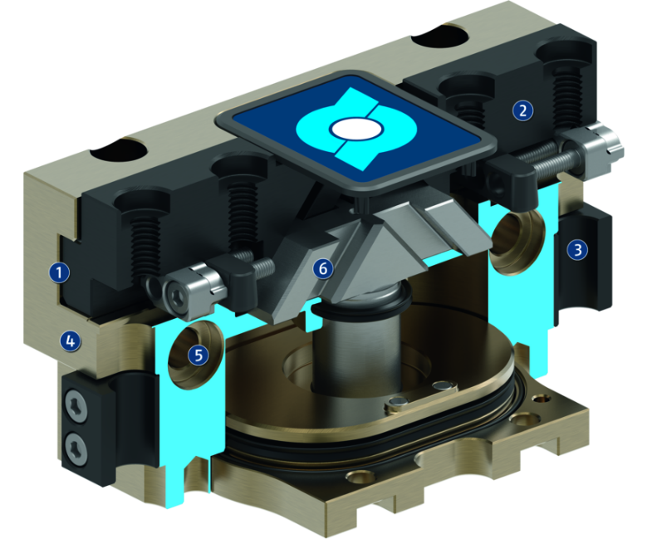
Principle of function
Functional description
The oval piston is moved up or down by compressed air.
The angled active surfaces of the wedge-hook produce a synchronized, parallel jaw motion.
1
T-slot guidance
2
Base Jaw
3
Sensor system
4
Housing
5
Centering and mounting possibilities
6
Wedge-hook design

Slide 5
Advantages – Your benefits
A firm focus on the essentials for maximum profitability
Sturdy T-slot guidance for the precise handling of different workpieces
Compact dimensions and low weight for minimal interfering contours in handling
High maximum moments possible suitable for using long gripper fingers
Wedge-hook design for high power transmission and synchronized gripping
Comprehensive sensor accessories for monitoring and control of the stroke position
Mounting from two gripper sides for universal and flexible gripper assembly
Air supply via hose-free direct connection or screw connections for flexible pressure supply in all automated systems

Slide 6
Technical data
Technical data overview
Size | Stroke per jaw | Closing force | Opening force | Recommended workpiece weight | Weight | Max. permissible finger length
 | [mm] | [N] | [N] | [kg] | [kg] | [mm]
40 | 2.5 | 123 .. 163 | 132 .. 182 | 0.62 | 0.08 .. 0.09 | 45 .. 50
50 | 2 .. 4 | 140 .. 385 | 145 .. 405 | 0.7 .. 1.45 | 0.15 .. 0.21 | 50 .. 64
64 | 3 .. 6 | 250 .. 710 | 270 .. 755 | 1.25 .. 2.6 | 0.28 .. 0.37 | 64 .. 80
80 | 4 .. 8 | 415 .. 1180 | 465 .. 1280 | 2.1 .. 4.3 | 0.5 .. 0.6 | 80 .. 100
100 | 5 .. 10 | 660 .. 1870 | 725 .. 2005 | 3.3 .. 6.85 | 0.81 .. 1 | 100 .. 125
125 | 6 .. 13 | 1080 .. 3040 | 1170 .. 3220 | 5.4 .. 11.2 | 1.35 .. 1.85 | 125 .. 160
160 | 8 .. 16 | 1640 .. 4420 | 1770 .. 4680 | 8.2 .. 16 | 2.6 .. 3.6 | 170 .. 200
200 | 25 | 2700 .. 3610 | 2870 .. 3780 | 13.5 | 5.2 .. 7 | 220 .. 240
240 | 30 | 4200 .. 5300 | 4440 .. 5540 | 21.5 | 8 .. 11.5 | 260 .. 280
300 | 35 | 6000 .. 7400 | 6260 .. 7660 | 30 | 13.5 .. 17.5 | 290 .. 320

