Slide 1

Product presentation
GAP
Gripper for small components

Slide 2
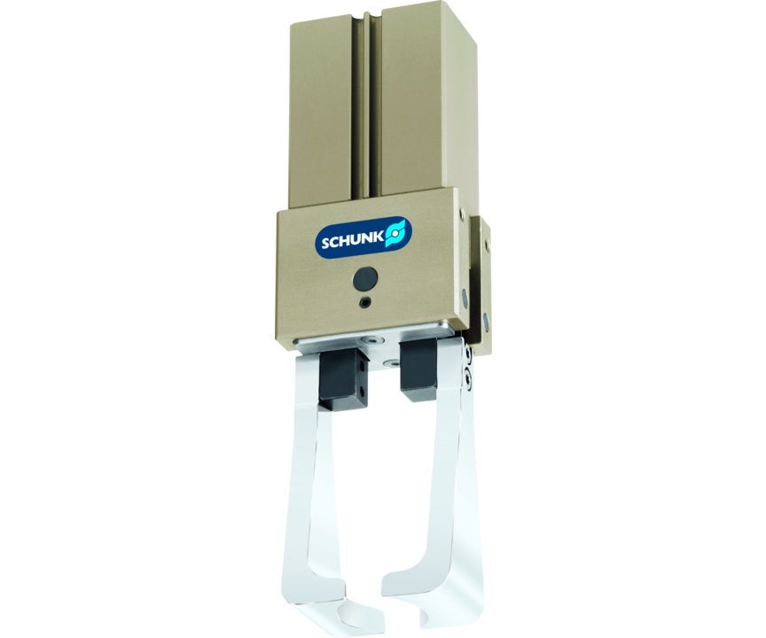
Gripper for small components
2-finger angular parallel gripper with gripper finger actuation of up to 90° per jaw

Slide 3

Flexible. Productive. Slim.

Slide 4
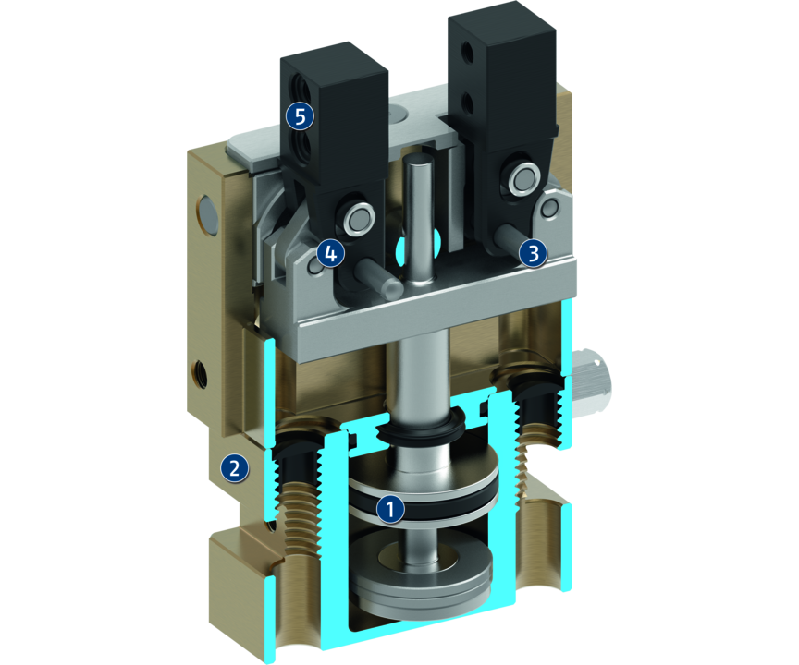
Principle of function
Functional description
The piston is moved up or down with compressed air. The base jaws are first put into a rotating and then into a parallel movement via the toggle-lever kinematics.
1
Drive
2
Housing
3
Base jaw seated
4
Kinematics
5
Base Jaws

Slide 5
Advantages – Your benefits
Positively driven angle and parallel stroke in one functional unit
Absolutely clamping in parallel stroke for highest positioning accuracy
Stable kinematics for high power transmission and synchronized gripping
High gripping force in parallel stroke
Opening angle of jaws up to 180° for maximum flexibility in applications
Integration of a gripping force maintenance is optional for firm grip even in the event of power failure
End-position monitoring with optional standardized monitoring sets
Standardized mounting bores for numerous combinations with other components from the modular system

Slide 6
Technical data
Technical data overview
Size | Stroke per jaw | Closing force | Opening angle per jaw | Weight | Recommended workpiece weight | Max. permissible finger length
 | [mm] | [N] | [°] | [kg] | [kg] | [mm]
20 | 1 | 92 .. 150 | 30 .. 90 | 0.3 .. 0.39 | 0.46 | 40
28 | 1.5 | 180 .. 270 | 30 .. 90 | 0.54 .. 0.7 | 0.9 | 50
32 | 2 | 250 .. 430 | 30 .. 90 | 1.03 .. 1.33 | 1.25 | 65

