Slide 1

Product presentation
DPG-plus
Sealed gripper

Slide 2
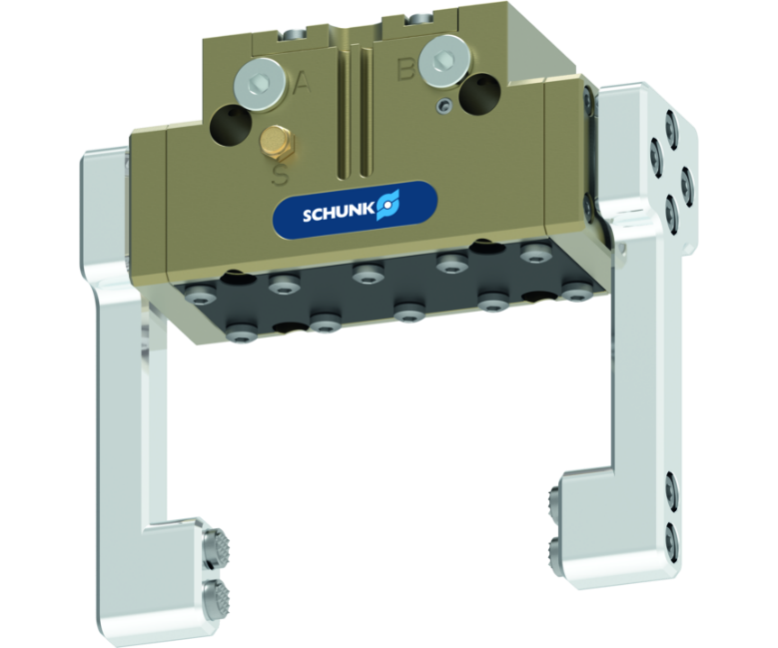
Sealed gripper
Dense 2-finger parallel gripper that meets the requirements of IP67 and does not allow substances to enter the working environment
The most proven sealed gripper on the market for wet and dirt-intensive environments.
Protection class IP 67

Slide 3

Reliable. Fully encapsulated. Loadable.

Slide 4
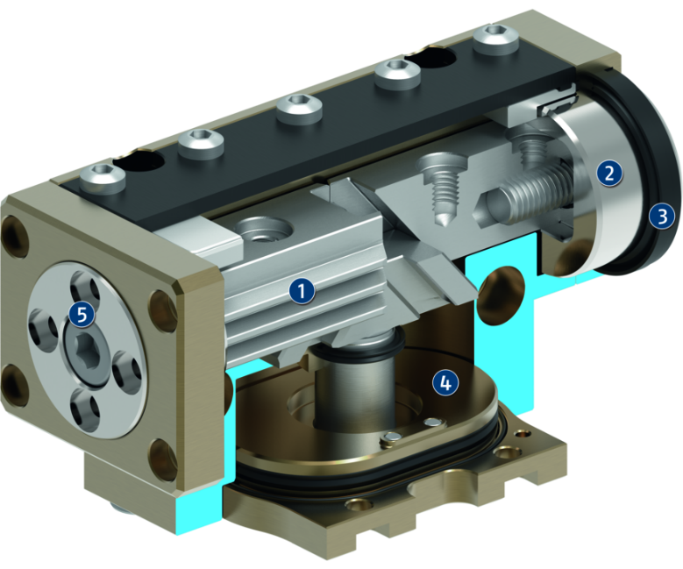
Principle of function
Functional description
The piston is moved up and down by compressed air.
The angled active surfaces of the wedge-hook produce a synchronized, parallel jaw motion.
1
Inner base jaw with multi-tooth guidance
2
External round base jaw
3
Lip seal
4
Oval piston with rod and wedge-hook
5
Centering and mounting possibilities

Slide 5
Advantages – Your benefits
Robust interior multi-tooth guidance for the precise handling of different workpieces
Lip seal at the outside round guidance for permanent, secure gripper sealing
High maximum moments possible suitable for using long gripper fingers
Sealed 2-Finger Parallel Gripper complies to IP67 requirements despite a high moment load
Drive concept oval piston for maximum gripping forces
Mounting from two sides in three screw directions for universal and flexible gripper assembly
Air supply via hose-free direct connection or screw connections for flexible pressure supply in all automated systems
Compact dimensions for minimal interfering contours in handling

Slide 6
Technical data
Technical data overview
Size | Stroke per jaw | Closing force | Opening force | Recommended workpiece weight | Weight | Max. permissible finger length
 | [mm] | [N] | [N] | [kg] | [kg] | [mm]
40 | 2.5 | 110 .. 145 | 120 .. 165 | 0.55 | 0.12 .. 0.14 | 40
50 | 2 .. 4 | 125 .. 424 | 130 .. 453 | 0.6 .. 2.3 | 0.25 .. 0.34 | 30 .. 50
64 | 3 .. 6 | 225 .. 780 | 240 .. 834 | 1.1 .. 4.2 | 0.39 .. 0.55 | 40 .. 64
80 | 4 .. 8 | 375 .. 1270 | 415 .. 1406 | 1.8 .. 6.9 | 0.68 .. 0.95 | 50 .. 80
100 | 5 .. 10 | 625 .. 2120 | 685 .. 2318 | 3.1 .. 11.7 | 1.1 .. 1.61 | 64 .. 100
125 | 6 .. 13 | 1025 .. 3486 | 1110 .. 3760 | 5.1 .. 19.1 | 1.9 .. 2.9 | 64 .. 125
160 | 8 .. 16 | 1560 .. 4995 | 1680 .. 5402 | 7.8 .. 27.3 | 3.65 .. 8 | 80 .. 160
200 | 14 .. 25 | 2565 .. 5940 | 2730 .. 6490 | 12.8 .. 22.1 | 7.3 .. 9.5 | 125 .. 200
240 | 17 .. 30 | 3780 .. 7500 | 4000 .. 7835 | 18.9 .. 29.25 | 11.5 .. 14.6 | 150 .. 240
300 | 20 .. 35 | 5400 .. 11250 | 5635 .. 11700 | 27 .. 46.35 | 19.6 .. 23.6 | 150 .. 300
380 | 45 | 8140 .. 11240 | 8460 .. 11430 | 40.7 | 42 .. 52 | 300 .. 380

