Slide 1


Toolholding systems
TENDO Hydraulic Expansion Toolholders

Slide 2
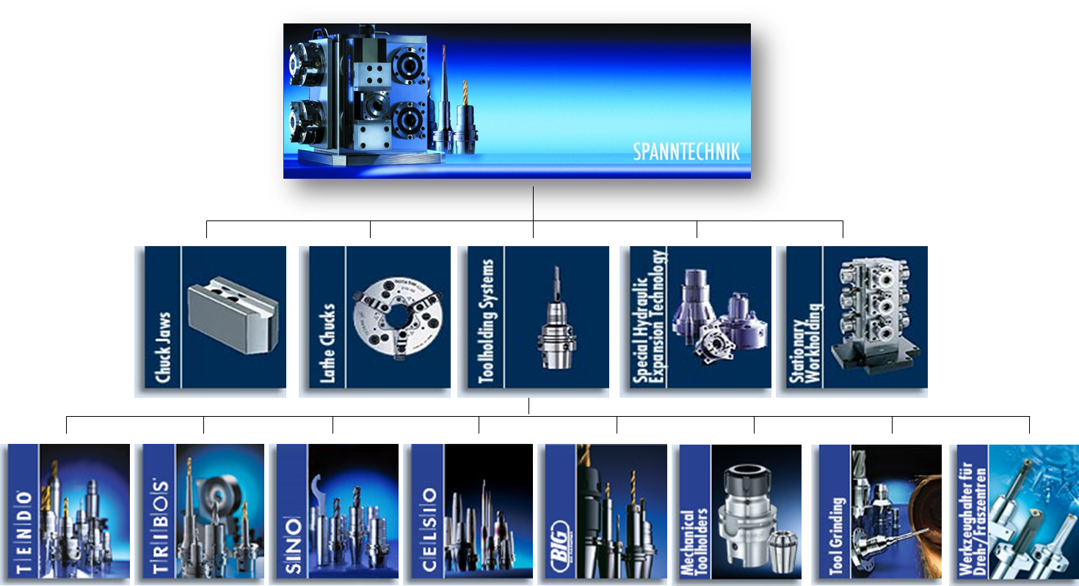
Product overview

Slide 3
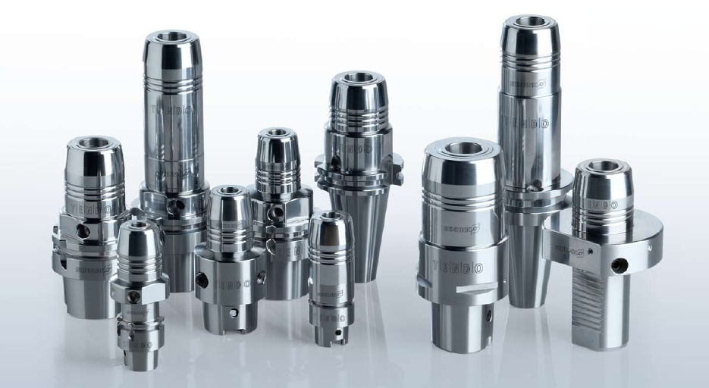
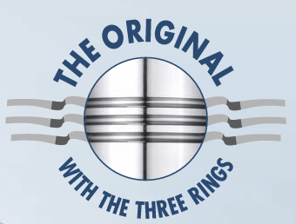
TENDO

Slide 4
TENDO hydraulic expansion toolholders
A success story in innovation
Keeps redefining technological progress in the premier class, for more than 30 years
Stands for efficiency in production and continuity in development
TENDO – the epitome of the best that SCHUNK offers in toolholders, perfectly combined in a multifaceted product range that is second to none in the market
Select the right TENDO model that you need to meet your requirements:
  short and strong
  in a slim or super-slim design
  with extensions or with intermediate sleeves for flexible clamping ranges

Slide 5
TENDO hydraulic expansion toolholder –
The original
Precise! Multi-functional in 29 interfaces
The hydraulic expansion toolholder from SCHUNK
Extensive range of 29 interfaces
All-rounder in precision and compatible for use in all machine tool spindles
The technologically advanced hydraulic expansion toolholder
Universally applicable
Cost-effective in its use
Micron-accurate in its precision.

Slide 6
TENDO hydraulic expansion toolholder –
The original
Advantages
100% clamping, 100% reliability, 100% universal in its application
Milling, reaming, boring, chamfering, thread milling, tapping, or high-speed machining
Precision is guaranteed
Tool changes in seconds without peripheral equipment
29 interfaces available
Run-out and repeat accuracy < 0.003 mm
Excellent vibration damping
Versatile clamping range due to intermediate sleeves
Exact axial length preadjustment
Fine-balanced

Slide 7
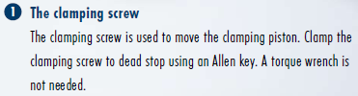



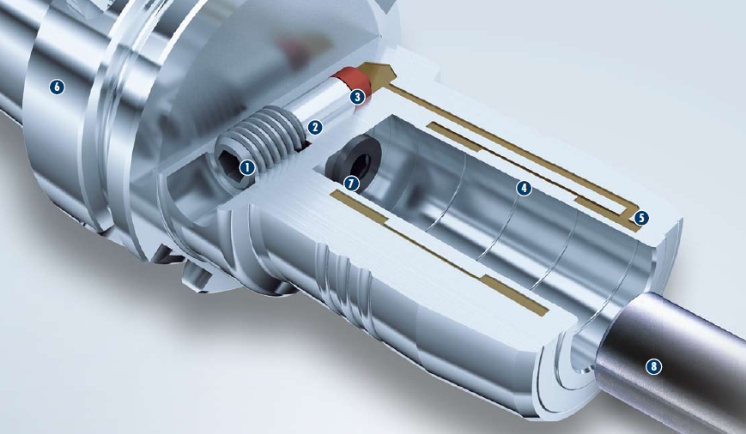




TENDO in detail

Slide 8
Technical highlights
Set-up time minimizer! Precision tool change without peripheral equipment
Micron-accurate tool change in seconds
With a few simple actions, the tool can be changed quickly and process reliably
Insert the tool into the hydraulic expansion toolholder, screw in the clamping screw to dead stop using an Allen key – finished!
Clamping result: maximum run-out accuracy
Convincingly simple handling using an Allen key
No additional investment costs for peripheral equipment
Manufacturing down-times and set-up times are reduced at the machine
Maintenance costs or failure of external clamping devices are no longer applicable

Slide 9
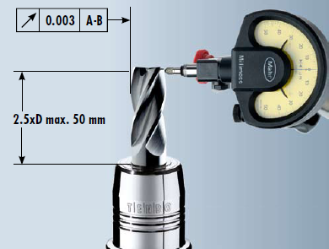
Features
Run-out and repeat accuracy
Optimal continous run-out and repeat accuracy of < 0.003 mm
Even cutting actions
Minimizes wear to the cutting edges of the tool
Increases tool service life considerably
Reduces the costs incurred for regrinding or buying new tools

Slide 10
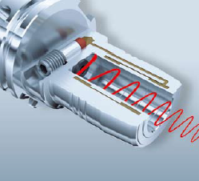
Features
Excellent vibration damping for perfect surfaces
The hydraulic sytem is synonymous with excellent vibration damping
Micro-blowouts on the cutting edge of the tool are prevented
Achieves optimum workpiece surfaces
The spindle performance will be enhanced
The tool service life is considerably increased and costs reduced

Slide 11
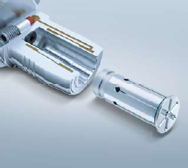
Features
High flexibility through the use of intermediate sleeves
Application of slotted or coolant-proof intermediate sleeves
Different tool diameters ranging from 0.8 – 25 mm tensible
Can be used flexibly within the clamping range
The run-out accuracy of the sleeve is < 0.003 mm

Slide 12
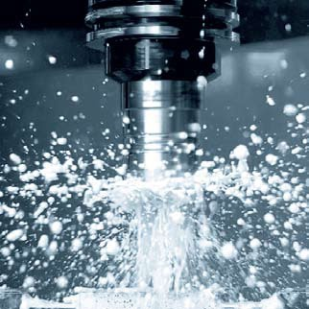
Features
Dirt resistance for long lasting functional reliability
Completely closed TENDO system
Prevents the penetration of dirt, chips, coolants, and grease
Clamping range is not damaged
Functionality and perfect tool clamping system remain fully preserved
Freedom from maintenance and a long service life for the TENDO clamping system are guaranteed

Slide 13
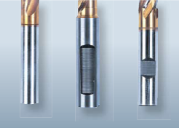
Features
All commercially available shank types can be clamped for process reliable clamping
Tools with both smooth cylindrical shanks in accordance with DIN 6535, Type HA up to Ø 32 mm and also those with recesses in accordance with:
DIN 1835 Types B, E DIN 6535 Types HA, HB, HE can be clamped directly and without the use of an intermediate sleeve

Slide 14
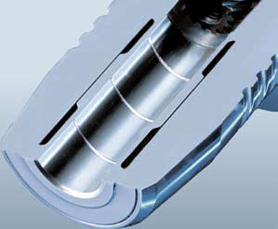
Features
Dirt grooves for reliable torque transmission
Enormous clmaping pressure
Displacement of oil, grease, or grease residue into the dirt groove
The clamping face remains dry
Reliable torque transmission is guaranteed

Slide 15
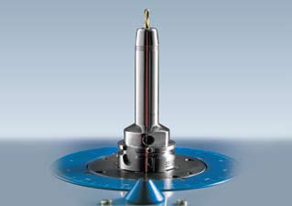
Features
Fine-balanced for maximum running smoothness
As a standard requirement fine-balanced for the use on HSC machines
The fine-balancing contributes significantly to:
  Maximum running smoothness
  Enhancing the performance of the machine spindle
  Reducing vibrations

Slide 16
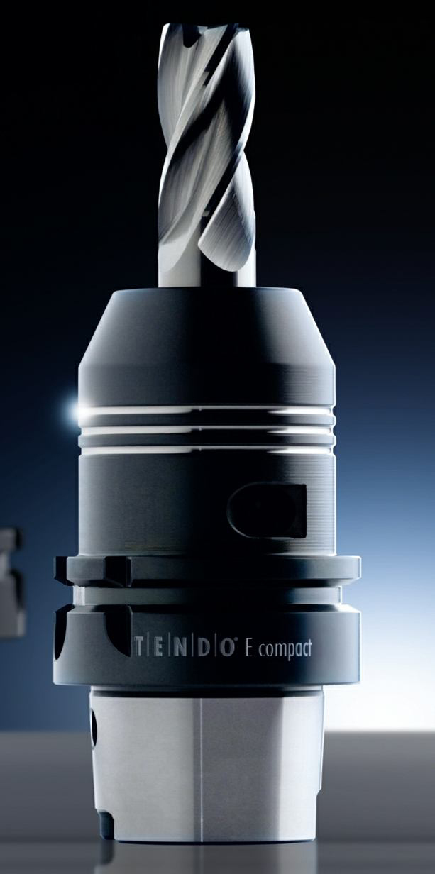
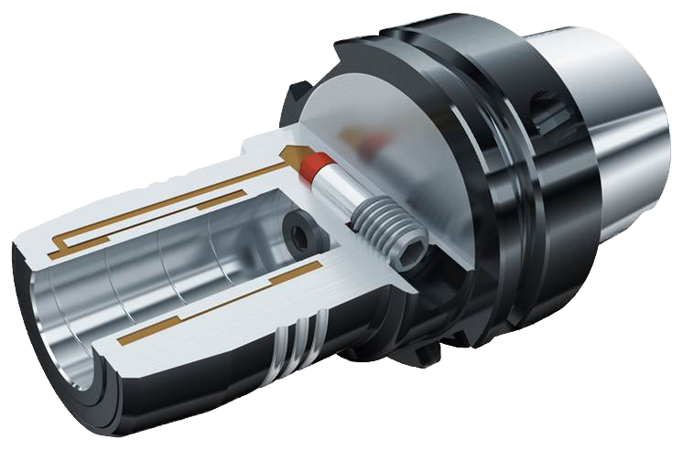
TENDO E compact

Slide 17
TENDO E compact
More robust! With a torque up to 900 Nm (Ø 20 mm) for volume machining, boring, reaming, and thread-milling.
Tighter tolerances, huge cost pressure, better quality
Highest torques, now up to 900 Nm wit h Ø 20 mm under dry clamping conditions, 520 Nm with oily tool shanks
Constant run-out and repeat accuracy < 0.003 mm
For universal use in milling, bor ing, reaming, and thread-milling
Increased service tool life up to 40% leads to cost savings
Tool changes in seconds with no peripheral equipment – clamping to a dead stop
Excellent price/performance ratio

Slide 18
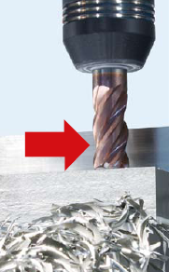
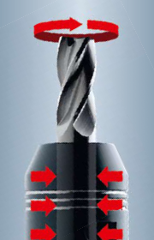
TENDO E compact
High radial rigidity for the best shape accuracy
Optimal radial rigidity through a sturdy base body prevents lateral deflection during the cutting process
Your benefit: high part accuracy geometry at the workpiece combined eith the highest removal rates (e. g. 400 cm³/min for 42CrMo4*)
High torque up to 900 Nm (Ø 20) for maximum volume machining
Compact design
Strong holding forces
Thus high torque transmission
Your benefit: a significantly higher metal cutting volume
*abhängig von Werkzeugmaschine und Werkzeug

Slide 19
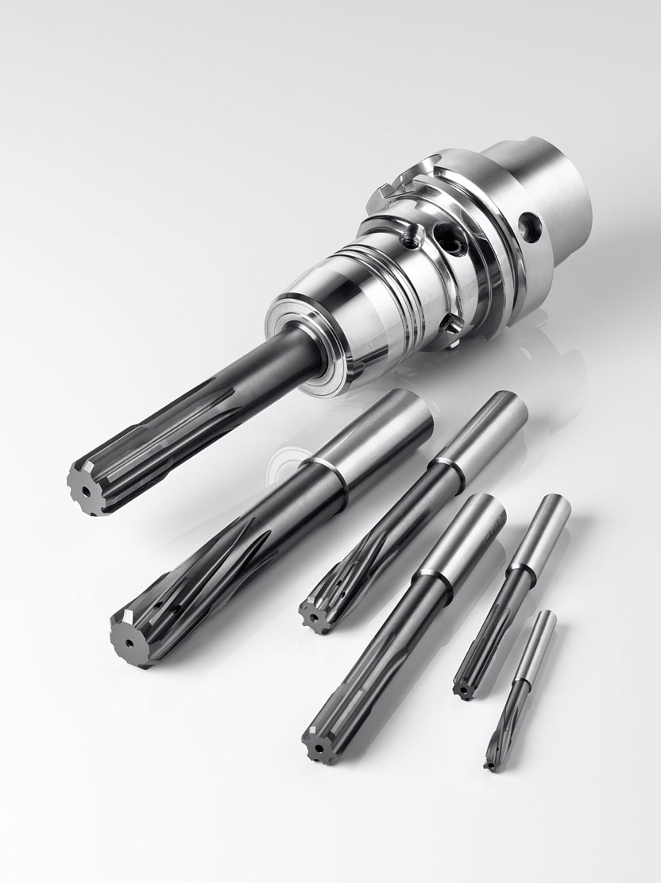
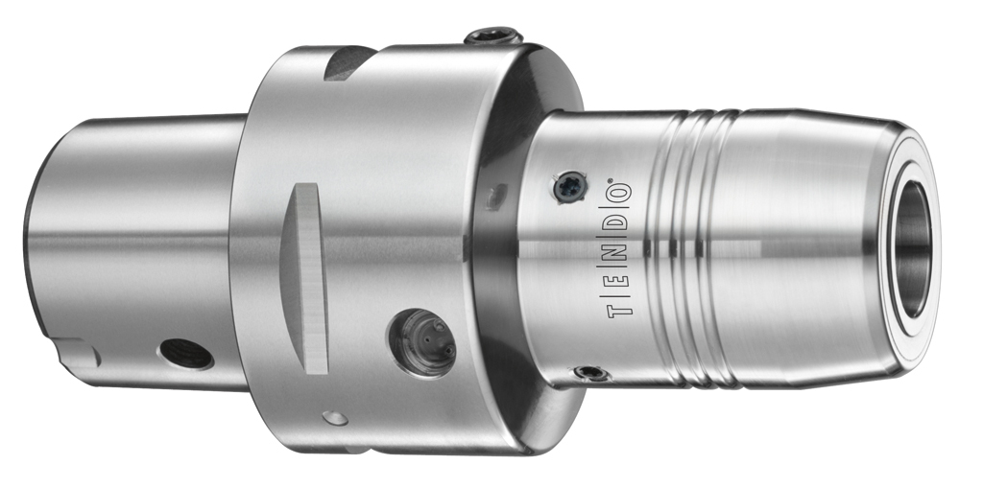
TENDOzero

Slide 20
TENDOzero
Micron precise! To 0.000 mm in next to no time
Professional for tight tolerances for boring, reaming, drill-finishing, or wherever perfect run-out accuracy is a must
Even minimal concentricity errors with tools, spindle mounts, and the spindles can be individually compensated
Constant run-out accuracy can be adjusted to 0.000 mm for optimum shape and positional tolerances
Perfect vibration damping for up to 50% long er tool lives
Easy handling for precise setting of high-quality precision tools

Slide 21
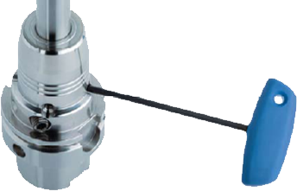
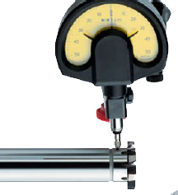
TENDOzero
  A TORX PLUS® key is used on the four set-screws to correct the angular position of the clamped precision tool, and the run-out accuracy is set to 0.000 mm
It is even possible to set a run-out accuracy of 0.000 mm with intermediate sleeves

Slide 22
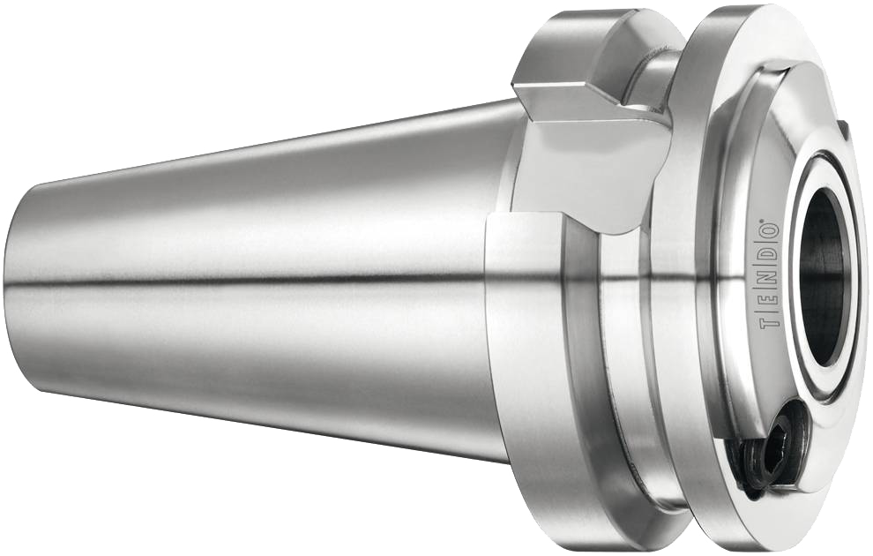
TENDO ES

Slide 23
TENDO ES
Space-saving! Precision in tight machine rooms
With zero interfering contour
Is used when every centimeter in the machine room counts
Extremely short hydraulic expansion toolholder
Perfectly suited for machining large workpieces – even when space in the machine room is tight – and for deep-hole drilling
Tools are mounted directly in the mounting taper
The mounting taper is supported in the spindle
Result: Maximum radial rigidity at high torques and plenty of additional space in the machine room

Slide 24
TENDO ES
Extremely short, extremely powerful, extremely cost-effective
No interfering contour – optimal freedom of movement where working space is limited
Excellent vibration damping guarantees optimum workpiece surfaces and long tool life
Perfectly suited for large volume cutting
Easy and quick handling, micron precise tool change
Can be ideally combined with TENDO SVL and TRIBOS SVL extensions

Slide 25
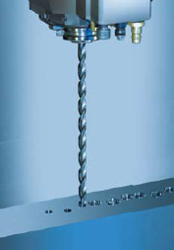
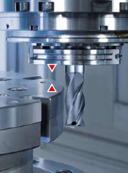
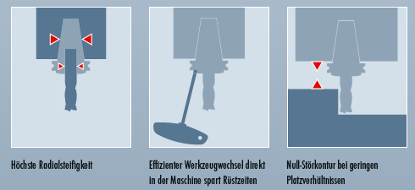
TENDO ES
Ideal for deep-hole drilling:
Extremely short design
Frees up plenty of machine room space
Guarantees that there is sufficient freedom of movement for the axes before tool immersion
Collisions are eliminated

Slide 26
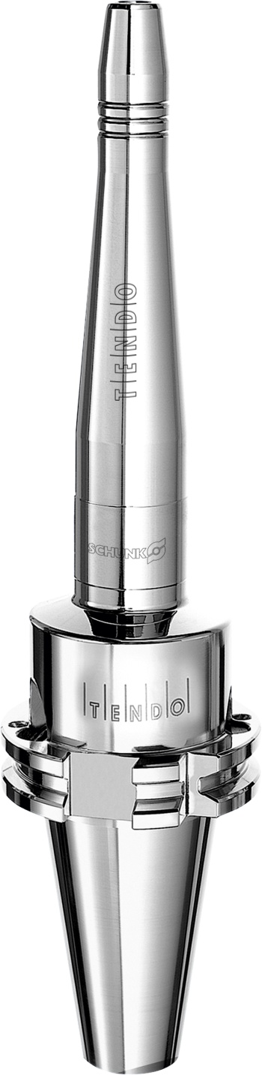
TENDO LSS

Slide 27
TENDO LSS
No competition! Super-slim and offering high precision – with a run-out accuracy < 0.006 mm (when L1 = 200 mm and with an unclamping length of 2.5xD)
Optimized interfering contours, which results in excellent workpiece accessibility
Sets standards, therefore saves costs in the fabrication of expensive special tools
Negotiates the obstacles posed even by the trichiest of tasks, when machining at the narrowest of angles and where workpieces are difficult to access
High stability and high radial rigidity
super-slim toolholder is ideally suited to boring, reaming, and for finish milling machining operations
Maximum run-out and repeat accuracy
Excellent vibration damping

Slide 28
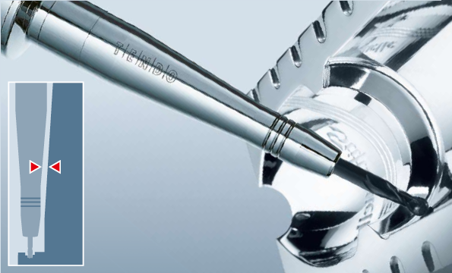
TENDO LSS
  Ideally suited for the the precision machining of hard-to-reach areas
  For example, when milling difficult, deep contours in die construction

Slide 29
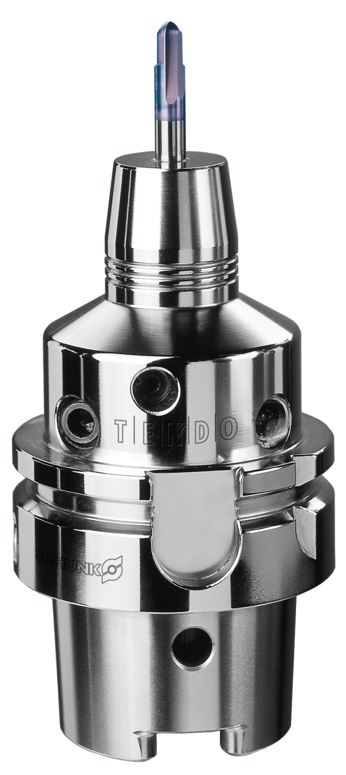
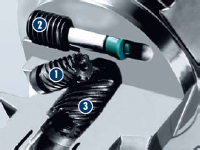

TENDO SDF-KSR

Slide 30
TENDO SDF-KSR
More precise! Radial length adjustment for micron precise positioning
When the sensitive adjusting mechanism is oriented, this set-up time minimizer gives you micron precise positioning for the tool length
Length-setting screw equipped with a front and back stop, self-locking, 10 mm adjustment travel for all clamping diameters
Position of the tool can′t be changed by its own weight or through axial pressure
The balancing grade is not affected
Radial length adjustment can be actuated easily and process reliably using a set screw and an Allen key
Micron precise length adjustment of the machining tools using the compact adjusting mechanism

Slide 31
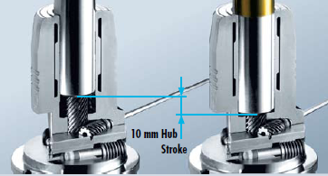
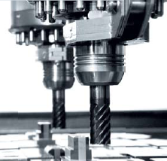
TENDO SDF-KSR
  Radially operated adjustment mechanism for pre-setting the tool length with micron accuracy in seconds
  Possible applications, e. g. on multi-spindle machines

Slide 32
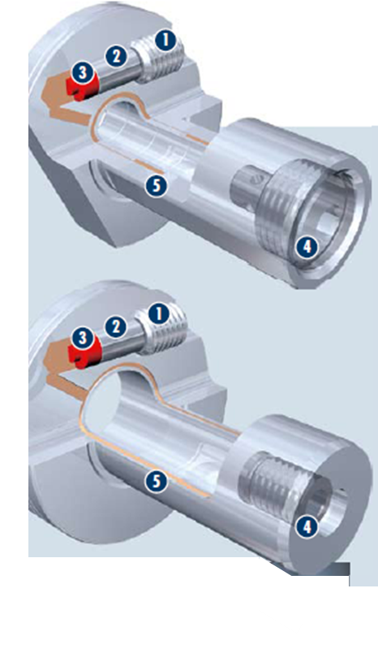
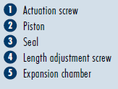
TENDOturn

Slide 33
TENDOturn
Low-vibration! Improvement of surface finish by up to 300%
Applications on lathes/milling centers
Versatile clamping range by virtue of intermediate sleeves
Run-out and repeat accuracy of < 0.003 mm (DSE double clamping insert)
Easy handling
Unique vibration damping
This helps to realize excellent workpiece surfaces
Axial length-setting screw
All shank types can be clamped, including Weldon and Whistle Notch
Improvement of vibration damping
Visible improvement in the surface quality by up to 300%

Slide 34
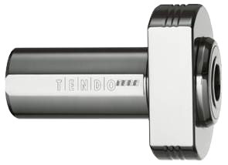
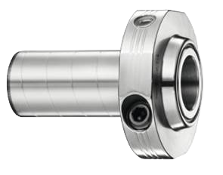
TENDOturn
TENDOturn lathe clamping insert DKE
Increase the productivity by using the lathe clamping insert DKE
Does not require any specific interface
Can be held in any customary VDI bore rod holders in order to absorb vibrations
TENDOturn double clamping insert DSE
Modular insert for driven tools, for perfect performance on existing equipment
Maximum run-out quality and great vibration damping ensure optimum results
Uniform internal/external clamping force centers the insert providing maximum holding forces correct and precise clamping of your tool

Slide 35
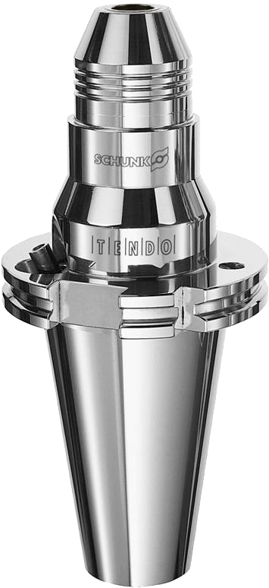
TENDO WZS for tool grinding

Slide 36
TENDO WZS for tool grinding
Process reliable! Through maximum run-out accuracy < 0.003 mm
Uncompromisingly meets the high demands in tool sharpening
High run-out and repeat accuracy
Material is removed evenly during the grinding procedure
Increases the process reliability for grinding and sharpening operations
Enables you to clamp shank tools up to 32 mm in diameter as well as special tools with large shank lengths of up to 95 mm depth
Intermediate sleeves enhance the clamping options
Especially slim interfering contour for improved interference between grinding wheel
Optimal shape accuracy, surface quality, and run-out accuracy of the cutting edges of the tool ensures better chip flow and a more even cutting action
Versatile clamping range due to intermediate sleeves

Slide 37
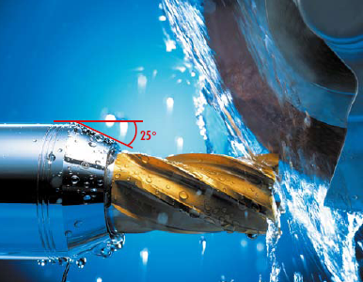
TENDO WZS for tool grinding
  With ist 25° chuck chamfer, TENDO WZS has an optimally adapted interfering contour for the tool grinding process in comparison to other hydraulic toolholders

Slide 38
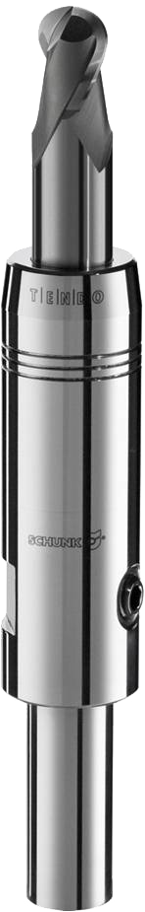
TENDO SVL

Slide 39
TENDO SVL
Superior! Long, slim design, and optimized interfering contours
Predestined and designed for the precise machining of hard-to-reach areas
Is setting the standards in regard to set-up time and costs
The extension can be quickly clamped in every type of precision tool-holder
Huge advantage: a single TENDO extension can be fitted with a variety of standard tools, dispensing with the need for expensive special tools
Clamping in seconds without peripheral equipment
Proven hydraulic expansion technology
Excellent vibration damping
Suitable for nearly every precision toolholder, commercially available shank types can be clamped
Option to use intermediate sleeves

Slide 40
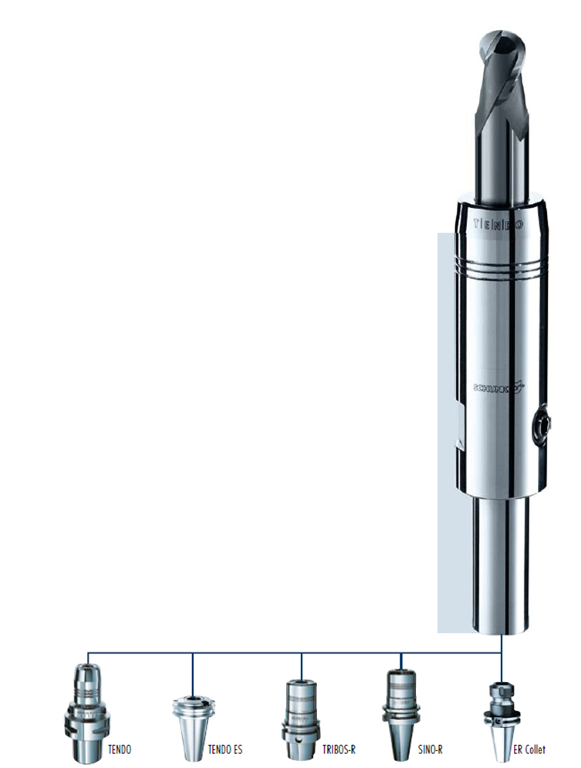
TENDO SVL
TENDO SVL extensions fit in almost all toolholding systems

Slide 41
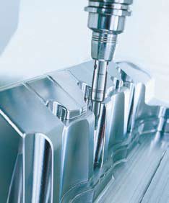
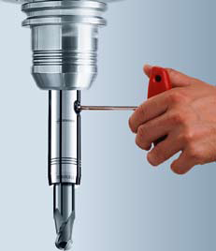
TENDO SVL
  Optimized interfering contour
  Ideal for bores on deep parts in fixture cosntruction
  Micron precise tool changes in seconds guaranteed – even in the machine
  Clamping screw actuated to a dead stop using an Allen key, and the tool is clamped

Slide 42
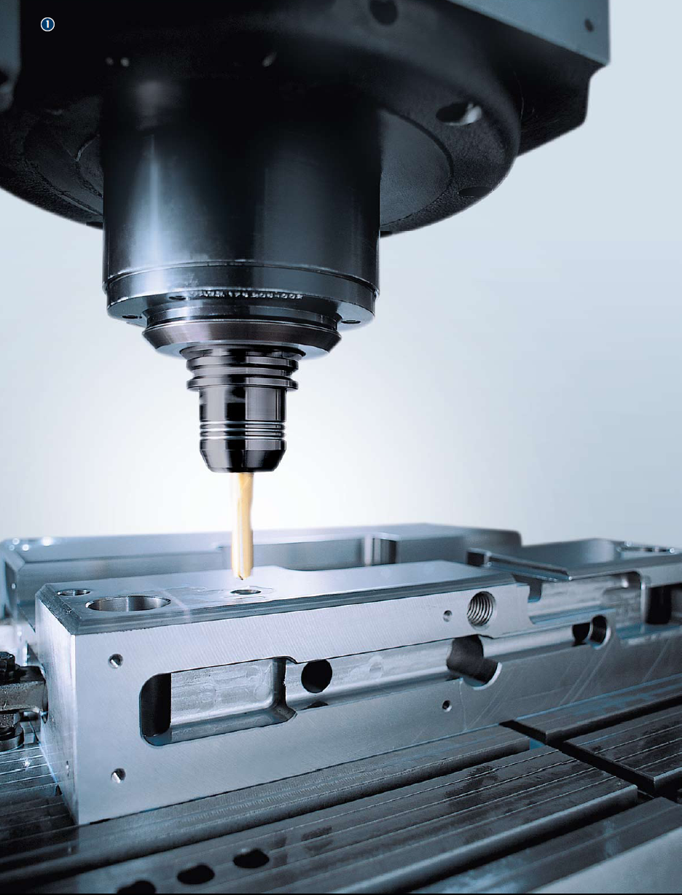
Applications
Precision drilling in tool making

Slide 43
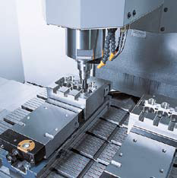
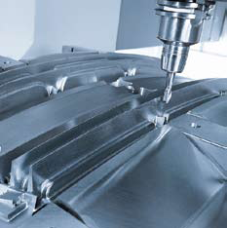
Applications
Milling operation in tool making Milling of die inserts

Slide 44
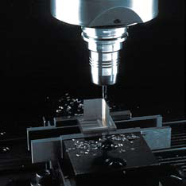
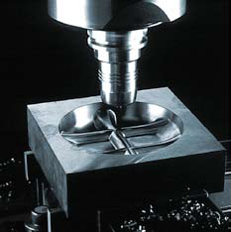
Applications
High-speed milling of a copper electr ode HSC hard milling of a for ging die

Slide 45
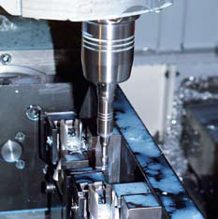
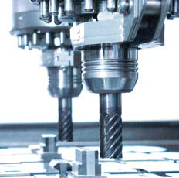
Applications
  Prefinishing of base jaws
  TENDO with radial length adjustment on double spindle
  Machining a piston bore with PKD reamer
  Combination TENDO + TRIBOS SVL extension

Slide 46
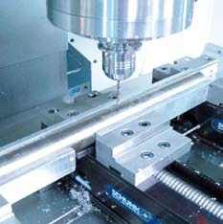
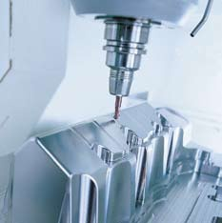
Applications
High-performance drilling in machine building Profile cutting in mould making

