Slide 1

Product presentation
PZH-plus
Universal gripper

Slide 2
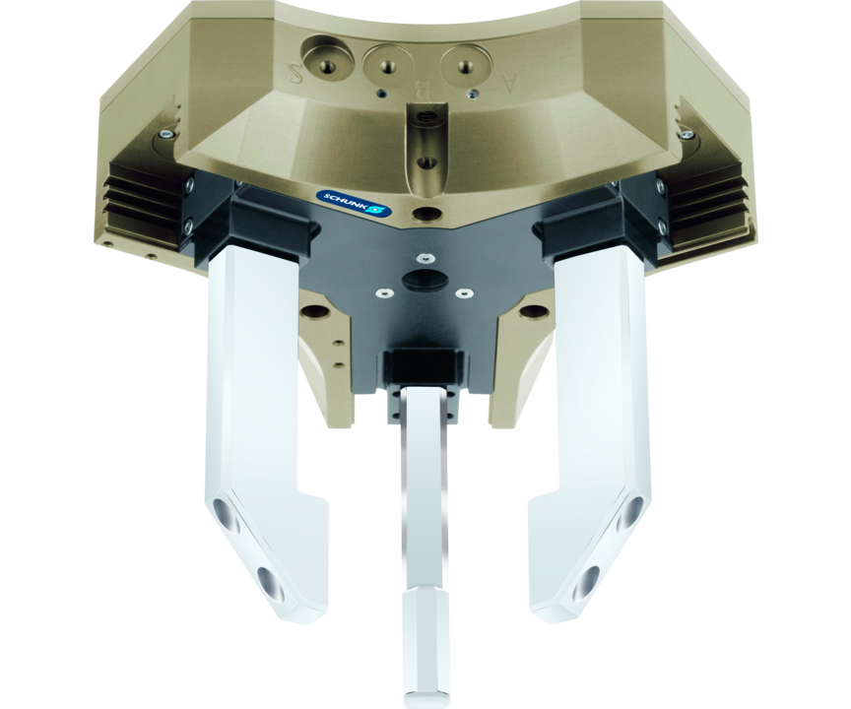
Universal gripper
Universal gripper with long travel and high maximum moment due to multi-tooth guidance
First long-stroke gripper with the proven multi-tooth guidance.
Up to 22 kg workpiece weight

Slide 3

Flexible. Robust. Flat.

Slide 4
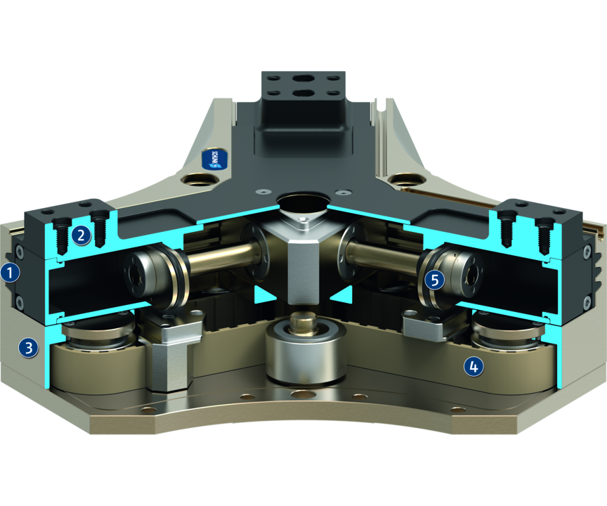
Principle of function
Functional description
The base jaws form the moving cylinder housing while the oval cylinder pistons are fixed. The piston areas are actuated with compressed air so that they are opened or closed. The base jaws are synchronized by a toothed belt which is connected to one carrier per jaw.
1
Multi-tooth guidance
2
Base Jaws
3
Housing
4
Toothed belt for synchronization
5
Drive

Slide 5
Advantages – Your benefits
Robust multi-tooth guidance for precise handling
High maximum moments possible suitable for using long gripper fingers
Sensitive gripping for handling or large, sensitive workpieces
Air supply via hose-free direct connection or screw connections for flexible pressure supply in all automated systems
Comprehensive sensor accessory program for versatile querying possibilities and stroke position monitoring
Long stroke for a flexible range of parts
Flat design for less interfering contours
Center through-hole for feed-through of workpieces, supply hoses, sensor systems, optical workpiece recognition systems, etc.

Slide 6
Technical data
Technical data overview
Size | Stroke per jaw | Closing force | Opening force | Recommended workpiece weight | Weight | Max. permissible finger length
 | [mm] | [N] | [N] | [kg] | [kg] | [mm]
20 | 20 | 375 | 400 | 1.9 | 1.5 | 150
30 | 30 | 900 | 950 | 4.5 | 3.9 | 200
50 | 50 | 2000 | 2100 | 10 | 12.5 | 300
75 | 75 | 4200 | 4400 | 22 | 33 | 400

