Slide 1
EGP 2-finger gripper for small components
2013 Competitor Analysis

Slide 2
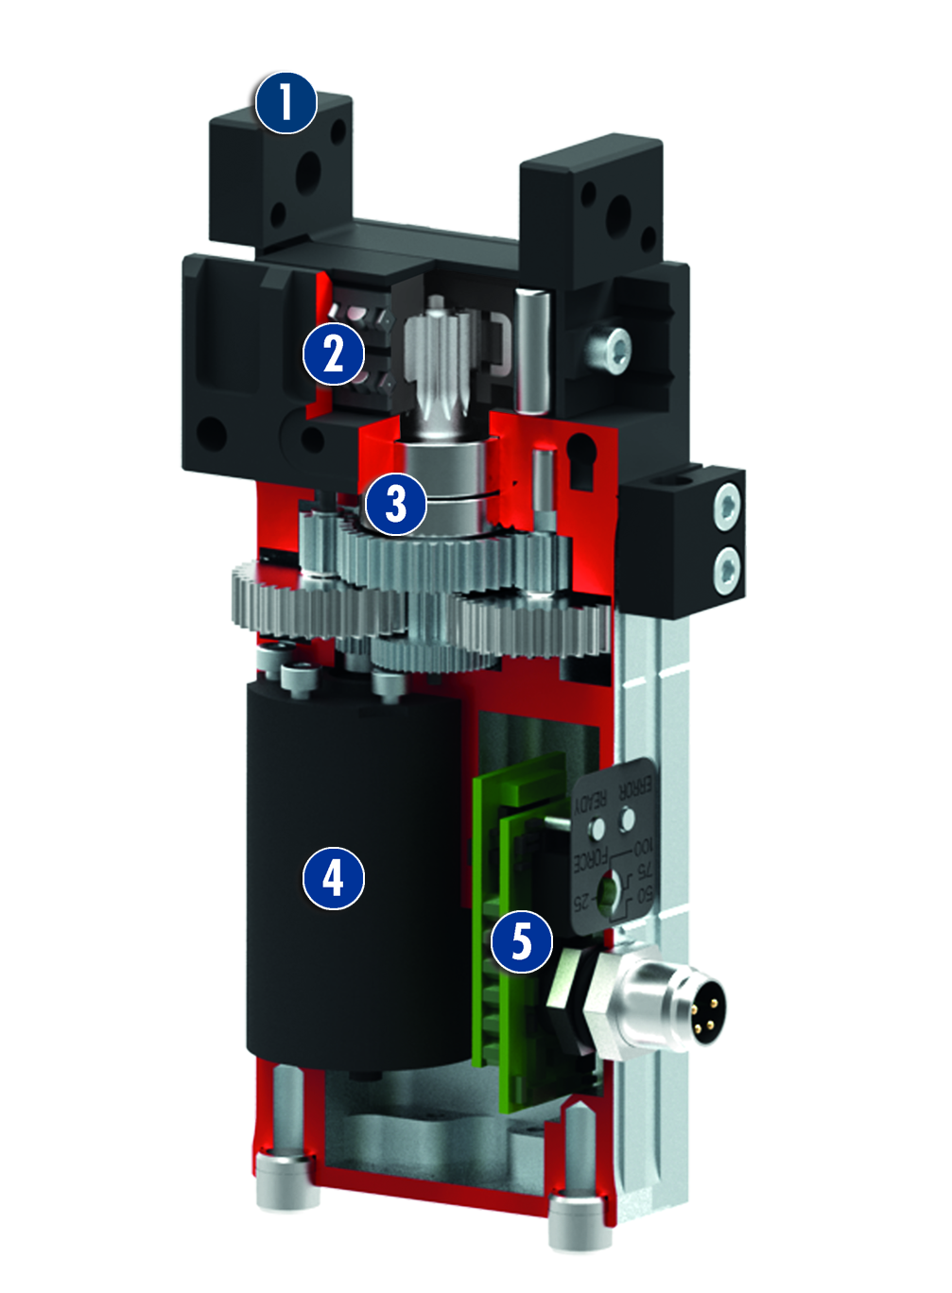
Functional Principle of EGP
Sectional diagram of function
Function
Base jaw For adaptation of the workpiece-specific gripper fingers
Junction roller guide For precise gripping using a base jaw guide with minimal play
Gear Rack and pinion design for centric clamping
Drive Brushless DC servo motor
Electronic control unit Integrated control and regulation electronics for actuating the servo motor
The brushless servo motor drives the base jaw via a toothed-belt drive.
The jaw stroke is synchronized via rack and pinion kinematics.

Slide 3

EGP Animation

Slide 4
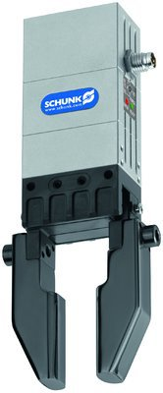
EGP
#1: The most compact electric gripper for small components on the market
Basic technical functions:
* Identical with MPG+ pneumatic series
 |  | EGP 25 | EGP 40
Stroke per finger | [mm] | 3* | 6*
Gripping force | [N] | 40* | 140*
Workpiece weight | [kg] | 0.2* | 0.7*
Operating voltage | [V DC] | 24 | 24
Weight | [kg] | 0.11 | 0.32
Closing time | [s] | 0.09 | 0.22
  Complementary products:
Modular assembly automation, e.g. PPU-E
OAS optical distance and presence sensor
IN inductive monitoring
FPS flexible position sensor

Slide 5
EGP
#1: The most compact electric gripper for small components on the market
Unique selling points: | Customer benefits:
High power density | Stronger gripping forces with the same volume/mass ratio => smaller grippers can be used than with competitors
Stroke and gripping force like pneumatics | Mechatronics can replace pneumatics 1:1
Gripping force adjustable to four levels | Can be adjusted to sensitive, elastic workpieces
Tried and tested MPG-plus basis with junction roller guide | Tried and tested technology with great efficiency
Pneumatic sensor systems can be directly taken over, with the exception of MMS-P (IN 40, IN 5, FPS) | Compact and inexpensive position monitoring => process reliable
Brushless servo motor in this price category | Virtually wear-free, long life span, max. torque possible during shutdown, large overload
Other characteristics: | Customer benefits:
Simple digital actuation | No SW and complex commissioning, benefits of mechatronics
Electronics installed internally | Decentralized and space-saving
Housing of high-performance aluminum | Higher dynamics because of lower weight, less energy needed
Variety of mounting options (like MPG+) | For max. versatility/standardization
Rapid gripping with high force | Ideal for pick & place

Slide 6
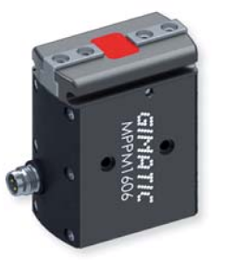
EGP - Analysis of Competitors
GIMATIC
SCHUNK EGP 25
40
3
0,09
24
IP30
26,5x18x73
34678
0,11
33,3
Adjustable gripping force
Actuated like pneumatic valve
364
Internal
581
GIMATIC MPPM
60
3
0,08
24
IP54
43x25x53,5
57512,5
0,15
37,5
Power preservation
Actuated like pneumatic valve
413,79
Internal
690
Gripping force [N]
Stroke per finger [mm]
Closing time [s]
Supply voltage [VDC]
IP protection class
Measurement [mm]
Volume [mm³]
Mass [kg]
Stroke/Closing time [mm/s]
Remark
Gripping force/mass [N/kg]
Electronics
Catalog price [euro]

Slide 7
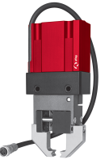
EGP - Analysis of Competitors
AFAG
SCHUNK EGP 25
40
3
0,09
24
IP30
26,5x18x73
34678
0,11
33,3
Adjustable gripping force
Actuated like pneumatic valve
364
Internal
581
AFAG EG 20P
40
5
0,18
24
IP44
53x29x103
158311
0,32
28
Power preservation
dig. exits
100
Internal
900
Gripping force [N]
Stroke per finger [mm]
Closing time [s]
Supply voltage [VDC]
IP protection class
Measurement [mm]
Volume [mm³]
Mass [kg]
Stroke/Closing time [mm/s]
Remark
Gripping force/mass [N/kg]
Electronics
Catalog price [euro]

Slide 8

EGP - Analysis of Competitors
Sommer
SCHUNK EGP 25
40
3
0,09
24
IP30
26,5x18x73
34678
0,11
33,3
Adjustable gripping force
Actuated like pneumatic valve
364
Internal
581
Sommer 9002
15
2
0,02
24
IP40
42x27x77,5
92070
0,25
100
Power only in end position and only in one direction!
Motion time ; dig. exits
60
Internal
499
Gripping force [N]
Stroke per finger [mm]
Closing time [s]
Supply voltage [VDC]
IP protection class
Measurement [mm]
Volume [mm³]
Mass [kg]
Stroke/Closing time [mm/s]
Remark
Gripping force/mass [N/kg]
Electronics
Catalog price [euro]

Slide 9
EGP - Analysis of Competitors
Sommer
SCHUNK EGP 25
40
3
0,09
24
IP30
26,5x18x73
34678
0,11
33,3
Adjustable gripping force
Actuated like pneumatic valve
364
Internal
581
Sommer 9004
26
4
0,03
24
IP40
59x35x99,5
205467,5
0,57
133,3
Power only in end position and only in one direction!
Motion time ; dig. exits
45,6
Internal
586
Gripping force [N]
Stroke per finger [mm]
Closing time [s]
Supply voltage [VDC]
IP protection class
Measurement [mm]
Volume [mm³]
Mass [kg]
Stroke/Closing time [mm/s]
Remark
Gripping force/mass [N/kg]
Electronics
Catalog price [euro]

Slide 10
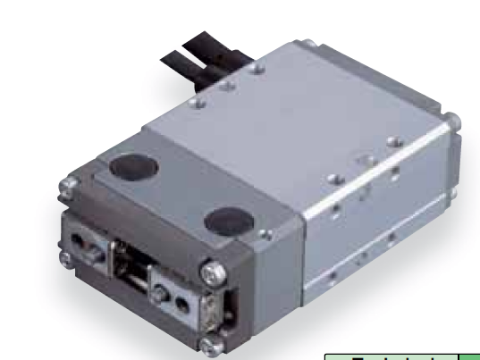
EGP - Analysis of Competitors
IAI
SCHUNK EGP 25
40
3
0,09
24
IP30
26,5x18x73
34678
0,11
33,3
Adjustable gripping force
Actuated like pneumatic valve
364
Internal
581
RCP2-GRSS
14
4
0,15
24
bis IP50
42x24x71
71568
0,2
41,7
70
External
?
Gripping force [N]
Stroke per finger [mm]
Closing time [s]
Supply voltage [VDC]
IP protection class
Measurement [mm]
Volume [mm³]
Mass [kg]
Stroke/Closing time [mm/s]
Remark
Gripping force/mass [N/kg]
Electronics
Catalog price [euro]

Slide 11
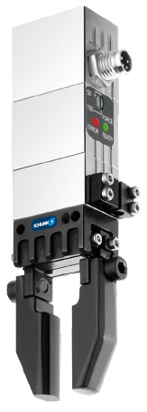
EGP - Analysis of Competitors
GIMATIC
SCHUNK EGP-S 25
7
3
0,03
24
IP30
26,5x18x65,5
31005
0,1
100
Adjustable gripping force
Actuated like pneumatic valve
70
Internal
?
GIMATIC MPPM
60
3
0,08
24
IP54
43x25x53,5
57512,5
0,15
37,5
Power preservation
Actuated like pneumatic valve
413,79
Internal
690
Gripping force [N]
Stroke per finger [mm]
Closing time [s]
Supply voltage [VDC]
IP protection class
Measurement [mm]
Volume [mm³]
Mass [kg]
Stroke/Closing time [mm/s]
Remark
Gripping force/mass [N/kg]
Electronics
Catalog price [euro]

Slide 12
EGP - Analysis of Competitors
AFAG
SCHUNK EGP-S 25
7
3
0,03
24
IP30
26,5x18x65,5
31005
0,1
100
Adjustable gripping force
Actuated like pneumatic valve
70
Internal
?
AFAG EG 20P
40
5
0,18
24
IP44
53x29x103
158311
0,32
28
Power preservation
dig. exits
100
Internal
900
Gripping force [N]
Stroke per finger [mm]
Closing time [s]
Supply voltage [VDC]
IP protection class
Measurement [mm]
Volume [mm³]
Mass [kg]
Stroke/Closing time [mm/s]
Remark
Gripping force/mass [N/kg]
Electronics
Catalog price [euro]

Slide 13
EGP - Analysis of Competitors
Sommer
SCHUNK EGP-S 25
7
3
0,03
24
IP30
26,5x18x65,5
31005
0,1
100
Adjustable gripping force
Actuated like pneumatic valve
70
Internal
?
Sommer 9002
15
2
0,02
24
IP40
42x27x77,5
92070
0,25
100
Power only in end position and only in one direction!
Motion time ; dig. exits
60
Internal
499
Gripping force [N]
Stroke per finger [mm]
Closing time [s]
Supply voltage [VDC]
IP protection class
Measurement [mm]
Volume [mm³]
Mass [kg]
Stroke/Closing time [mm/s]
Remark
Gripping force/mass [N/kg
Electronics
Catalog price [euro]

Slide 14
EGP - Analysis of Competitors
Sommer
SCHUNK EGP-S 25
7
3
0,03
24
IP30
26,5x18x65,5
31005
0,1
100
Adjustable gripping force
Actuated like pneumatic valve
70
Internal
?
Sommer 9004
26
4
0,03
24
IP40
59x35x99,5
205467,5
0,57
133,3
Power only in end position and only in one direction!
Motion time ; dig. exits
45,6
Internal
586
Gripping force [N]
Stroke per finger [mm]
Closing time [s]
Supply voltage [VDC]
IP protection class
Measurement [mm]
Volume [mm³]
Mass [kg]
Stroke/Closing time [mm/s]
Remark
Gripping force/mass [N/kg]
Electronics
Catalog price [euro]

Slide 15
EGP - Analysis of Competitors
Sommer
SCHUNK EGP 40
140
6
0,22
24
IP41
40x26x89
92560
0,32
27,3
Adjustable gripping force
Actuated like pneumatic valve
467
Internal
630
Sommer 9002
15
2
0,02
24
IP40
42x27x77,5
92070
0,25
100
Power only in end position and only in one direction!
Motion time ; dig. exits
60
Internal
499
Gripping force [N]
Stroke per finger [mm]
Closing time [s]
Supply voltage [VDC]
IP protection class
Measurement [mm]
Volume [mm³]
Mass [kg]
Stroke/Closing time [mm/s]
Remark
Gripping force/mass [N/kg]
Electronics
Catalog price [euro]

Slide 16
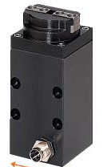
EGP - Analysis of Competitors
Sommer
SCHUNK EGP 40
140
6
0,22
24
IP41
40x26x89
92560
0,32
27,3
Adjustable gripping force
Actuated like pneumatic valve
467
Internal
630
Sommer GEP1402
115
2
0,02
24
IP52
32x32x72
73728
0,3
100
383
external
500
Gripping force [N]
Stroke per finger [mm]
Closing time [s]
Supply voltage [VDC]
IP protection class
Measurement [mm]
Volume [mm³]
Mass [kg]
Stroke/Closing time [mm/s]
Remark
Gripping force/mass [N/kg]
Electronics
Catalog price [euro]

Slide 17
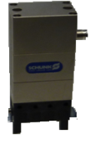

EGP - Analysis of Competitors
Destaco
SCHUNK EGP 40
140
6
0,22
24
IP41
40x26x89
92560
0,32
27,3
Adjustable gripping force
Actuated like pneumatic valve
467
Internal
630
Destaco DPE 200-25
90
12,5
0,25
24
IP54
54x28x128
193536
0,53
50
Actuated like pneumatic valve
170
Internal
920
Gripping force [N]
Stroke per finger [mm]
Closing time [s]
Supply voltage [VDC]
IP protection class
Measurement [mm]
Volume [mm³]
Mass [kg]
Stroke/Closing time [mm/s]
Remark
Gripping force/mass [N/kg]
Electronics
Catalog price [euro]

Slide 18
EGP - Analysis of Competitors
AFAG
SCHUNK EGP 40
140
6
0,22
24
IP41
40x26x89
92560
0,32
27,3
Adjustable gripping force
Actuated like pneumatic valve
467
Internal
630
AFAG EG 20P
40
5
0,18
24
IP44
53x29x103
158311
0,32
28
Power preservation
dig. exits
100
Internal
900
Gripping force [N]
Stroke per finger [mm]
Closing time [s]
Supply voltage [VDC]
IP protection class
Measurement [mm]
Volume [mm³]
Mass [kg]
Stroke/Closing time [mm/s]
Remark
Gripping force/mass [N/kg]
Electronics
Catalog price [euro]

Slide 19

EGP - Analysis of Competitors
PHD
SCHUNK EGP 40
140
6
0,22
24
IP41
40x26x89
92560
0,32
27,3
Adjustable gripping force
Actuated like pneumatic valve
467
Internal
630
PHD EGP 5Mx – 7 x 5
90
4,4
0,17
24
?
55x26x148,4
0,25
25,9
459
External
1.681
Gripping force [N]
Stroke per finger [mm]
Closing time [s]
Supply voltage [VDC]
IP protection class
Measurement [mm]
Volume [mm³]
Mass [kg]
Stroke/Closing time [mm/s]
Remark
Gripping force/mass [N/kg]
Electronics
Catalog price [euro]

Slide 20
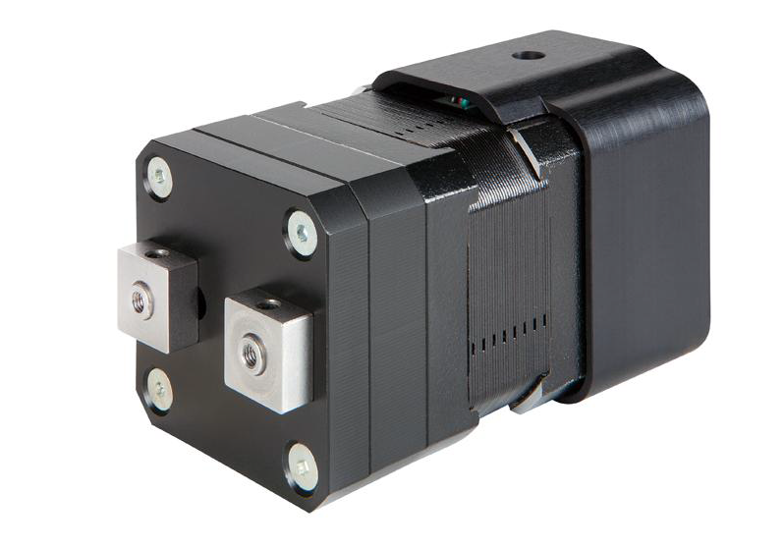
EGP - Analysis of Competitors
Gunda
SCHUNK EGP 40
140
6
0,22
24
IP41
40x26x89
92560
0,32
27,3
Adjustable gripping force
Actuated like pneumatic valve
467
Internal
630
Gunda ELGE 17
15
7
0,5
24
?
42x42x82
144648
0,5
14
Adjustable gripping force
30
Internal
1000
Gripping force [N]
Stroke per finger [mm]
Closing time [s]
Supply voltage [VDC]
IP protection class
Measurement [mm]
Volume [mm³]
Mass [kg]
Stroke/Closing time [mm/s]
Remark
Gripping force/mass [N/kg]
Electronics
Catalog price [euro]

Slide 21


