Slide 1
Short presentation
LDF

Slide 2
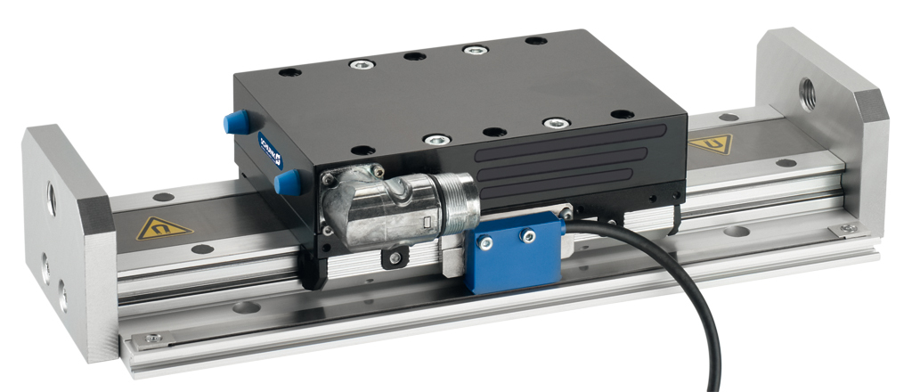
Direct Drive LDF
in an extra-flat version for payloads with highly dynamic requirements

Slide 3
Benefits LDF
Unique Selling Points | Your Surplus Value
+15 % higher nominal force towards the previous version Absolute position measuring system Without hall sensors Hardly no wear parts No mechanical play between the drive elements Low oscillations and high holding force Integrated motor and measuring system in the axis Multiple freely programmable slides on one profile guide Many different variants (twin engine, long slide, mechanically supported version) | more powerful modules in the same installation space No reference runs are necessary less cables in the energy chain, less wearing parts long service life and reliability of the system enabling high precision positioning shortest positioning times and stable positioning minimize interference contours and spare requirements allow exceptionally compact and economical drive concept optimal axis for every kind of application

Slide 4
Fields of Application LDF
Application Solution | Industries | Application Examples
The axis module is suitable for low to medium loads with high dynamic requirements. | Electro Plastic Automotive Pharmaceuticals Assembly of consumer Goods | Can be built as a very flat cross-table Assembly of cannulas Assembly of diesel injection pumps Handling of electronic components for testing and processing stations Assembly of disposable razors Production of circuit boards Assembly of „Trodat “stamps Assembly of lipsticks Assembly of toothbrushes

Slide 5
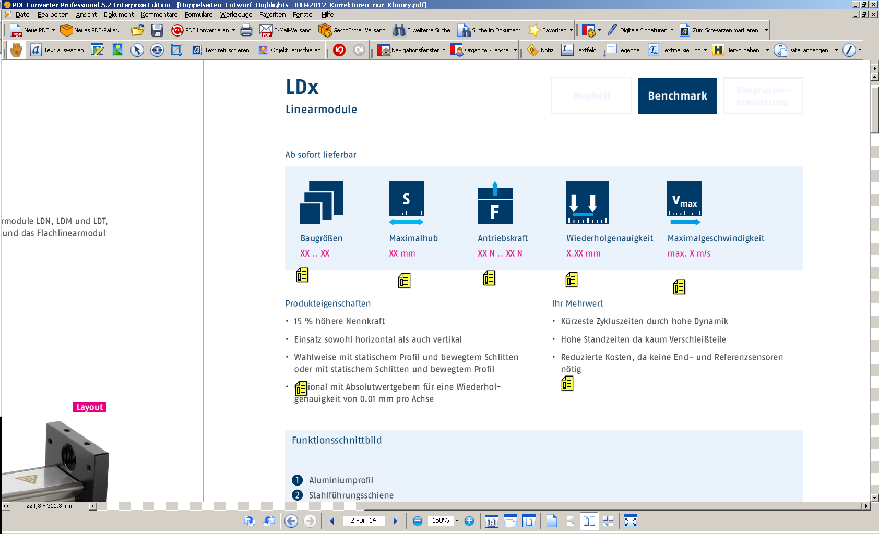
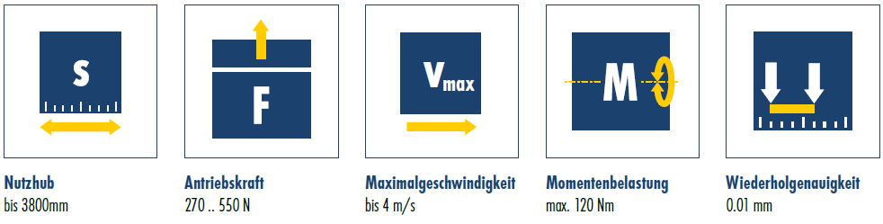
LDF Technical Specifications
Sizes
100…200 mm
Stroke
Bis 3.800 mm
Driving Force
Bis 500 N
Repeat accuracy
0,01 mm
Maximum speed
4 m/s
Drive:
3-phase, electronically commutated AC synchronous linear motor.
Primary part 3-phase copper coil body, secondary part iron mount with permanent
magnets and dirt cover
Stroke measuring system:
Non-contact magnetic measuring system
Profile:
Aluminum section with steel rails
Standard guided slide:
Aluminum skid, primary part and and measuring system reading head directly integrated

Slide 6
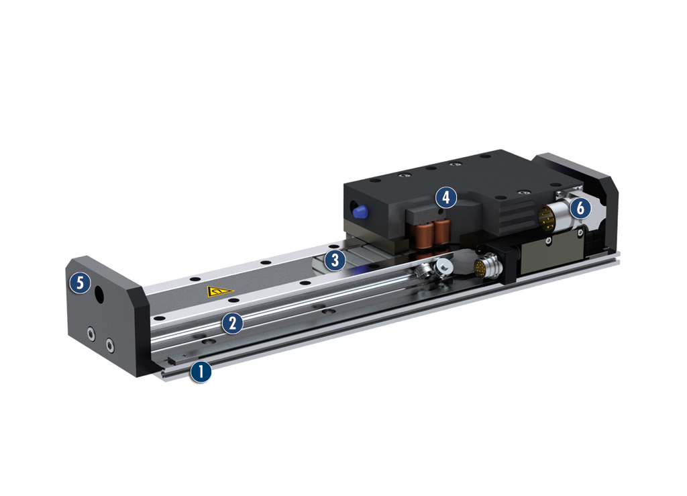
LDF Principle of Function
Cross Section
Aluminum section:
in flat design
Precise, polished spring steel guide rails:
for optimum guidance properties and speeds
(3) Integrated secondary parts:
with high power magnets
(4) Compact primary part slide:
with mounting surfaces, roller shoes adjusted without play and integrated measuring system
(5) End plates:
for mounting sensors and shock absorbers
(6) Motor plug

Slide 7


