Slide 1


ROTA-S plus 2.0
Manual Lathe Chucks

Slide 2















Product overview
Gripping Systems
Clamping Technology
Chuck Jaws
Stationary Workholding
Lathe Chucks
Toolholders
Hydraulic Expansion Technology
Manual Lathe Chucks
Power Lathe Chucks with Jaw Quick-change System
Power Lathe Chucks with Through-hole
Power Lathe Chucks without Through-hole
Pneumatic Power Chucks
Steady Rests
Quick-change Systems
Customized Solutions

Slide 3
Challenges
Variants
Required accuracy
Time
Time
Demand
Time
Flexibility and und set-up time optimization
heute
zukünftig

Slide 4

ROTA Manual Lathe Chucks
heute
zukünftig

Slide 5


ROTA overview
Manual Lathe Chuck
ROTA-S plus 2.0
ROTA-S flex
SPK
6

Slide 6
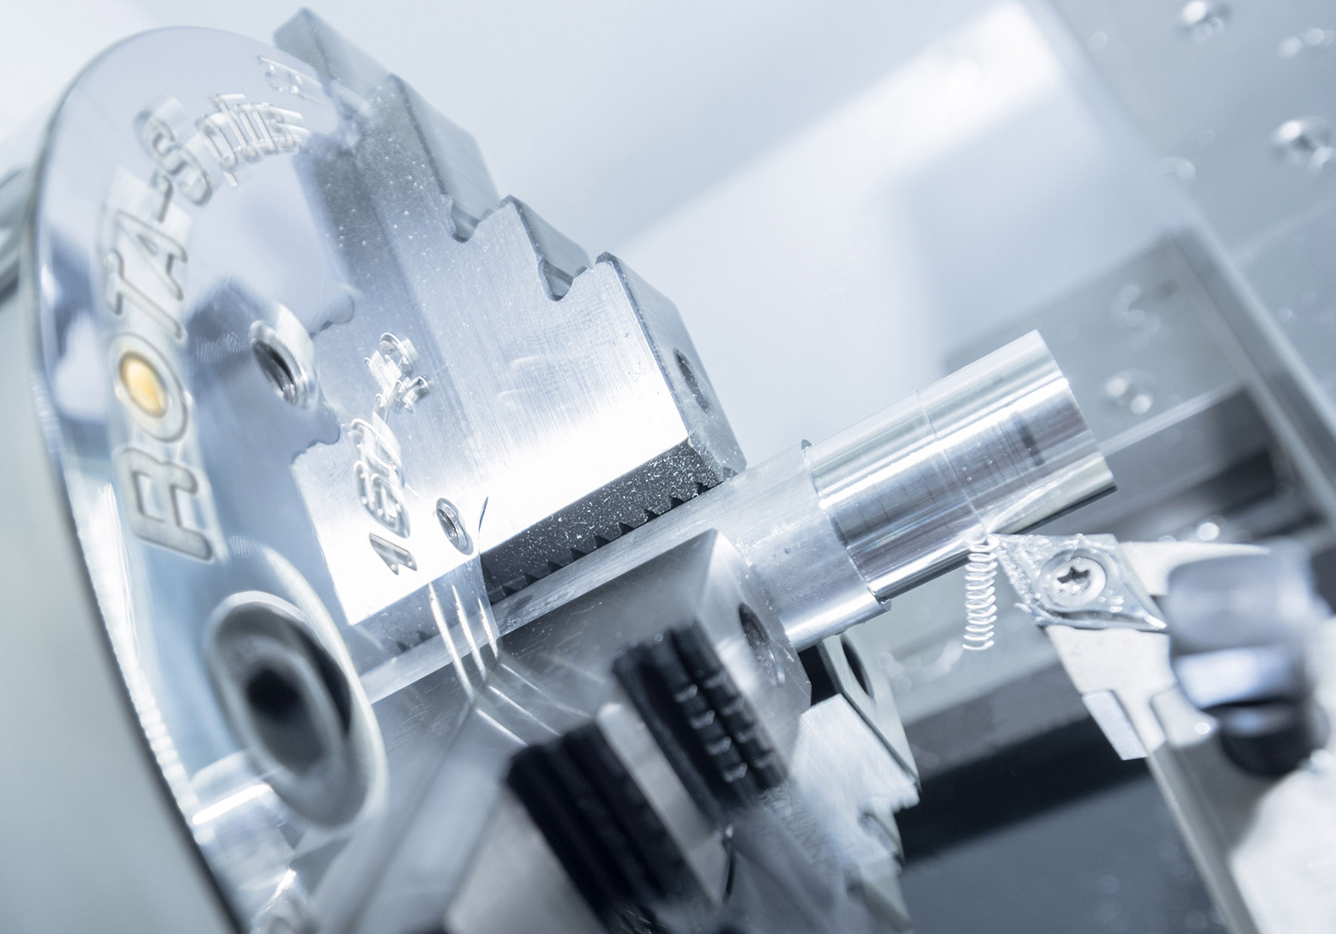
ROTA-S plus 2.0
Example of application
Clamping device:
ROTA-S plus 2.0 160 with stepped jaw.
Features/Application:
O.D. clamping of bars. Precise and safe clamping for best turning results. Easy and efficient retrofitting for changing diameter ranges with jaw quick-change.

Slide 7
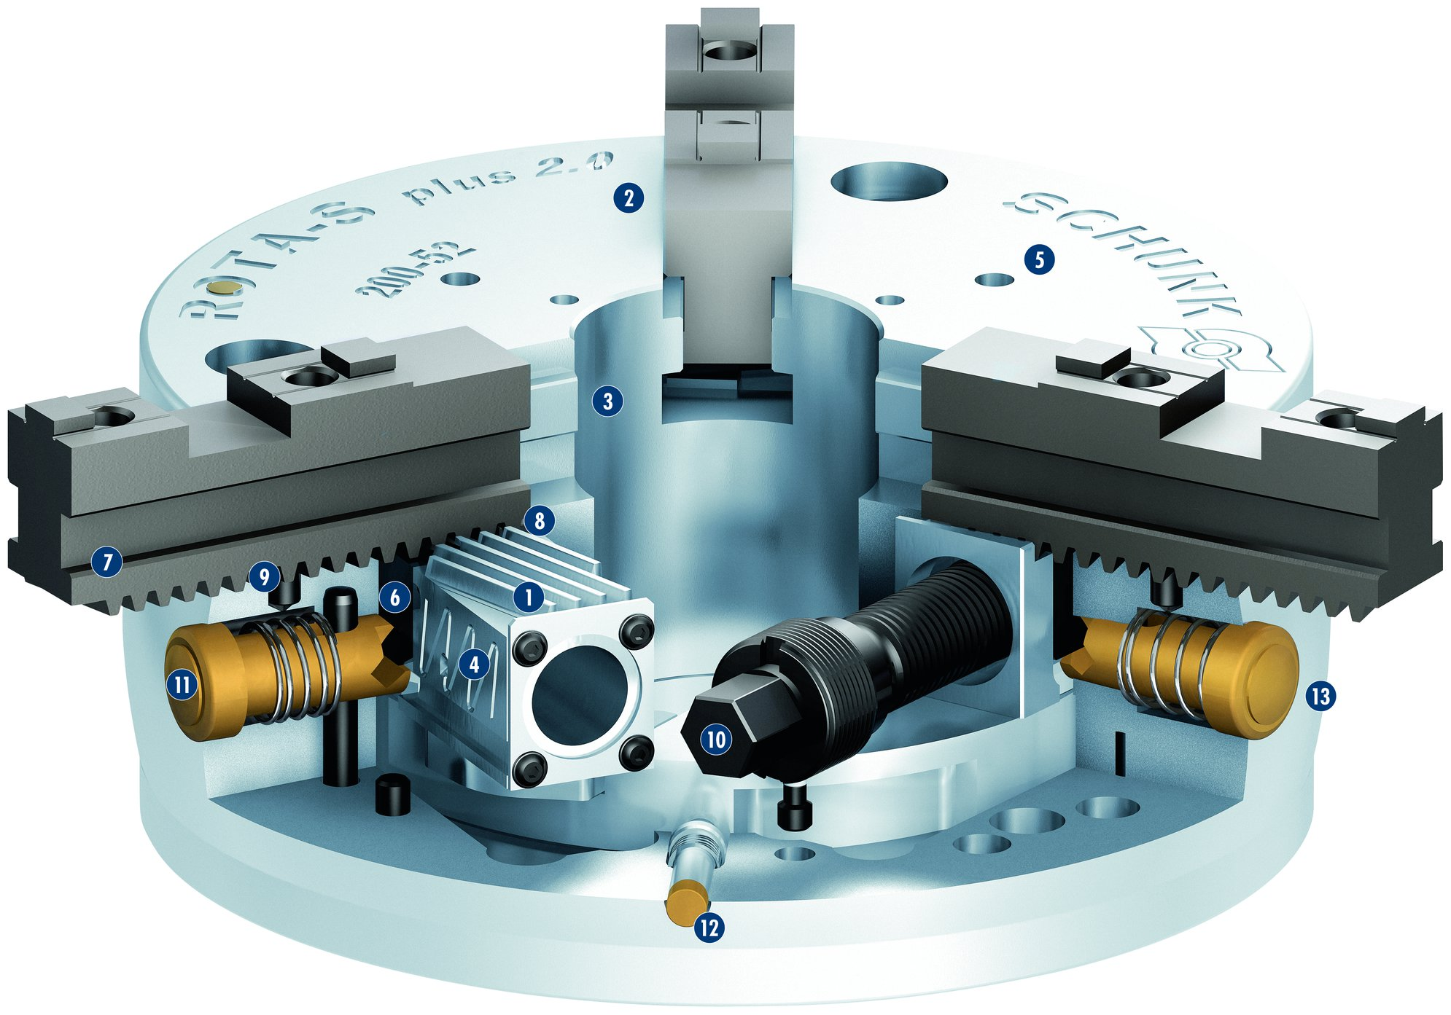
ROTA-S plus 2.0
1
Wedge bar actuation system
Hardened and extremely rigid base body
Large through-hole
Optimized lubrication system
Mounting threads
Jaw quick-change system
Base jaw with angled serration (SFG)
Locking mechanism
The plunger pin
Operation via hexagon connection
Push button for jaw change
Indicator pin
Special shaping with „edge profile for coolant run-off“
2
2
3
5
4
3
5
6
8
7
7
9
1
8
6
11
4
13
9
10
10
11
12
12
13

Slide 8
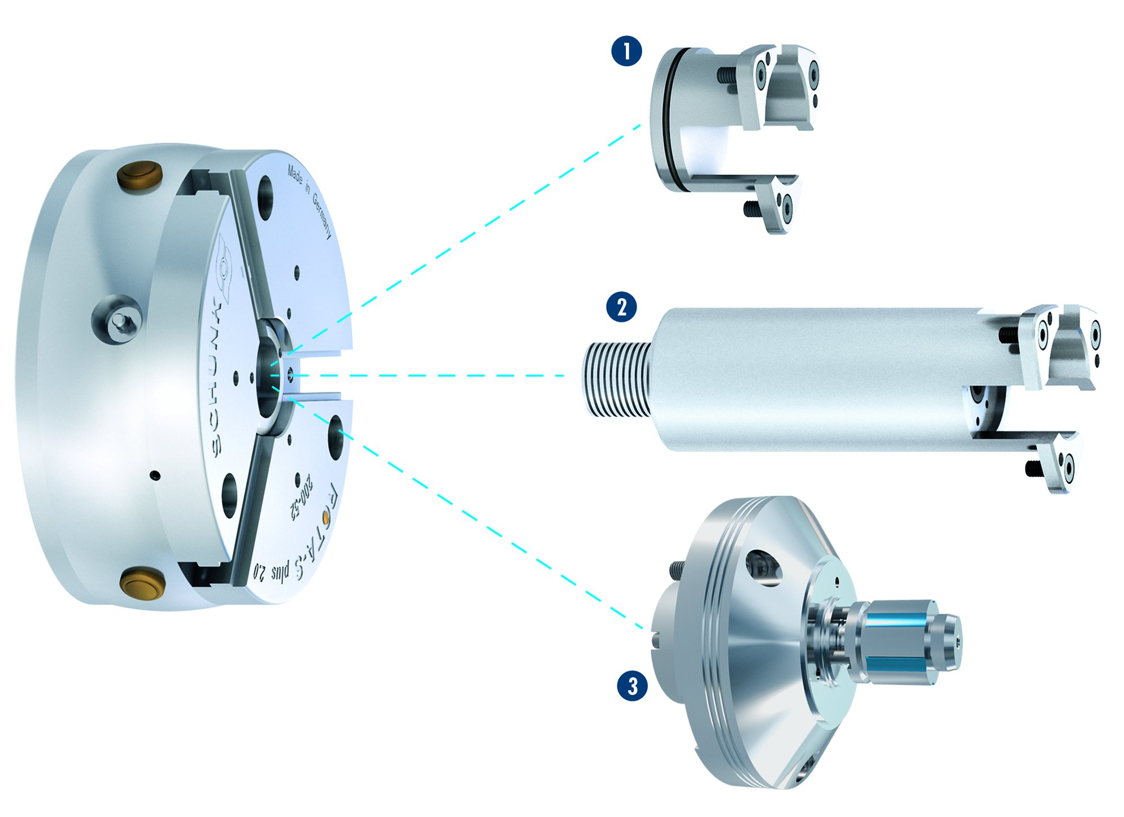
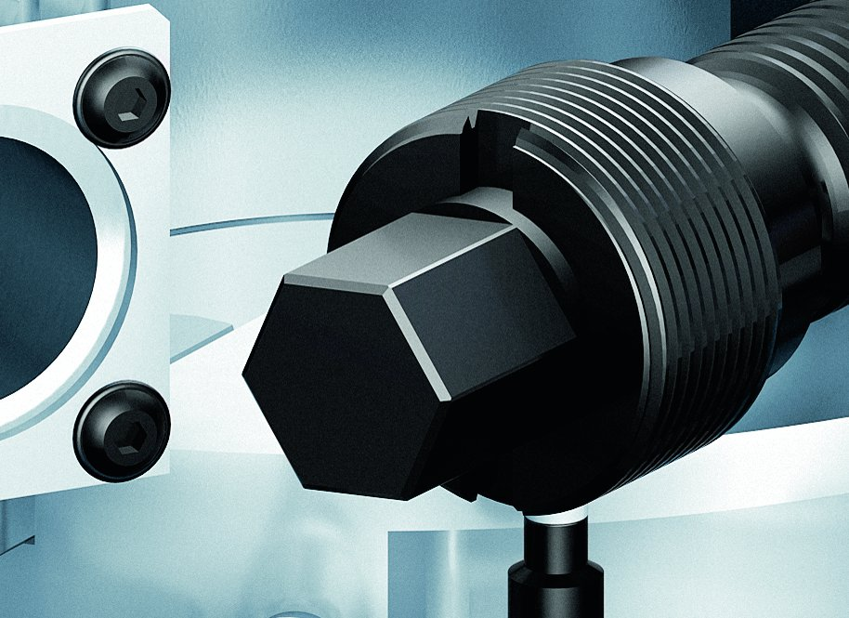
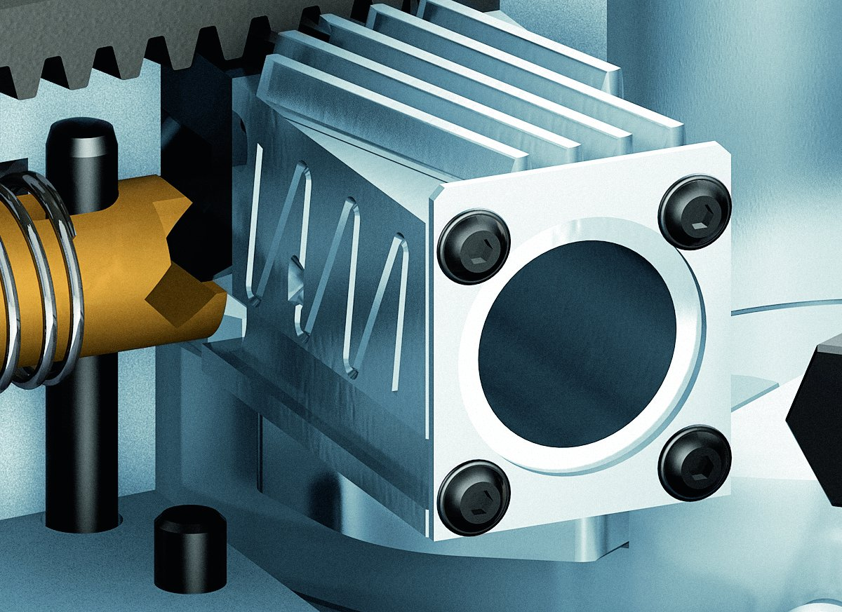
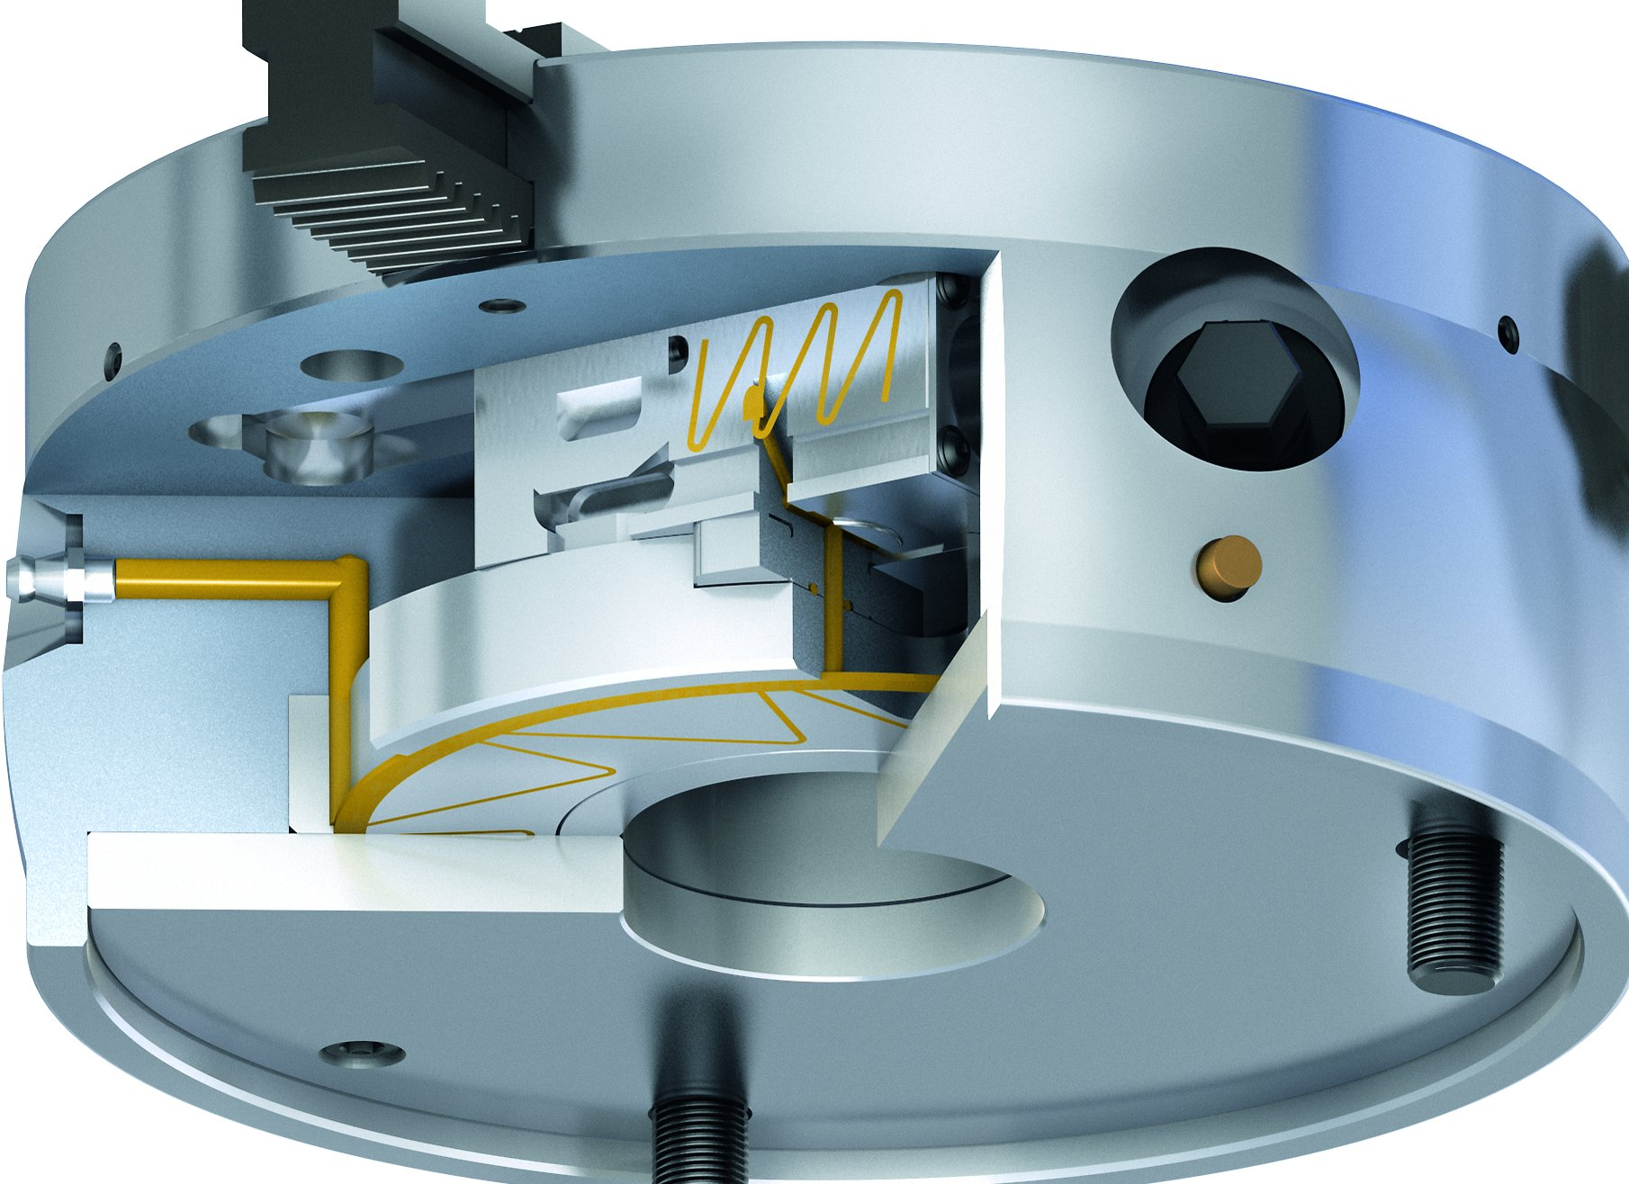
ROTA-S plus 2.0
Modular Center Sleeve System
Spindle with hexagon connection
1
1
Closed center sleeve
Adjustable stop in the center sleeve
Expansion arbor
2
2
3
3
Wedge bar system with wiper
Central lubrication system

Slide 9
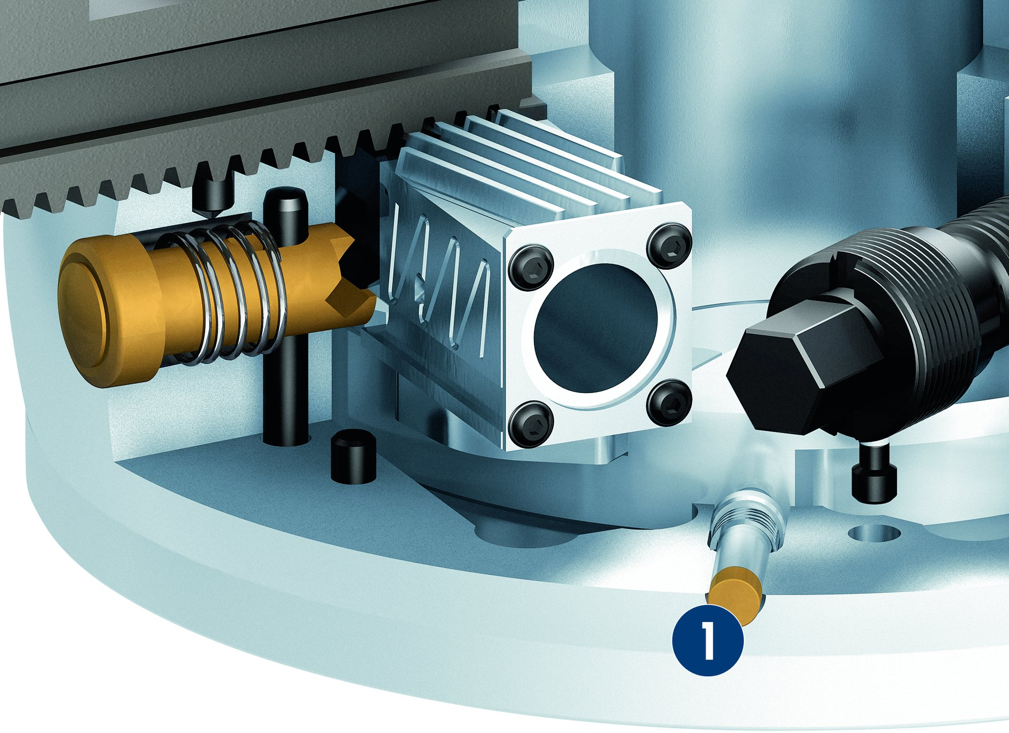
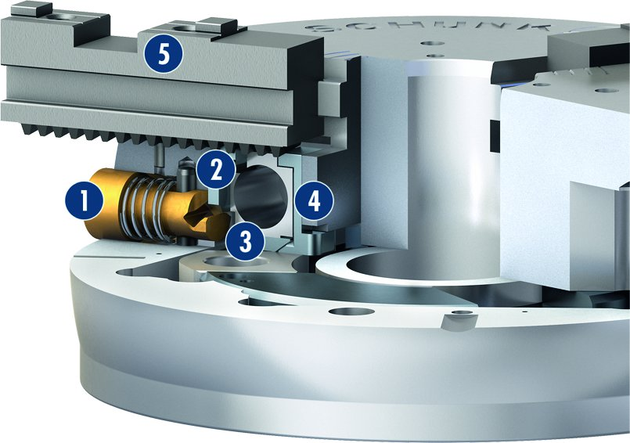
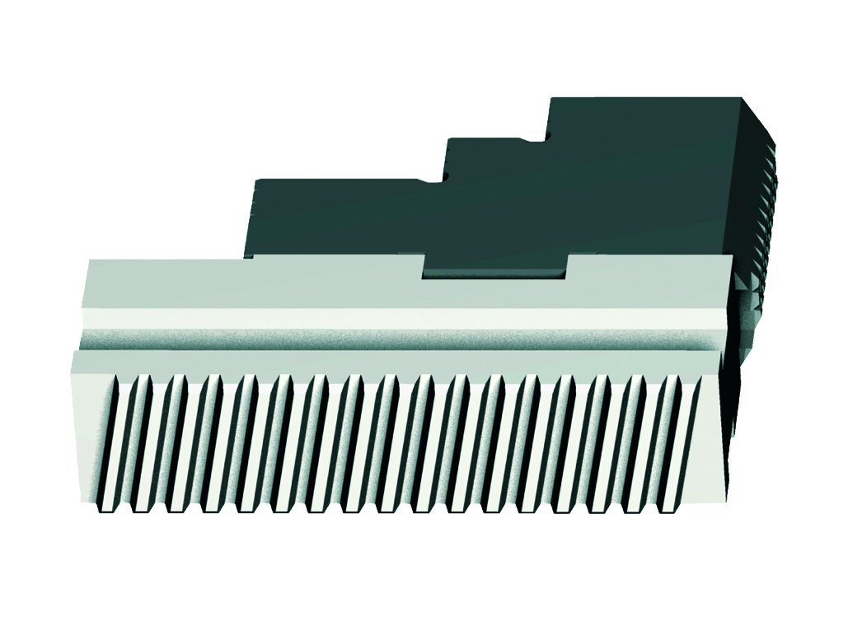
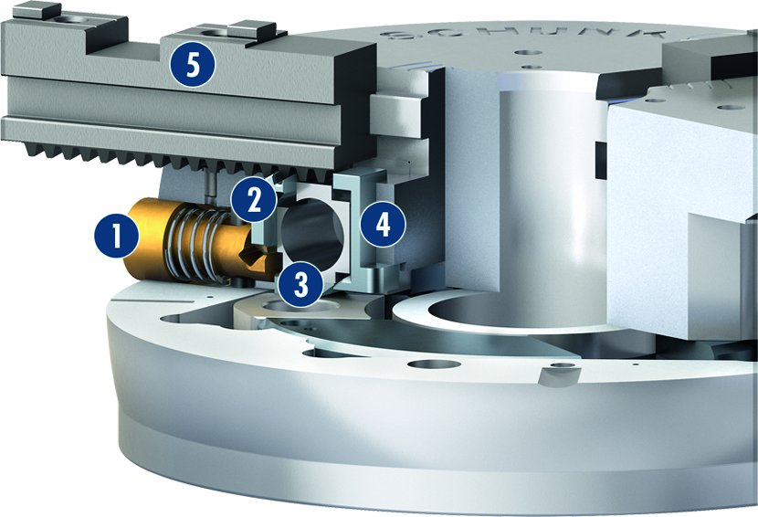
ROTA-S plus 2.0
Maximum operating safety
Correct jaw change
1
Push button
Slide
Traverse slide
Locking slide
Base jaw
5
2
Indicator pin
1
2
4
1
3
3
4
1
5
Incorrect jaw change
Angle serrated base jaws
1
Push button
Slide
Traverse slide
Locking slide
Base jaw
5
2
1
2
4
3
3
4
5

Slide 10
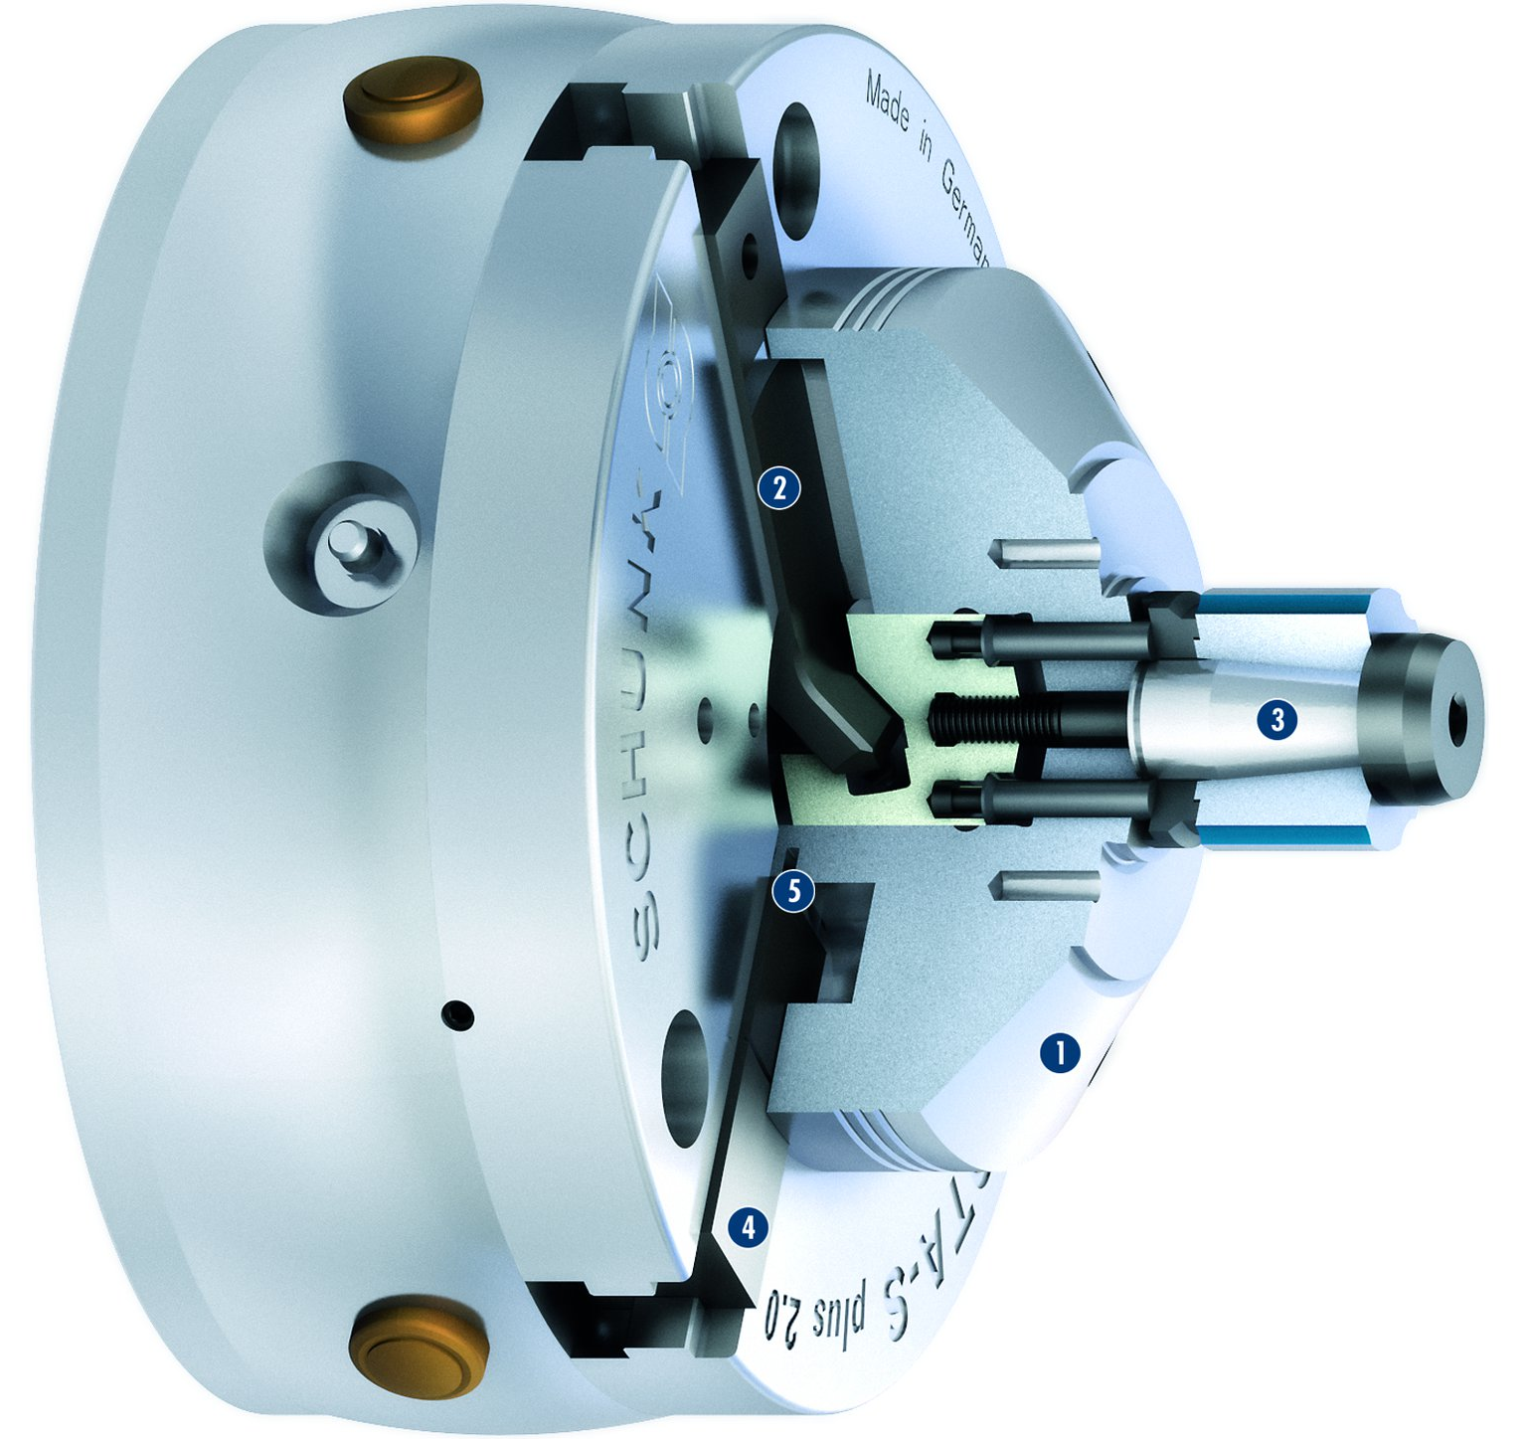
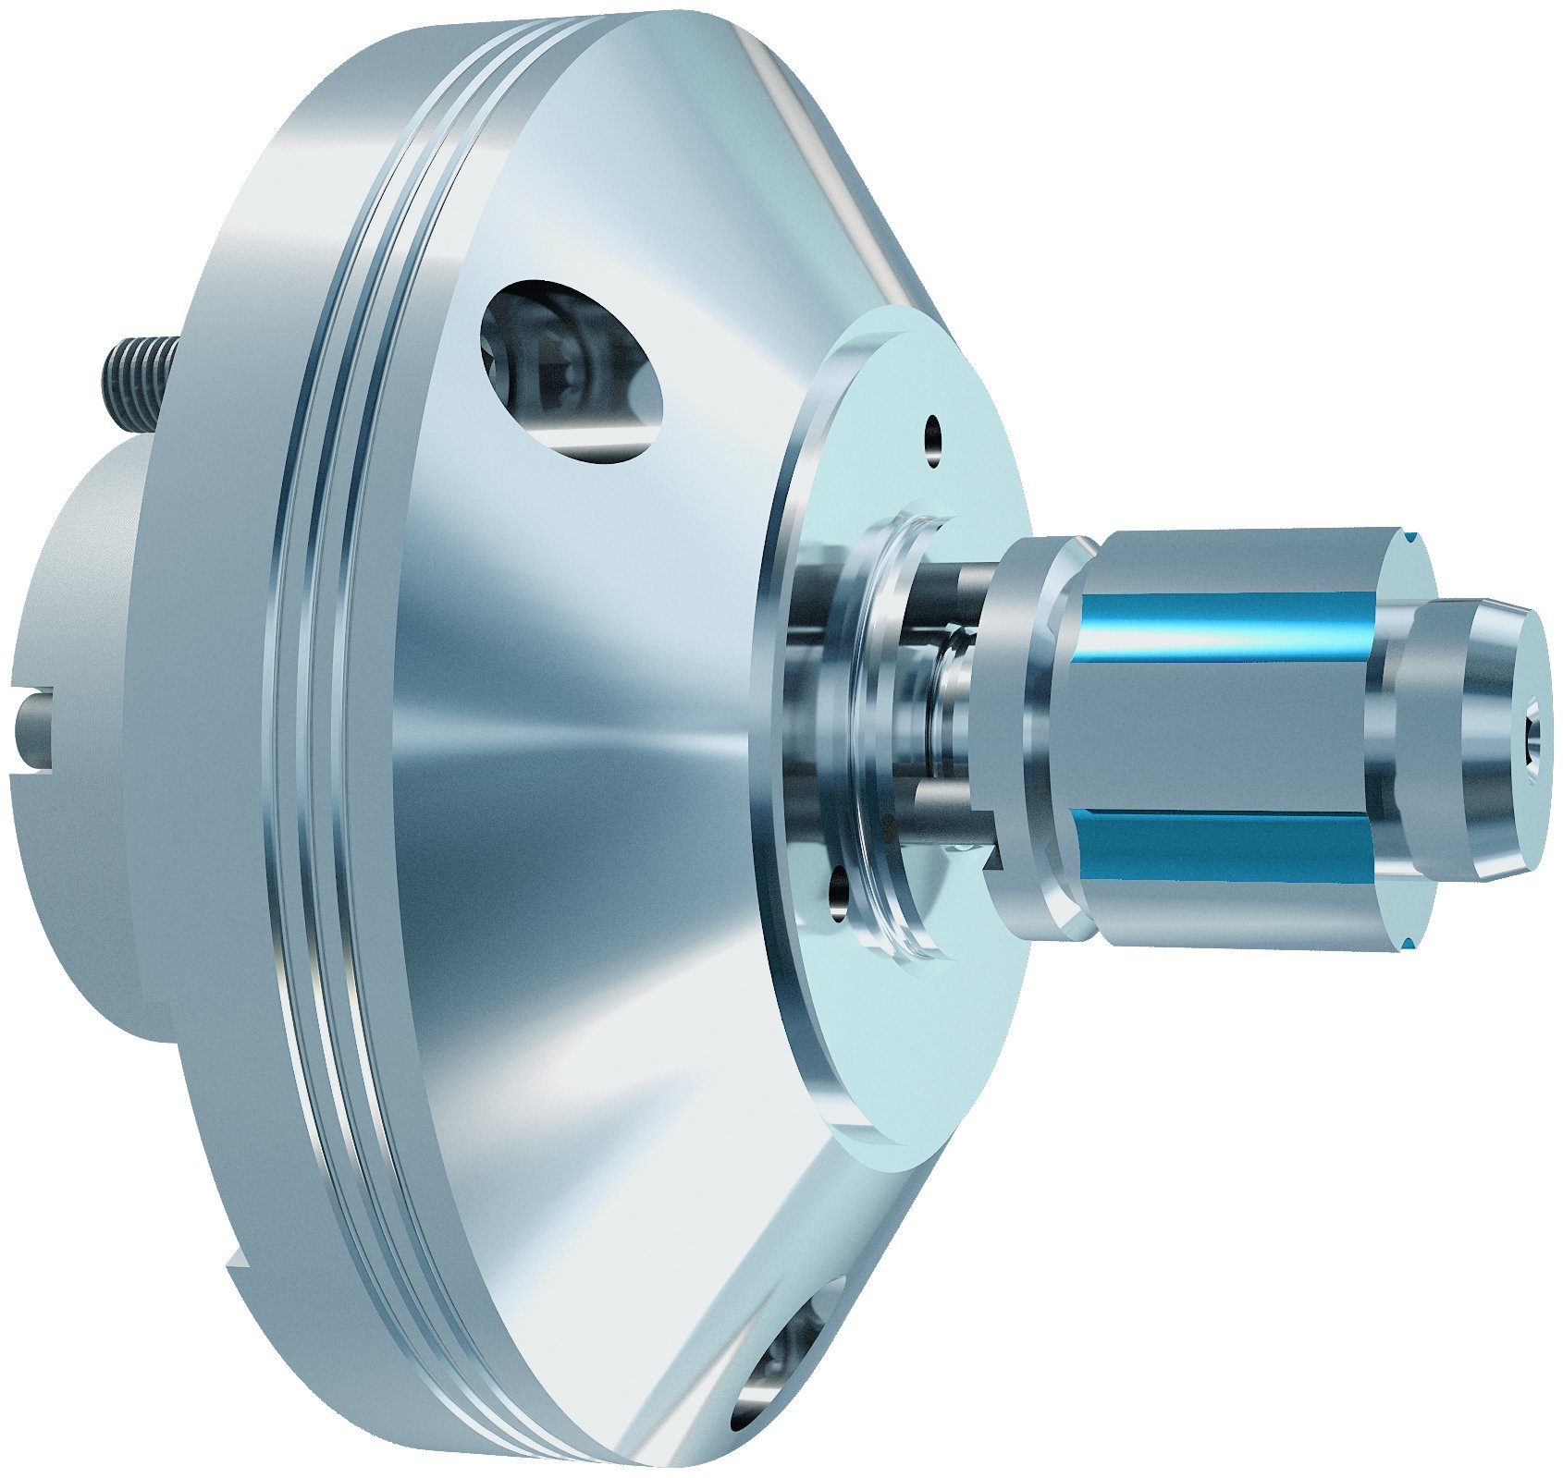
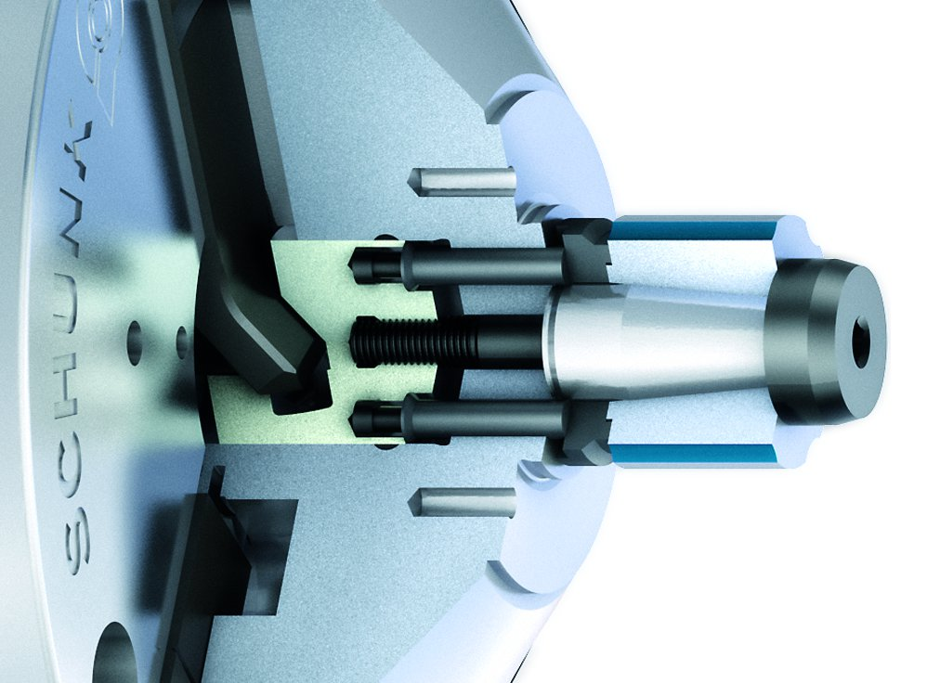
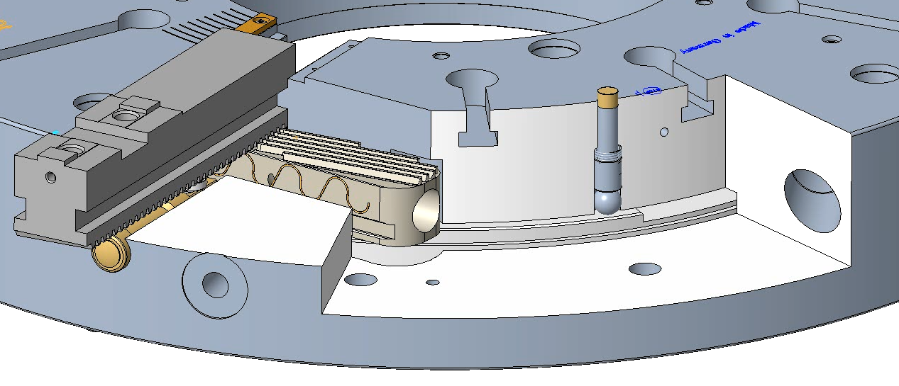
ROTA-S plus 2.0
vario M
Expansion Arbor for I. D. Clamping
1
Expansion arbor
Actuating jaw with wedge hook drive
Clamping sleeve
Dummy jaw
Flex cone in the chuck bore
2
2
3
3
5
4
1
4
5
Easy Actuation of the Expansion Arbor
Indicator pin ROTA-S plus

Slide 11
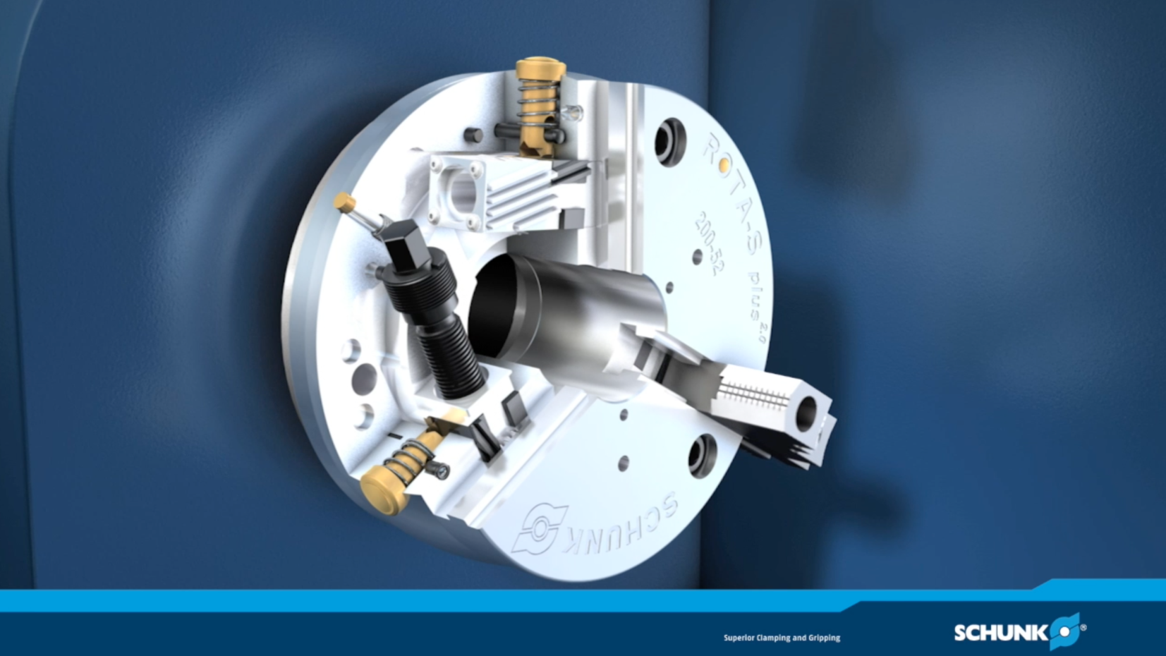
ROTA-S plus 2.0

Slide 12
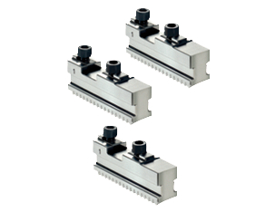
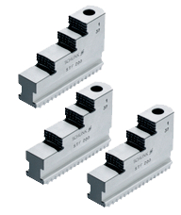
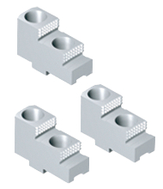
ROTA-S plus 2.0
Standardpaket
Special Offer Package 1
Chuck ROTA-S plus 2.0
Base jaws
Chuck ROTA-S plus 2.0
Stepped block jaws
ground on the chuck
Special Offer Package 2
Chuck ROTA-S plus 2.0
Base jaws
Hard top jaws
ground on the chuck

Slide 13
Variants ROTA-S plus 2.0
Technical data | Max. RPM [min⁻¹] | Max. clamping force [kN] | Max. torque [Nm] | Stroke/jaw [mm] | Through-hole (max. enlargement) [mm]
ROTA-S plus 2.0 160-42 | 5400 | 65 | 80 | 6.5 | 42 (45)
ROTA-S plus 2.0 200-52 | 4800 | 100 | 120 | 7 | 52 (55)
ROTA-S plus 2.0 250-62 | 4200 | 160 | 210 | 7.5 | 62 (75)
ROTA-S plus 2.0 315-92 | 3400 | 180 | 220 | 9.7 | 92 (102)
ROTA-S plus 400-102 | 2200 | 230 | 280 | 12 | 102 (130)
ROTA-S plus 500-162 | 1500 | 270 | 320 | 12 | 162 (180)
ROTA-S plus 630-252 | 1000 | 270 | 350 | 15 | 252 (270)
ROTA-S plus 800-252 | 1000 | 270 | 350 | 15 | 252 (270)
ROTA-S plus 1000-402 | 900 | 270 | 350 | 15 | 402 (412)
Technical data | Max. clamping force [kN] | Clamping range [mm]
vario M0 | 42 | 20-28
vario M1 | 42 | 26-38
vario M2 | 85 | 36-54
vario M3 | 105 | 50-80

Slide 14




SCHUNK Services
Engineering
Dimensioning of special plates designed to the manufacturing specifications
Development of special solutions together with the customer
FEM analysis for critical components
Testing
Endurance tests with all new developments
Abrasion checking
Measurement of accuracy
Service
Initial operation of customer´s solution
Inspection and maintenance
Repairs

