Slide 1
Short presentation
PGN-plus 64/100 Valve Add-on Box

Slide 2
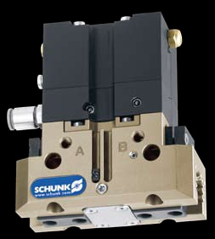
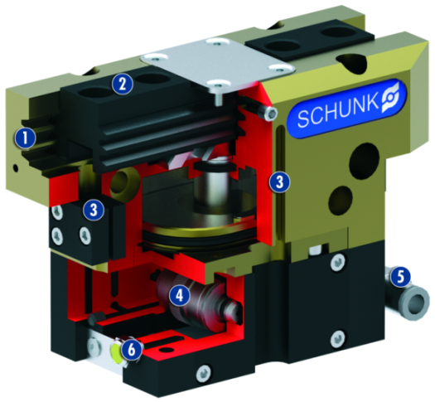
PGN-plus 64/100 Valve Add-on Box
#1: The first valve box for integrated mounting on the gripper
Unique selling points:
Unique valve module for direct mounting on the gripper
Integrated valve technology reduces cycle times
More energy-efficient use of compressed air thanks to shorter hose lengths
Gripper ready for connection with valve actuation
Central connections for air and electrical actuation
Further product features:
The valve add-on box can be retrofitted
Easy to install, even if gripping force maintenance device is used
Optional use of throttles and proximity switches also possible

Slide 3
PGN-plus 64/100 Valve Add-on Box
#1: The first valve box for integrated mounting on the gripper
Customer value/selling points
Total cycle time → faster by a factor of "2" with PGN plus 64 than add-on valve/external valve with 1 m feed line (electronic). No filling and ventilation channels (exhaust line)
Approx. 1/3 less power loss in the valve box than with an add-on valve. Unlimited on-time without excess temperature, as a result
During the gripping cycle, only the gripper volume has to be ventilated, not the gripper volume + supply hose → less compressed air consumption
Only minor tubing/cabling necessary due to direct assembly on the actuator → Saving on control and compressed air lines
Minimal interfering contour → compact system design possible
Decentralized valve technology – components ready for use – plug and work/valve box can be retrofitted as option

Slide 4
PGN-plus 64/100 Valve Add-on Box
#1: The first valve box for integrated mounting on the gripper
  Basic technical functions:
Sizes: 64, 100
Pneumatic connection to
customer interface
Connection via 4-pin M8 circular plug
2 – 8 bar supply pressure
Micro valve type MV 15, MV 25 depending on gripper size
  Complementary products:
PGN-plus 64 and 100
Multi-tooth guidance
Base jaw guide with minimal play and high load bearing
capacity for long finger lengths
Base jaw
For adaptation of the workpiece-specific gripper fingers
Sensor systems
Brackets for proximity switches and adjustable
control cams in the housing
Micro valve
For direct and fast actuation
Supply air and actuation
For easy operation and precise handling
Exhaust air
Via sound absorber or trapped

Slide 5


