Slide 1
Short presentation MV 10

Slide 2
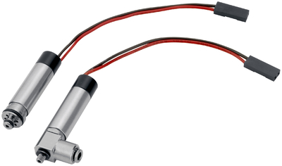
Mikroventil MV 10
#1: Shortest cycle times at a maximum flowrate and compact design
New Product
Sucessor product
New Sizes
Unique selling points:
Maximum flow rate at a compact design/less interfering contours
Short switching times cause faste motion times of the grippers
Variable mounting concepts: plug-in or screw-in
Other features:
Flow volume 30 NL/min
Complete separation of media, suitable for non-corrosive gases and fluids
Flow rate and switching time are configurable to customer requirements

Slide 3
Mikroventil MV 10
#1: Shortest cycle times at a maximum flowrate and compact design
New Product
Sucessor product
New Sizes
Cost Effectiveness/ Customer Benefits :
Can be used for direct assembly at the actuator even in confined spaces. Therefore a considerable saving of air and reduced cycle times are achieved
Integrable into customer applications
Electrical control via impulses of up to 4 valves per control unit

Slide 4
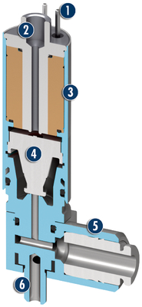
Mikroventil MV 10
#1: Shortest cycle times at a maximum flowrate and compact design
New Product
Sucessor product
New Sizes
  Basic technical data:
Size 10
Nominal size 1mm
12V and 24V operating voltage
Up to 30 NI/min
Outer diameter 9 mm
Pressure ranges: -1…1 bar
Options: 3-8 bar
  Complementary products:
MPG-plus
SWS 001
Electric connection
Pneumatic connection
Valve housing
Valve piston
Pneumatic connection
Pneumatic connection A

Slide 5
