Slide 1
Short presentation
SRH-plus 20-S

Slide 2
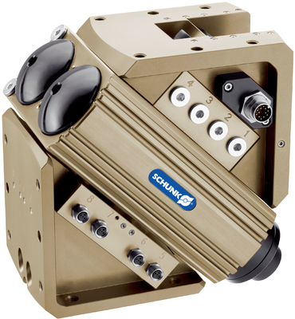
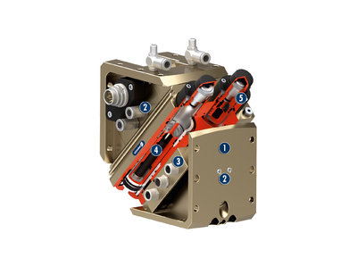
SRH-plus 20-S
#1: Sets a new standard for swivel units in terms of cycle time and frequency
Unique selling points:
Consistent modularity
Suitable variant design with identical external
dimensions for optimum use in any application
Patented shock absorber elastomer dampening sets
new standard for swivel units
Further product features:
Tried-and-tested hydraulic high-performance shock
absorber combined with elastomer
More compact system design because higher loads
possible in the same space for the existing
units with the same cycle time
Higher energy absorption than previous shock absorbers
Increased compact performance in terms of load,
cycle time and cycles per hour

Slide 3
SRH-plus 20-S
#1: Sets a new standard for swivel units in terms of cycle time and frequency
Customer value/selling points
More compact system design, since higher loads are possible using the same space
Internal high-performance dampening for reliable swivel processes
Greater system productivity due to reduced cycle times and more cycles per hour
Can be used in tough environments thanks to standard compliance with IP67
protection class

Slide 4
SRH-plus 20-S
#1: Sets a new standard for swivel units in terms of cycle time and frequency
  Basic technical functions:
Sizes: 20
Weight: 2.1 kg
Axial force: 800 N
Torque: 3.0 Nm
Bending moment: 10.4 Nm
Cycles per hour for SRH-plus
20-S up to 3700 1/h
Swiveling times for SRH-plus
20-S up to 0.3 s
  Complementary products:
  PGN+, MPG+, MMS, IN, etc.
Drive side
For mounting end actuators, such as grippers
Media feed-through
Air feed-through from static to dynamic
Electrical feed-through
Completely integrated for transmission of sensor
signals, actuator signals and energy
Shock absorber with elastomer dampening
Highly dynamic energy is absorbed by shock absorber, remaining dampening is via elastomer
Absorber stroke adjustment
The usable absorber stroke can be varied
according to the load

Slide 5


