Slide 1
Short presentation
SRU-plus 20-S

Slide 2
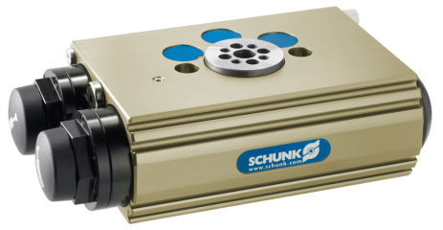
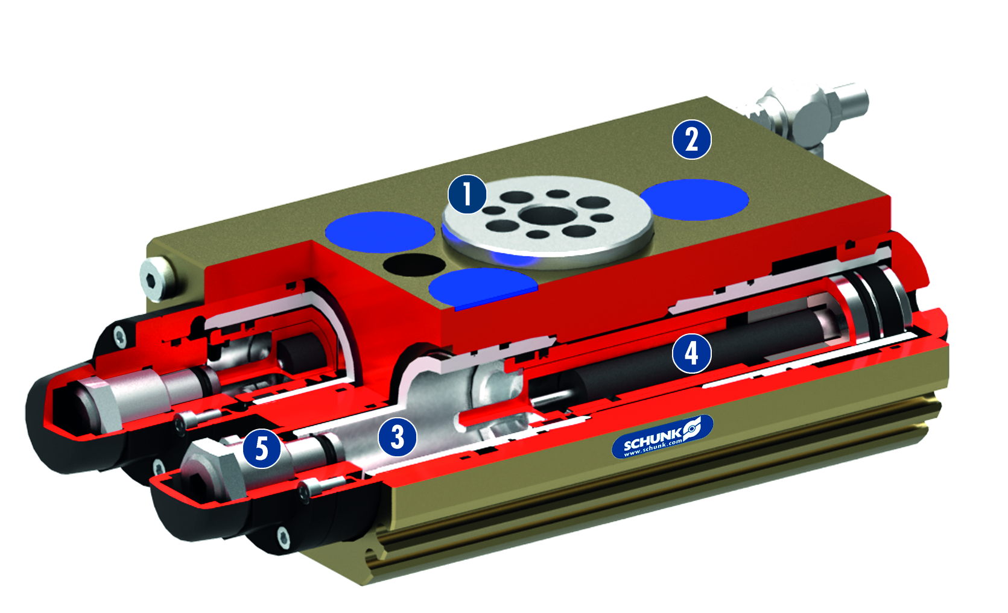
SRU-plus 20-S
#1: Sets a new standard for swivel units in terms of cycle time and frequency
Unique selling points:
Consistent modularity
Suitable variant design with identical external dimensions
for optimum use in any application
Patented shock absorber elastomer dampening sets
new standard for swivel units
Further product features:
Tried-and-tested hydraulic high-performance shock
absorber combined with elastomer
More compact system design because higher loads
possible in the same space for the existing units with the
same cycle time
Higher energy absorption than previous shock absorbers
Increased compact performance in terms of load,
cycle time and cycles per hour

Slide 3
SRU-plus 20-S
#1: Sets a new standard for swivel units in terms of cycle time and frequency
Customer value/selling points
More compact system design, since higher loads are possible using the same space
Internal high-performance dampening for reliable swivel processes
Greater system productivity due to reduced cycle times and more cycles per hour
Can be used in tough environments thanks to standard compliance with IP67
protection class

Slide 4
SRU-plus 20-S
#1: Sets a new standard for swivel units in terms of cycle time and frequency
  Basic technical functions:
Sizes: 20
Weight: 2.1 kg
Axial force: 800 N
Torque: 3.0 Nm
Bending moment: 10.4 Nm
Cycles per hour for SRU-plus
20-S up to 3700 1/h
Swiveling times for SRU-plus
20-S up to 0.3 s
  Complementary products:
  PGN+, MPG+, MMS, IN, etc.
Drive flange
Pneumatic, powerful double piston drive
Housing
Weight-reduced through the use of a hard-anodized,
high-strength aluminum alloy
Sleeve technology
For radial end position adjustment with no setting
effect and rapid replacement for maintenance
Shock absorber with elastomer dampening
Highly dynamic energy is absorbed by shock
absorber, remaining dampening is via elastomer
Absorber stroke adjustment
The usable absorber stroke can be varied according
to the load

Slide 5


