Slide 1
Short Presentation
VCU 50

Slide 2
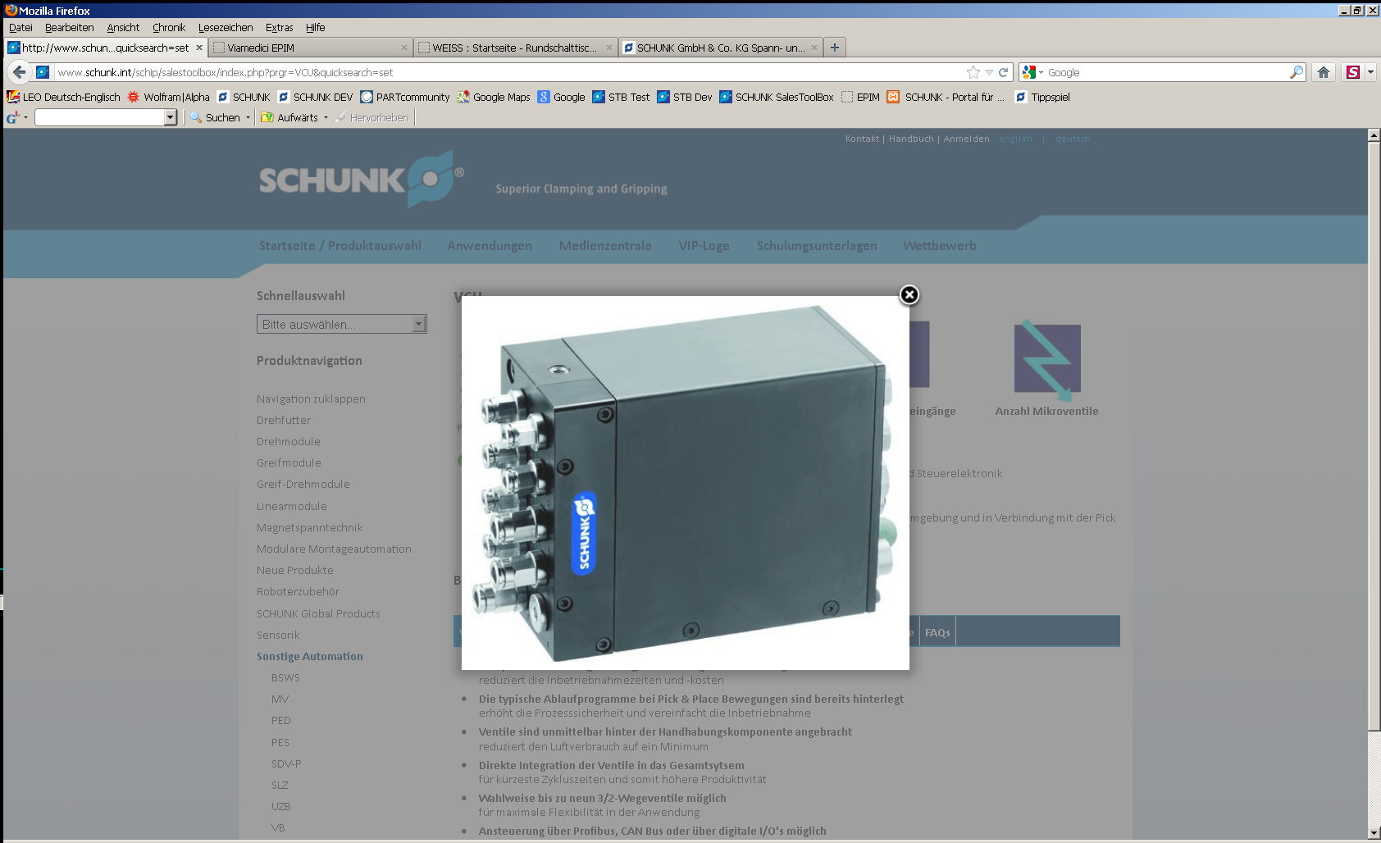
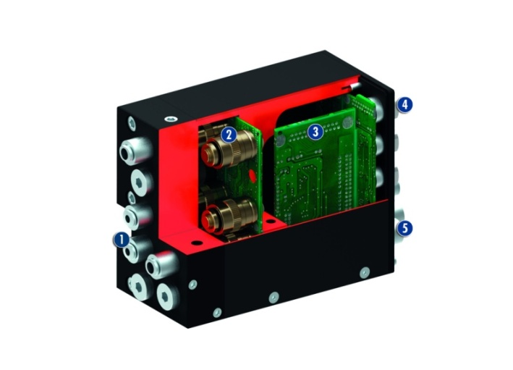
VCU 50
#1: Compact Valve Control Unit with integrated sequence programs for PPU-P and DRL
New Product
Sucessor product
New Sizes
Unique Selling Points:
The typical sequence programs of pick & place applications are integrated in the VCU, and are easily callable via the higher-level control unit (With the sequence programs for the PPU-P 30 and DRL 25, which are integrated in the VCU and the attached handling components(such as gripping and/or rotary modules) the VCU is unique on the market.
Thus the customer can connect and start the system, which has ready pre-assembled hoses and wires (P&P + gripper)
Further Features:
Direct communication/control in the valve
block. There are no "long" communication
times with the SPS
Very compact design
Complete ready-to-install solution
Low air consumption of the system
On request with five to nine 3/2-way valves (micro valves) equipped. To control up to two components in addition to handling PPU-P 30 or DRL 25.
On request, control via digital I/O’s, via Profibus or CAN Bus
Every supply lines are connected on the back

Slide 3
VCU 50
#1: Compact Valve Control Unit with integrated sequence programs for PPU-P and DRL
New Product
Sucessor product
New Sizes
Kundenmehrwert / Verkaufsargumentation
Complete ready-to-install solution (almost no hose connection effort):
screw the unit, connect one hose and two cables. Ready.
Time- and therefore cost saving system (VCU with PPU-P/DRL and if necessary gripper/rotary module) is ready programmed. No programming effort. Plug&play solution. Time- and therefore cost saving
Valves are located very close to the handling components, and therefore have a low air consumption. Cost saving
Low cycle times, due to short paths to the valve block (short hose loading and unloading, and direct control of the handling components in the valve block)
Time saving and therefore higher productivity

Slide 4
VCU 50
#1: Compact Valve Control Unit with integrated sequence programs for PPU-P and DRL
New Product
Sucessor product
New Sizes
  Basic technical data:
Sizes: VCU 025 - 050
Suitable for:
VCU 25 -> PPU-P 10
VCU 50 -> PPU-P 30 und DRL 25
Valves:
On request 4, 5, 6, 7, 8 oder 9 3/2-way valves
Complementary Products:
PPU-P 30
DRL 25
MPG+, MPZ, KGG (every gripper for small components used in
the assembly automation)
SRU Mini
RP, RC, RW (products from the modular system
1.Output air pipes
2. Micro valves
3. Control electronics
4. Sensor inputs
5. Connector control unit

Slide 5


