Slide 1
Short presentation
MMS 22-PI-HD

Slide 2
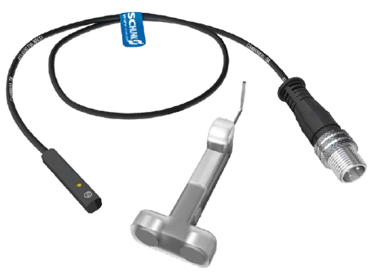
MMS 22-PI-HD
#1 Programmable C-slot sensors in sturdy stainless steel housing
Unique selling points of C-slot sensor for up to two positions, integrated electronics and stainless steel housing:
Programmable switching points (optionally one or two points)
Sturdy and resistant stainless steel housing
Further product features:
Non-contact programming via
"MT-MMS 22-PI magnet teaching tool"
Decentralized programming via optional
"ST-MMS 22-PI plug teaching tool" on any easily
accessible point
Hysteresis programming for more precise switching points
"Cable strain relief" on the sensor, delivered with CLI –
CLIP for mounting the connecting plug
Minimum prices for basic variant

Slide 3
MMS 22-PI-HD
#1 Programmable C-slot sensor in sturdy stainless steel housing
Customer value/selling points
Smaller overlap between sensors thanks to teachable switching points,
no separate recesses needed in adapter plates
One magnetic switch for almost all actuator (for MMS 22-PI1 only)
One sensor for both end positions (for MMS 22-PI2 only)
Standardization of magnetic switches
Programmable hysteresis improves evaluation of positions,
processes, various workpieces, etc., making them controllable and adjustable
Programming makes it much easier to adjust a sensor
Slot switch for high-duty applications

Slide 4
MMS 22-PI-HD
#1 Programmable C-slot sensor in sturdy stainless steel housing
  Basic technical functions:
  Sizes: diameter 4 mm, length 22 mm
  Sensor variants: one switching point (PI1-HD) or two switching points (PI2-HD)
  Connection variants: plug and cable variant
  Complementary products:
  All actuators that could previously also be used with MMS-P 22
  CLI – CLIP for mounting the connecting plug to avoid cable breakage

Slide 5


