Slide 1
Short Presentation
DDF-I

Slide 2
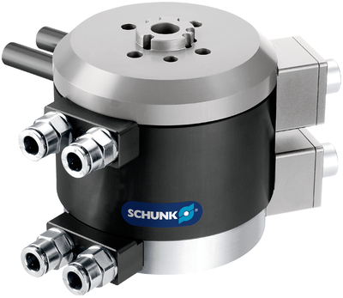
DDF-I
#1: Rotary feed-through with BUS technology
New Product
Sucessor product
New Sizes
Unique selling points:
  Version 1:with integrated (1x) air transmission and vacuum transmission
  Version 2: with integrated (1x) air transmission
  Integrated BUS technology
  ISO flange pattern
  Profibus connection bustechnology-encoded
Further product features:
Air purge connection

Slide 3
DDF-I
#1: Rotary feed-through with BUS technology
New Product
Sucessor product
New Sizes
Customer value/selling points:
Possibility of 360° endless movement
Direct mounting on ISO flange pattern
Integrated air and electric through-feeding for a safe power supply of the handling modules and tools
Predestined for applications, where several actuators are controlled via BUS
Modularity to other SCHUNK products

Slide 4
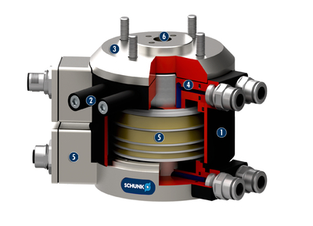
DDF-I
#1: Rotary feed-through with BUS technology
New Product
Sucessor product
New Sizes
  Basic technical functions:
  Sizes: 040, 050, 063
  Weight: 1.9 kg
  ISO-9409: 40, 50, 63
  Transmission: 2x air / 2x vacuum
  Electrical transmission: 26
  Complementary products:
SWS-I
PGN+
EGP
Housing
Torque support
ISO screwed flange
Pneumatic feed-through
Electrical feed-through
Central bore

Slide 5


