Slide 1


Short presentation
DRL with middle position
Superior Clamping and Gripping

Slide 2
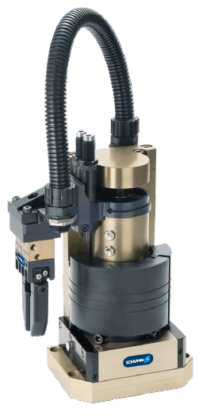
New Product
Successor product
New Sizes
DRL with middle position
#1: Translate and rotate in a compact space. Now also with a middle position
Unique Selling Points:
  Highly flexible control
  Transfer and rotate in a single unit
  Extremely compact footprint. Radius of the mounting pattern is 52mm and fits in small areas.
  Further Product Features:
  Sturdy construction
  Short cycle times
  Realized by driving two waiting positions
  Especially smooth and fast actuation
  Compact footprint – easy assembly
  The rotation can be stopped at 90°. Can be used for example to reject bad parts from the process

Slide 3
New Product
Successor product
New Sizes
DRL with middle position
#1: Translate and rotate in a compact space. Now also with a middle position
Cost Effectiveness/ Customer Benefits:
  Higher cycles per hour via reduced cycle times lead to much higher productivity
  Highly flexible controls. The unit can be stopped directly above the pickup or dropoff positions to exit the working area.
  Rotation able can be adjusted by +/- 2° on both side and can compensate for position tolerance. Vertikalhub je Seite um 10 mm unabhängig voneinander einstellbar dadurch verschiedene Aufnahme- und Ablagepositionen realisierbar
  Completely compatible with the modular assembly automation system
  Highest flexibility with the middle position. The unit can stop, for example, if the dropoff station isn‘t ready and wait in the middle position. Or, pieces that aren‘t good can be removed from the system in the middle position.
  The middle position can be reached from both end positions.

Slide 4
New Product
Successor product
New Sizes
DRL with middle position
#1: Translate and rotate in a compact space. Now also with a middle position
  Basic Technical Data:
  Swivel angle either 90° or 180°
  Middle position at 90°, but only with the 180° version
  Swivel angle adjustability +/- 2° per side
  Vertical stroke: 33 mm; 18mm linear
  Vertical stroke adjustment per side: 10mm
  Operating air pressure: 6 bar
  Torque: 2.26 Nm (6 bar)
  Stroke force: 245 N (6 bar)
  Max. moment of inertia: 0,008 kgm2
  Middle position approachable from both sides.
Function:
  The movement of a vertical cylinder and the rotation drive are guided via a curve roller. Therefore the cylinders can be activated earlier than with a conventional stroke/rotation unit.
  This allows for a cycle rate of up to 90 cycles/min (with miniamal loading and 180° rotation angle, only the movement time without gripping)
  The middle position cylinder stops the rotation at 90°
Center position
Vertical drive
Rotary drive
Assembly connection
Connecting member

Slide 5




Jens Lehmann, a German goalkeeper legend,
brand ambassador for SCHUNK since 2012
www.schunk.com

