Slide 1

Product presentation
CLM
Compact slide

Slide 2
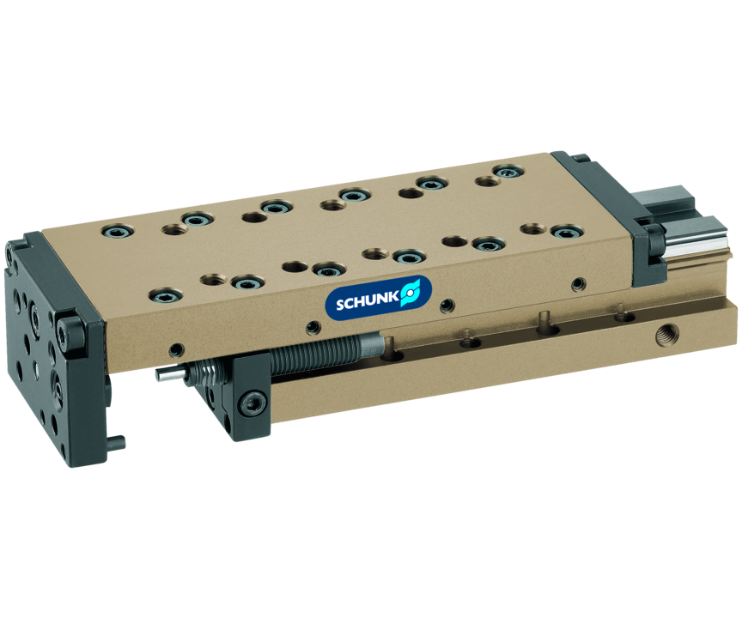
Compact slide
Linear module with optimized length, with pneumatic drive and pre-loaded crossed roller bearings, free from play
The compact slide with the best guidance for assembly automation.
0.01 mm repeat accuracy

Slide 3

Precise. Modular. Compact.

Slide 4
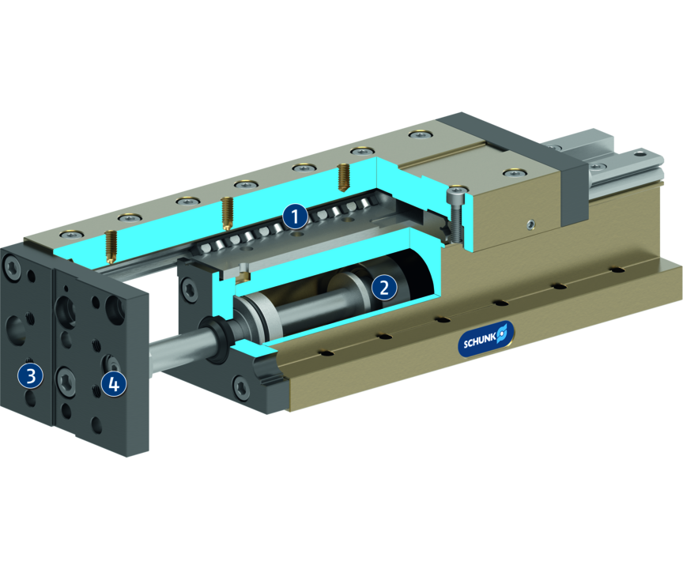
Principle of function
Functional description
The upper part of the slide linearly moves out and in. The drive is a compressed air driven piston.
1
Cross roller guidance
2
Drive
3
Mounting pattern
4
Damping adjustment

Slide 5
Advantages – Your benefits
Crossed roller guide design and solid design ensured high load bearing capacities and end position accuracy in all installation positions
Pretensioned junction rollers That means absolutely scope-free
High basic load ratings in all load directions
Standardized fixing bores and connection dimensions identical for LM series for numerous combinations with other components from the modular system
Shock absorbers and proximity switches integrated in the projecting surfaces for vibration-free movements and end position monitoring
Rod lock by means of clamping cartridge for safety in case of emergency stops
Mounting pattern on the rear side (from CLM 25) this means it can also be used as a stroke unit

Slide 6
Technical data
Technical data overview
Size | Stroke | extend force | retracted force | Weight
 | [mm] | [N] | [N] | [kg]
8 | 14 .. 42 | 30 | 25 | 0.07 .. 0.103
10 | 20 .. 48 | 47 | 39 | 0.135 .. 0.195
25 | 25 .. 59 | 67 | 50 | 0.44 .. 0.6
50 | 25 .. 100 | 120 | 103 | 0.76 .. 1.39
100 | 25 .. 150 | 294 | 247 | 1.45 .. 3.07
200 | 50 .. 150 | 482 | 415 | 3.1 .. 5.32

