Slide 1
Short presentation
ELS

Slide 2
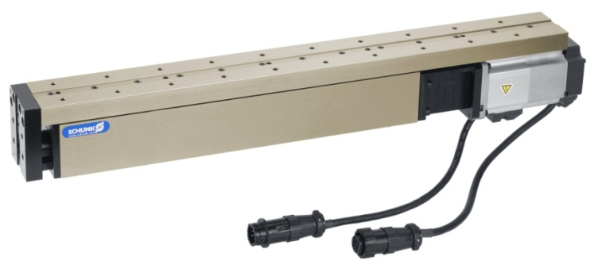
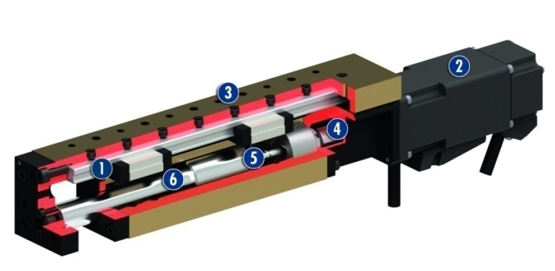
ELS
#1: Compact boom axis with spindle drive
Product features:
Fully integrated in the assembly system
Based on the ELM modules of the modular assembly automation
Profiled rail guide
Compact design
Can be combined with pneumatic linear modules and/or linear motors as standard
Driven by external motor: Standard: BoschRexroth MSM, other drives also possible
Telescopic extension of the slide results in smaller space requirements

Slide 3
ELS
#1: Compact boom axis with spindle drive
Customer value/selling points
Motor is always fixed, only slide moves. Low moving mass (compared to conventional spindle axes, e.g. HSB) → smaller drives can be used
Thread and centering holes used for mounting instead of T-nuts. This makes for easier assembly and simple alignment of the axis or gripper → time savings

Slide 4
ELS
#1: Compact boom axis with spindle drive
  Basic technical functions:
  Sizes: 23 & 37
  Strokes: max. 260 mm
  Repeat accuracy: ± 0.01 mm
  Max. speed: 1 m/s
  Max. acceleration: 25 m/s²
  Max. feeding force: 200 N
  Complementary products:
  LM
  KLM
  CLM
  ELM
  HSB Beta
  HSB Delta
Profiled rail guide
Drive
Modular design hole pattern
Ball screw nut
Spindle
Cover tube

Slide 5


