Slide 1

Product presentation
EGA
Long-stroke gripper

Slide 2
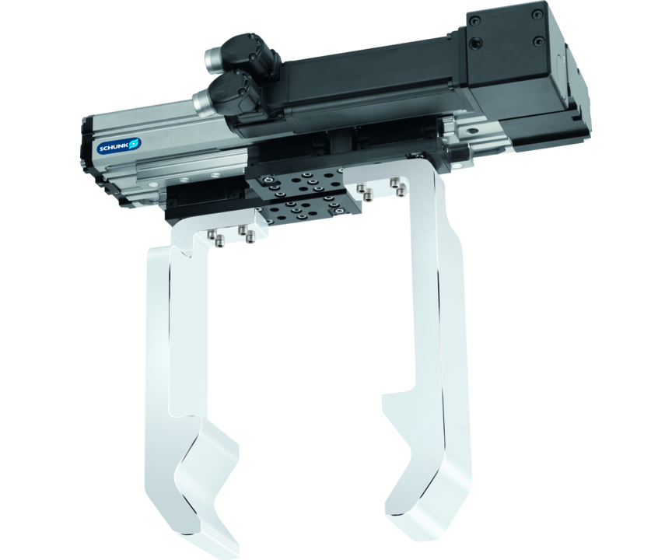
Long-stroke gripper
Electric 2-finger parallel gripper with lightweight profile rail guide and adaptable servomotor
The most flexible long-stroke gripper on the market. Adaptable motor, robust, compact.
Up to 1,300 N gripping force

Slide 3

Flexible. Modular. Robust.

Slide 4
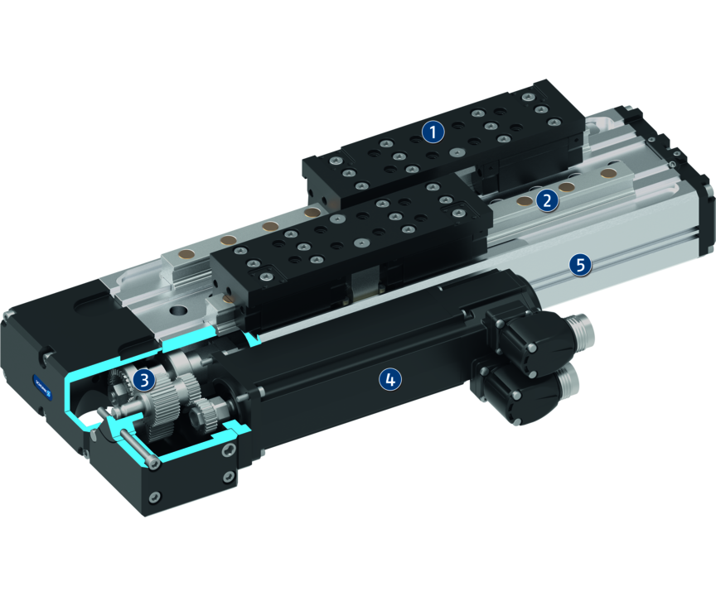
Principle of function
Functional description
The adaptable servomotor drives the base jaw via the gear spindle mechanism.
The jaw stroke is synchronized by means of rack and pinion kinematics.
1
Base Jaw
2
Profiled rail guide
3
Special gear drive
4
Drive
5
Housing

Slide 5
Advantages – Your benefits
High moments due to profiled rail guide suitable for using long gripper fingers
Extremely flat design for minimal interfering contours
Adaptable drive motor for versatile approach and easy integration into existing control concepts
Position and torque-controlled movement of the gripper For very flexible gripping of various geometries and types of components
Radial motor and parallel assembly for flexible adaptation to gantries or robots
Safety functions such as STO and SLS can be realized by the use of a suitable drive motor and controller

Slide 6
Technical data
Technical data overview
Size | Stroke per jaw | Min. gripping force | Max. gripping force | Weight | Max. permissible finger length | Recommended workpiece weight
 | [mm] | [N] | [N] | [kg] | [mm] | [kg]
25 | 30 .. 60 | 150 | 500 | 1.8 .. 2.7 | 200 | 2.5
40 | 50 .. 100 | 200 | 1300 | 6.57 .. 9.1 | 500 | 6.5

