Slide 1

Product presentation
LOG
Internal hole gripper

Slide 2
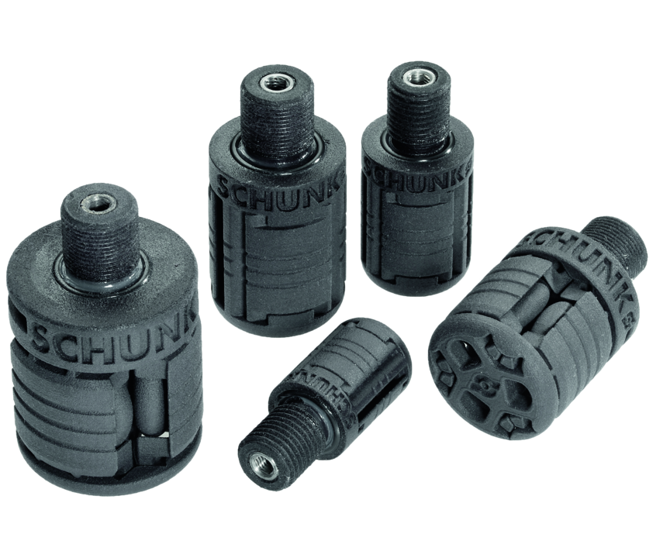
Internal hole gripper
Light gripper made of very resistant polyamide with closed diaphragm system

Slide 3

Cost-effective. Smooth. Reliable.

Slide 4
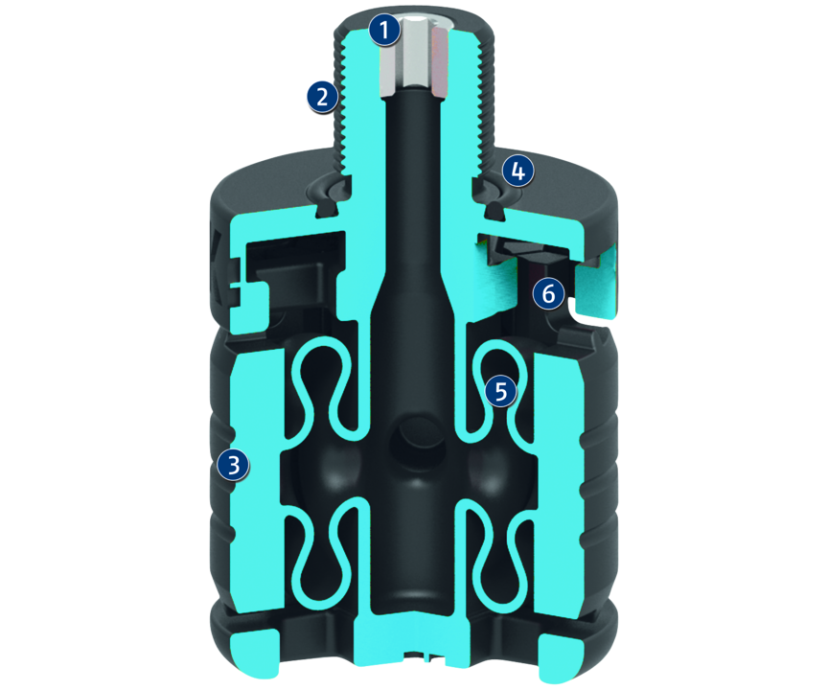
Principle of function
Functional description
The membrane expands when pressure is applied, creating a synchronized movement of the gripping surfaces.
1
Air connection thread
2
Mounting threads
3
Gripping surface
4
O-ring seal
5
Membrane
6
Internal stop/overload protection

Slide 5
Advantages – Your benefits
Low weight allows high dynamics in the application
Closed membrane system and internal stop protect the expansion membrane against damage
Short delivery time for customized measurements
Long service life enables long-lasting economical use
Air supply via hose-free direct connection or screw connections for flexible pressure supply in all automated systems

Slide 6
Technical data
Technical data overview
Size | Gripper Ø D ±0.2 | Height H | Opening force for Ø Dmin | Opening force for Ø Dmax | Weight | Recommended workpiece weight
 | [mm] | [mm] | [N] | [N] | [kg] | [kg]
20 | 19.8 | 29 | 107.2 | 27.3 | 0.008 | 0.55
40 | 39.6 | 47 | 241.4 | 66.7 | 0.034 | 1.23
60 | 59.4 | 70.5 | 596.7 | 190.5 | 0.108 | 3.04
80 | 79.2 | 94 | 972.7 | 433.3 | 0.238 | 4.96
99 | 98.01 | 116.33 | 2516.7 | 1166.7 | 0.44 | 12.83

