Slide 1
Short presentation
PHL

Slide 2
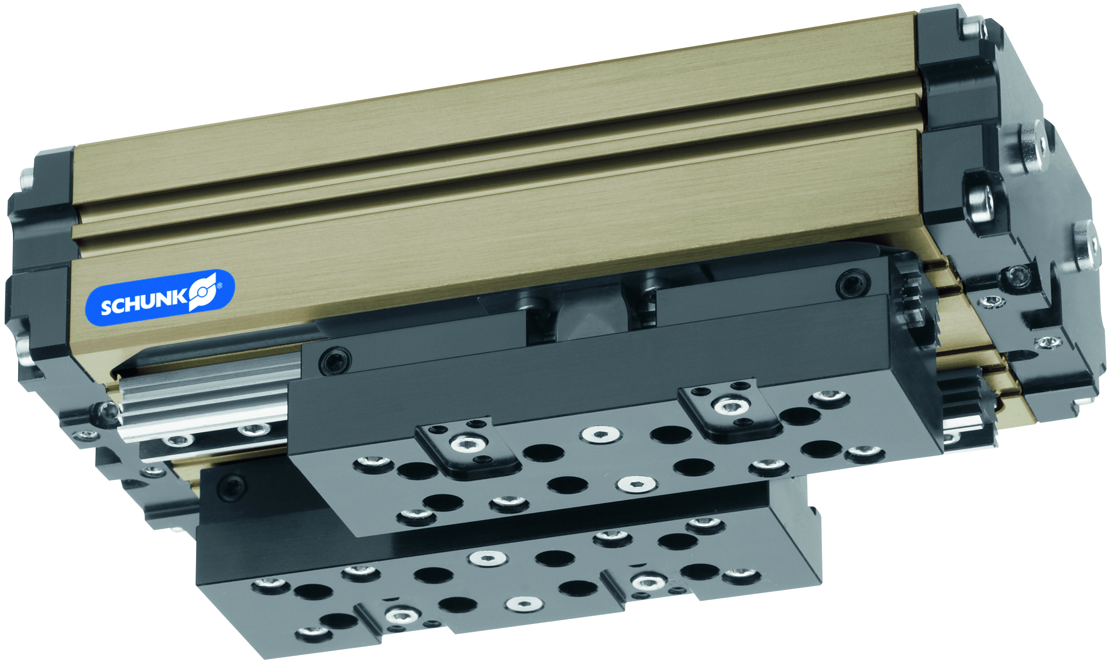
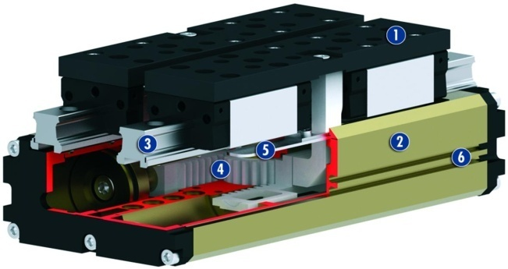
PHL
#1: The most modular long-stroke gripper on the market
New Product
Sucessor product
New Sizes
Unique selling points:
Modular design – one drive – two outputs
Output with roller guide or reverse multi-tooth guide
Roller guide → + 20% efficiency
Roller guide → constant force along entire finger length
Multi-tooth guide → exceptionally sturdy
Further product features:
Based on aluminum press-drawn section
Gripping force maintained by springs
Jaw adaptation for jaws in line
Monitoring via inductive or magnetic field sensors
Viton version for ambient temperatures up to 130 °
or aggressive ambient conditions

Slide 3
PHL
#1 : The most modular long-stroke gripper on the market
New Product
Sucessor product
New Sizes
Customer value/selling points
Output with roller bearings → for longer finger lengths and improved efficiency
Output with friction bearings → for applications with a risk of impact – especially sturdy guide
Modular design concept → for maximum flexibility – in particular, any stroke can be implemented with a minimum length
Guide according to customer use (value for money)
Increased efficiency with roller bearing guide → greater energy efficiency
and lower energy costs

Slide 4
PHL
#1: The most modular long-stroke gripper on the market
New Product
Sucessor product
New Sizes
  Basic technical functions:
  Sizes: 25, 32, 40, 50, 63
  Weight: 1.5 kg … 21 kg
  Gripping force: 390 N … 3290 N
  Opening stroke per finger:
  30 mm … 160 mm
  Workpiece weight: 2.0 kg … 16.6 kg
  Complementary products:
  PFH replacement
  IN, MMS sensors
Base jaws
Housing
Profiled rail guide
Kinematics
Dirt cover
Sensor systems

Slide 5


