Slide 1

Product presentation
PWG-plus
Universal gripper

Slide 2
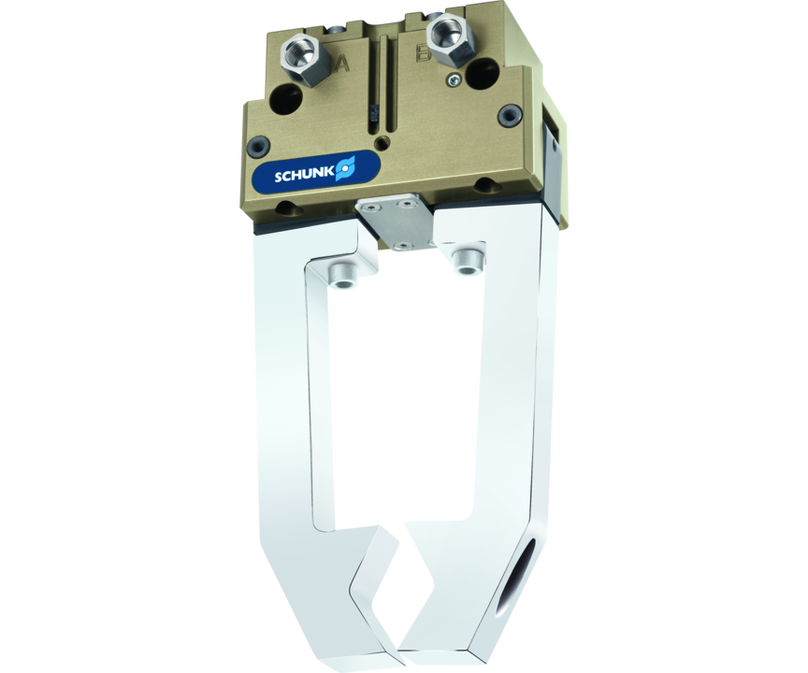
Universal gripper
Robust 2-finger angular gripper with oval piston and bone drive
Compact powerhouse with oval piston drive and high-strength aluminum housing.
Up to 1,025 Nm gripping torque

Slide 3

Reliable. Robust. Compact.

Slide 4
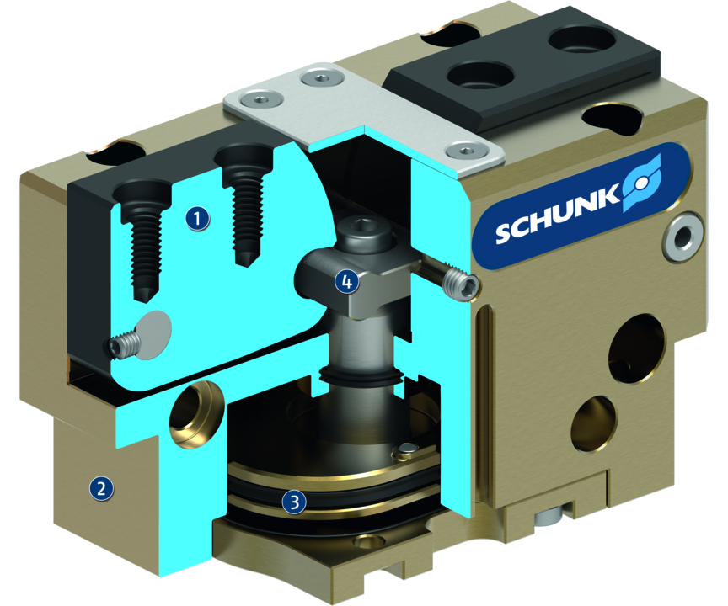
Principle of function
Functional description
The kinematics transforms this vertical motion into a synchronous and rotatory gripping motion of the base jaws.
1
Base Jaw
2
Housing
3
Drive
4
Lever mechanism

Slide 5
Advantages – Your benefits
Variable top jaw design since grippers are available in jaw version, but also in finger version via intermediate jaws
Gripping force maintenance device for a high process reliability
Stroke limitation while opening optional available for confined spaces and short cycle times
Can be used in tough environments due to the gripper’s sturdy set-up

Slide 6
Technical data
Technical data overview
Size | Opening angle per jaw | Max. permissible finger length
 | [°] | [mm]
50 | 15 | 64
64 | 15 | 80
80 | 15 | 100
100 | 15 | 125
125 | 15 | 160
160 | 15 | 200
200 | 15 | 240
240 | 15 | 300

