Slide 1
Short presentation
PZH-SF

Slide 2
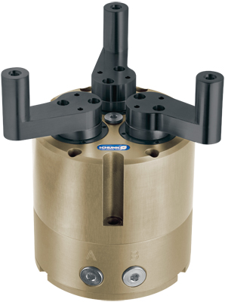
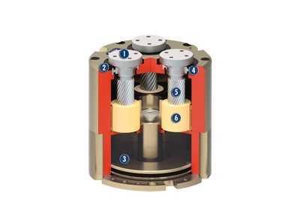
PZH-SF
#1: Standard centric gripper with swiveling fingers
Unique selling points:
Swiveling fingers for a long stroke
(large workpiece range)
Further product features:
Engineering design based on aluminum
housing, customer-specific special strokes
can be easily implemented by adjusting the
"swivel arm"
Jaw adaptation possible for top jaws
Monitoring via inductive sensors
(standard in the automotive industry)
Magnetic field sensors for standardized,
compact monitoring options

Slide 3
PZH-SF
#1: Standard centric gripper with swiveling fingers
Customer value/selling points
Gripper with longer stroke replaces multiple grippers with short strokes
Gripper removes need for time-consuming jaw change if there is a large
range of workpieces/diameters
Gripper suitable for I.D. and O.D. gripping
Can be connected to PZN-plus

Slide 4
PZH-SF
#1: Standard centric gripper with swiveling fingers
  Basic technical functions:
  Size: 125
  Weight: approx. 3.4 kg
  Gripping force: approx. 3000 N (50 Nm per finger)
  Stroke per finger: approx. 22 mm
  Stroke per jaw: approx. 100°
  IP 65 protection class (max. IP 67)
  Workpiece weight: 15 kg
  Optionally available with maintenance of gripping force
  Complementary products:
  Magnetic switch, inductive sensors
  TCU-Z
  AGE-F
  SW-B
Rotary flange
For adaptation of the workpiece-specific gripper fingers
Dust protection cover
For use in dirty environments
Drive
Double pressurized pneumatic piston
Storage
High-precision bearing thanks to use of
high-quality rolling-contact bearing
Steep-threaded spindle
For transforming the linear piston movement
into the rotary finger movement
Ball screw nut

Slide 5


