Slide 1

Product presentation
ERD
Universal rotary unit

Slide 2
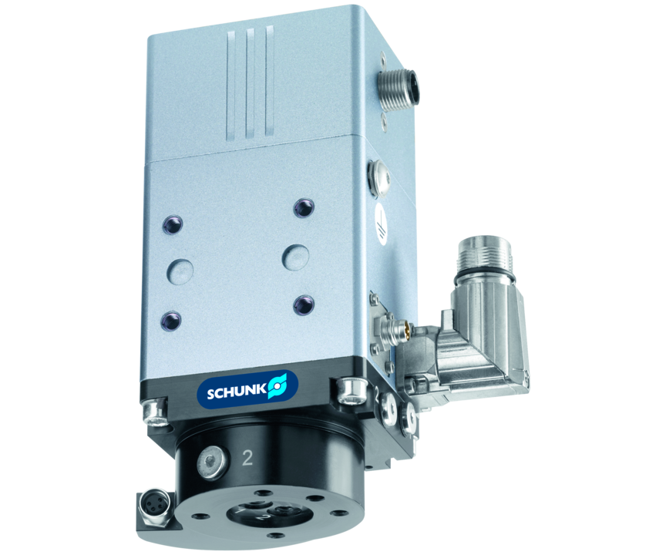
Universal rotary unit
Powerful torque motor with absolute encoder and electric and pneumatic rotary feed-through
The most compact torque motor with integrated electric and pneumatic rotary feed-through.
0.01° repeat accuracy

Slide 3

Fast. Compact. Flexible.

Slide 4
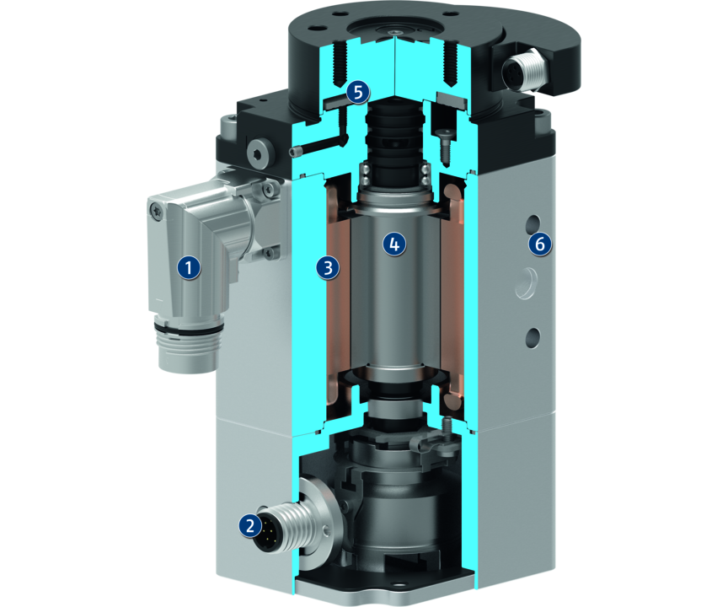
Principle of function
Functional description
The unit is driven by a 3-phase brushless synchronous motor with permanent excitation.
As it is a direct drive, it no longer needs mechanical transmission elements such as gears, eliminating the resulting inaccuracies.
1
Motor plug
2
Absolute encoder plug
3
Fixed primary part
4
Secondary component
5
Energy feed-through
6
Housing

Slide 5
Advantages – Your benefits
With absolute position measurement system Less programming effort and time saving when commissioning and in operation
High dynamics for shorter cycle times therefore a high productivity is achieved
Integrated air and electric feed-through for safe energy supply of grippers
Almost no wear parts For long service life and reliability of the system
No mechanical play between the drive components for flexible response behavior and high positioning accuracy
Optionally certified safety devices according to SIL2/PLd with the HIPERFACE® and DRIVE-CliQ interfaces for applications with high standards in the area of machine safety

Slide 6
Technical data
Technical data overview
Size | Nominal torque | Peak torque | Max. RPM | Max. mass moment of inertia | Repeat accuracy | Weight
 | [Nm] | [Nm] | [1/min] | [kgm²] | [°] | [kg]
4 | 0.4 | 1.2 | 600 | 0.008 | 0.01 | 1.2
8 | 0.8 | 2.4 | 600 | 0.009 | 0.01 | 1.5 .. 1.55
12 | 1.2 | 3.6 | 600 | 0.011 | 0.01 | 1.8

