Slide 1

Product presentation
ERM
Heavy-duty rotary module

Slide 2
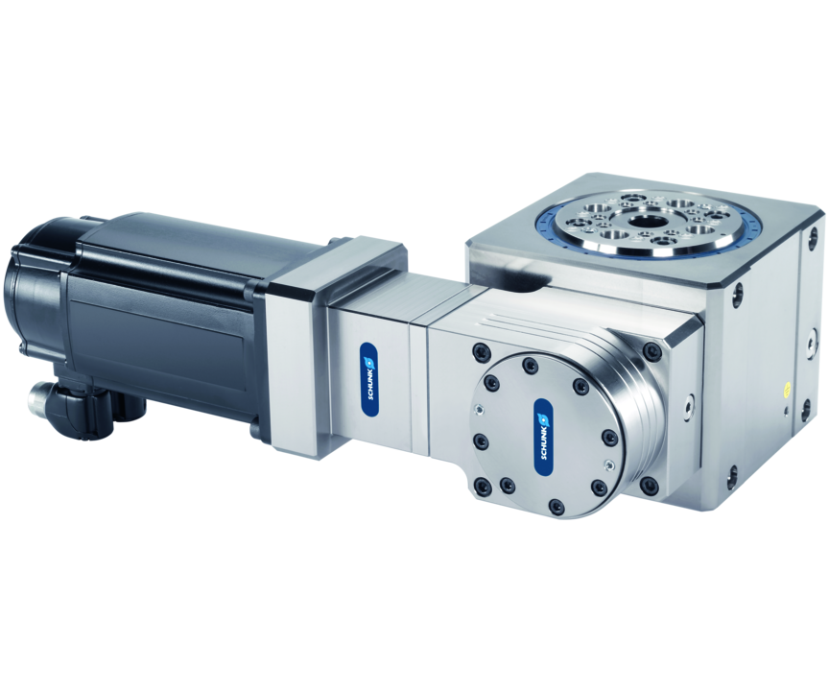
Heavy-duty rotary module
Electric rotary module for high loads with adaptable servomotor, rotary angle > 360°, center bore, and optional feed-throughs
The most powerful modular rotary module for use in automated systems.
75 Nm torque for high loads

Slide 3

Adaptable. Strong. Loadable.

Slide 4
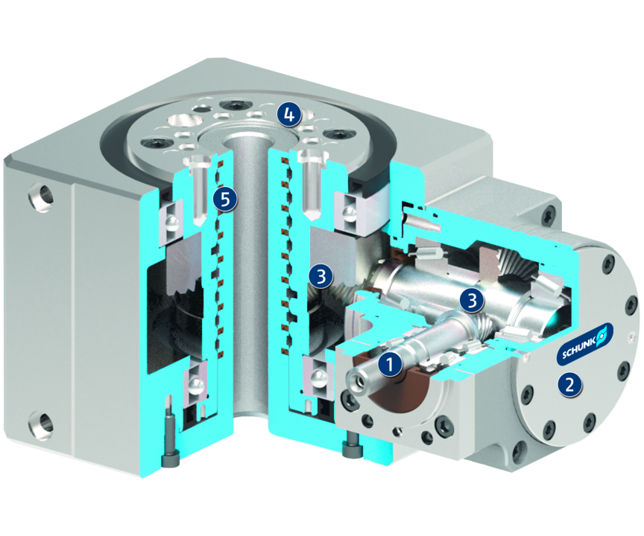
Principle of function
Functional description
The torque of the motor is transferred from the driving shaft via the two stage hypoid gearing to the output flange. Via the rotary feed-through compressed air can be fed through to the distributor flange for connection of the output flange. The orientation of the transmission housing can be adjusted in 4 x 90° steps (for fastening the module or the attachment).
1
Drive shaft
2
Bevel gear
3
2-step hypoid gear speed
4
Output flange
5
Integrated air supply with mounting holes

Slide 5
Advantages – Your benefits
Modular drive concept for adaption of common servomotors for example from Bosch or Siemens
Easy system integration by use of a preferred motor with available fieldbus and safety technology
90° swivel-mounted drive for flexible adaptation to gantries or robots
High torque and precision for the positioning of heavy loads with high precision
Center bore and integrated feed-through for cable and media feed-through
High robustness and large loading area for demanding applications

Slide 6
Technical data
Technical data overview
Size | Peak drive moment | Peak output moment | Repeat accuracy | Weight
 | [Nm] | [Nm] | [°] | [kg]
160 | 2.3 | 75 | 0.035 | 15.5 .. 21.5

