Slide 1

Product presentation
ERS
Universal rotary unit

Slide 2
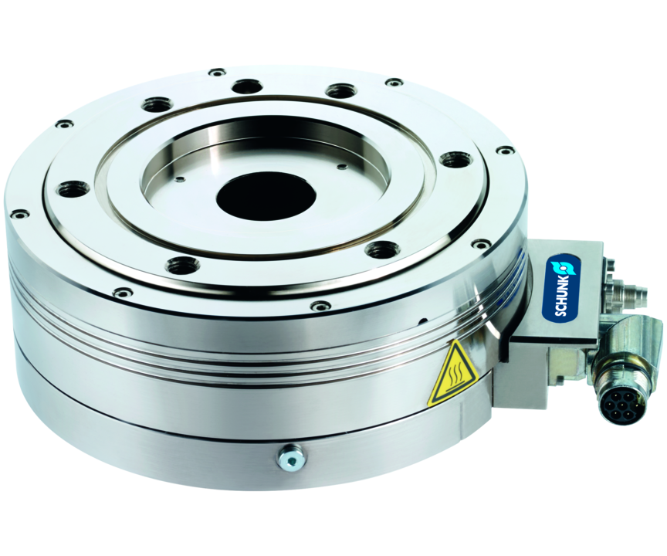
Universal rotary unit
Electrical rotary unit with torque motor and angle of rotation > 360° as well as the optional pneumatic brake and rotary feed-through, and if desired increased protection class (IP54)
The flattest torque motor with the highest torque for industrial automation.
77 mm design height for 27 Nm torque

Slide 3

Compact. Flexible. Fast.

Slide 4
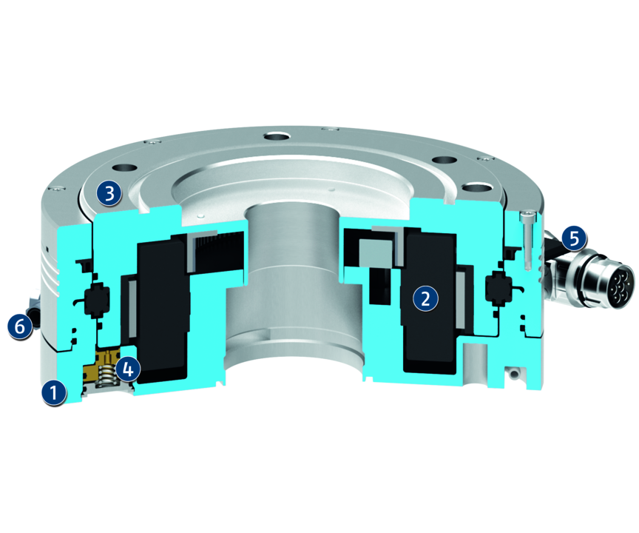
Principle of function
Functional description
The rotary module ERS is based on a permanently energized torque motor, whose large center bore ensures a media feed-through. The position is ensured using a four point bearing, which is designed for high maximum moments.
1
Base support stator
2
Stator
3
External rotor with center bore
4
Pneumatic holding brake
5
Electrical coupling flange with plug connectors
6
Micro valve

Slide 5
Advantages – Your benefits
Integrated torque drive for high torque and flexible use by controlled position, velocity and torque
Large center bore for feed-through lines and media hoses
Compact design for minimal interfering contours and for use in confined spaces
Easy system integration by standard encoder interface (Sin/Cos)
Versatile actuation options for simple integration into existing control concepts using different external third-party controllers (e.g. Bosch Rexroth IndraDrive or Siemens SINAMICS)
Optional pneumatic holding brake for maintaining the position in downtime

Slide 6
Technical data
Technical data overview
Size | Nominal torque | Peak torque | Nominal speed | Max. mass moment of inertia | Repeat accuracy | Weight
 | [Nm] | [Nm] | [1/min] | [kgm²] | [°] | [kg]
135 | 2.5 | 8 | 1000 | 0.07 | 0.01 | 2.7
170 | 4.7 .. 5 | 17 | 250 .. 700 | 0.2 | 0.01 | 4.2 .. 6.3
210 | 9.3 .. 10 | 27 | 250 .. 600 | 0.6 | 0.01 | 7.4 .. 10.9

