Slide 1

Toolholding Systems
TENDO ES

Slide 2
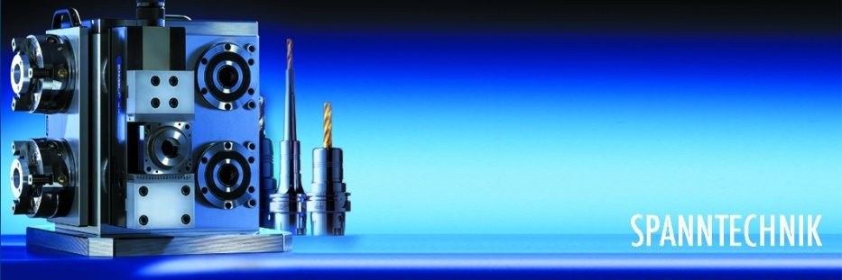
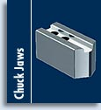



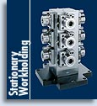






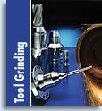

Product overview

Slide 3
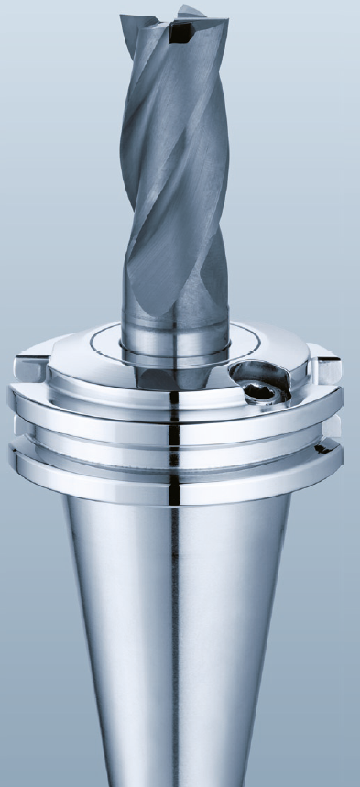
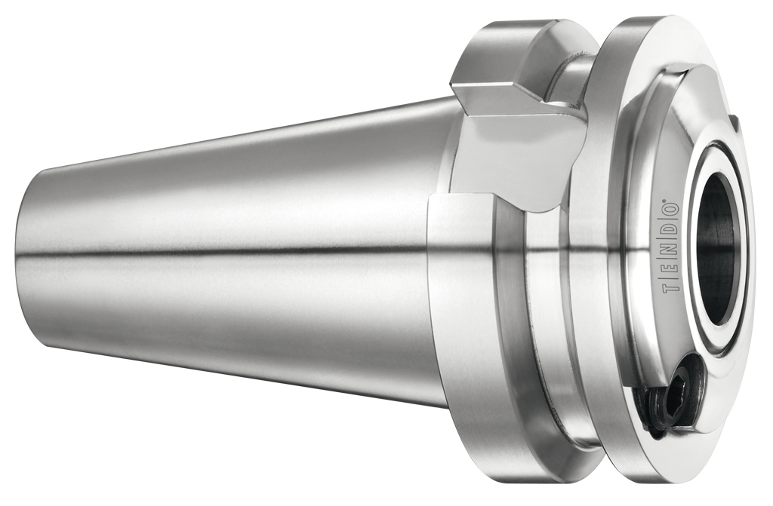
TENDO ES
Space-saving! Precision in tight machine rooms

Slide 4
TENDO ES
More machine room space
Extremely short
Frees up space between the spindle and workpiece
New possibilities for machining large workpieces, even when space in the machine room is tight
With no interference contour
Powerhouse amongst hydraulic expansion toolholders
Tools are mounted directly in the tool extension
The spindle directly supports the mounting shank
Result: Maximum radial rigidity at high torques and plenty of additional space in the machine room

Slide 5
TENDO ES
Flexible without interference contour
Perfectly suited for volume cutting, HPC/HSC, boring, reaming, tapping, thread milling and thread forming
Does not have any interference contours
Innovative precision toolholder is the ideal solution in areas where working space is limited
Additional advantages is the easy, micron precise tool change in seconds – without peripheral equipment, even in the machine
Extraordinary fl exibility
Precise concentricity
Excellent vibration dampening
Internal coolant supply
Guarantees outstanding machining results

Slide 6
TENDO ES
Flexible without interference contour
Advantage: Higher efficiency level machines can be used, you are no longer going to be in a squeeze when it comes to the size of your machine room
Extremely short design frees up plenty of machine room space
Guarantees there is sufficient freedom of movement for the axes before tool immersion
Collisions are eliminated
Toolholder damage prevented

Slide 7
Advantages
Optimum run-out accuracy < 0.003 mm
Maximum tool clamping for process reliable machining
High torque
Internal coolant supply
Fine balanced with balancing grade G 2.5 at 25000 rpm as standard
Vibration dampening preserves the spindle
Flexible clamping range due to intermediate sleeves
Simple and fast handling without peripheral equipment
Micron precise tool changes in seconds with absolute time savings and improved precision in no time at all.
A clamping screw and Allen key make it possible to easily change or extend tools in the machine
Excellent vibration dampening guarantees optimum workpiece surfaces and long tool life
Can be ideally combined with TENDO SVL and TRIBOS SVL Extensions

Slide 8
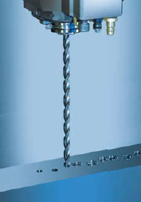
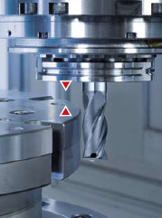
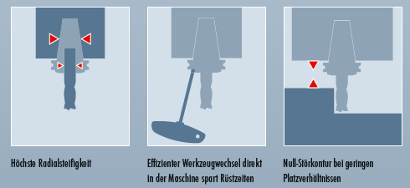



TENDO ES
Ideal for deep-hole drilling:
  Extremely short design
  Frees up plenty of machine room space
  Guarantees that there is sufficient freedom of movement for the axes before tool immersion
  Collisions are eliminated

