Slide 1
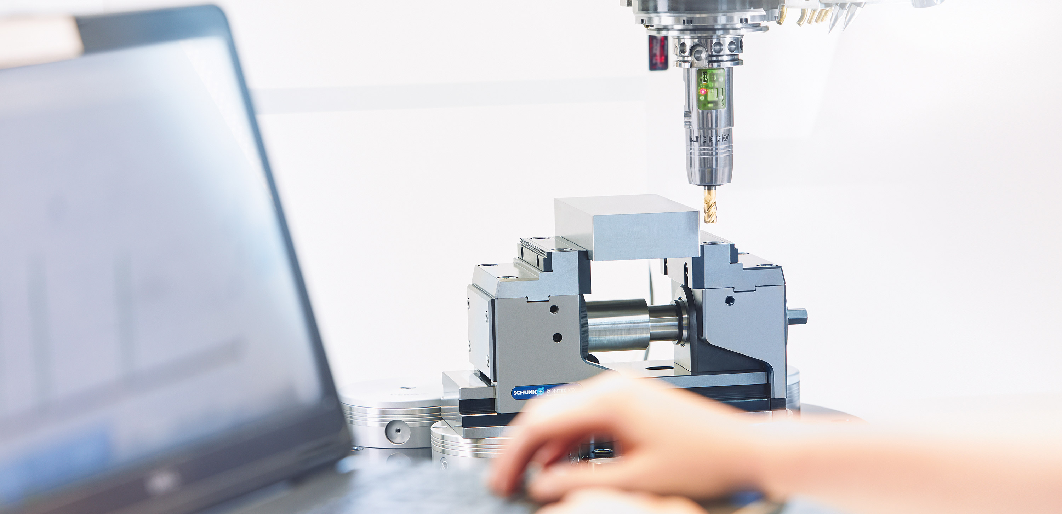

Toolholding Systems
TENDOzero

Slide 2
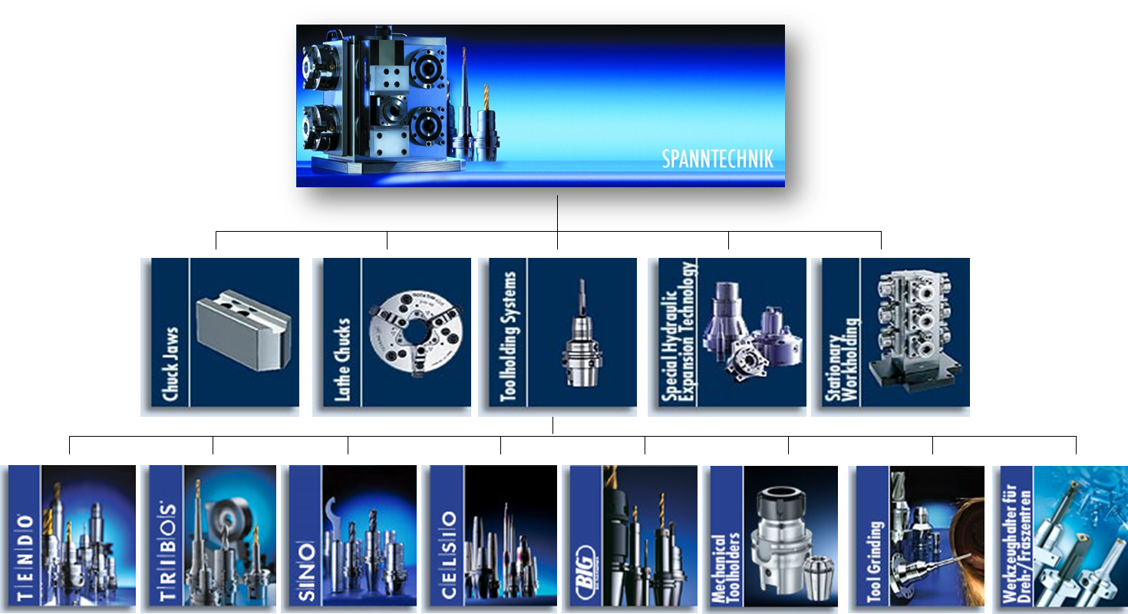
Product overview

Slide 3
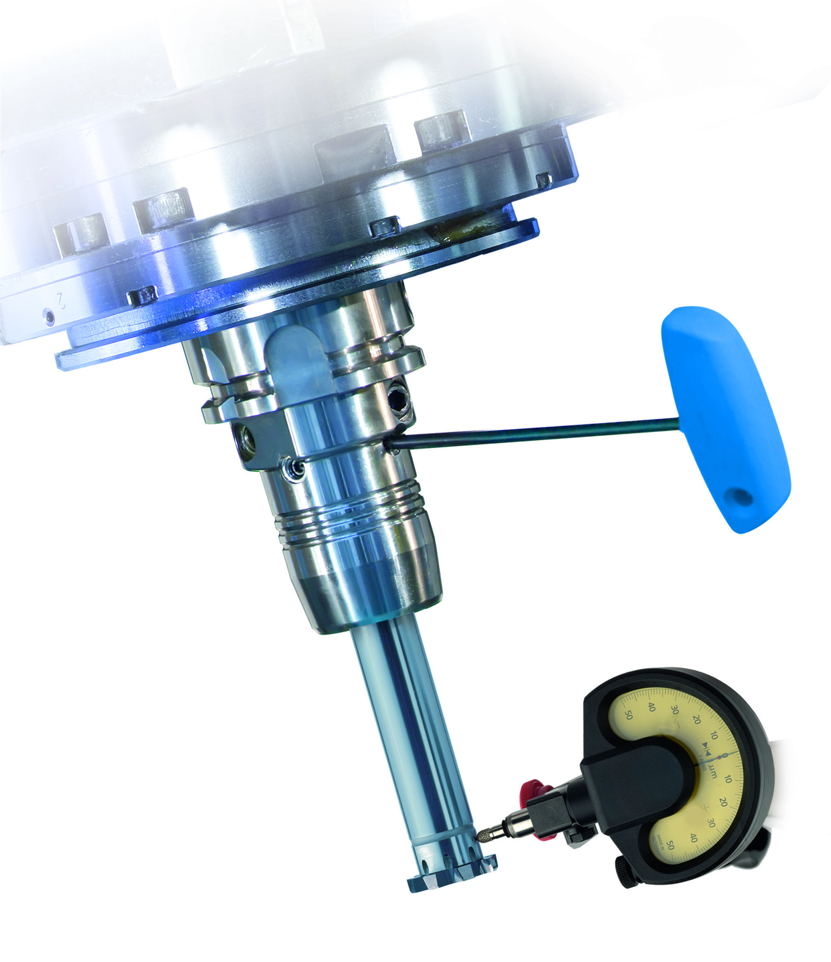
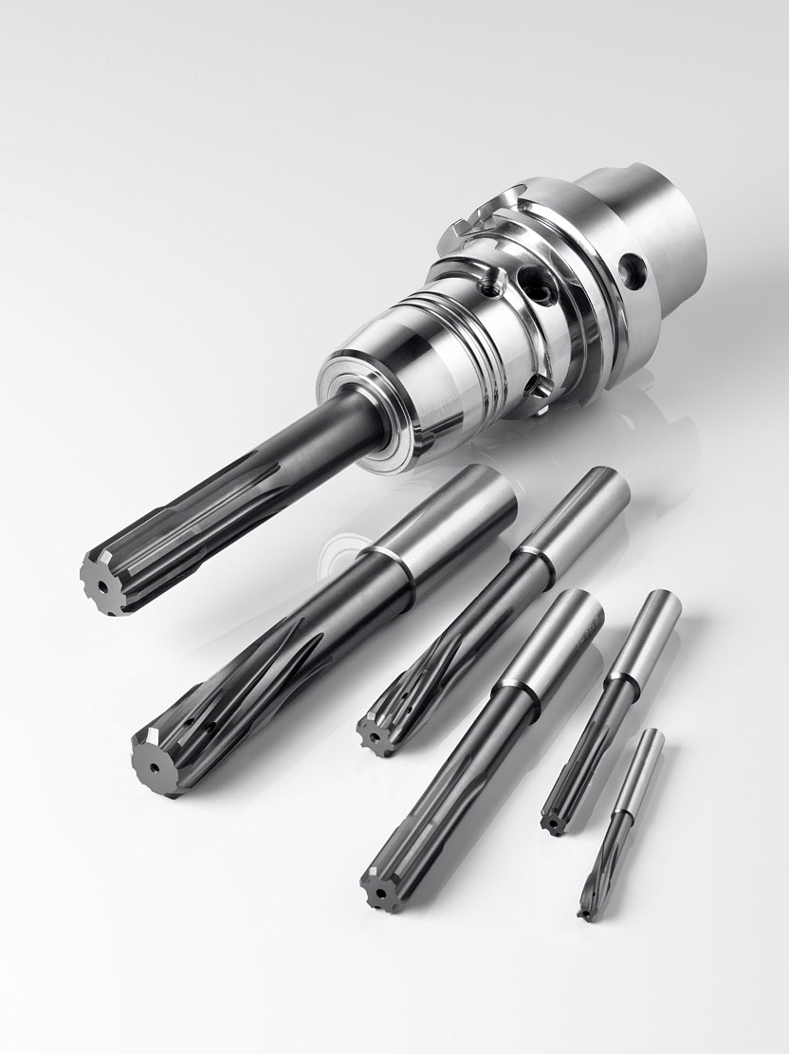
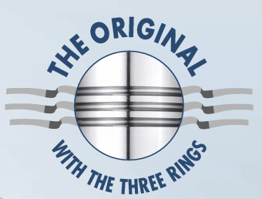
TENDOzero

Slide 4
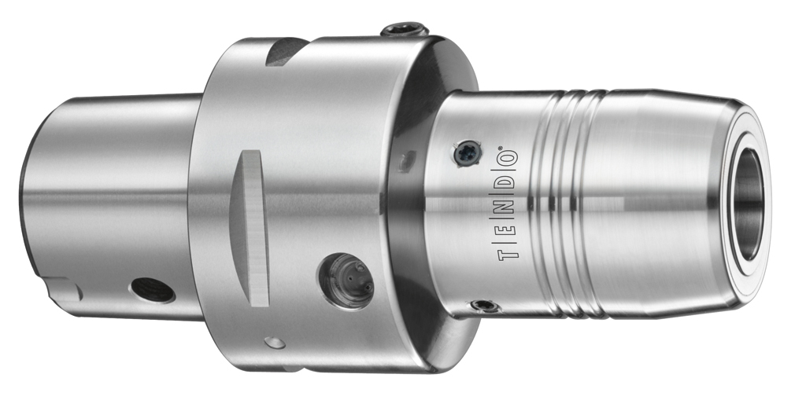
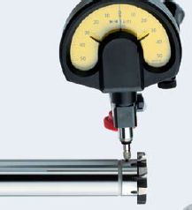
TENDOzero
Adjustable precision
Perfect concentricity
A TORX PLUS® key is used on the four set-screws to correct the angular position of the clamped precision tool, and the concentricity is set to 0.000 mm
It is possible to compensate individually for even a minimum concentricity error of the tool and the spindle.
The perfect solution when dimensional accuracy and quality are important.
When drilling. When reaming. When drill-finishing.
Wherever perfect concentricity is called for

Slide 5
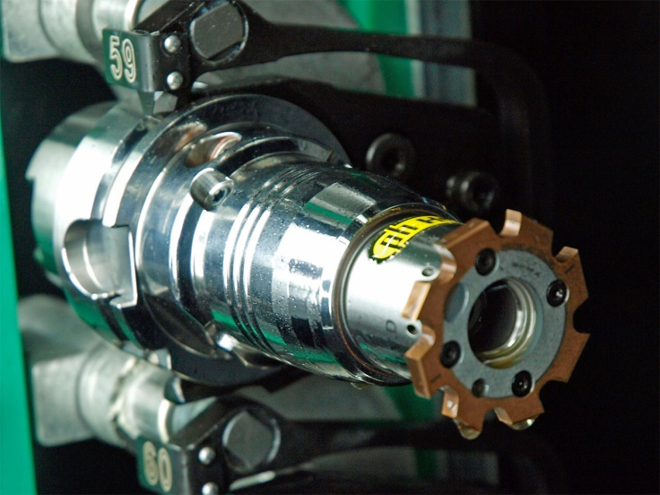
Advantages
Concentricity can be set to 0.000 mm
For even cutting action and minimum tool costs
For optimum shape and positional tolerances and therefore for dimensionally accurate workpieces
Perfect vibration damping
For brilliant surfaces and convincing roughness values
For up to 50 % longer tool life
For optimum spindle preservation
Easy handling
For a fast, safe tool change and minimum setup costs
For precise setting of high-quality precision tools

Slide 6
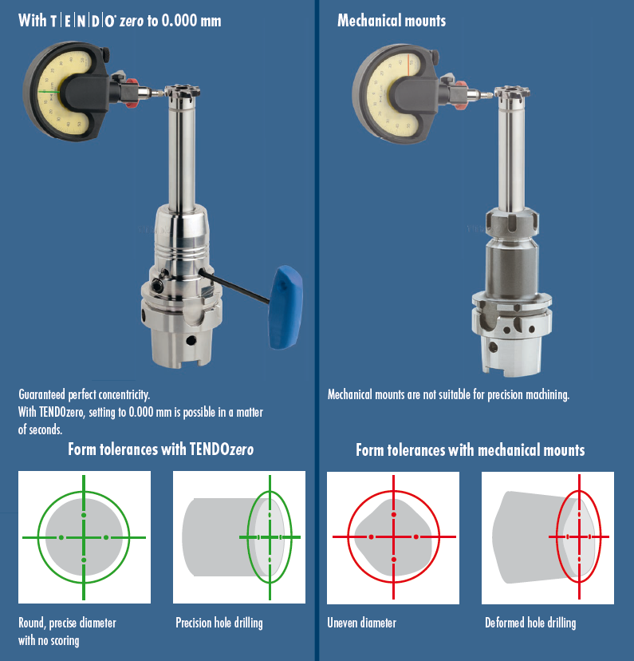
TENDOzero
The new benchmark
for precision

Slide 7

SCHUNK weltweit

