Slide 1

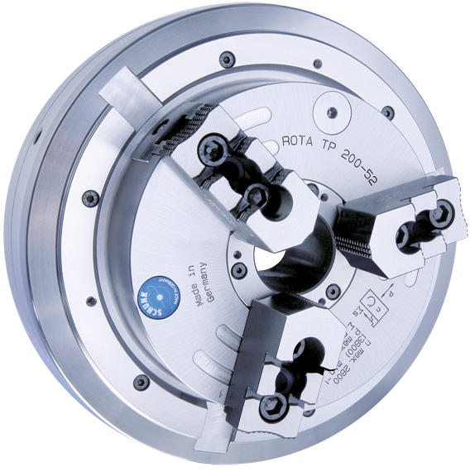
ROTA TP / TB / EP
Pneumatic Power Chucks

Slide 2

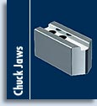


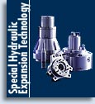
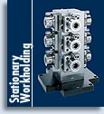
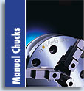

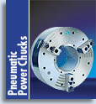
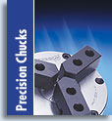
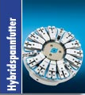
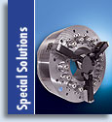
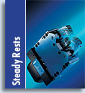

ROTA TP/TB/EP

Slide 3
ROTA TP

Slide 4
ROTA TP/TB/EP
The ROTA TP self-contained power chuck from SCHUNK is equipped with
an integrated pneumatic cylinder. The force transmission is effected by the
proven wedge hook system. The chuck contains an air supply system on
the distributor ring. Therefore no rotary feed throughs are necessary.
Especially on machines without hydraulic clamping cylinders, the ROTA TP
and the manual chucks can be easily exchanged.

Slide 5
ROTA TP/TB/EP
Your advantages | Your benefits
Very large through-hole | Machining all standard bar diameters
Safe lathe chuck process operation | Control of closing and opening via electropneumatic safety control unit (SCHUNK ELKE 24/ESIS 24)
Wedge hook power chuck with integrated pneumatic cylinder | Suitable for conventional or cycle controlled lathes (without hydraulic clamping cylinder)
Very high clamping forces already at a standard air pressure of 6 bar | Useable pressure range between 2 and 8 bar
With distributor ring cover (only ROTA TP) | Better protection against contamination compared to our competitors
Perfectly suitable for lathes without hydraulic cylinder | Quick and easy changeover to manual lathe chucks
All sides of the functioning parts are ground and hardened | High run-out and repeat accuracy
Very large jaw stroke (only ROTA EP-LH/TB-LH) | Safe and variable clamping of workpieces over interfering contours

Slide 6
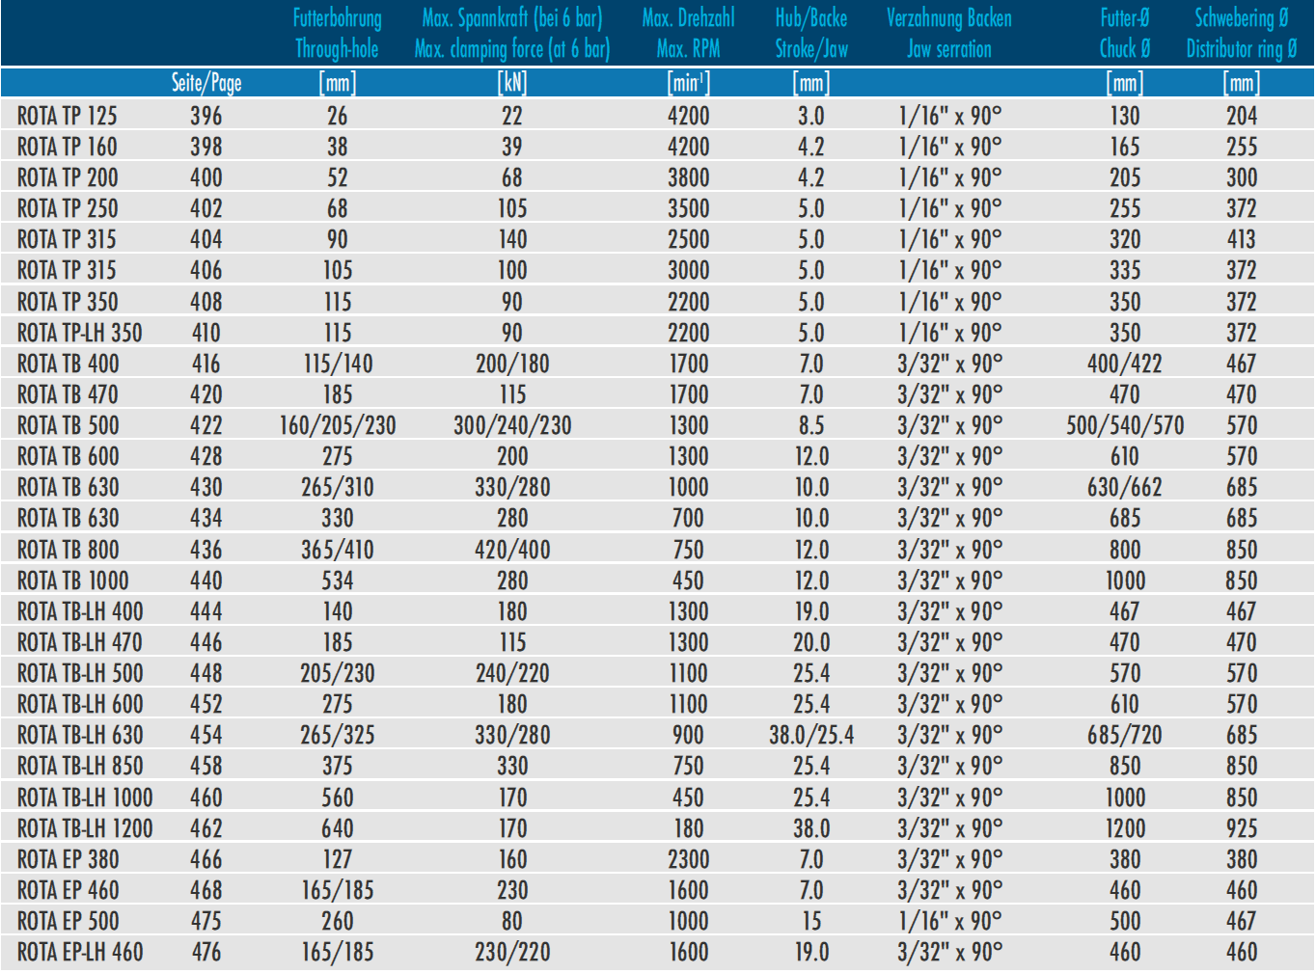
ROTA TP/TB/EP

Slide 7

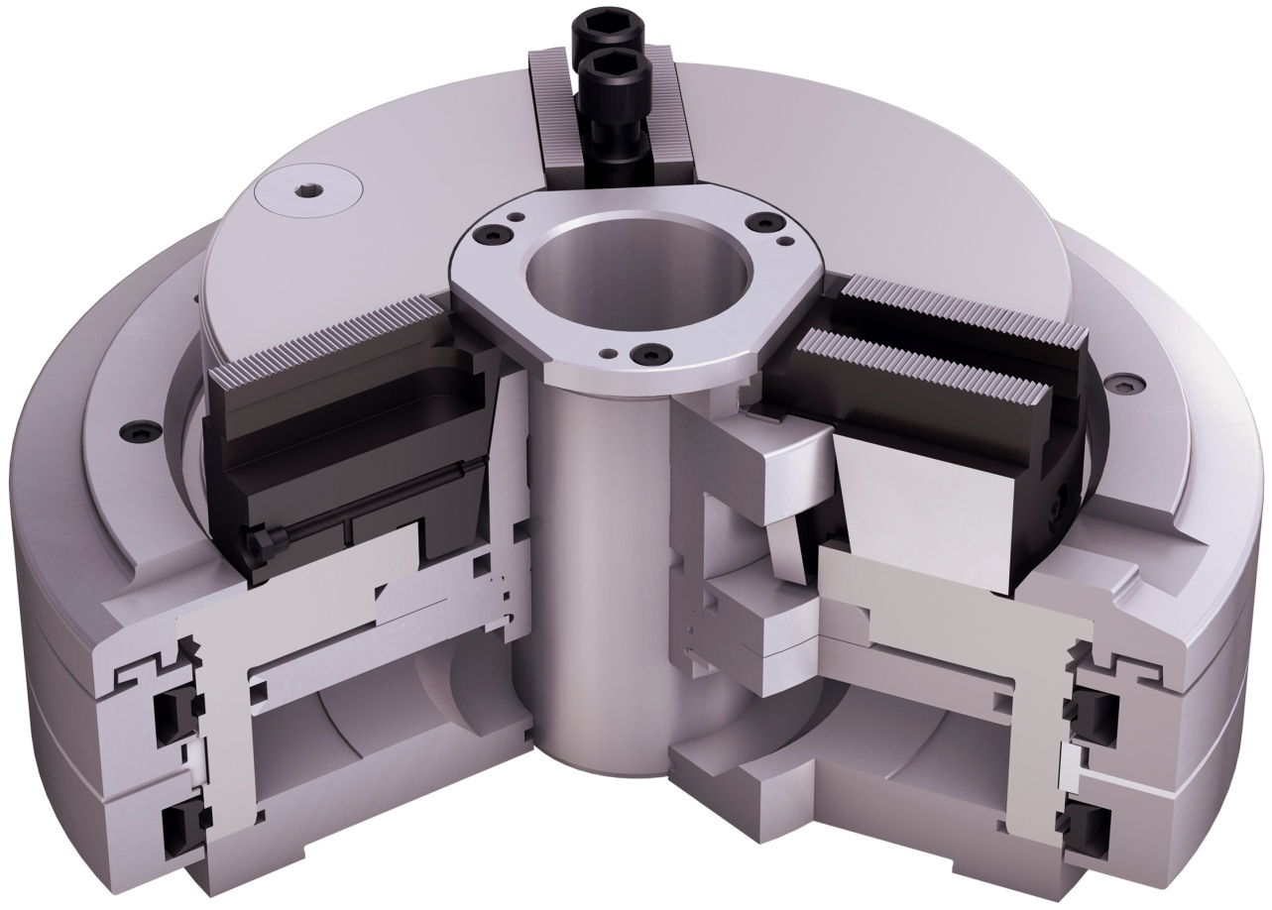
ROTA TP/TB/EP
Technology
Distributor ring
Distributor ring cover (only ROTA TP)
Profile sealing rings
Integrated pneumatic cylinder
very stable base jaws
very large through-hole
very stable wedge hook
long piston guidance
integrated double check valve
1
2
9
3
6
4
5
8
7
5
2
6
4
3
7
1
8
9

Slide 8
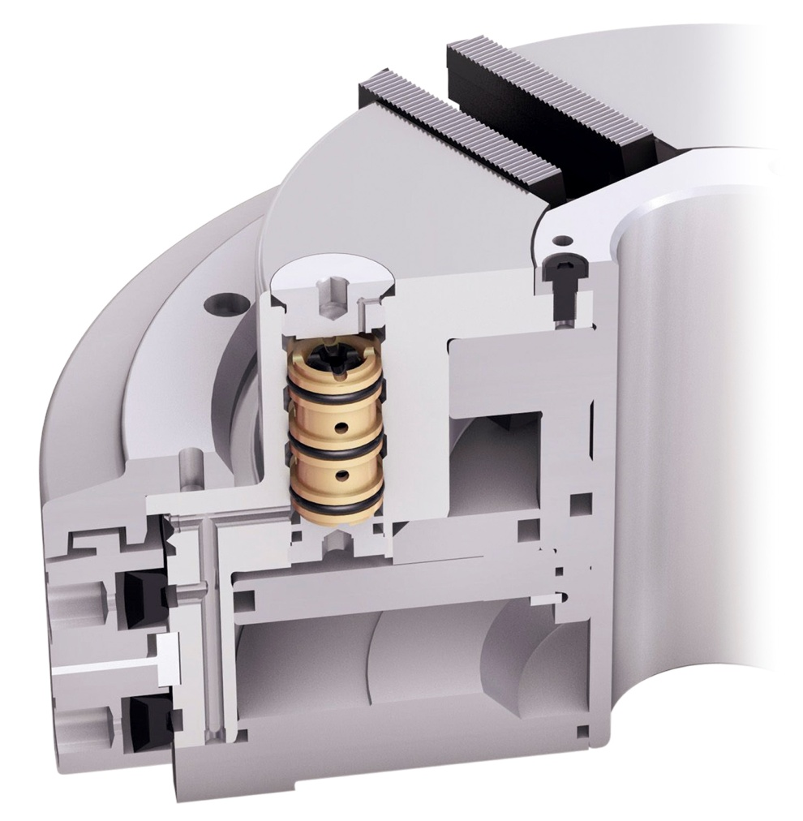
ROTA TP/TB/EP
Technology
Screw cap
double check valve
distributor ring cover
profile sealing ring A
distributor ring
profile sealing ring B
air supply channel holes
cylinder space
1
2
1
3
4
2
5
3
6
4
7
8
5
7
8
6

Slide 9
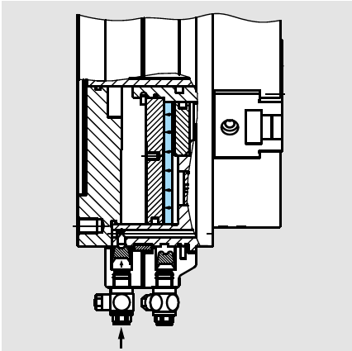
ROTA TP/TB/EP
Opening and closing only possible at stopped machine spindle.
The profile seals deform radially under pneumatic pressure and seal on the chuck body to fill the cylinder chamber. The reached air pressure is maintained permanently through a non-return valve in the chuck.

Slide 10
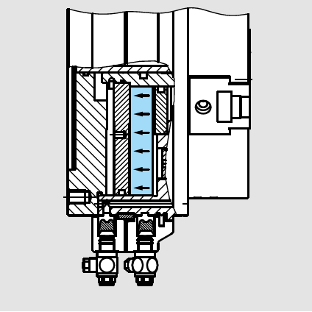
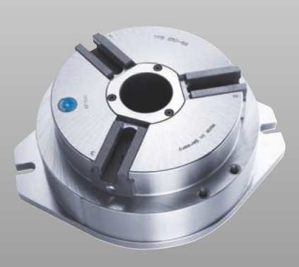
ROTA TP/TB/EP
The SCHUNK profile seals lift up to the expanded position.
The air pressure is maintained by a non-return valve. The chuck can start to rotate.
Also available for stationary applications

Slide 11
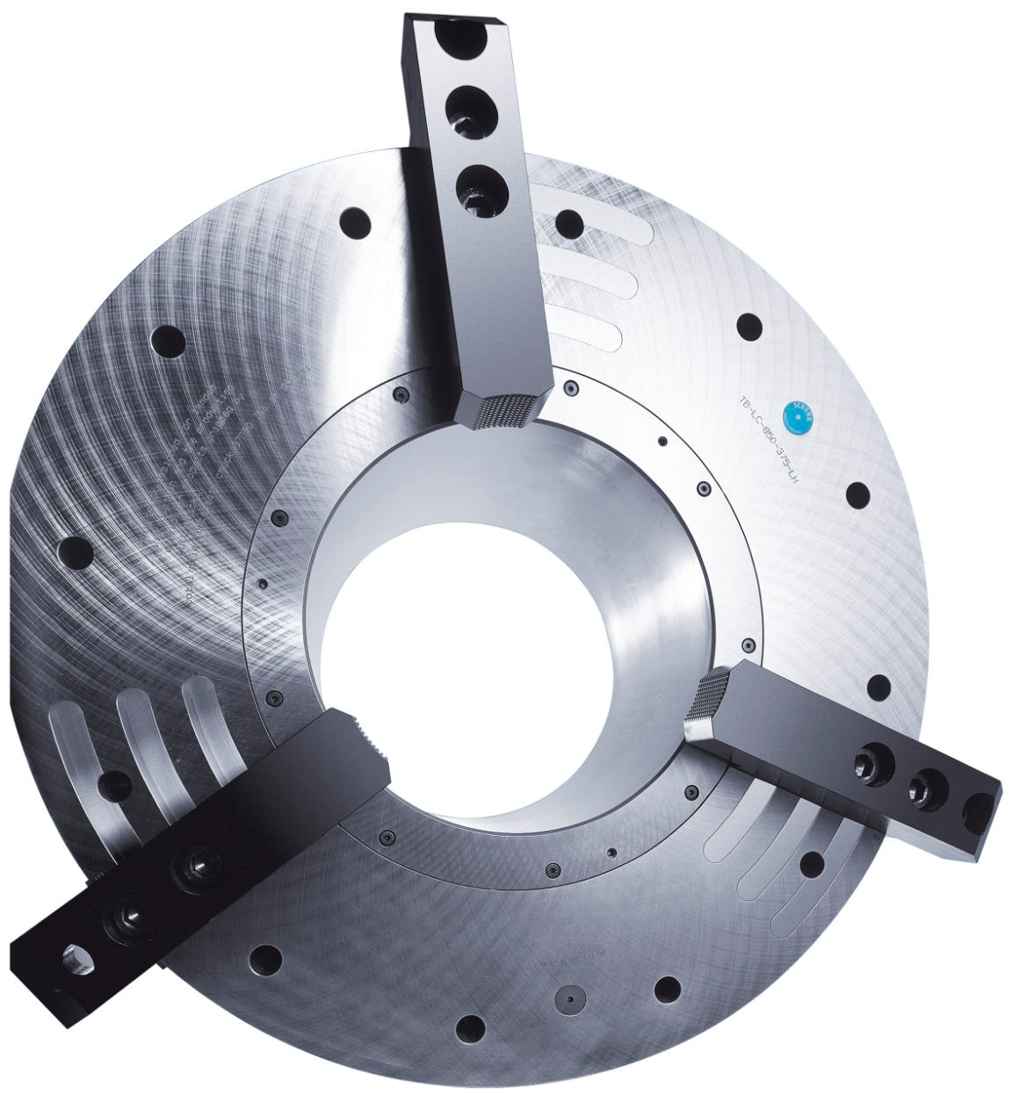
ROTA TB-LH/EP-LH

Slide 12
ROTA TB-LH/EP-LH
The technology of a self-contained power chuck with fast and extended stroke (LH) is based on a chuck piston with two different gear transmission ratios.
this technology can be used for O.D.-Clamping only!
a low air consumption
a large and fast jaw stroke combined with a maximum clamping force
due to the very large through-hole → chucks are suitable for the machining of large pipes
machining of adapter plate components is also possible
the chuck contains an air supply system on the distributor ring. Therefore no rotary feed throughs are necessary

Slide 13
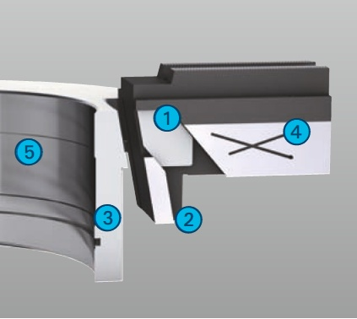
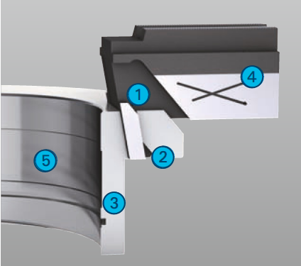
ROTA TB-LH/EP-LH
Fast stroke
extended jaw stroke
clamping stroke
piston
base jaw
extremely large through-hole
Clamping stroke
extended jaw stroke
clamping stroke
piston
base jaw
extreme large through-hole
1
2
1
4
3
5
4
3
2
5
1
2
1
4
3
4
5
2
5
3

Slide 14
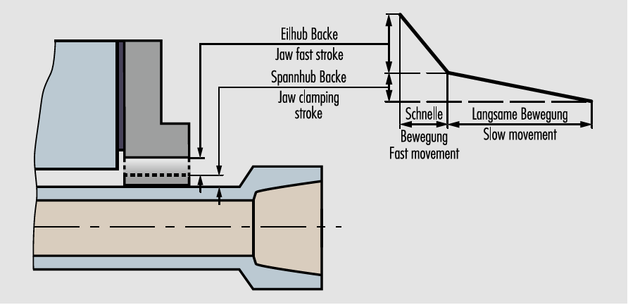
ROTA TB-LH/EP-LH
Principle of function
Fast- and clamping stroke

Slide 15
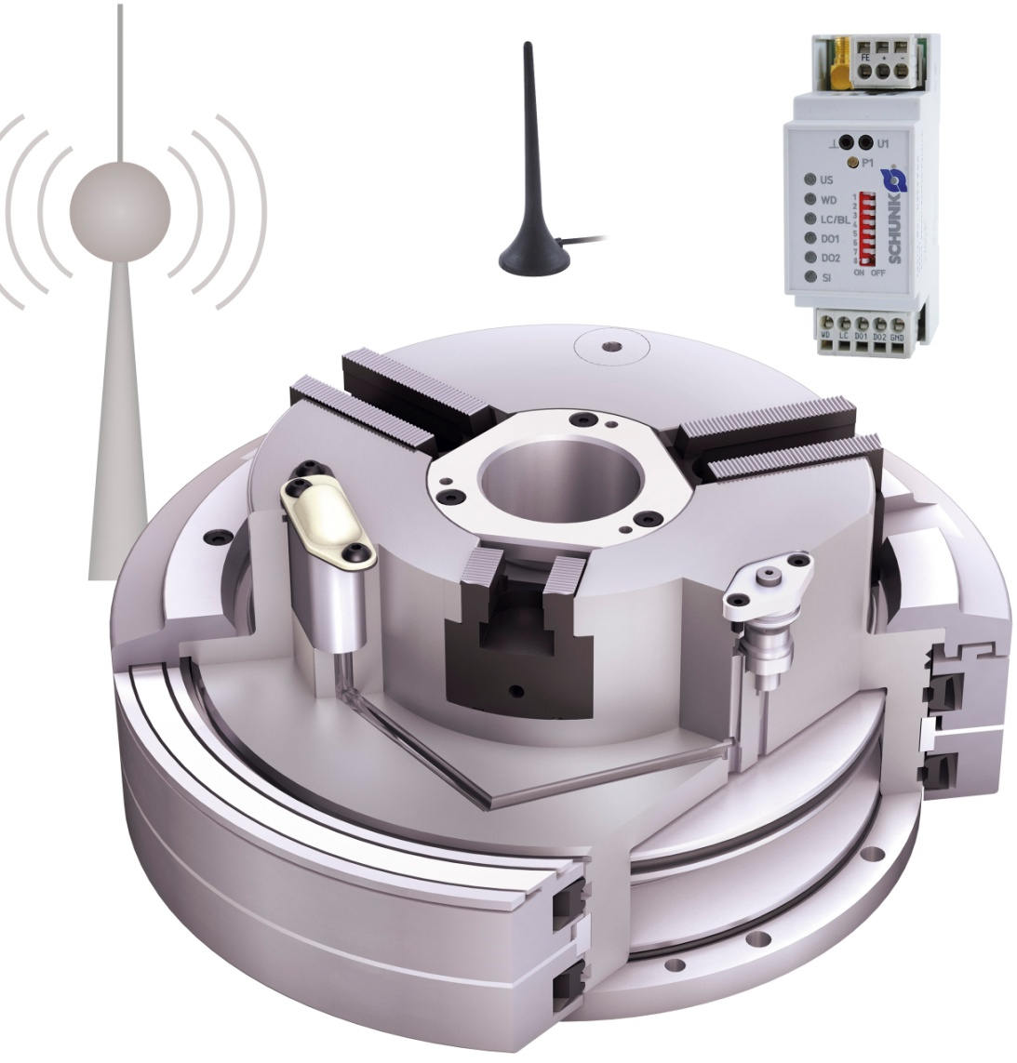
ROTA TP/TB/EP
Wireless pressure control
Optional for all pneumatic power chucks
1
receiver-antenna
protection cover
1
2
3
transmitter unit
4
4
receiver
5
pressure sensor connected with the cylinder
2
5
3

Slide 16
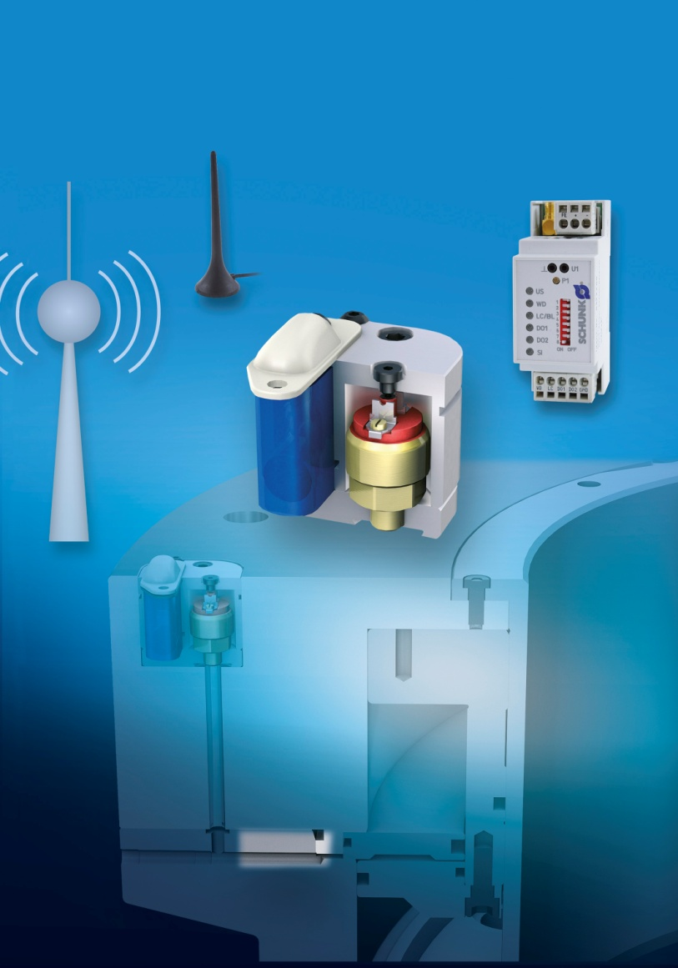
ROTA TP/TB/EP
Pressure monitoring for ROTA TB/EP
1
protection cover
4
2
transmitter unit
channel bores
5
3
1
6
4
receiver antenna
2
receiver
7
5
6
chuck body TB/EP made out of steel
7
pressure sensor connected with the cylinder
3

Slide 17
ROTA TP/TB/EP
RSS-W1: Wireless Path Control checks secure clamping
Product features
permanent control of the clamping path
high degree of safety for machining
interference-free radio signal transmission
available for all pneumatic lathe chuck models ROTA TB-LH/EP-LH from SCHUNK
Technical data
power supply is a lithium battery, lifetime with 1 signal/10 seconds approx. 6 years
frequency: 868-3 MHz
short-circuit-proof and overload-proof
permitted ambient temperature: 0°C up to +55 °C

Slide 18
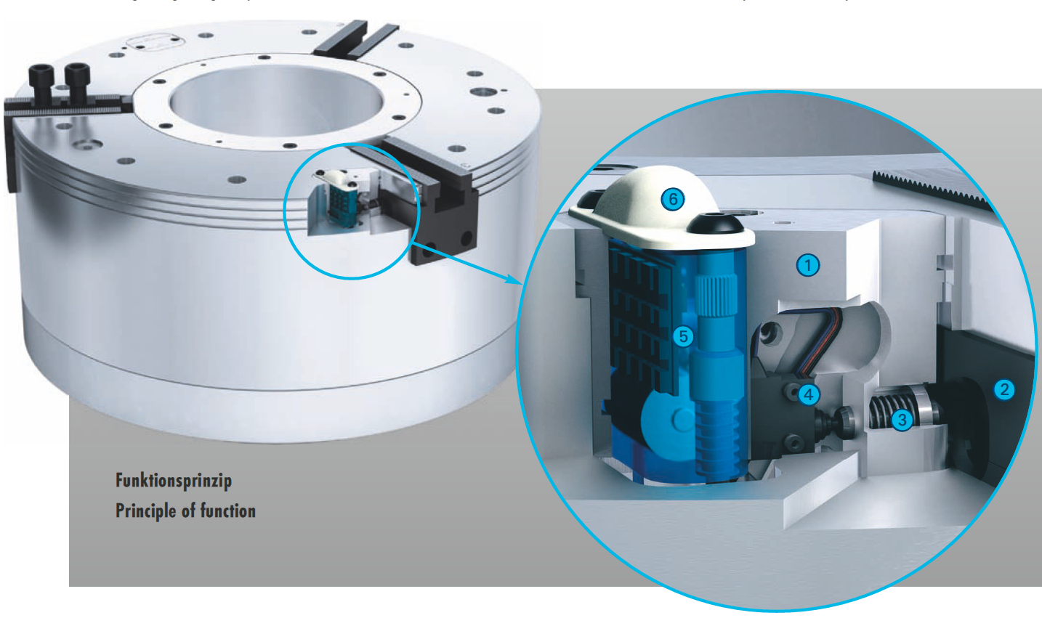
ROTA TP/TB/EP
RSS-W1 in detail
base body
base jaw TB-LH / EP-LH
tappet with spring support
mechanical feeler
transmission unit completely sealed with permanent battery
protective cap for the transmission unit
6
1
5
4
2
3
1
2
3
4
5
6

Slide 19
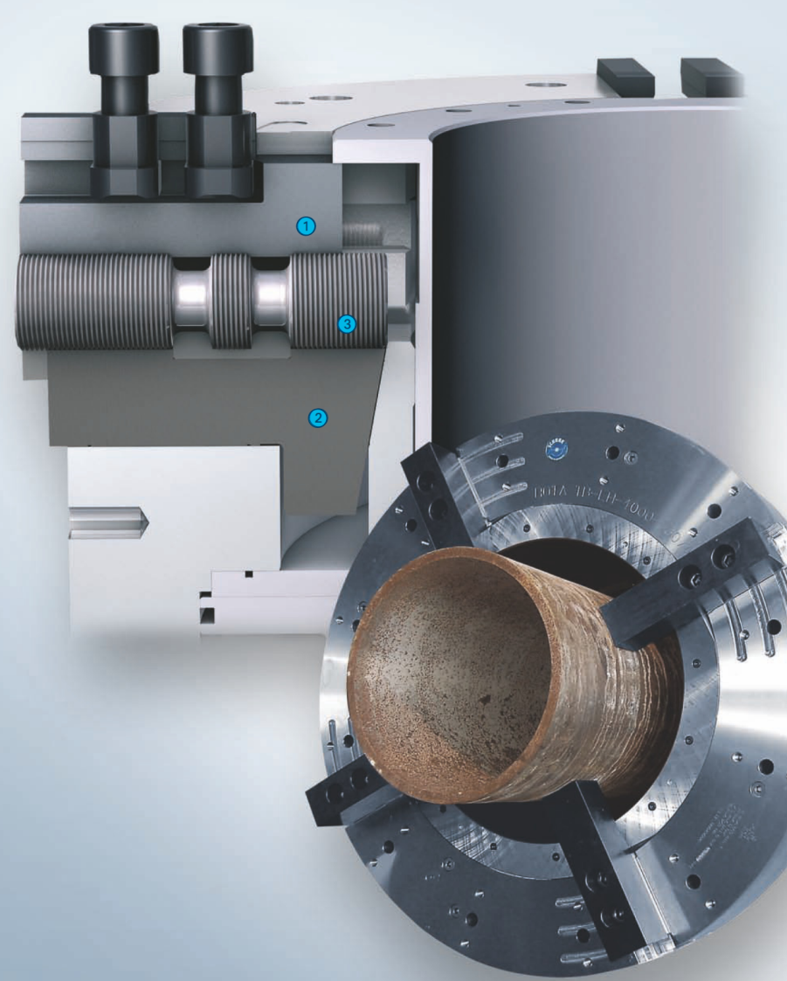
ROTA TP/TB/EP
Functional principle of the individual jaw adjustment for pneumatic air
chucks in the size 500 mm - 1000 mm
1
base jaw upper part
base jaw lower part
Adjustable spindle
2
1
3
2
3
Advantages at a glance
large through hole
large jaw adjusting range
high clamping forces transferable
fast and acurate adjustment possible
optional with RSS-P1 clamping pressure monitoring

Slide 20
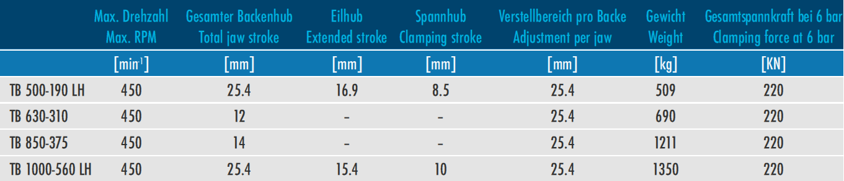
ROTA TP/TB/EP
Pneumatic 4-jaw power chucks with individual jaw adjustment

Slide 21
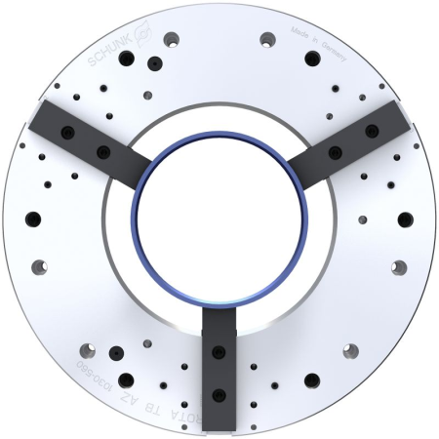
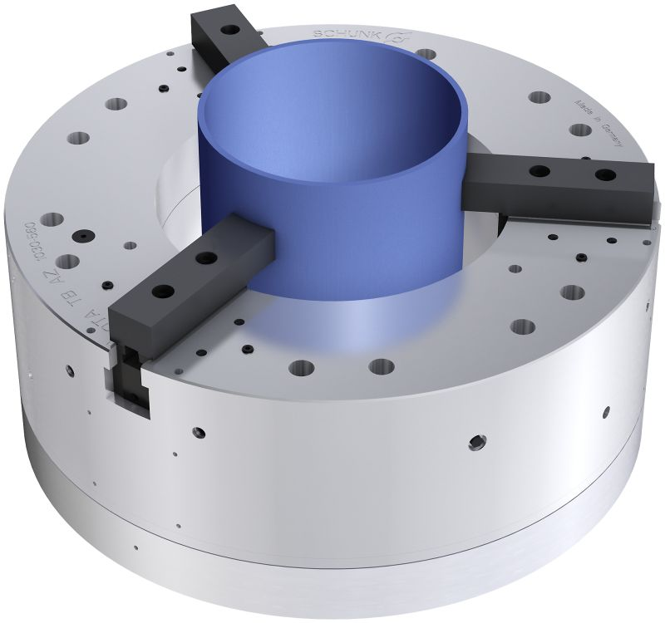
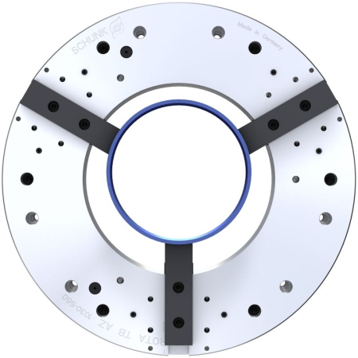
ROTA TB-AZ
Pneumatic Power Chuck:
Centric and compensating clamping, automatic change-over
centric clamping
compensational clamping

Slide 22
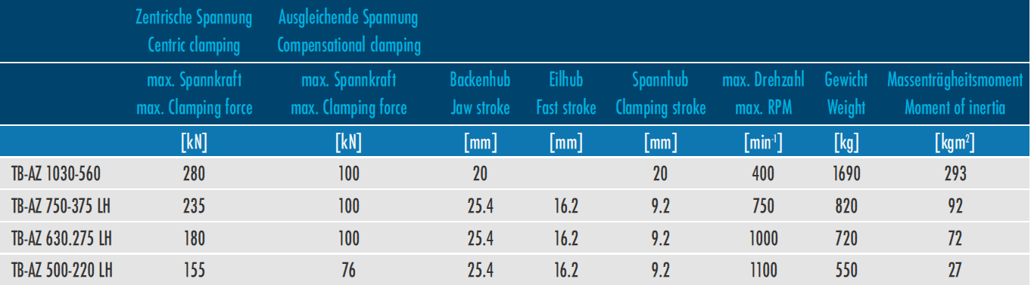
ROTA TB-AZ
Advantages at a glance
self-centering and compensational clamping combined in one air chuck
workpiece position will not be changed through the compensational clamping operation
automatic change-over through air feed via distributor ring
large through-hole
large jaw stroke
standard jaw interface

Slide 23
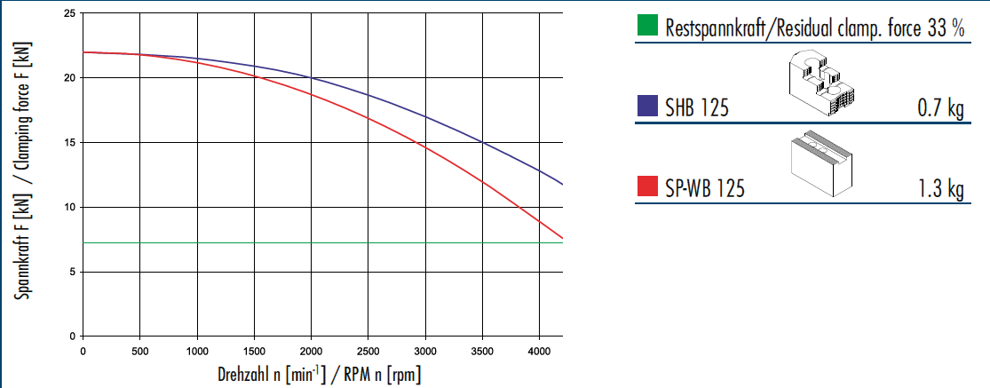
ROTA TP
Clamping force-RPM-diagram ROTA TP 125-26

Slide 24
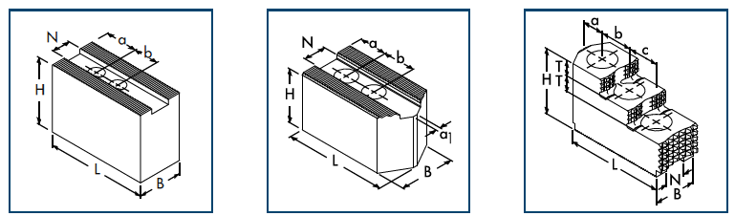
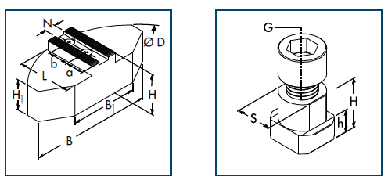
ROTA TP
Soft top jaws SP-WB, CWB, SWB and SWB-AL
Soft top jaws, SWBL
Hard top jaws, SHB and SP-HB
Soft full grip jaws, SWB-SM and SWB-SA
T-nuts-NS

Slide 25
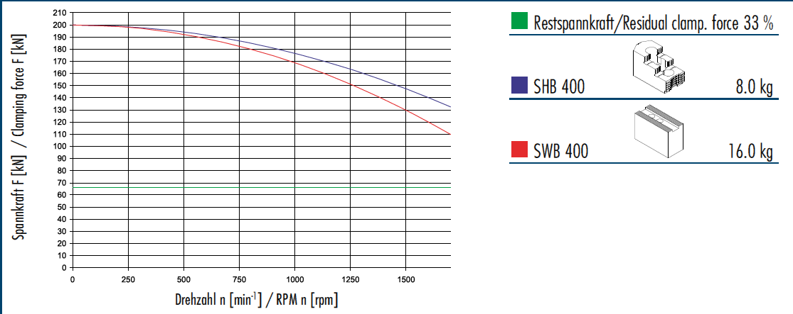
ROTA TB
Clamping force-RPM-diagram ROTA TB 400-115

Slide 26
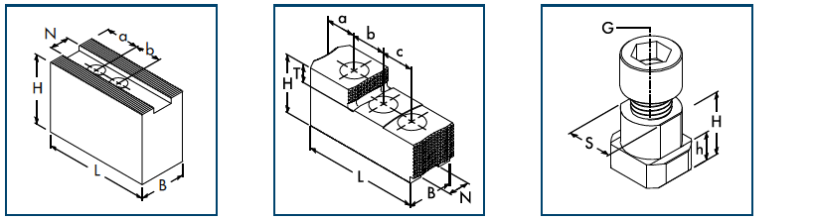
ROTA TB
Soft to jaws, SP-WB, SWB
Hard to jaws, SP-HB, SHB
T-nuts, NS

Slide 27
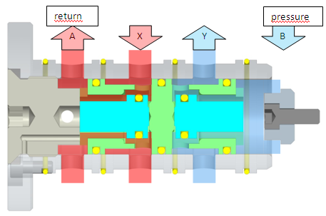
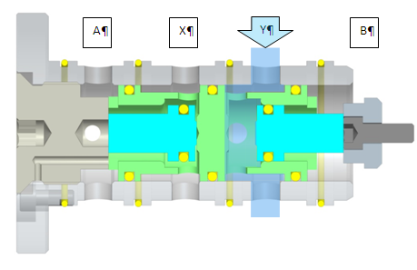
Function check valve
Switchpoint of check valve (unlockable check valve) during clamping and opening.
Clamping: Clamped:
A = to distributor ring
X = cylinder chamber II
Y = cylinder chamber I
B = from distributor ring
Y = pressure maintenance cylinder chamber II

Slide 28
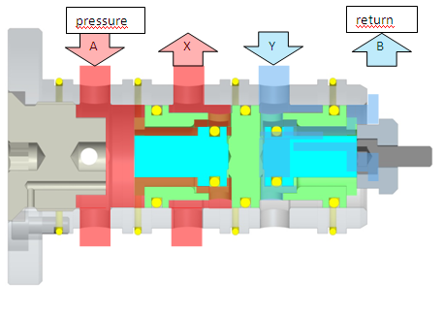
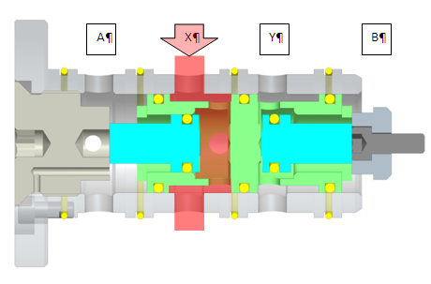
Function check valve
A = from distributor ring
Y = cylinder chamber II
X = cylinder chamber I
B = to distributor ring
X = pressure maintenance
cylinder chamber I
When the air feed is depressurized the piston in the check valve seals the bore of the distributor ring. By switching the air pressure of the distributor ring is led in the other chamber, which moves the entire check valve in the opposite position.

Slide 29
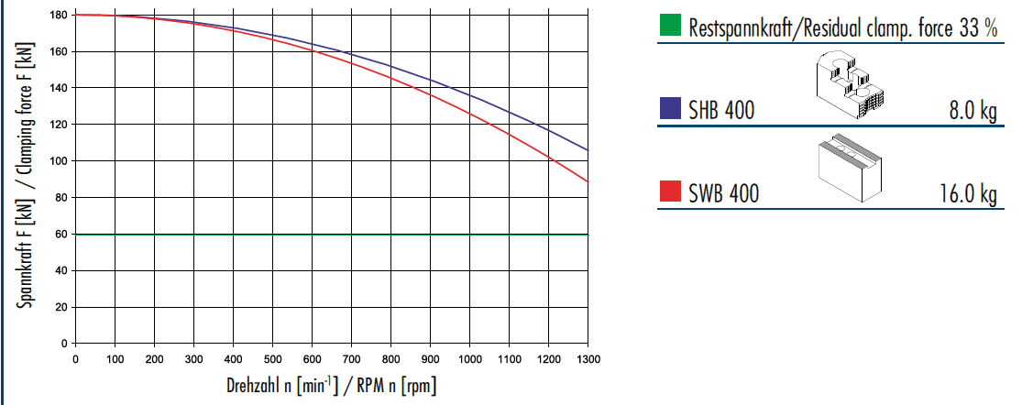
ROTA TB-LH
Clamping force-RPM-diagram ROTA TB-LH 400-140

Slide 30
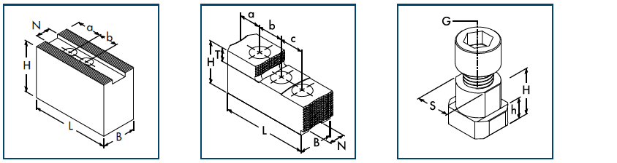
ROTA TB-LH
Soft to jaws, SP-WB, SWB
Hard top jaws, SP-HB, SHB
T-nuts, NS

Slide 31
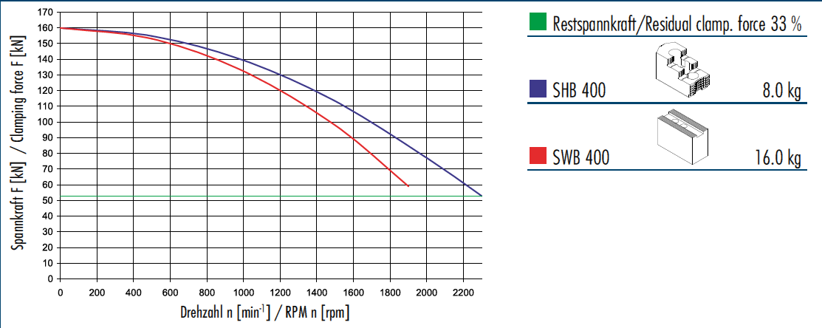
ROTA EP
Clamping force-RPM-diagram ROTA EP 380-127

Slide 32
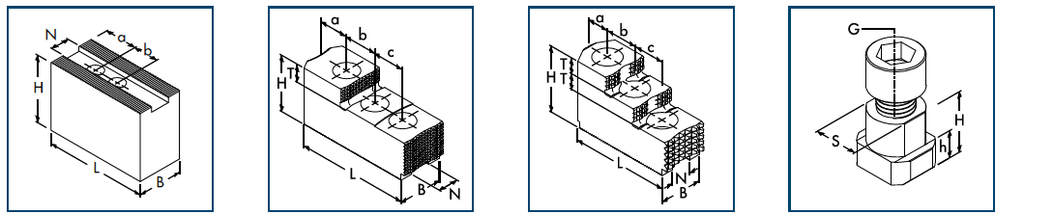
ROTA EP
Soft top jaws, SP-WB, CWB, SWB and SWB-AL
Hard top jaws, SP-HB
Hard top jaws, SHBc
T-nuts, NS

Slide 33
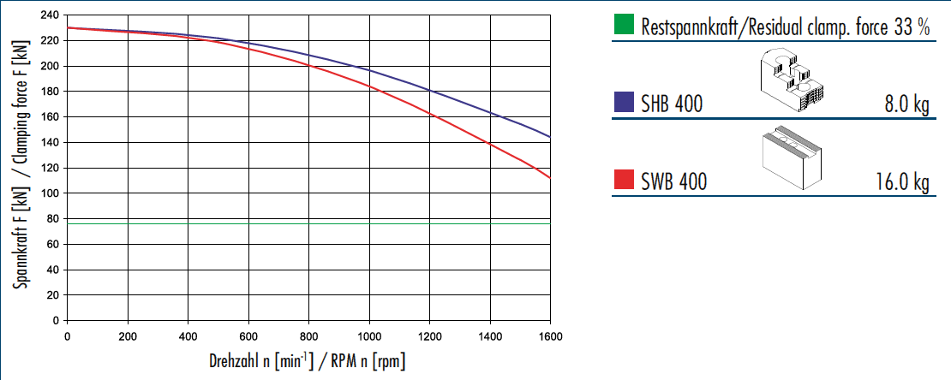
ROTA EP-LH
Clamping force-RPM-diagram ROTA EP-LH 400-165

Slide 34
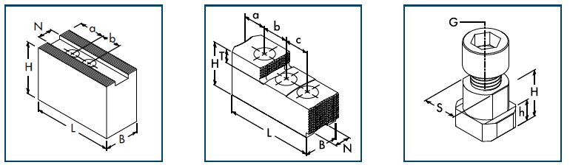
ROTA EP-LH
Soft top jaws, SWB
Hard top jaws, SHB
T-nuts, NS

Slide 35
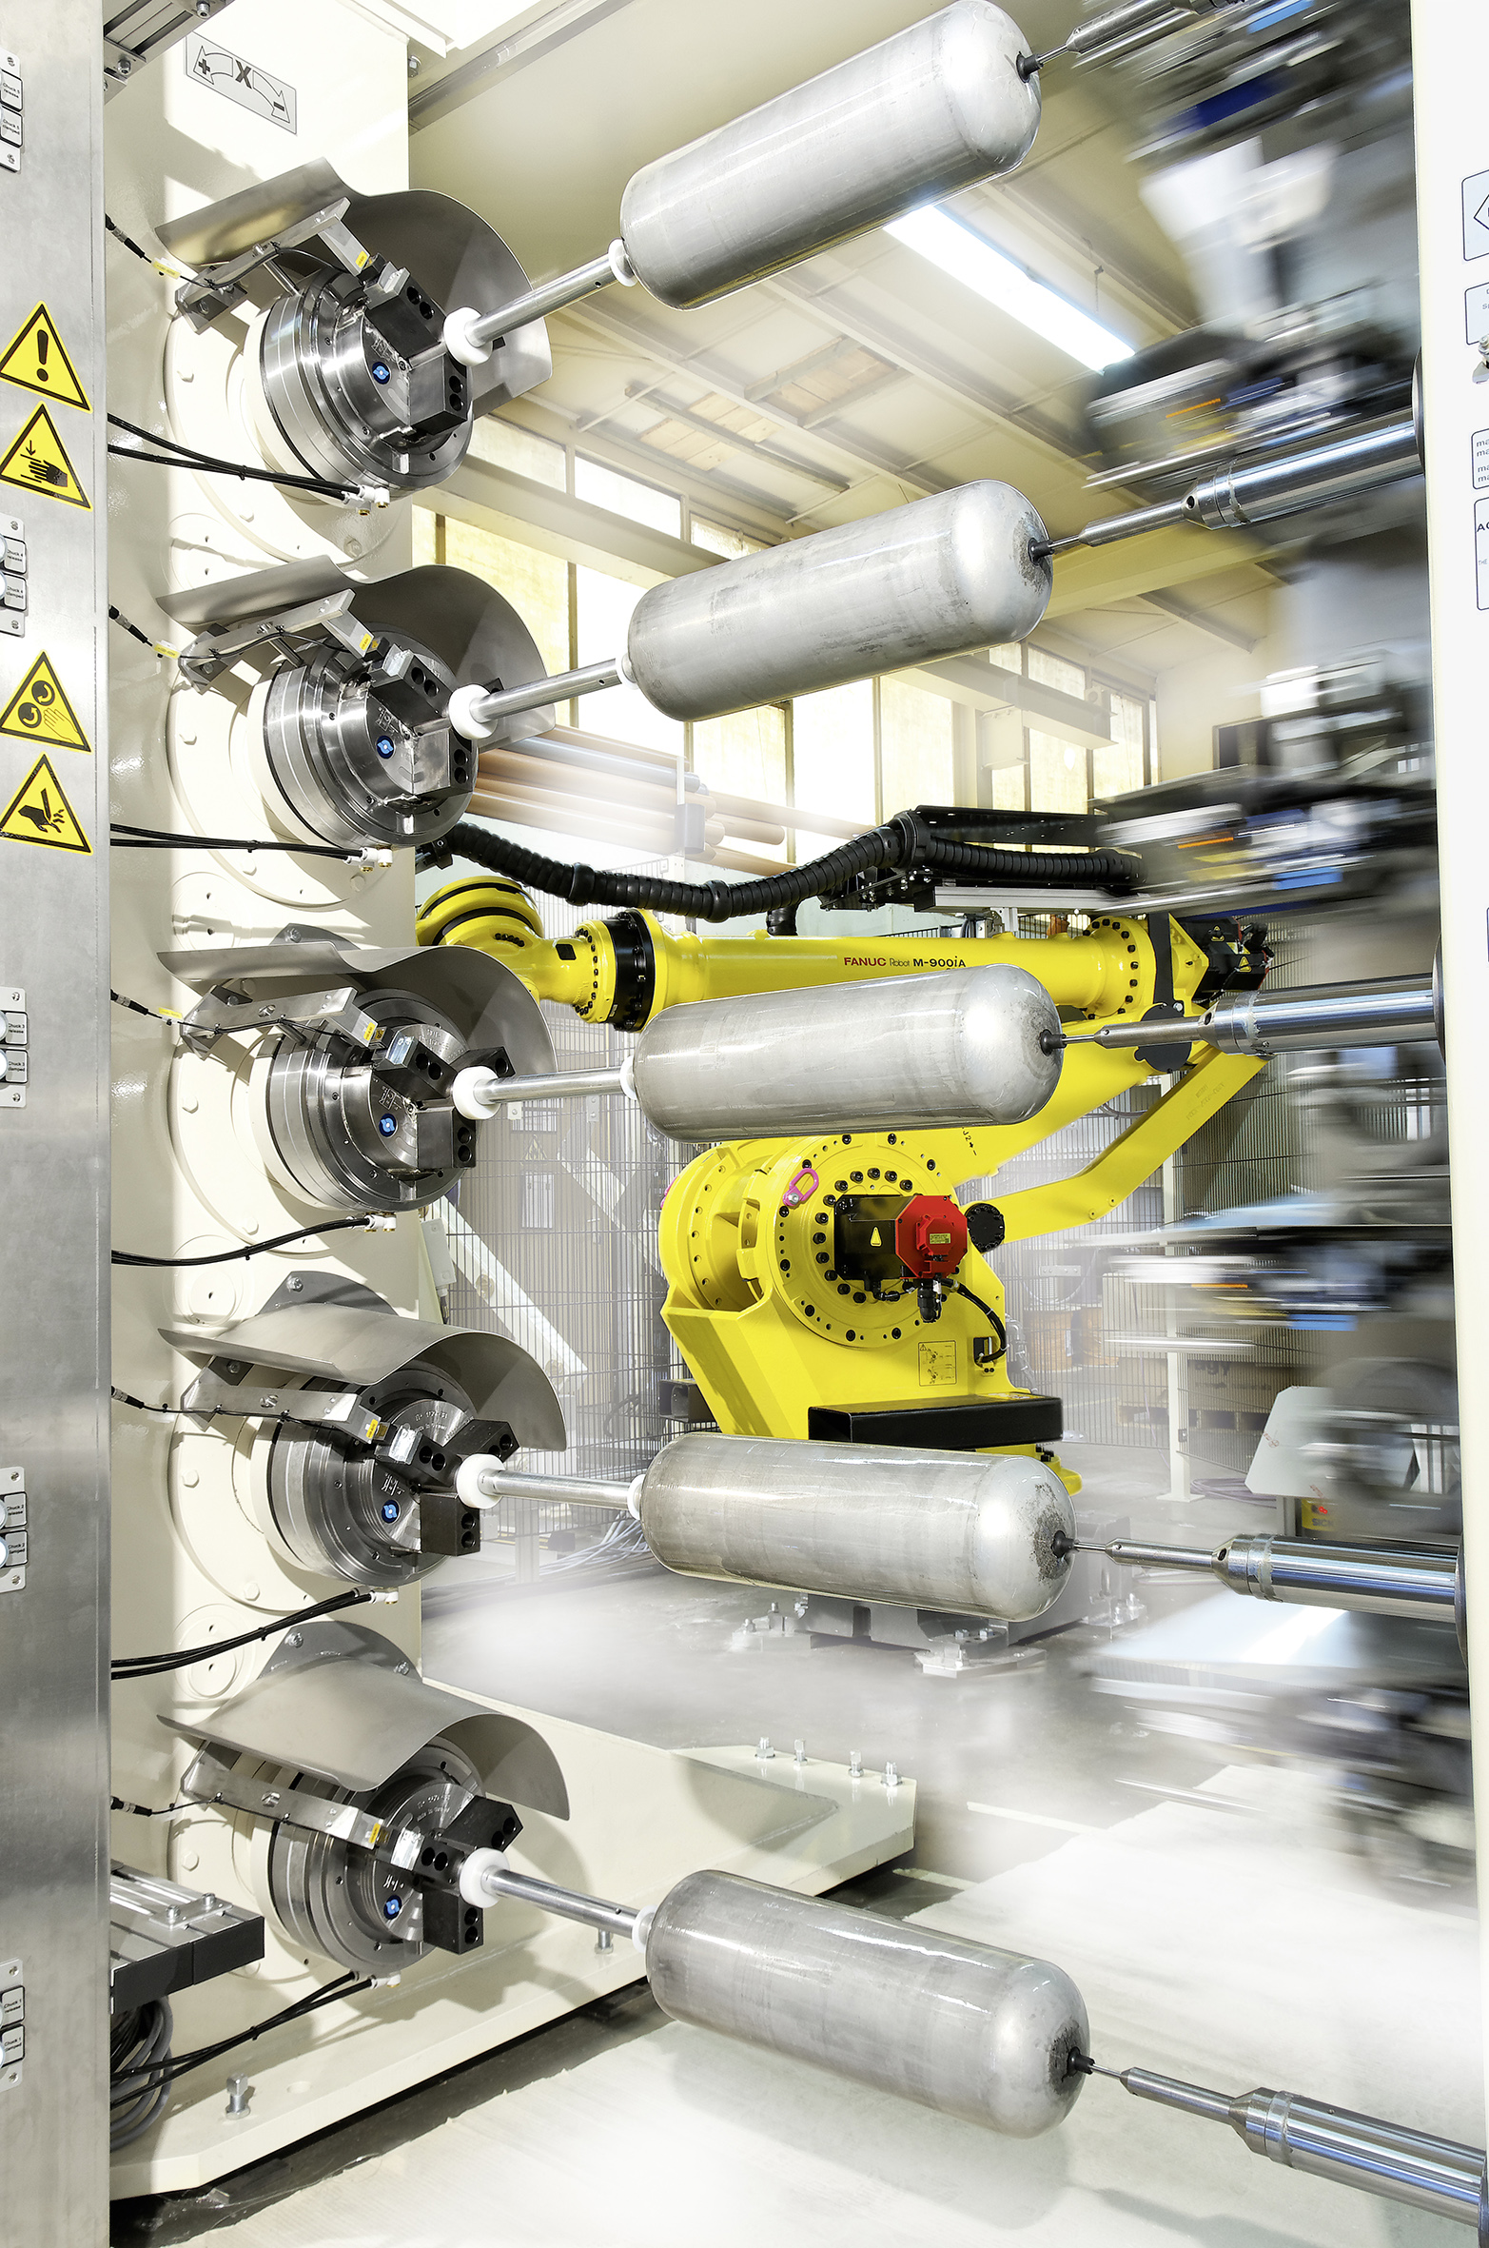
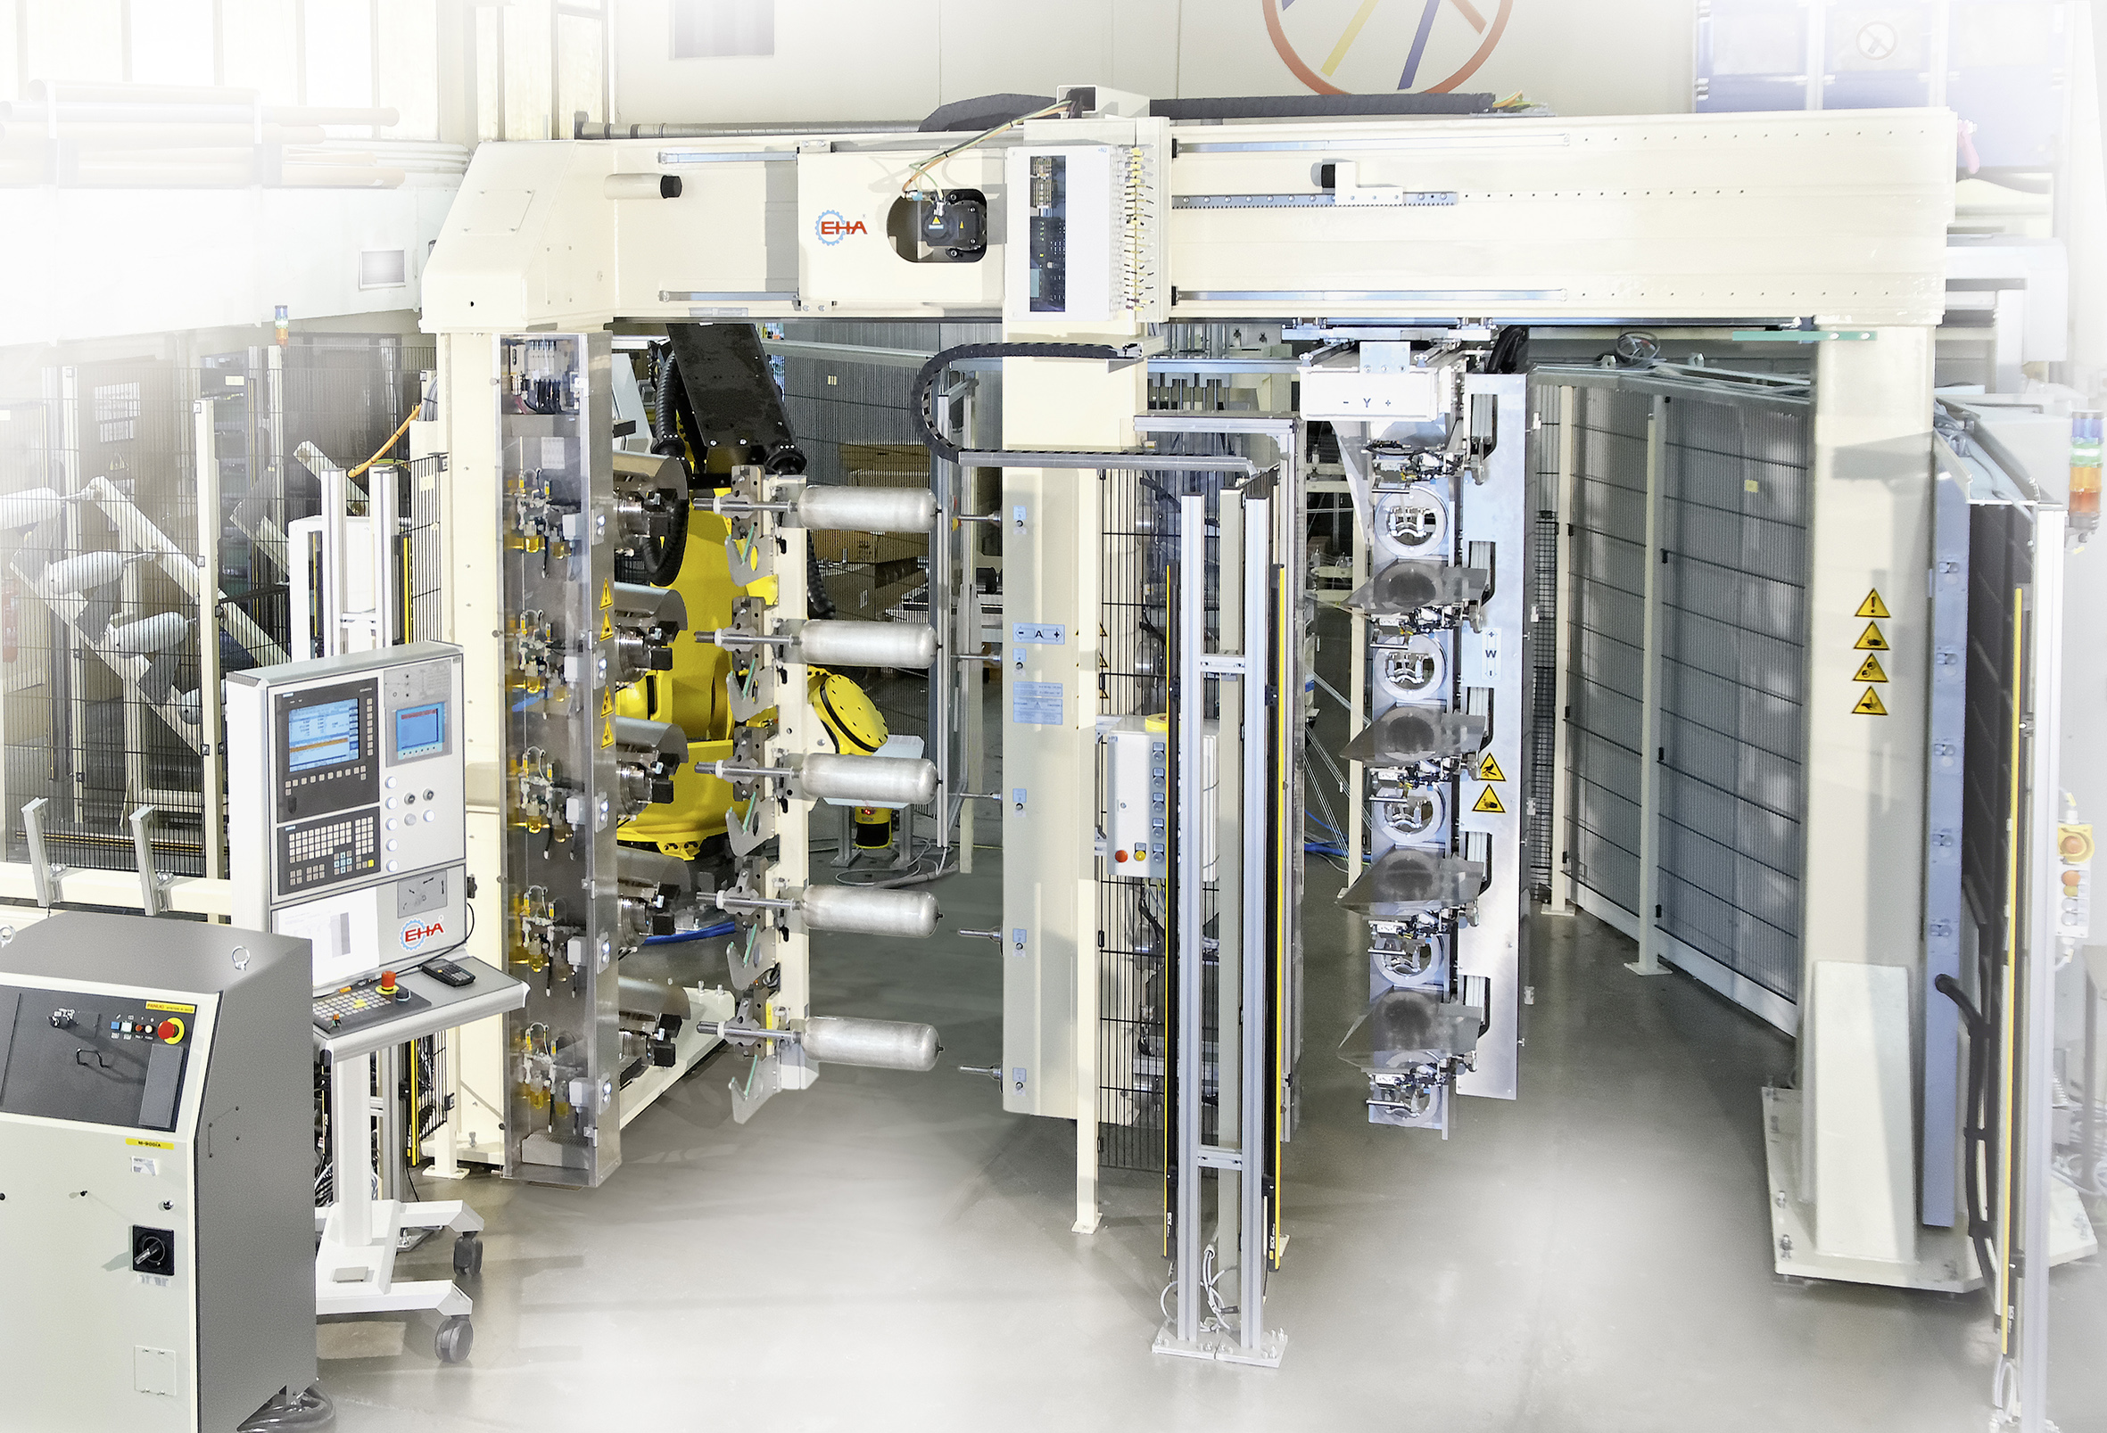
ROTA TP
Application examples

Slide 36
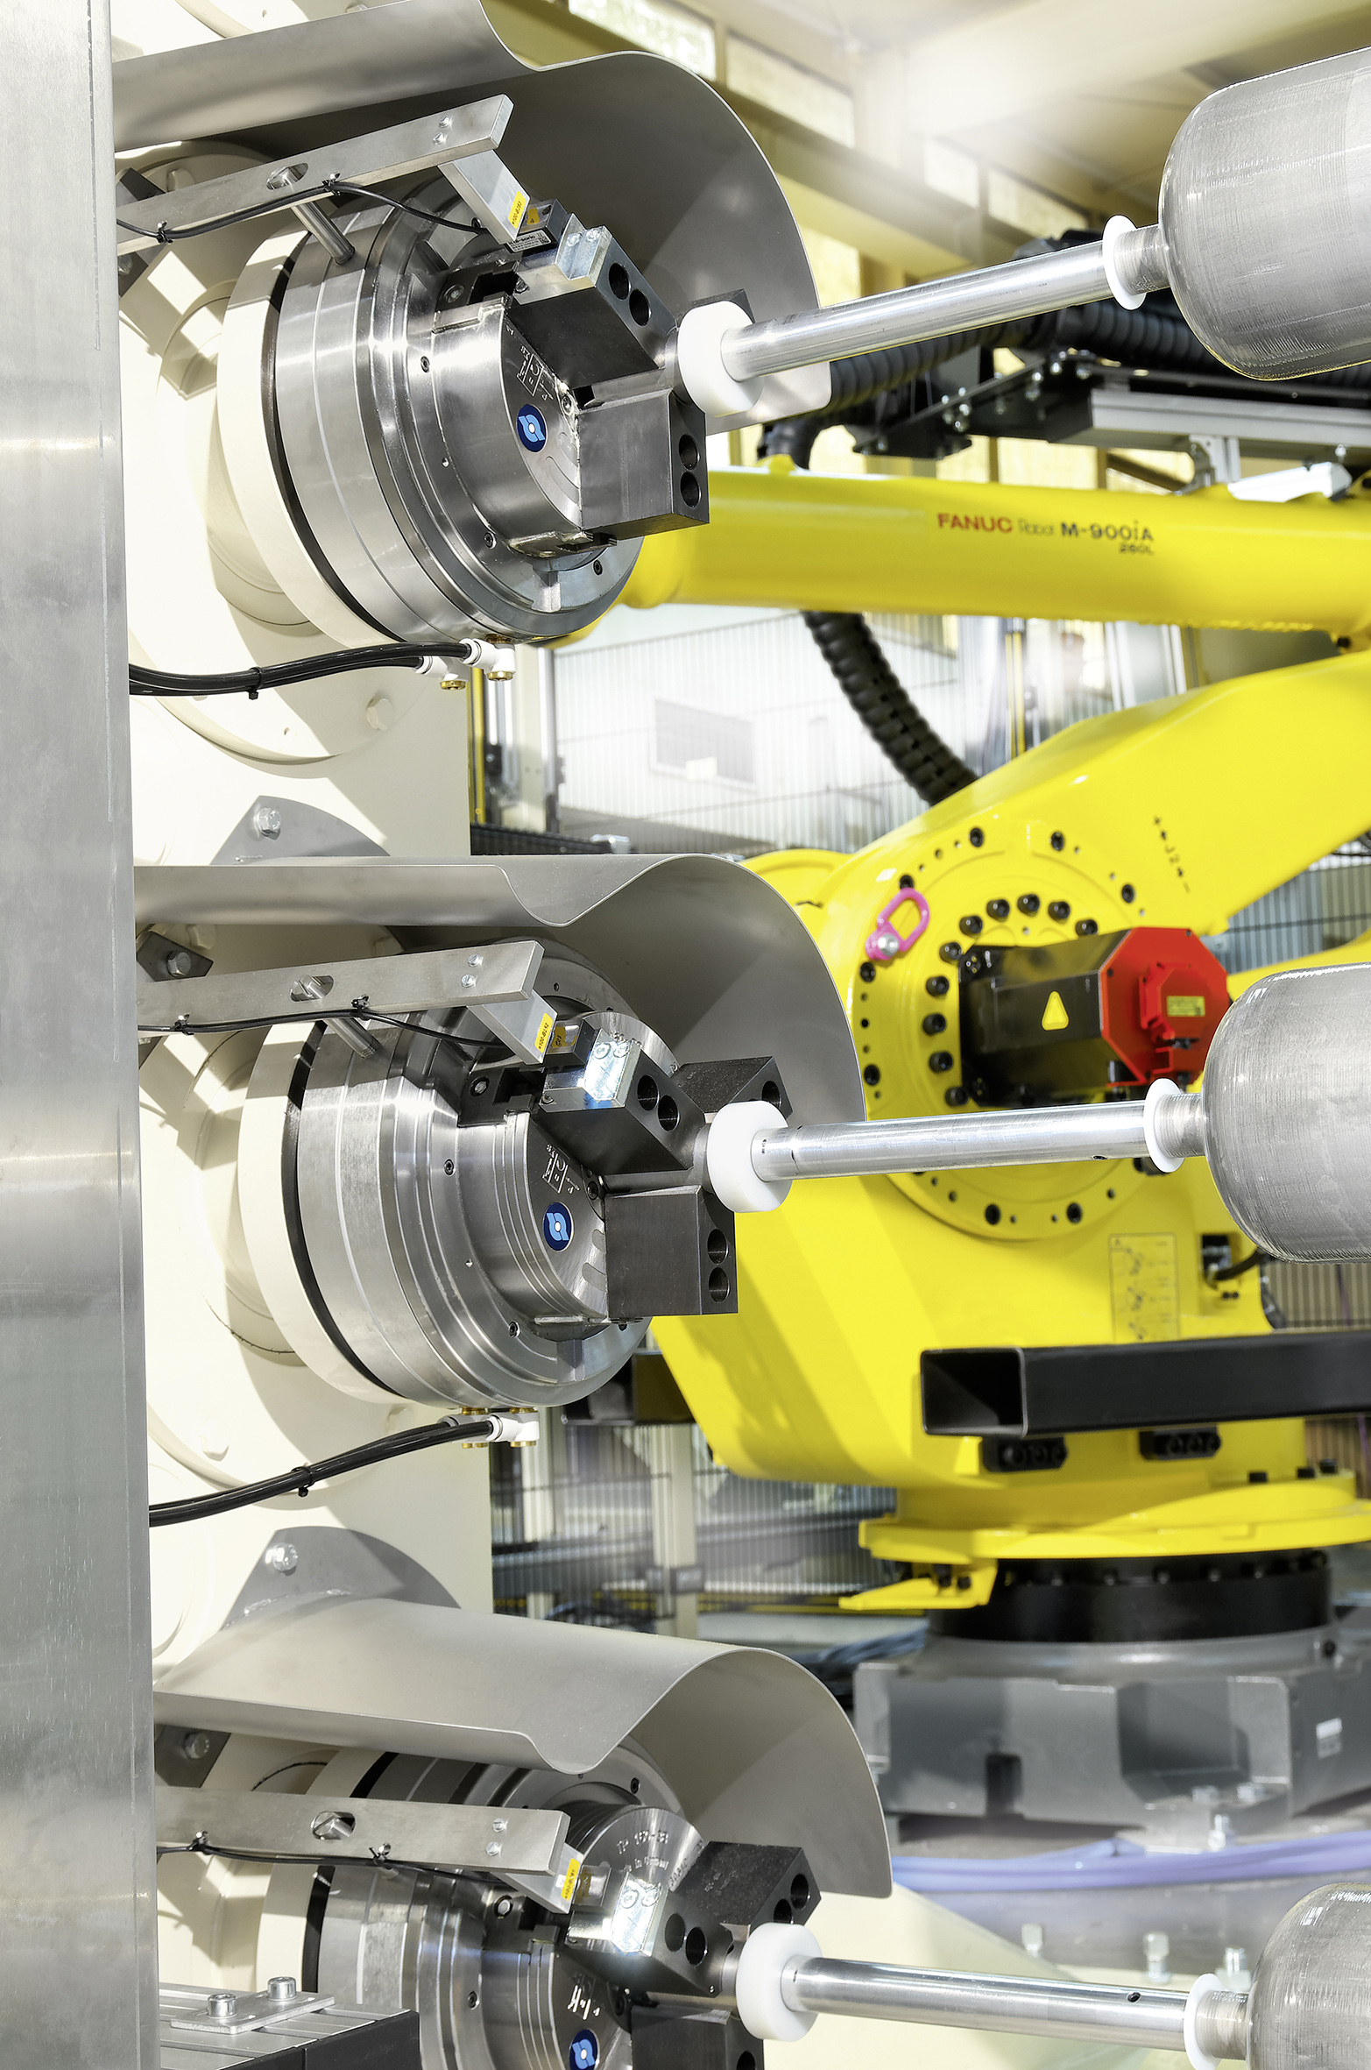
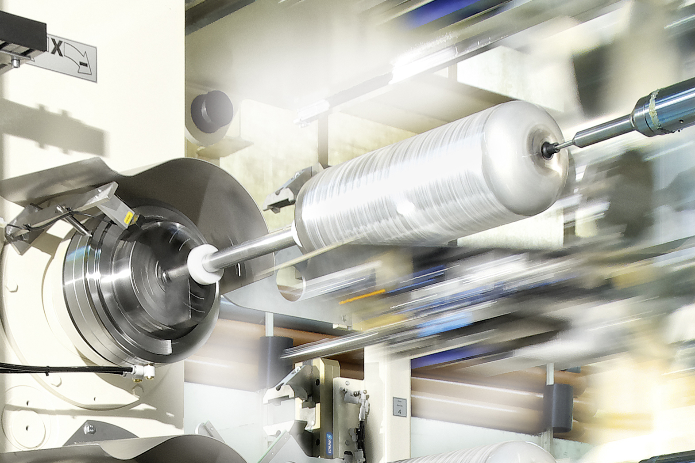
ROTA TP
Application examples

Slide 37
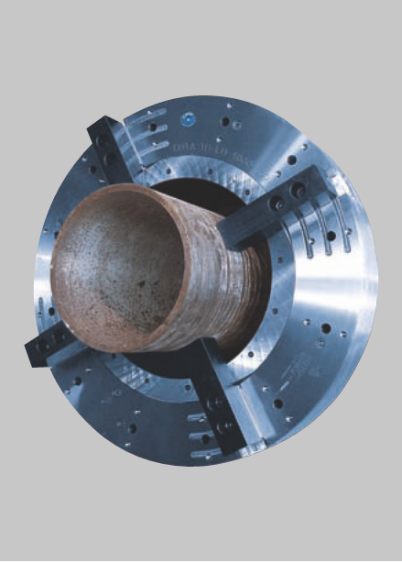
ROTA TP/TB/EP
ROTA TB 1000-560-LH 4
Special version with four jaws and independent top jaws
Main advantages
out-of-round and bent pipes can be aligned by the
single adjustable jaws
very large through-hole (chuck size 1000 mm –
through-hole 560 mm)
chuck in self-contained version with integrated
pneumatic clamping cylinder

Slide 38
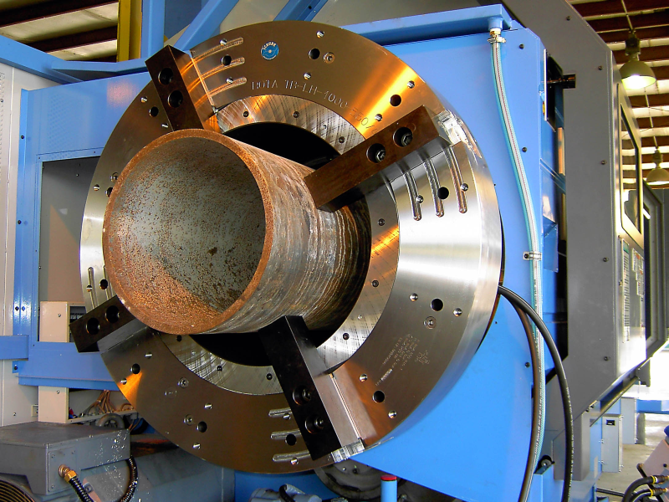

ROTA TB
Application examples

Slide 39


ROTA TB
Application examples

