Slide 1


ROTA NCS 3 I ROTA NCS 6
Power Lathe Chucks without Through-hole

Slide 2














Product overview
Gripping Systems
Clamping Technology
Chuck Jaws
Stationary Workholding
Lathe Chucks
Toolholders
Hydraulic Expansion Technology
Manual Lathe Chucks
Power Lathe Chucks with Jaw Quick-change System
Power Lathe Chucks with Through-hole
Power Lathe Chucks without Through-hole
Pneumatic Power Chucks
Steady Rests
Quick-change Systems
Customized Solutions

Slide 3
Challenges
Variants
Required
accuracy
time
time
Global competition
time
Requirements on the clamping fixture: efficiency, flexibility and…
heute
zukünftig

Slide 4

Power Lathe Chucks without Through-hole

Slide 5


ROTA overview
Power Lathe Chucks without Through-hole
ROTA NCO
ROTA 2B
ROTA NCR/ NCR-A
ROTA NCS 3/ NCS 6

Slide 6
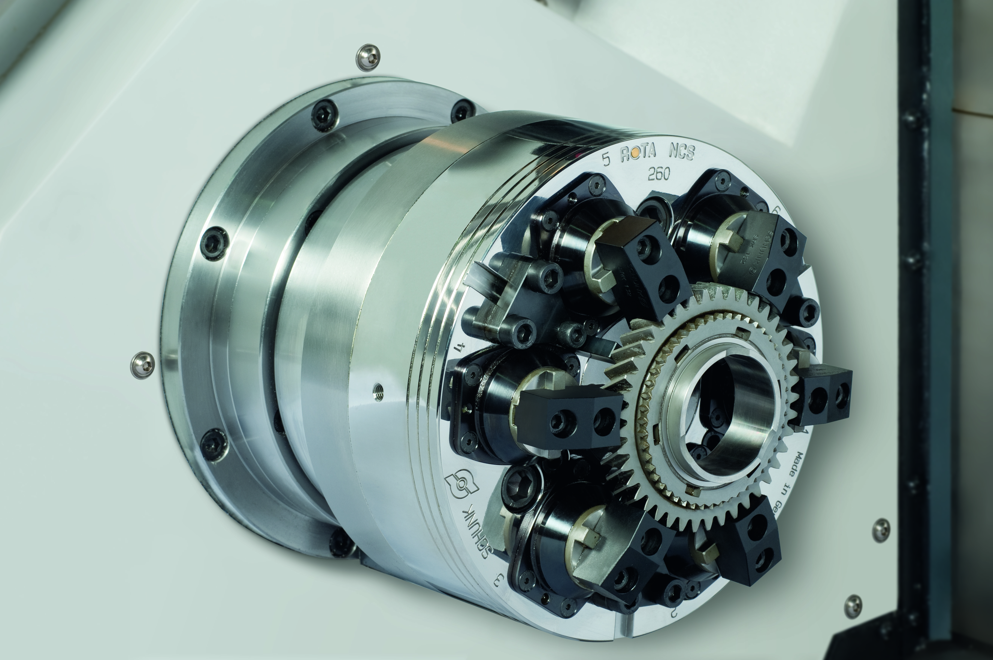
ROTA NCS 6
Example of application
Clamping device:
ROTA NCS 260/6 jaws with special chuck jaws.
Features/Application:
O.D of gear components with pull-down for highest requirements on plane parallelism. Sealed pendulum compensation chuck for series production even for workpieces that are sensitive to deformation.

Slide 7
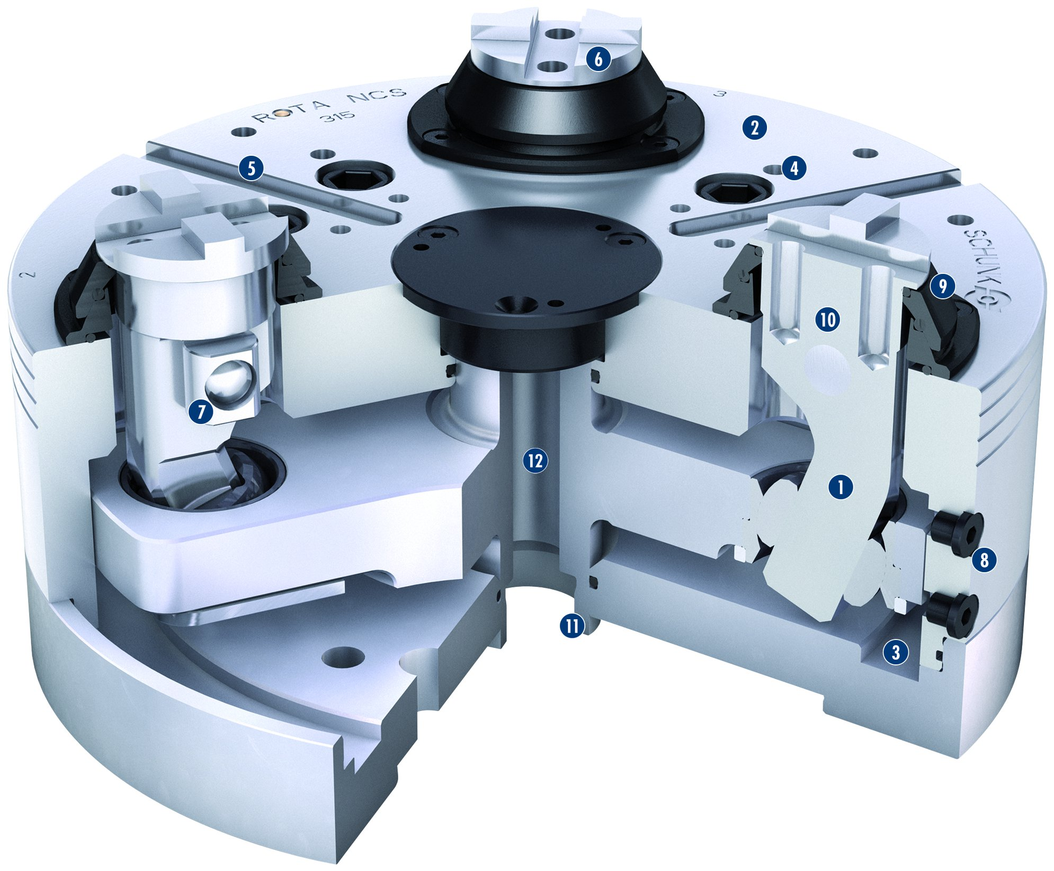
ROTA NCS 3
6
1
Lever drive
Hardened and extremely rigid base body
Hermetically sealed and oil-filled
Mounting threads
Additional slot guidance on the chuck face
Standard chuck jaw interface
Lever bearing
Oil drain-screw
Cover with integrated sealing element of the lever
Simple conversion
Optimized piston mount
Central media feed-through
2
2
5
4
3
9
4
10
5
7
6
12
1
7
8
8
9
11
3
10
11
12

Slide 8
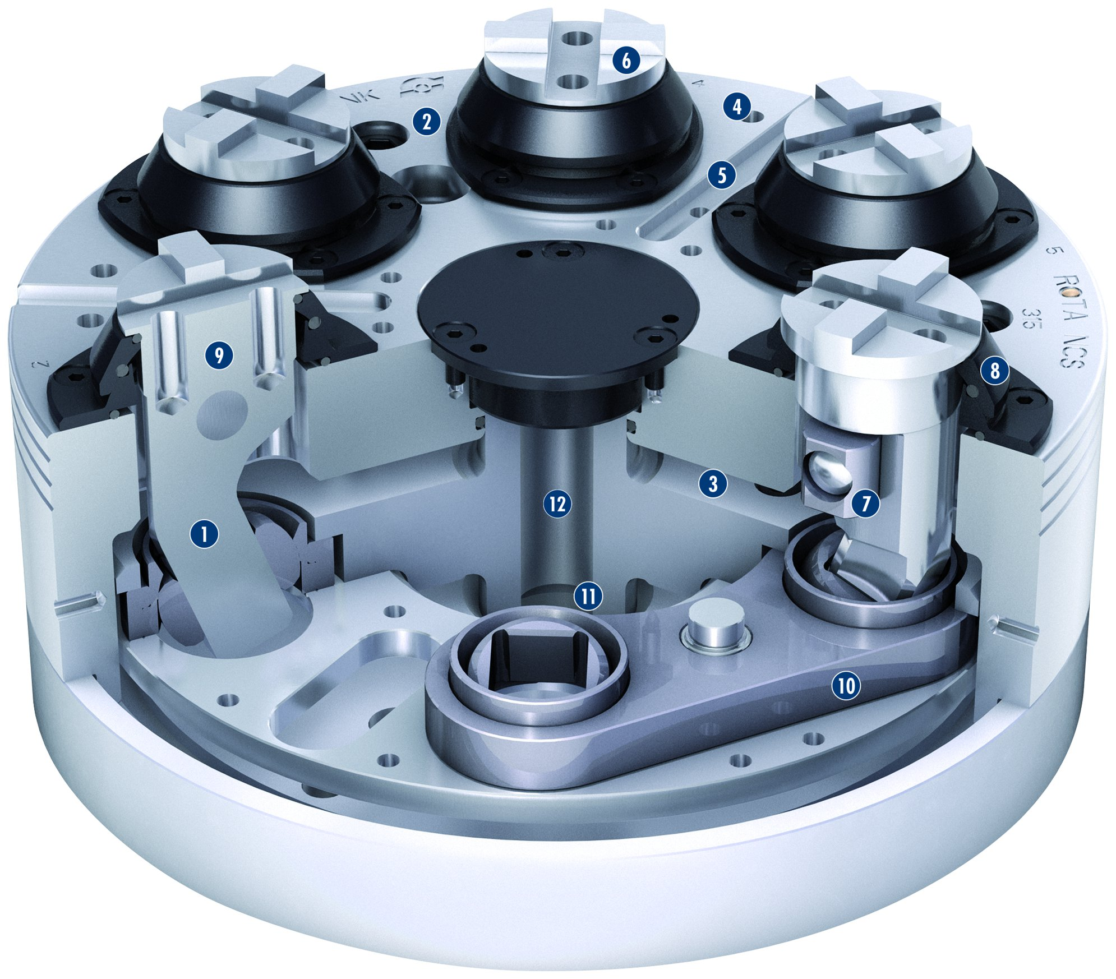
ROTA NCS 6
6
1
Lever drive
Hardened and extremely rigid base body
Hermetically sealed and oil-filled
Mounting threads
Additional slot guidance on the chuck face
Standard chuck jaw interface
Lever bearing
Cover with integrated sealing element of the lever
Simple conversion
Inside located pendulum body
Optimized pistion mount
Central media feed-through
2
4
2
5
3
4
9
8
5
3
6
12
7
7
1
11
8
10
9
10
11
12

Slide 9
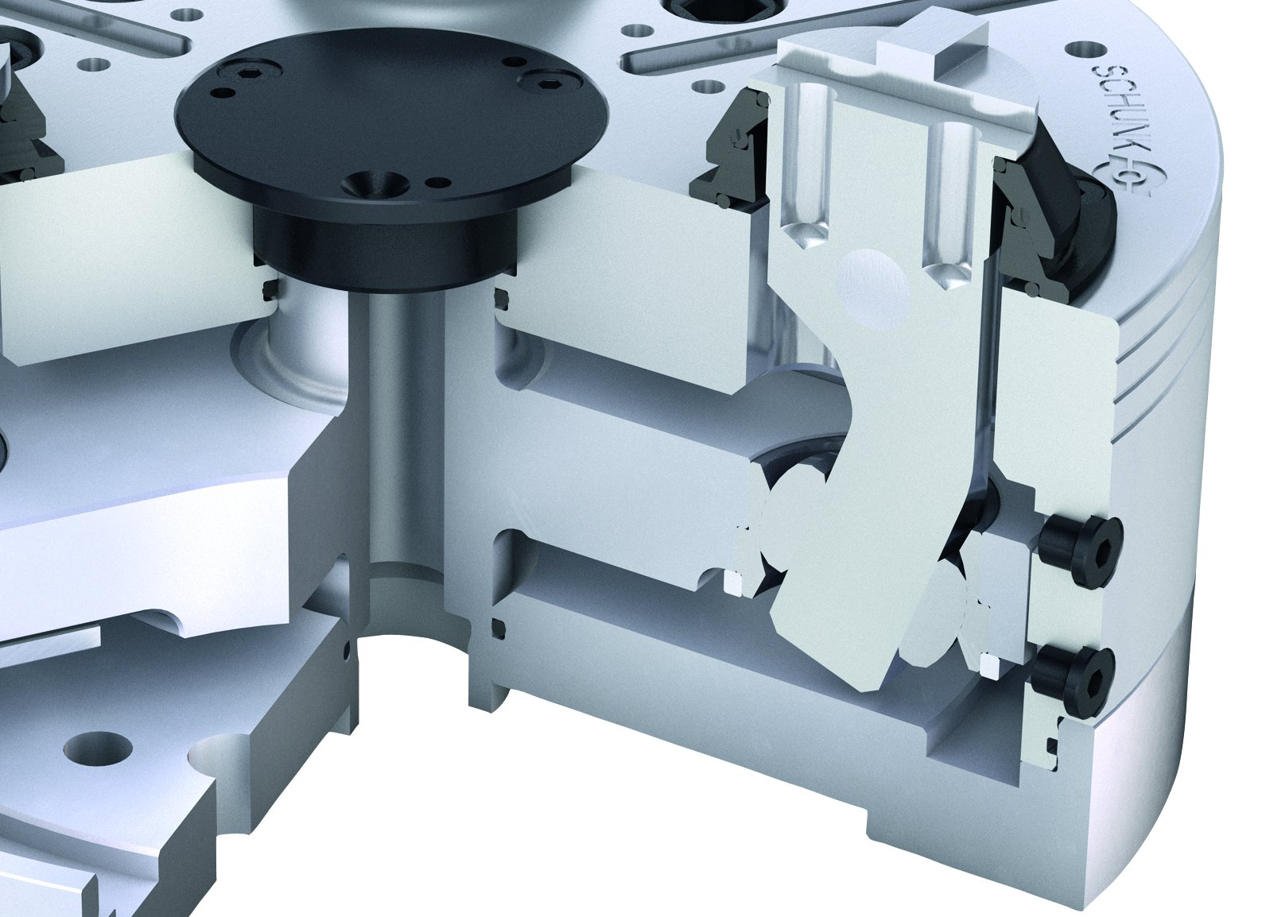
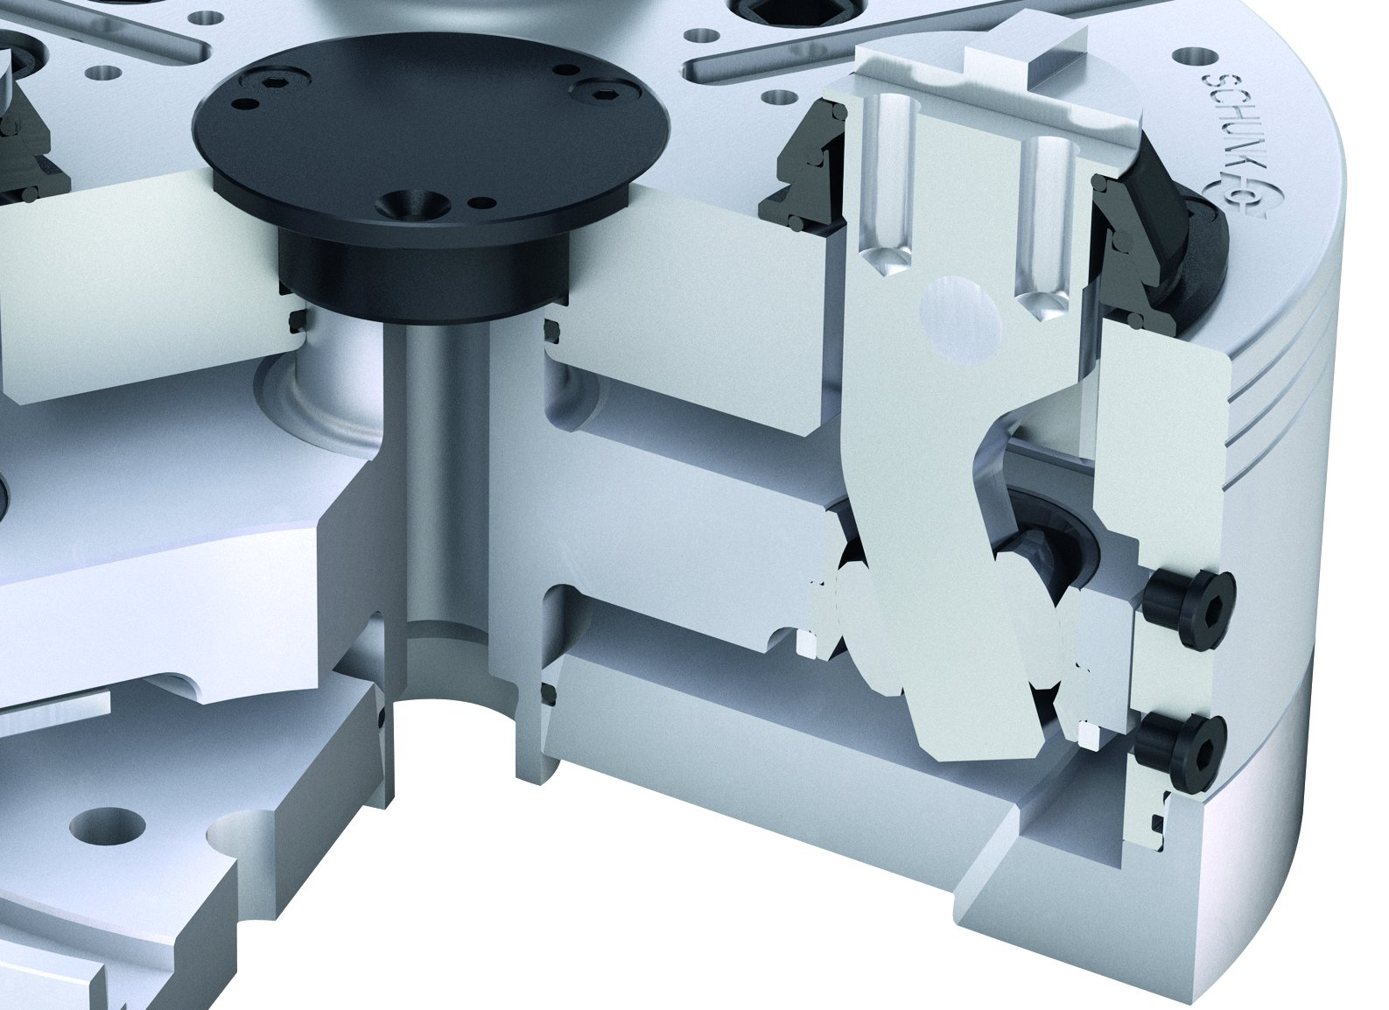
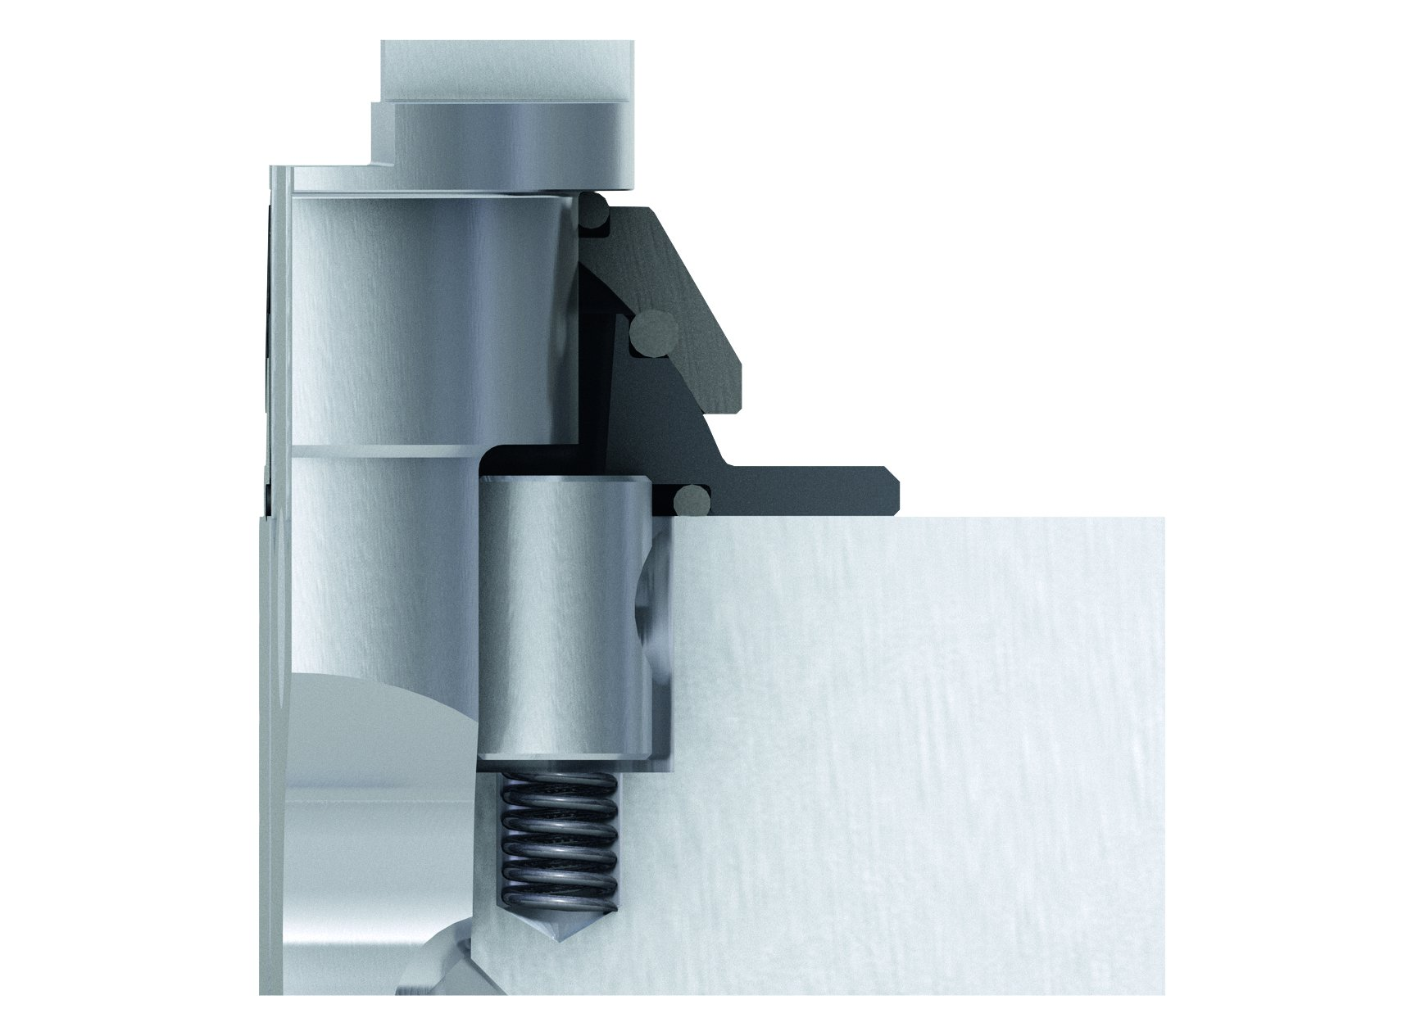
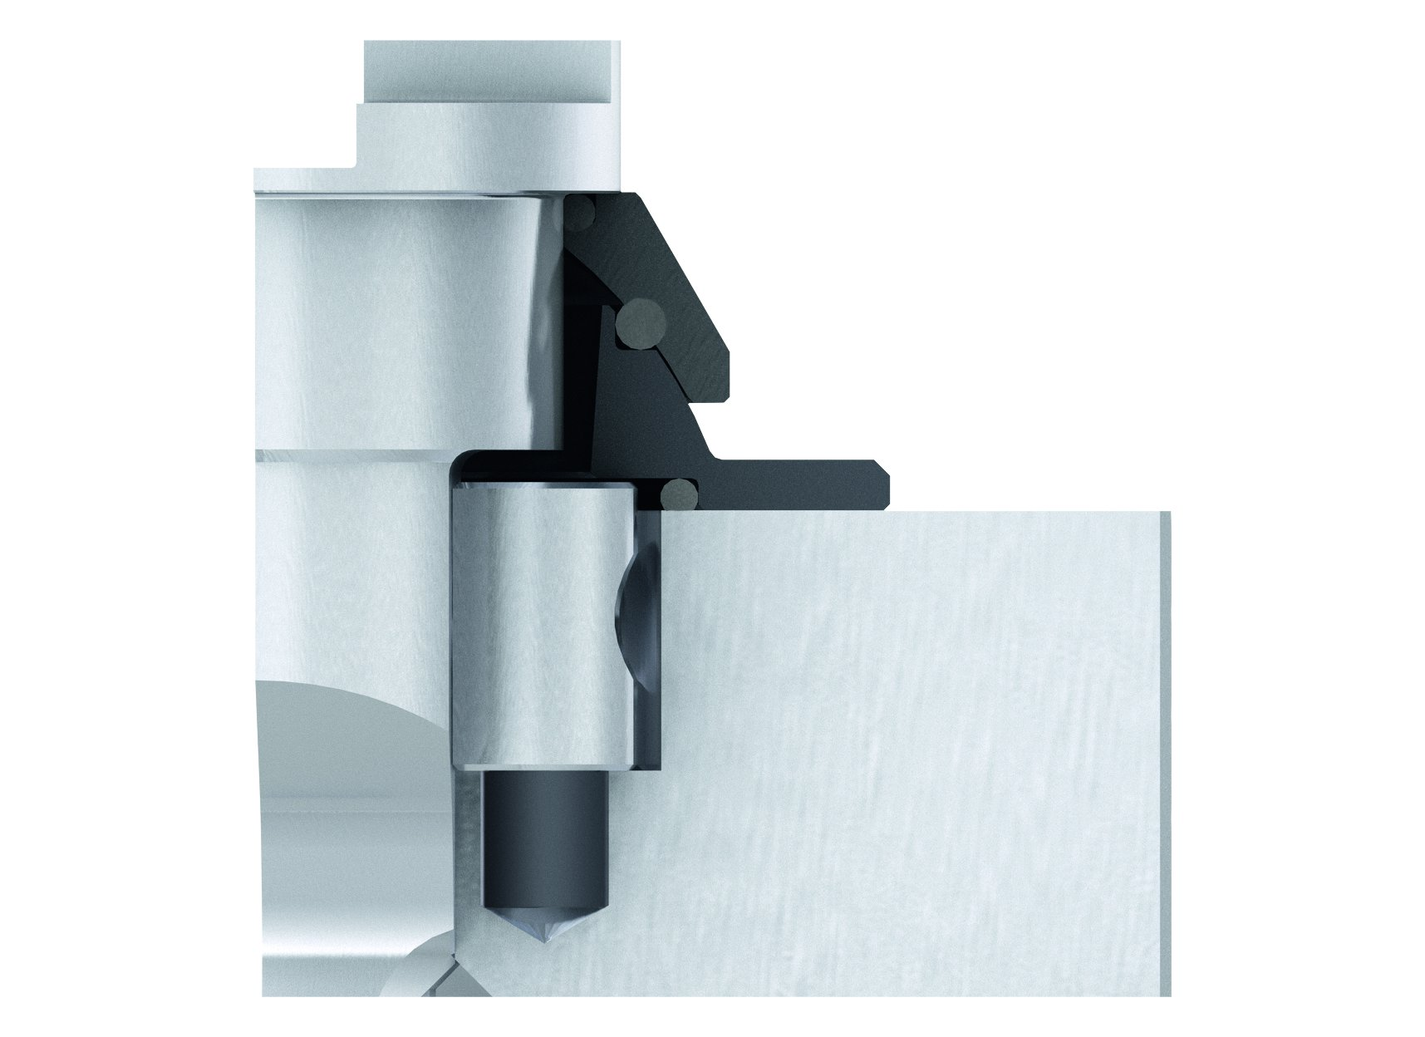
ROTA NCS 3/NCS 6
Lever assembly for external clamping
Lever assembly for internal clamping
Active pull down
Blocked pull down

Slide 10
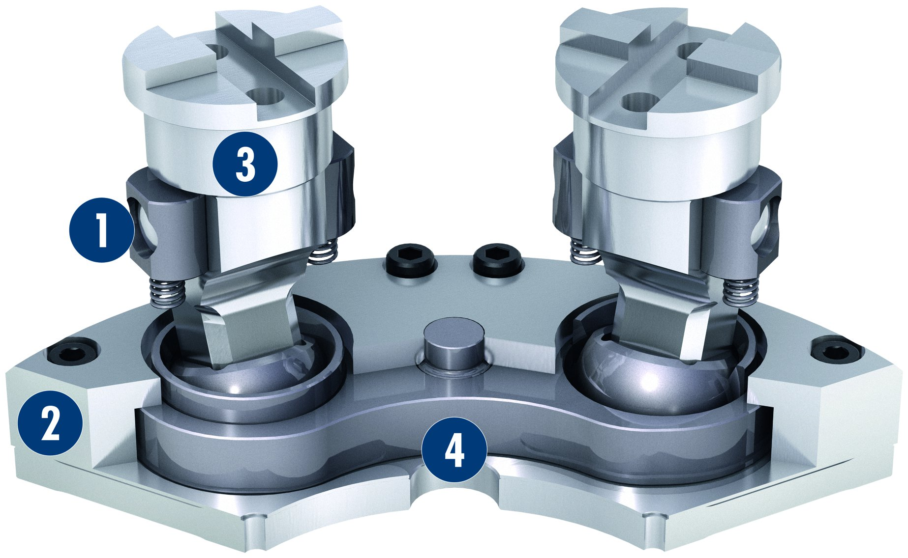
ROTA NCS 6
Pendulum mechanism ROTA NCS 6-jaw chuck
1
Active jaw pull-down
Piston
Lever
Pendulum body
3
1
2
2
4
3
4

Slide 11
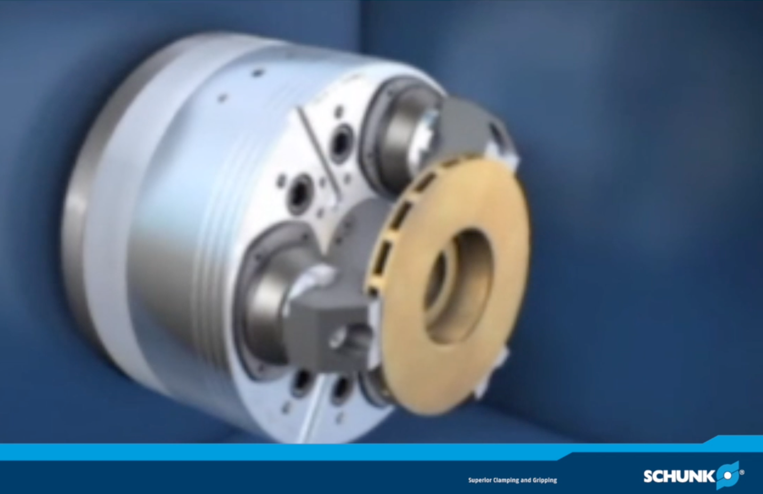
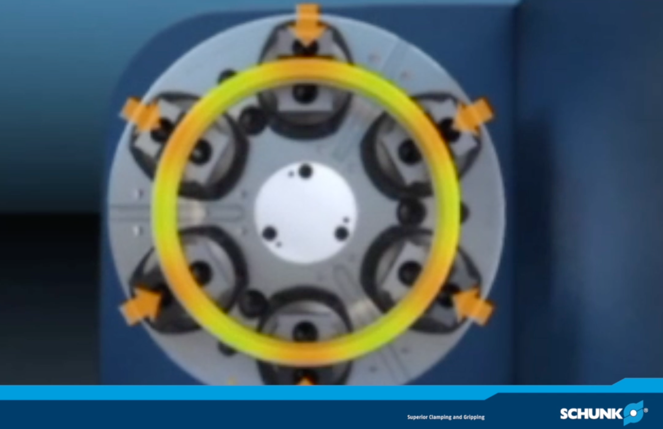
ROTA NCS 3/NCS 6
ROTA NCS 3
ROTA NCS 6

Slide 12
Variants ROTA NCS 3/NCS 6
Technical Data | Max. RPM [min⁻¹] | Max. Clamping force [kN] | Max. actuating force [kN] | Stroke/jaw [mm] | Piston stroke [mm] | Nieder-zug [mm] | Pull-down action [mm] | Recommendation clamping range
 |  |  |  |  |  |  |  | O.D. clamping [mm] | I. D. clamping [mm]
ROTA NCS 175/3 | 5000 | 44 | 20 | 5.8 | 21 | 0.3 |  | 32-100 | 80-150
ROTA NCS 210/3 | 4500 | 60 | 32 | 6.9 | 25 | 0.3 |  | 34-132 | 84-184
ROTA NCS 250/3 | 4000 | 80 | 48 | 7.7 | 25 | 0.3 |  | 38-168 | 92-224
ROTA NCS 315/3 | 3300 | 80 | 48 | 7.7 | 25 | 0.3 |  | 88-218 | 142-274
ROTA NCS 400/3 | 2200 | 120 | 60 | 8.2 | 30 | 0.5 |  | 102-272 | 160-332
ROTA NCS 500/3 | 1700 | 150 | 60 | 8.2 | 30 | 0.5 |  | 222-320 | 280-452
ROTA NCS 260/6 | 3800 | 44 | 20 | 5.8 | 21 | 0.3 | ± 2 | 38-168 | 92-224
ROTA NCS 315/6 | 2200 | 80 | 48 | 7.7 | 25 | 0.3 | ± 2 | 88-218 | 142-274
ROTA NCS 400/6 | 2000 | 80 | 48 | 7.7 | 25 | 0.3 | ± 3 | 132-258 | 192-318
ROTA NCS 500/6 | 1400 | 120 | 65 | 8.2 | 30 | 0.5 | ± 3 | 222-320 | 280-452

Slide 13



SCHUNK Services
Engineering
Dimensioning of special plates designed to the manufacturing specifications
Development of special solutions together with the customer
FEM analysis for critical components
Testing
Endurance tests with all new developments
Abrasion checking
Measurement of accuracy
Service
Initial operation of customer´s solution
Inspection and maintenance
Repairs

