Slide 1


ROTA NCR | ROTA NCR-A
Power Lathe Chucks without Through-hole

Slide 2














Product overview
Gripping Systems
Clamping Technology
Chuck Jaws
Stationary Workholding
Lathe Chucks
Toolholders
Hydraulic Expansion Technology
Manual Lathe Chucks
Power Lathe Chucks with Jaw Quick-change System
Power Lathe Chucks with Through-hole
Power Lathe Chucks without Through-hole
Pneumatic Power Chucks
Steady Rests
Quick-change Systems
Customized Solutions

Slide 3
Challenges
Variants
Required
accuracy
time
time
Global competition
time
Requirements on the clamping fixture: efficiency, flexibility and…
heute
zukünftig

Slide 4

Power Lathe Chucks without Through-hole

Slide 5


ROTA overview
Power Lathe Chucks without Through-hole
ROTA NCO
ROTA 2B
ROTA NCR/ NCR-A
ROTA NCS 3/ NCS 6

Slide 6
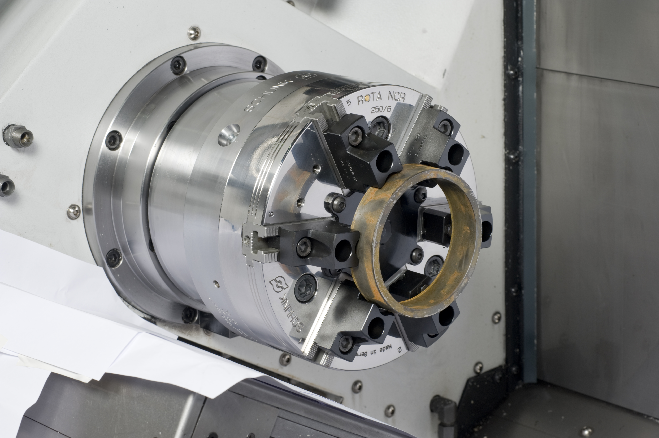
ROTA NCR
Example of application
Clamping device:
ROTA NCR 250 with claw jaws.
Features/Application:
Low-deformation ring clamping in 2+2+2 pendulum compensation chuck. Less deformation in OP10 and OP20 for best values of roundness.

Slide 7
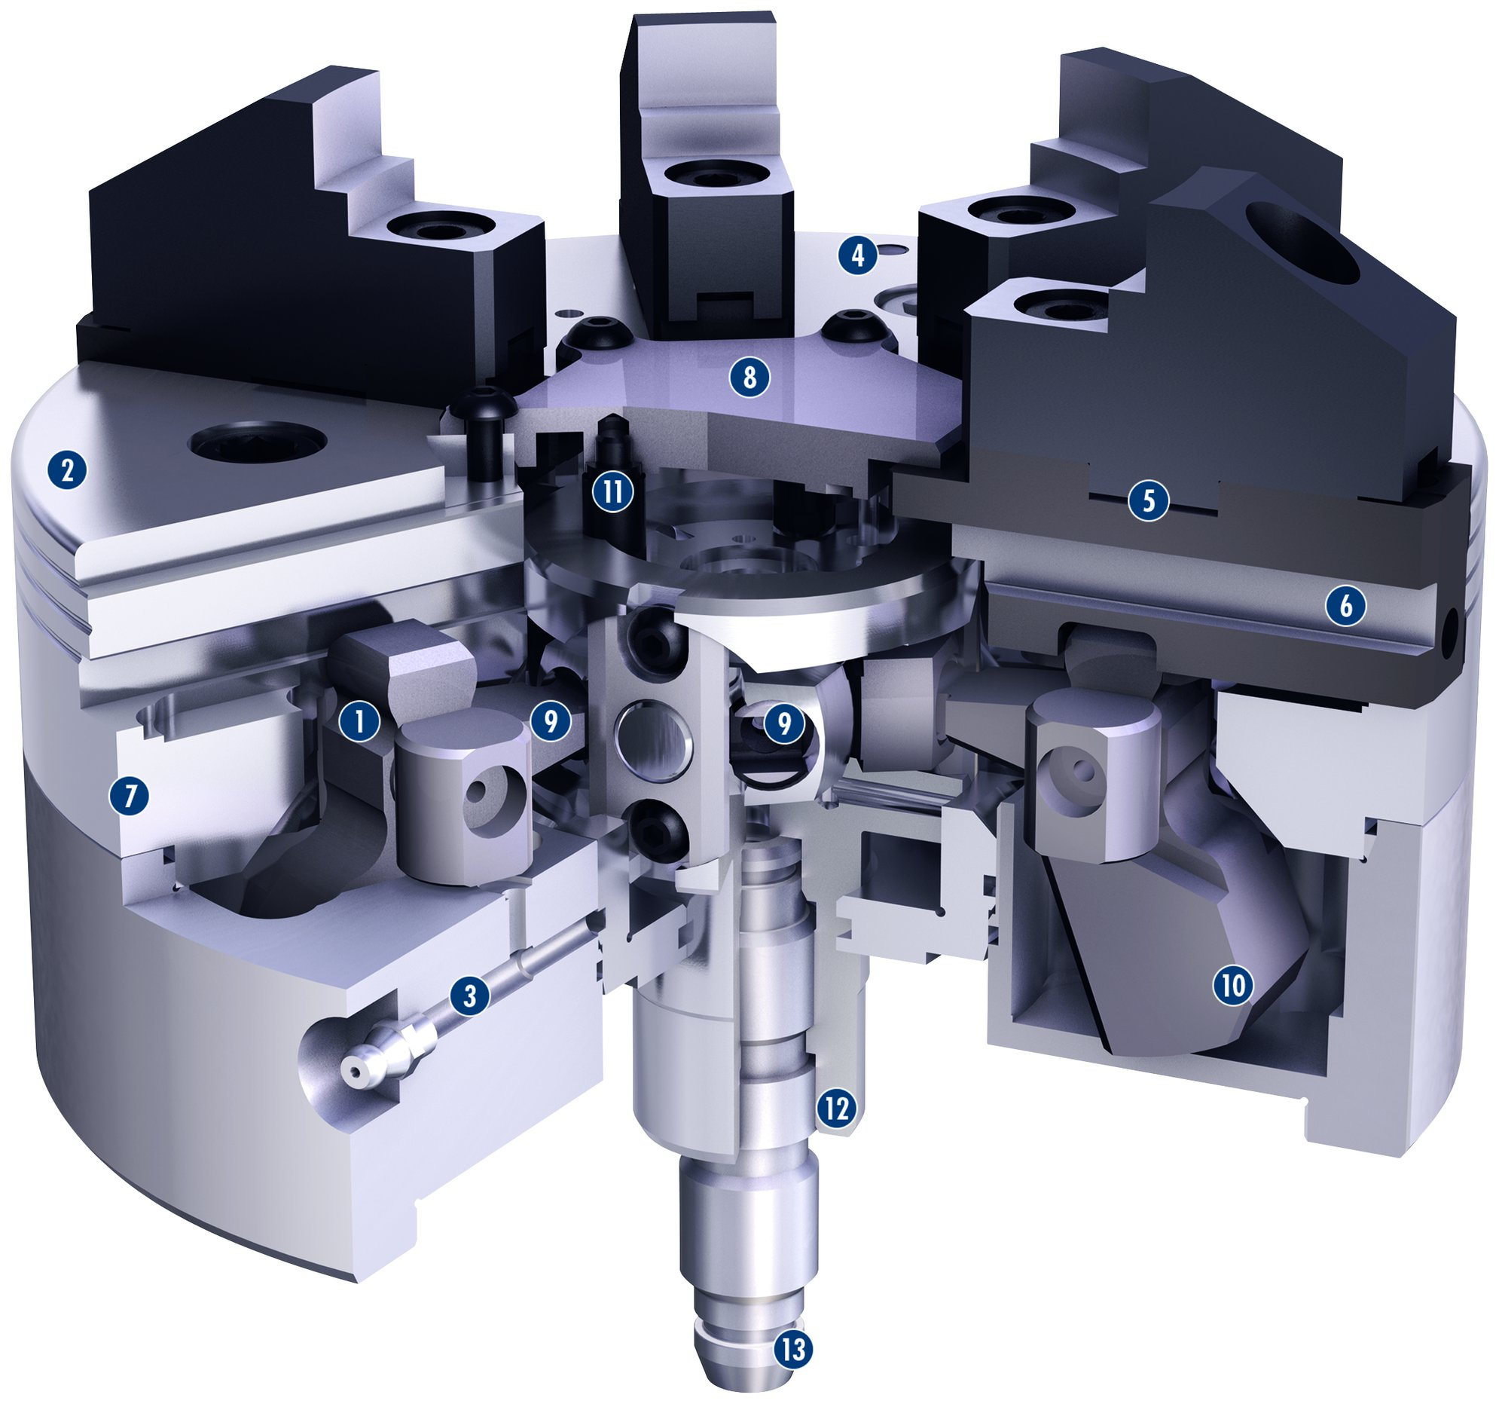
ROTA NCR
1
Angle lever drive
Hardened and extremely rigid base body
Optimized lubrication system
Mounting threads
Standard chuck jaw interface
Long jaw guidance
Low height
Dirt-resistant design
Inside located pendulum body
Integrated centrifugal force compensation as an option
Simple conversion
Optimized piston mount
Central media feed-through
2
4
8
3
2
4
11
5
5
6
6
1
9
9
7
7
8
9
10
3
10
12
11
12
13
13

Slide 8
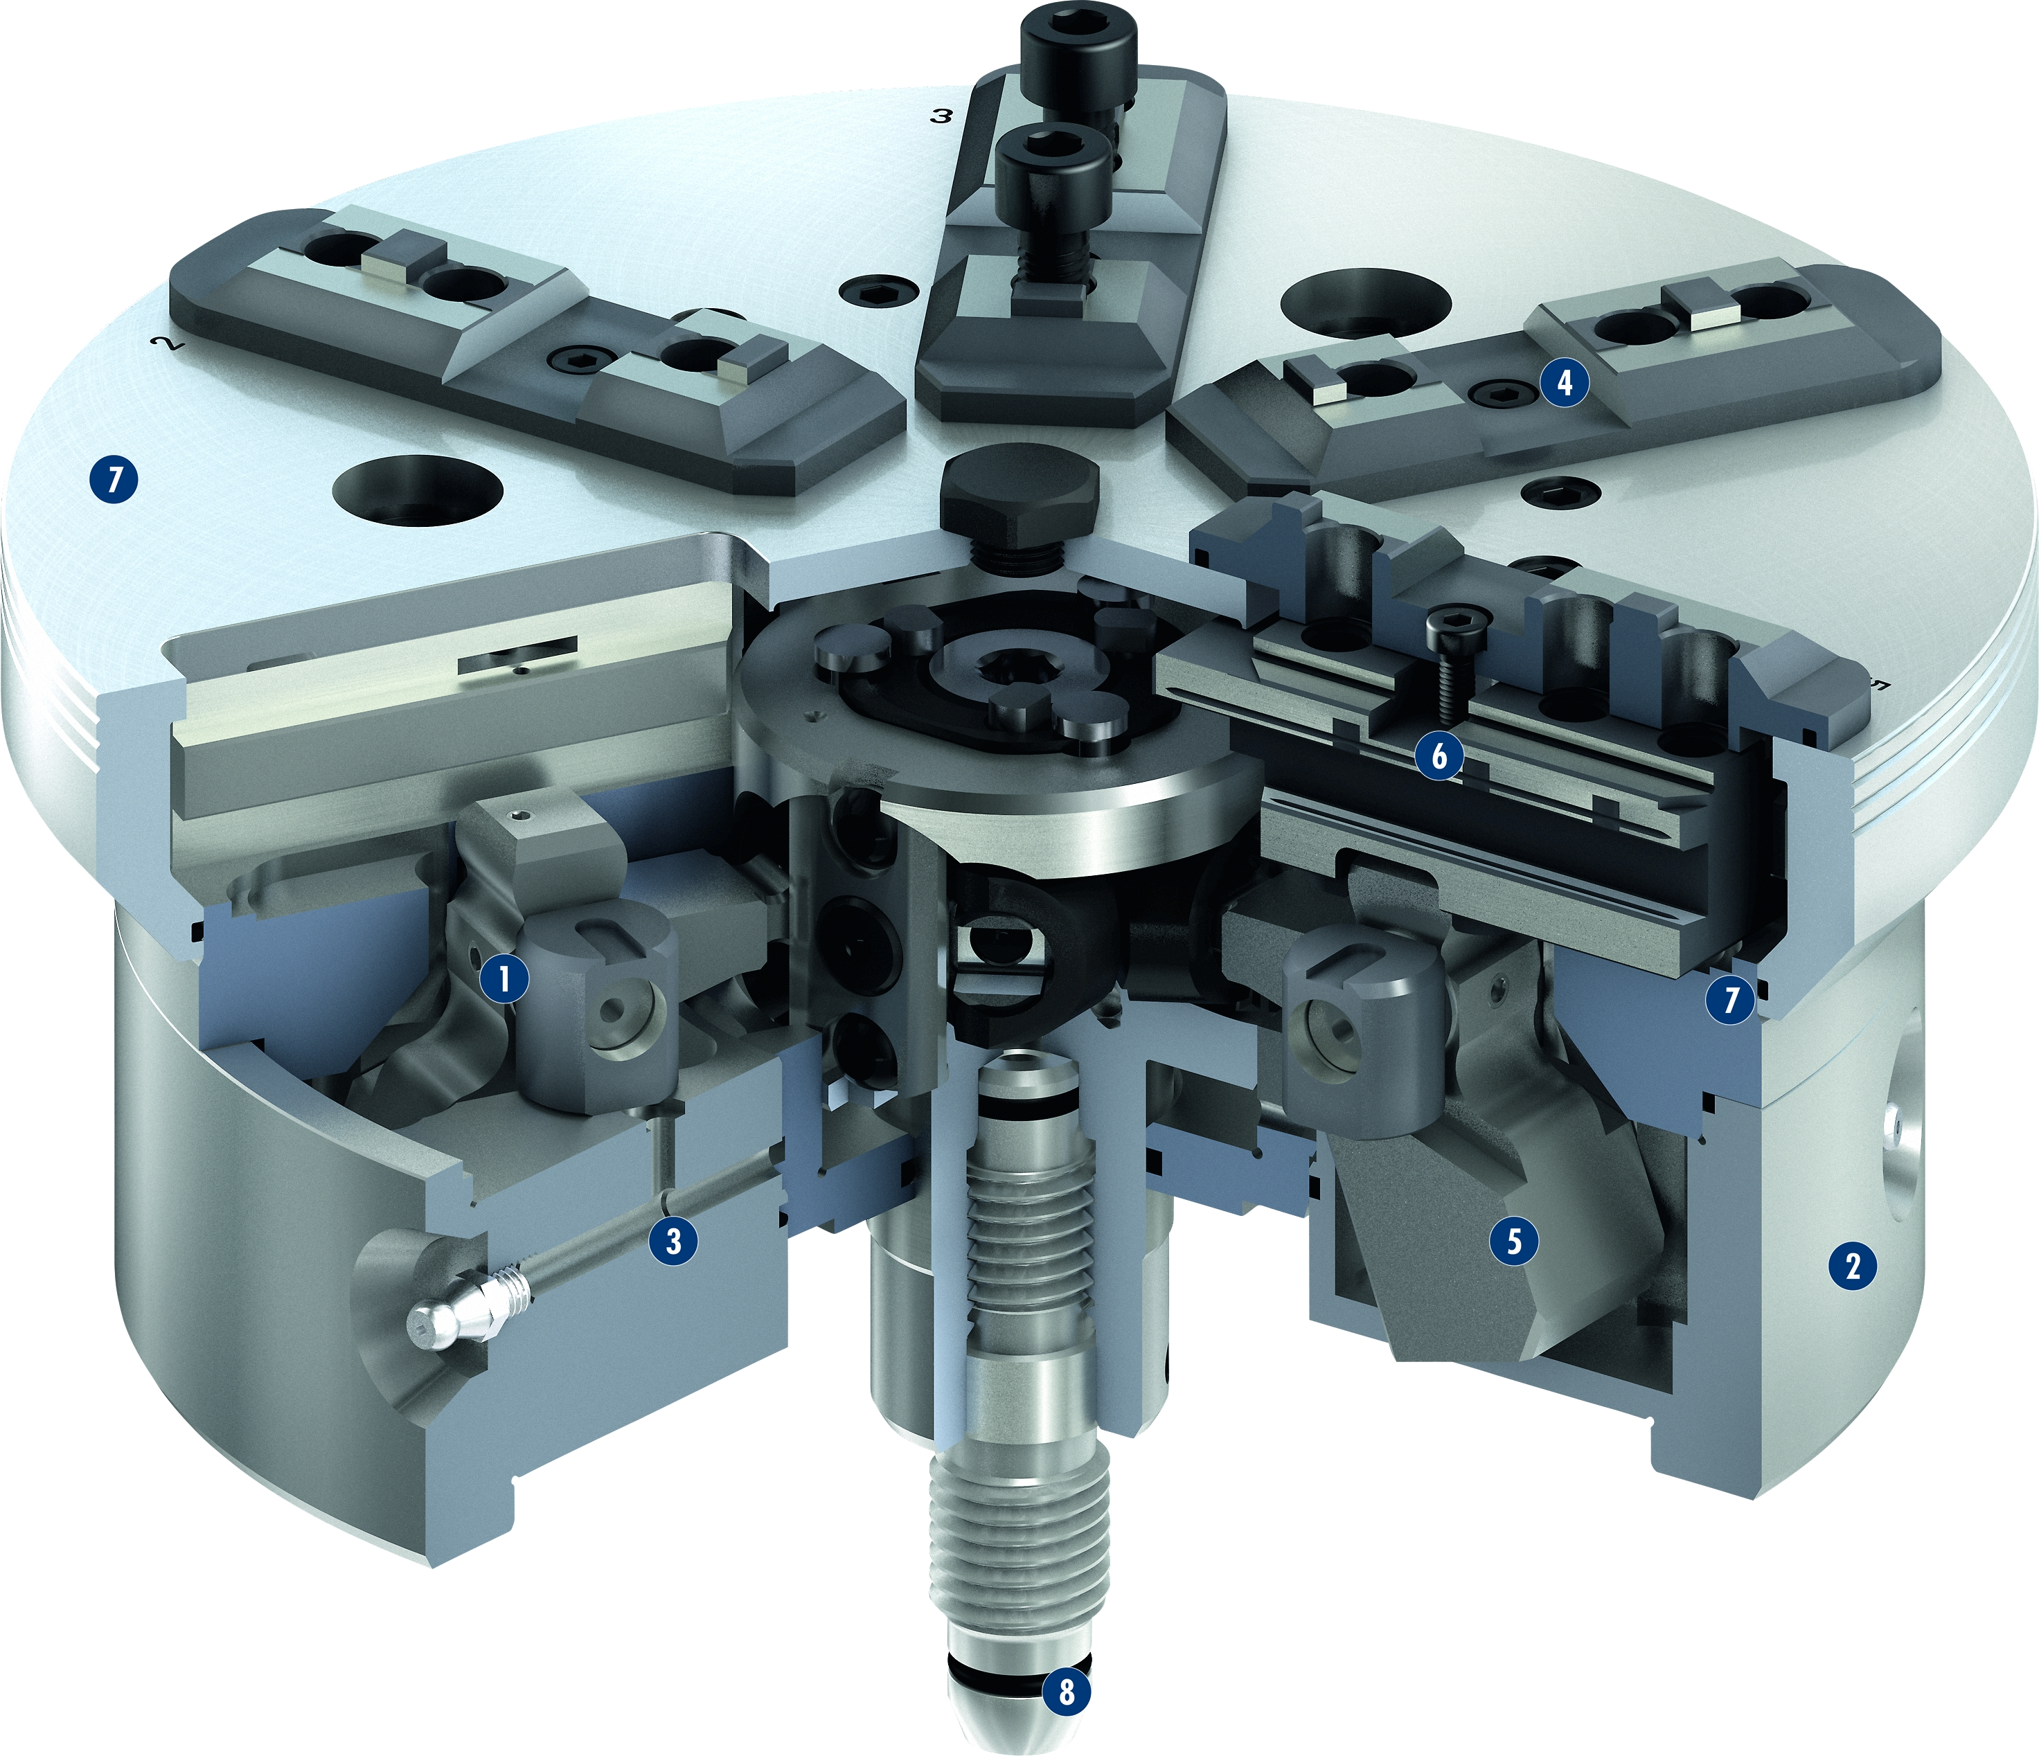
ROTA NCR-A
1
Angled lever drive
Hardened and extremely rigid base body
Optimized lubrication system
Mounting threads
Standard jaw interface
Inner laying pendulum bridge
Sealing for longer maintenance intervals
Wiper stripes at the base jaw guidance
4
7
2
3
6
4
5
1
9
7
6
7
3
5
2
8
8

Slide 9
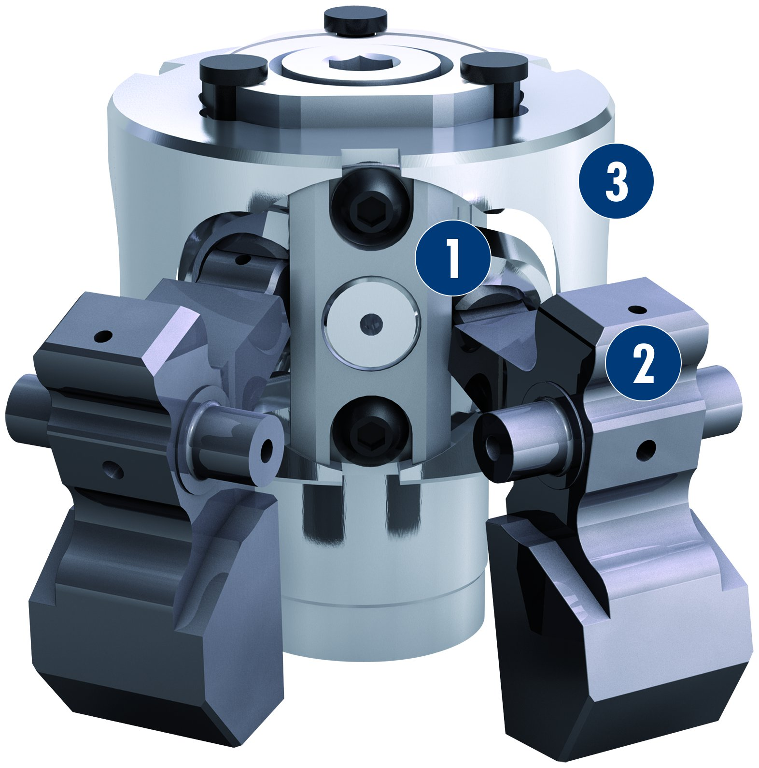
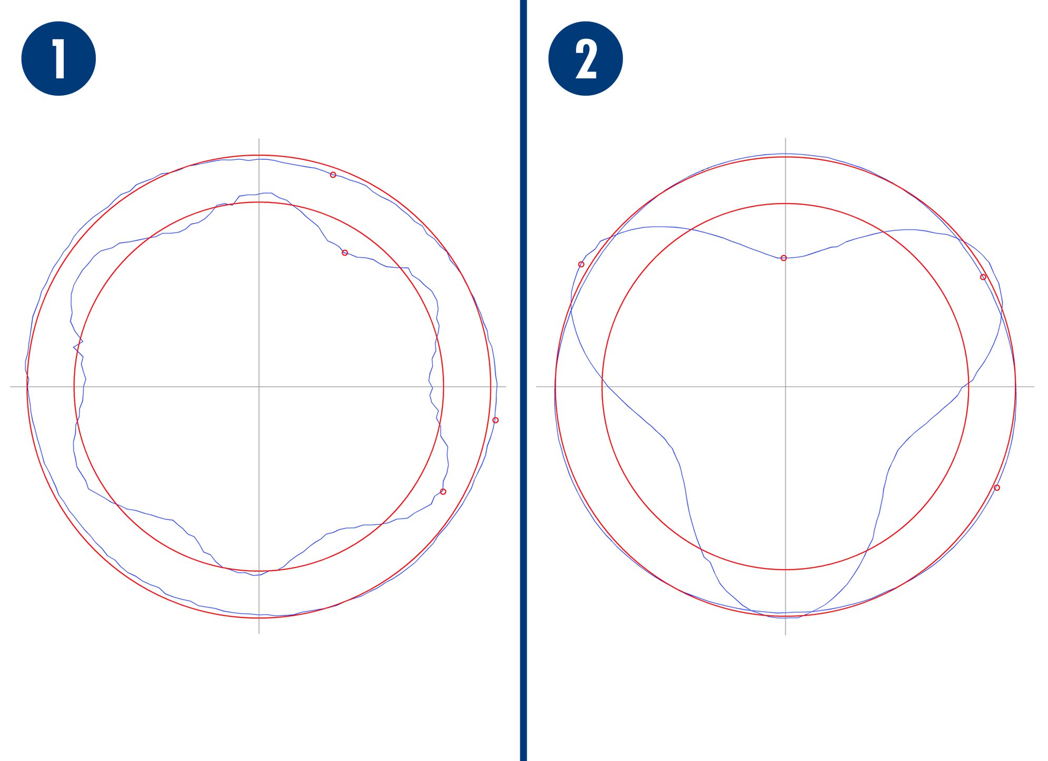
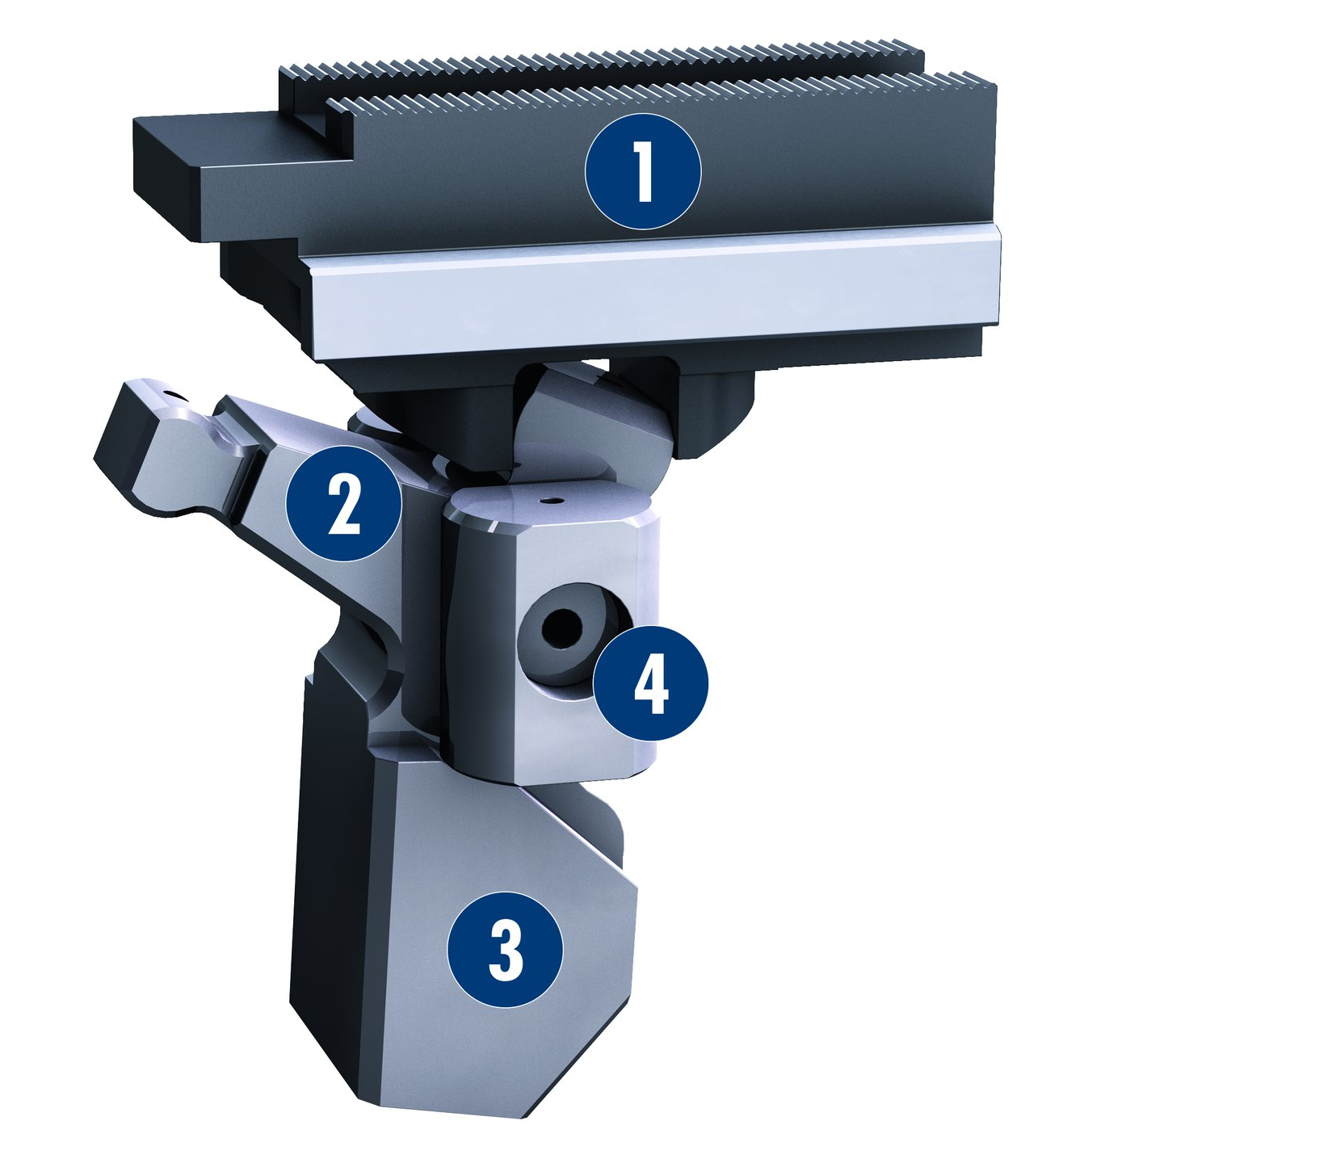
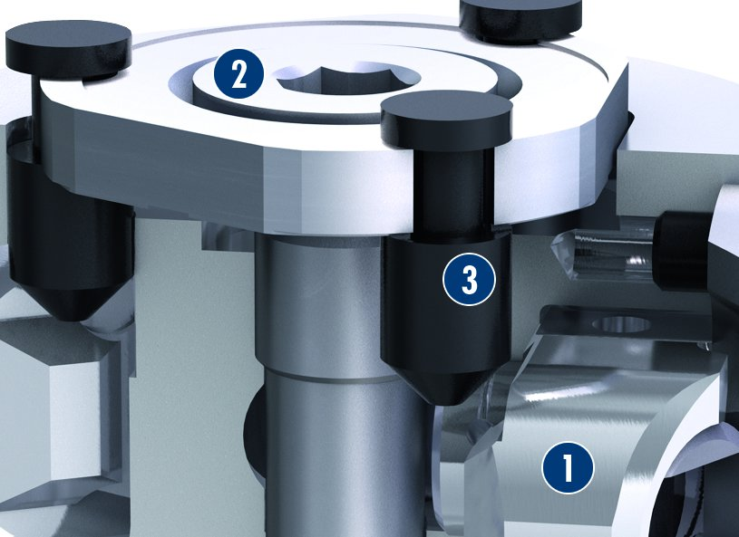
ROTA NCR
Advantages of the 6-point clamping over
3-point clamping
Easy actuation
1
Clamping of a ring in the 6-jaw pendulum compensating chuck ROTA NCR with a total clamping force of 20 kN
Clamping of a ring in the 3-jaw power chuck with a total clamping force of 20 kN
1
2
3
1
Pendulum bodies
Angle lever
Chuck piston
1
2
2
3
2
Force transmission
Compensating workpiece clamping
1
1
Base jaw
Angle lever
Optional with centrifugal force compensation
Lever bearing
2
1
Pendulum body loose
Adjusting screw
Pendulum locking open
2
2
4
3
3
2
3
3
1
4

Slide 10
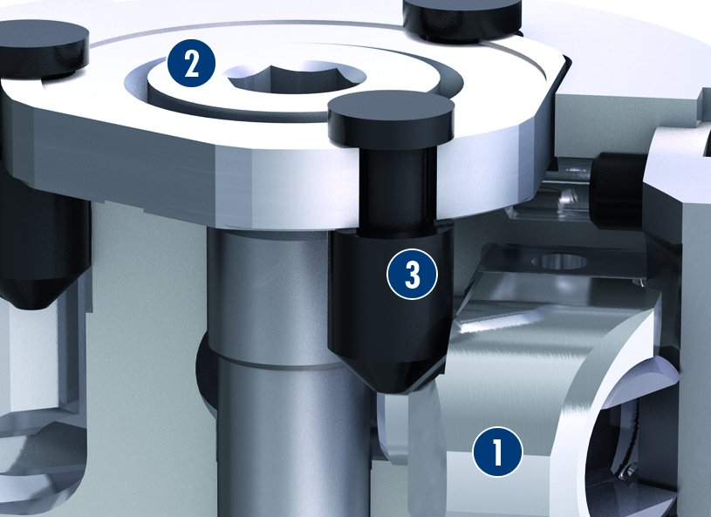
ROTA NCR
Compensating workpiece clamping
Centric workpiece clamping
2
1
Pendulum body loose
Adjusting screw
Pendulum locking open
2
1
Pendulum body locked
Adjusting screw
Pendulum clamping locked
3
2
3
2
3
3
1
1

Slide 11
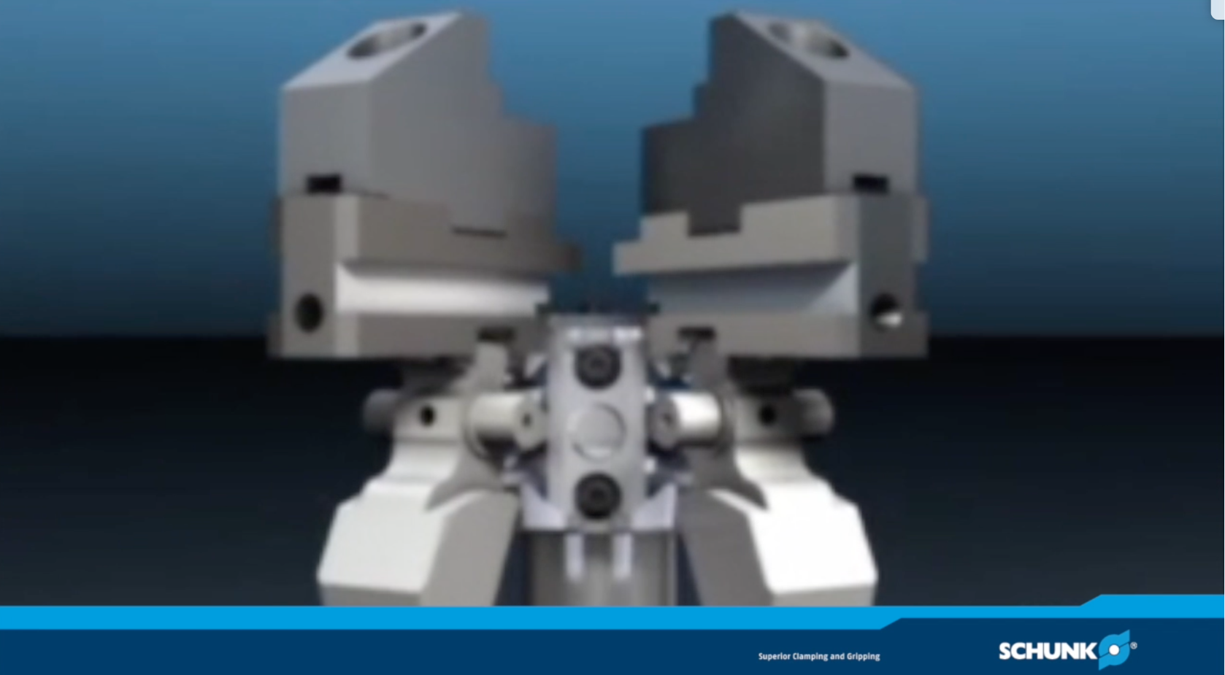
ROTA NCR

Slide 12
Variants ROTA NCR/NCR-A
Technical Data | Max. RPM [min⁻¹] | Max. clamping force [kN] | Max. actuating force [kN] | Stroke/jaw [mm] | Piston stroke [mm] | Pendular compensation [mm]
ROTA NCR 165 | 4000 | 36 | 20 | 6 | 13.5 | ± 1
ROTA NCR 200 | 3500 | 50 | 25 | 6 | 15 | ± 1
ROTA NCR 250 | 3000 | 64 | 38 | 8 | 18.8 | ± 2
ROTA NCR 315 | 2500 | 80 | 40 | 8 | 20 | ± 2
ROTA NCR 400 | 1400 | 100 | 54 | 12 | 30 | ± 2.5
ROTA NCR 500 | 1200 | 125 | 65 | 12 | 30 | ± 2.5
ROTA NCR 630 | 1000 | 160 | 80 | 16 | 40 | ± 3.5
ROTA NCR 800 | 700 | 160 | 80 | 16 | 40 | ± 3.5
ROTA NCR 1000 | 600 | 300 | 150 | 25 | 60 | ± 6
ROTA NCR 1250 | 450 | 300 | 150 | 25 | 60 | ± 6
ROTA NCR 1600 | 300 | 300 | 150 | 25 | 60 | ± 6
Technical Data | Max. RPM [min⁻¹] | Max. clamping force [kN]
ROTA NCR-A 190 | 4000 | 36
ROTA NCR-A 225 | 3500 | 50
ROTA NCR-A 250 | 3000 | 64
ROTA NCR-A 315 | 2500 | 80

Slide 13



SCHUNK Services
Engineering
Dimensioning of special plates designed to the manufacturing specifications
Development of special solutions together with the customer
FEM analysis for critical components
Testing
Endurance tests with all new developments
Abrasion checking
Measurement of accuracy
Service
Initial operation of customer´s solution
Inspection and maintenance
Repairs

