Slide 1

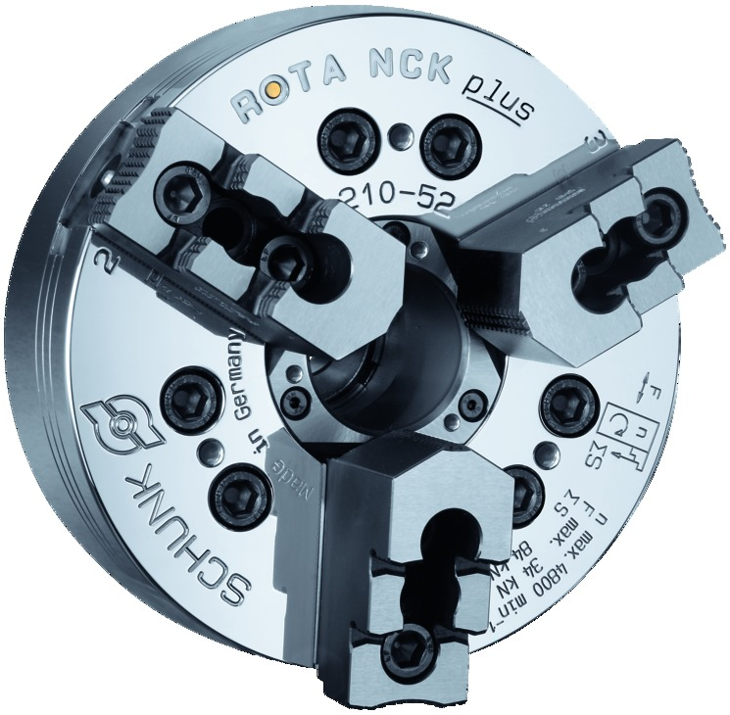
ROTA NCK plus
Power Lathe Chucks with Through-hole

Slide 2
ROTA NCK plus
Advantages – Your benefits
Interface 100% compatible with power chucks of the Kitagawa B200 series
Precision wedge hook power chuck for highest quality requirements
High efficiency of the wedge bar system
Optimized lubrication system
Base jaws with fine serration 1.5 mm x 60° and 1/16“ x 90° as standard
Blank draw nut which can be disassembled and removed is integrated in the chuck
Modular center sleeve system
All functional parts are ground and hardened

Slide 3
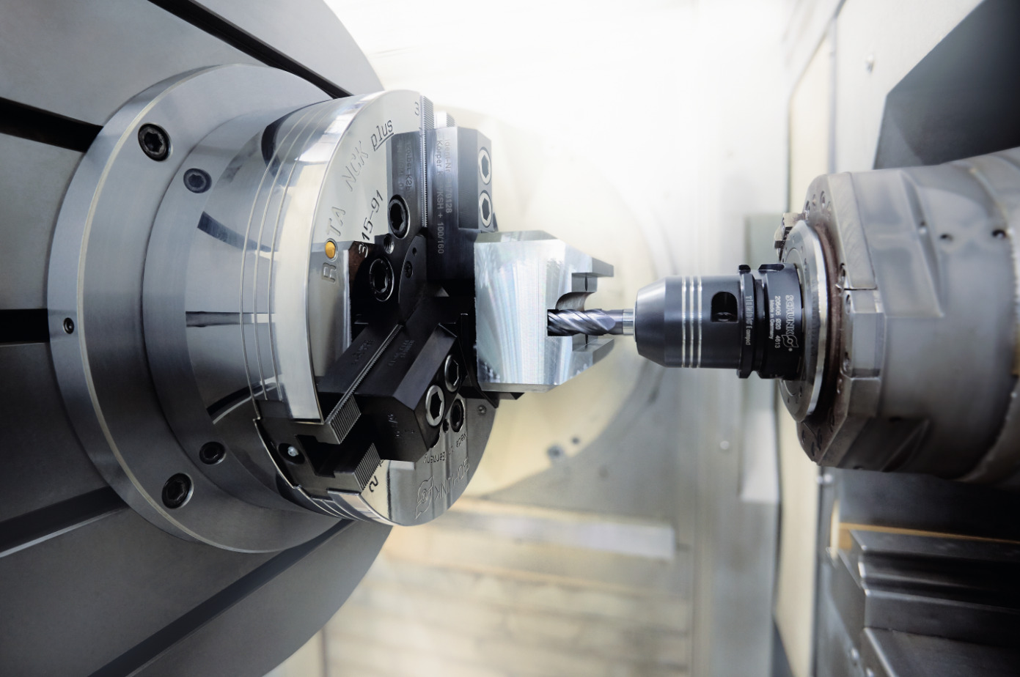
ROTA NCK plus
Example of application
Clamping device:
ROTA NCK-S plus 315 for stationary application.
Features/Application:
Lathe chuck with integrated hydraulic cylinder for automated manufacturing in milling centers.

Slide 4
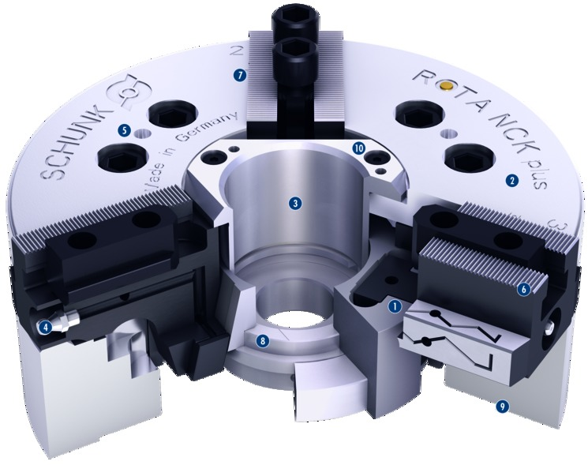
ROTA NCK plus
Functional diagram
7
Wedge hook drive
Hardened and extremely rigid base body
Large through-hole
Optimized lubrication system
Mounting threads
Base jaw serration
Jaw stroke display
Blank draw nut
Various direct mountings
Modular center sleeve system
1
2
5
10
3
2
3
4
5
6
6
4
1
7
8
8
9
9
10

Slide 5
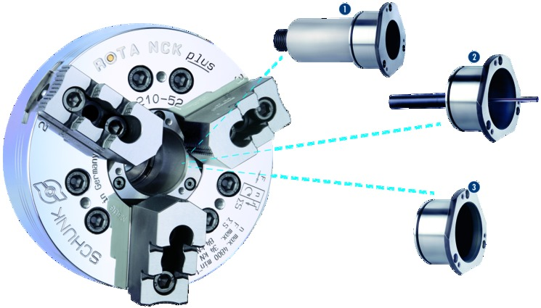
ROTA NCK plus
Modular Center Sleeve System
Adjustable stop in the center sleeve
Part ejector in the center sleeve
Closed center sleeve
1
1
2
3
2
3

Slide 6
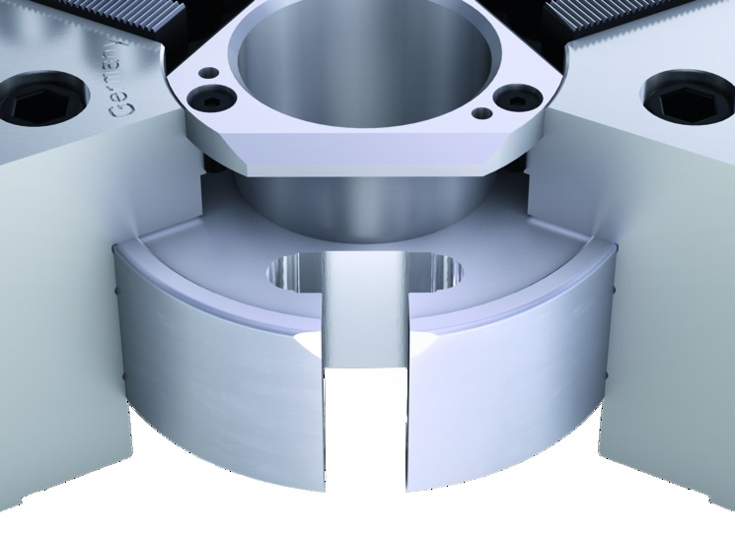
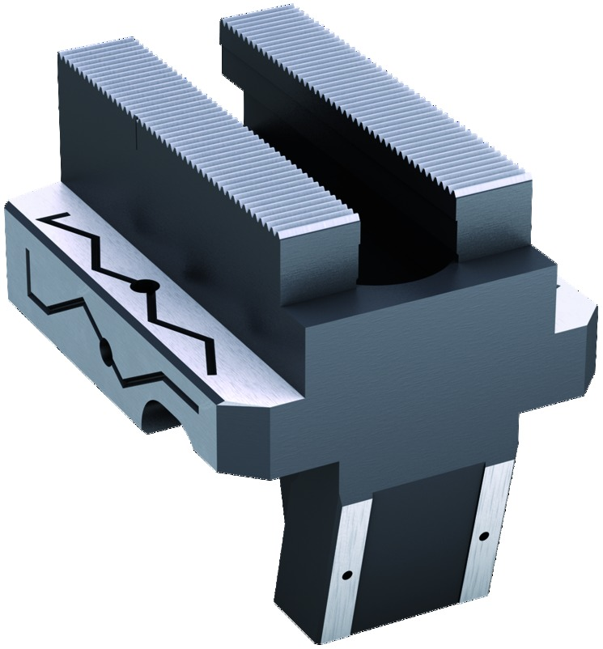
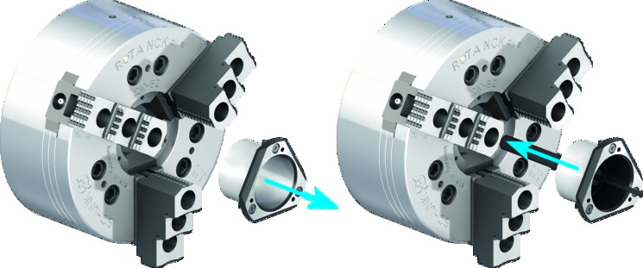
ROTA NCK plus
Highlights
Changing the center sleeve
The modular center sleeves can be changed quickly and easily while the chuck remains mounted. When the three screws are undone, all the protection sleeves can be pulled off from the front and replaced.
Long and precise piston guidance
For high clamping repeatability and long service life. All functional components used for force transmission are hardened and ground.
Absolute flexibility of the base jaw
Select between two standard jaw interfaces 1/16“ x 90° or 1.5 mm x 60° and profit from the fact that you can continue using existing top jaws on the new SCHUNK chuck.

Slide 7
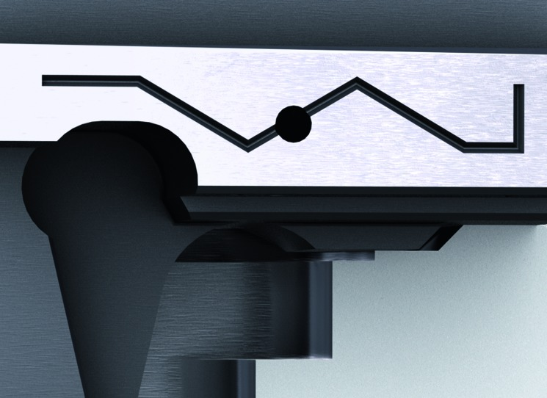
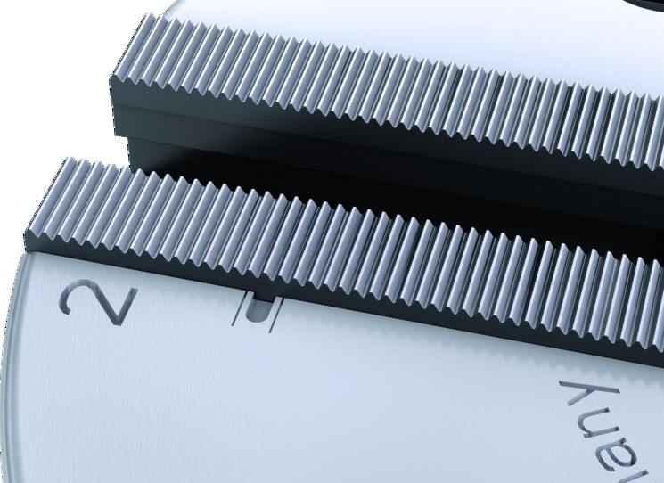
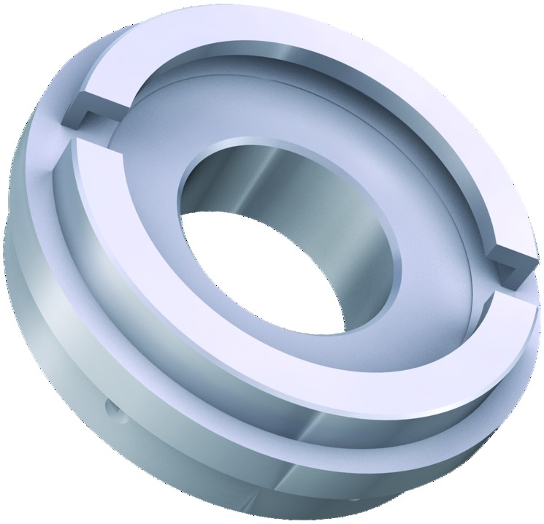
ROTA NCK plus
Highlights
Base jaw safety feature
The small nose at the base jaw remains on the chuck body. This prevents the ejection of the jaws in case of a crash.
Jaw stroke display
The jaw stroke display is an additional safety feature, which ensures safe workpiece clamping and simplifies the use of the chuck in daily operation.
Absolute flexibility – blank draw nut
The supplied center sleeve blank can be easily disassembled and quickly adjusted to the existing draw tube.

Slide 8
ROTA NCK plus
Variants
Technical data | Max. RPM [min⁻¹] | Max. clamping force [kN] | Max. actuating force [kN] | Stroke/jaw [mm] | Through-hole [mm] | Piston stroke [mm]
ROTA NCK plus 165-45 | 6000 | 57 | 22 | 2.75 | 45 | 12
ROTA NCK plus 210-52 | 4800 | 84 | 34 | 3.7 | 52 | 16
ROTA NCK plus 250-75 | 4200 | 111 | 44 | 4.4 | 75 | 19
ROTA NCK plus 315-91 | 3300 | 144 | 56 | 5.3 | 91 | 23

