Slide 1


ROTA NCO
Power Lathe Chucks without Through-hole

Slide 2














Product overview
Gripping Systems
Clamping Technology
Chuck Jaws
Stationary Workholding
Lathe Chucks
Toolholders
Hydraulic Expansion Technology
Manual Lathe Chucks
Power Lathe Chucks with Jaw Quick-change System
Power Lathe Chucks with Through-hole
Power Lathe Chucks without Through-hole
Pneumatic Power Chucks
Steady Rests
Quick-change Systems
Customized Solutions

Slide 3
Challenges
Variants
Required
accuracy
time
time
Global competition
time
Requirements on the clamping fixture: efficiency, flexibility and…
heute
zukünftig

Slide 4

Power Lathe Chucks without Through-hole

Slide 5



ROTA overview
Power Lathe Chucks without Through-hole
ROTA NCO
ROTA 2B
ROTA NCR/ NCR-A
ROTA NCS 3/ NCS 6

Slide 6
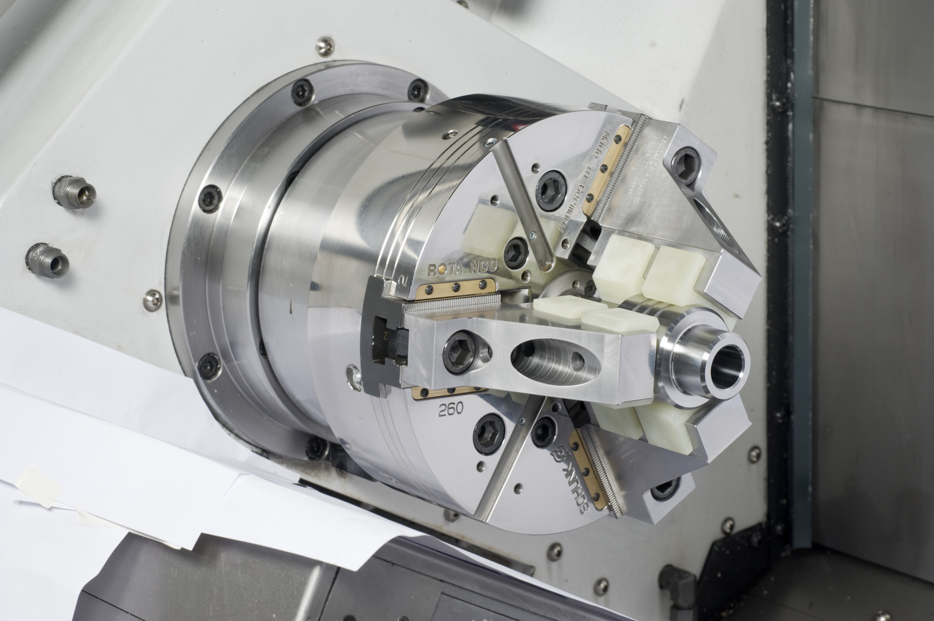
ROTA NCO
Example of application
Clamping device:
ROTA NCO 250 with Quentes special jaws.
Features/Application:
O.D. clamping of finished parts in OP20. Due to the high friction coefficient of the Quentes jaws, low clamping force is needed. No clamping marks at the surface of the workpieces.

Slide 7
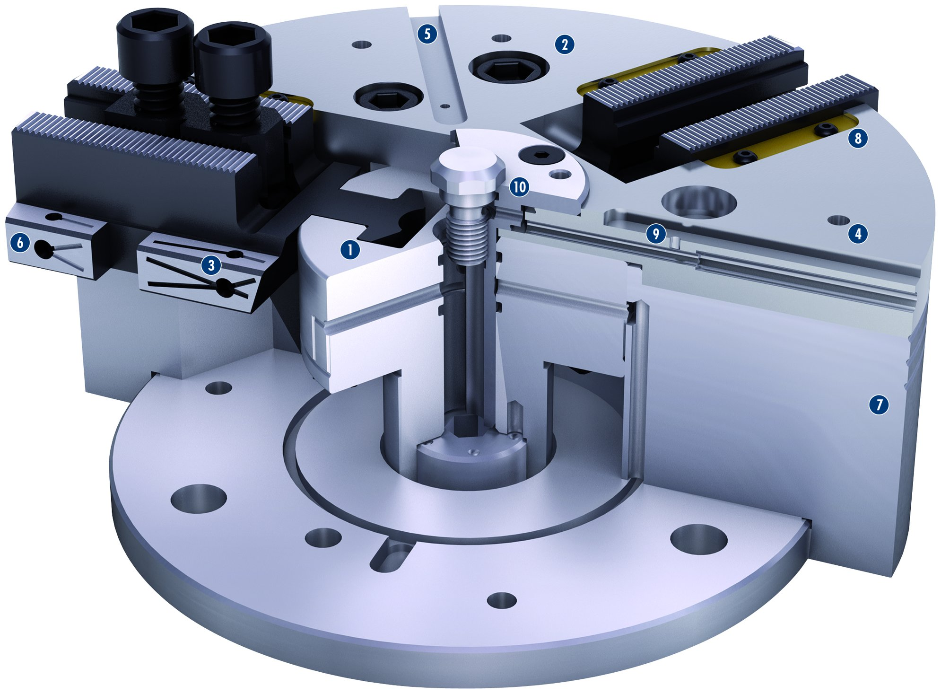
ROTA NCO
5
2
1
Wedge hook drive
Hardened and extremely rigid base body
Optimized lubrication system
Mounting threads
Additional slot guidance on the chuck face
Long jaw guidance
Low height
Wiper strips
Integrated air supply with mounting holes
Central media feed-through
8
2
10
3
6
1
9
4
3
4
5
7
6
7
8
9
10

Slide 8
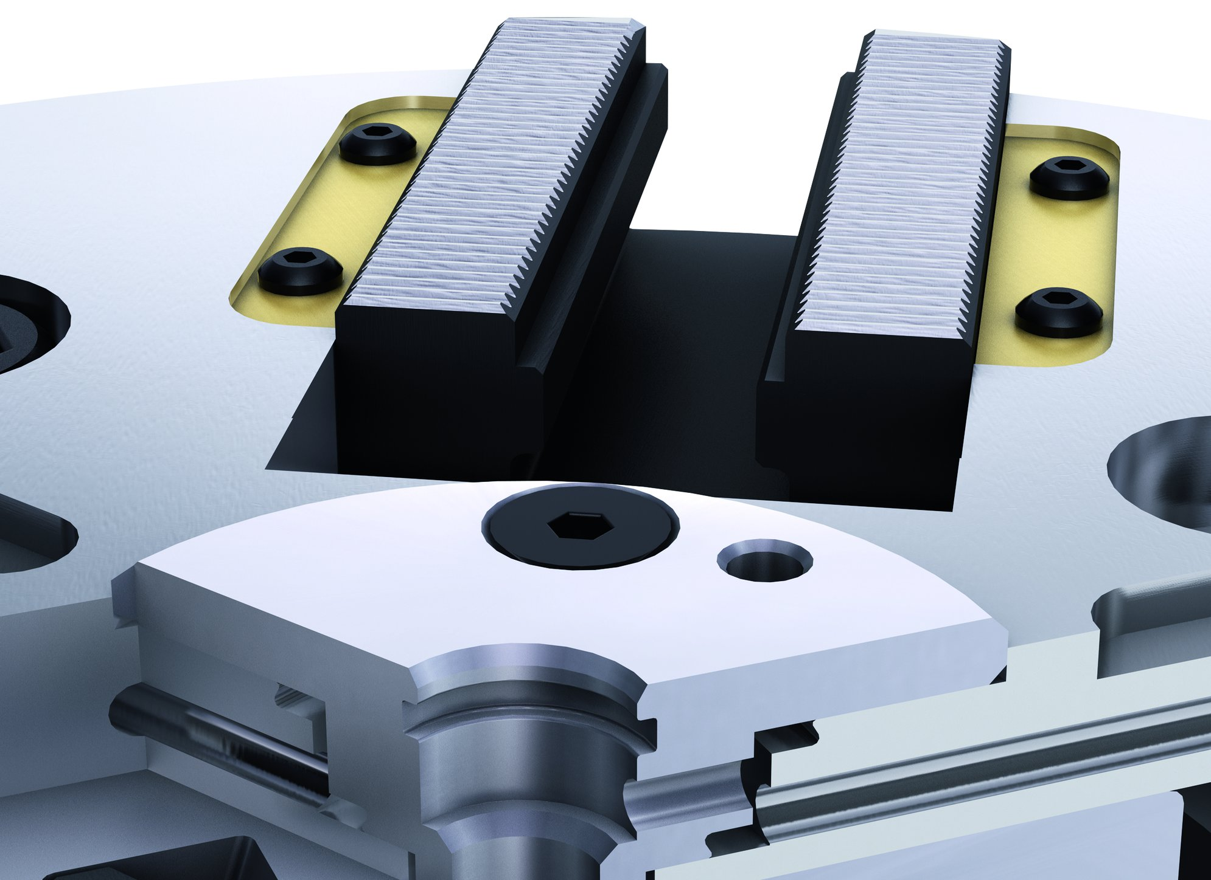
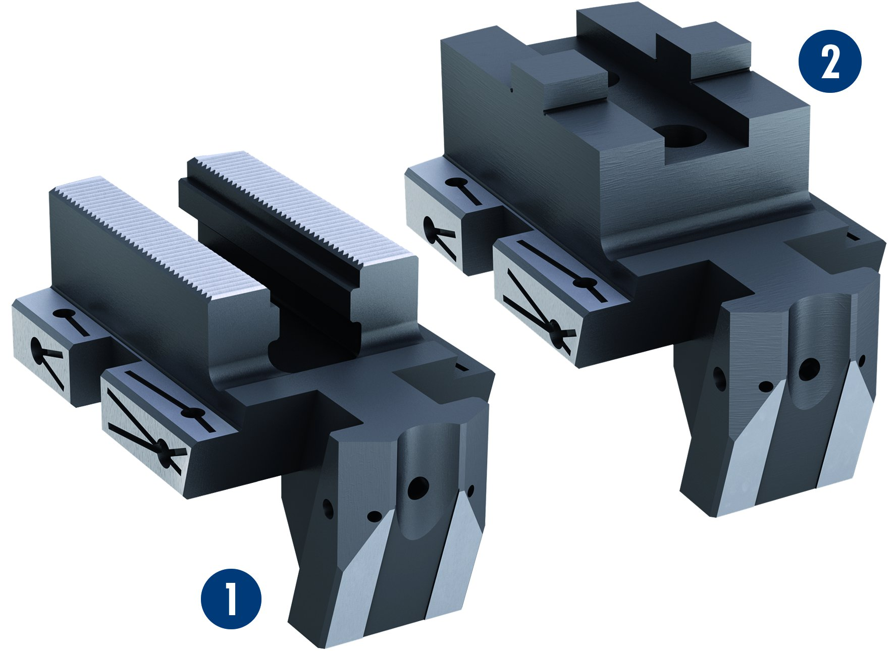
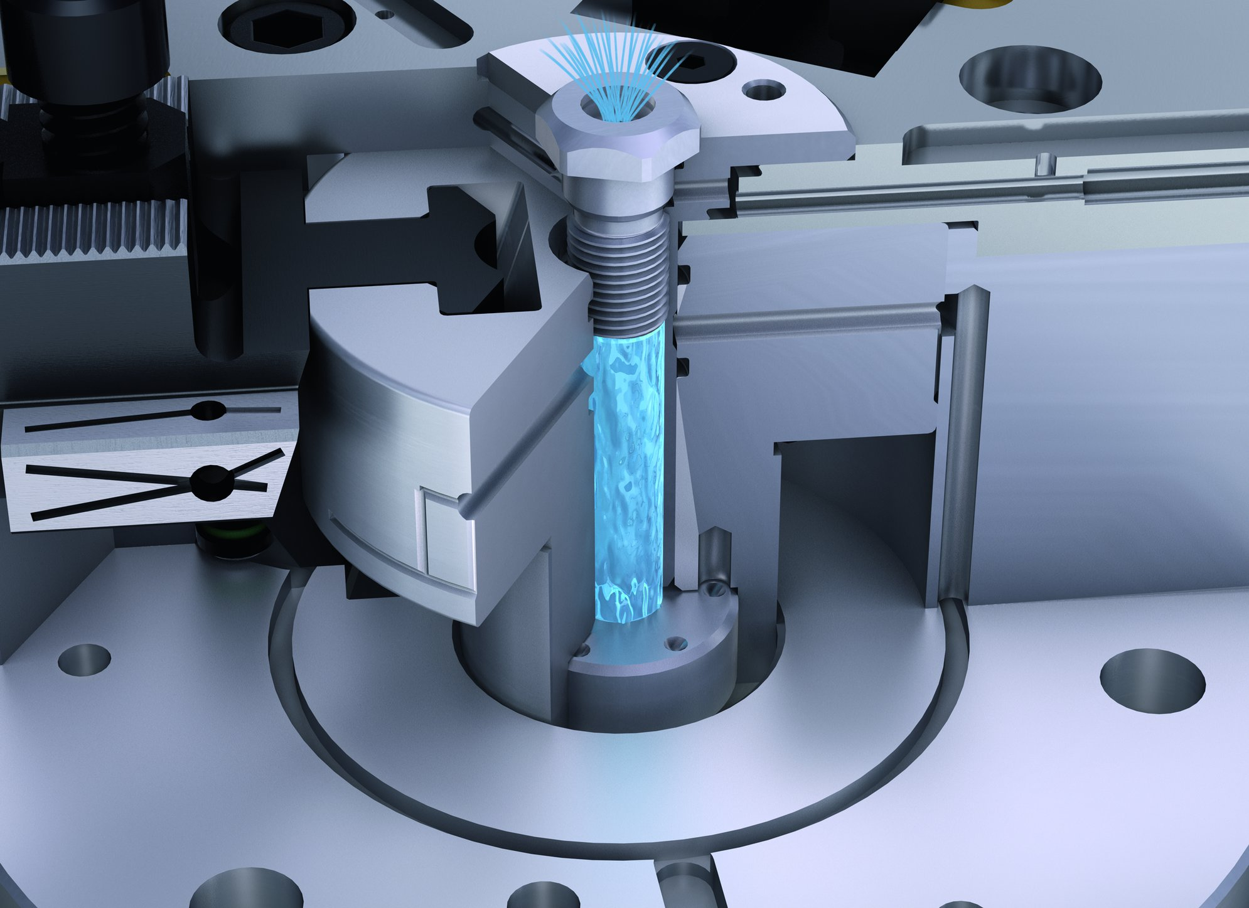
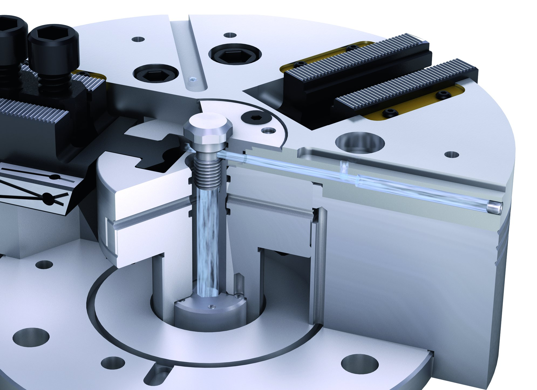
ROTA NCO
Standardized jaw interfaces
Adjustable brass wiper bars
2
1
Fine serration
Metric tongue and groove
2
1
Modification coolant supply
Modification air control

Slide 9
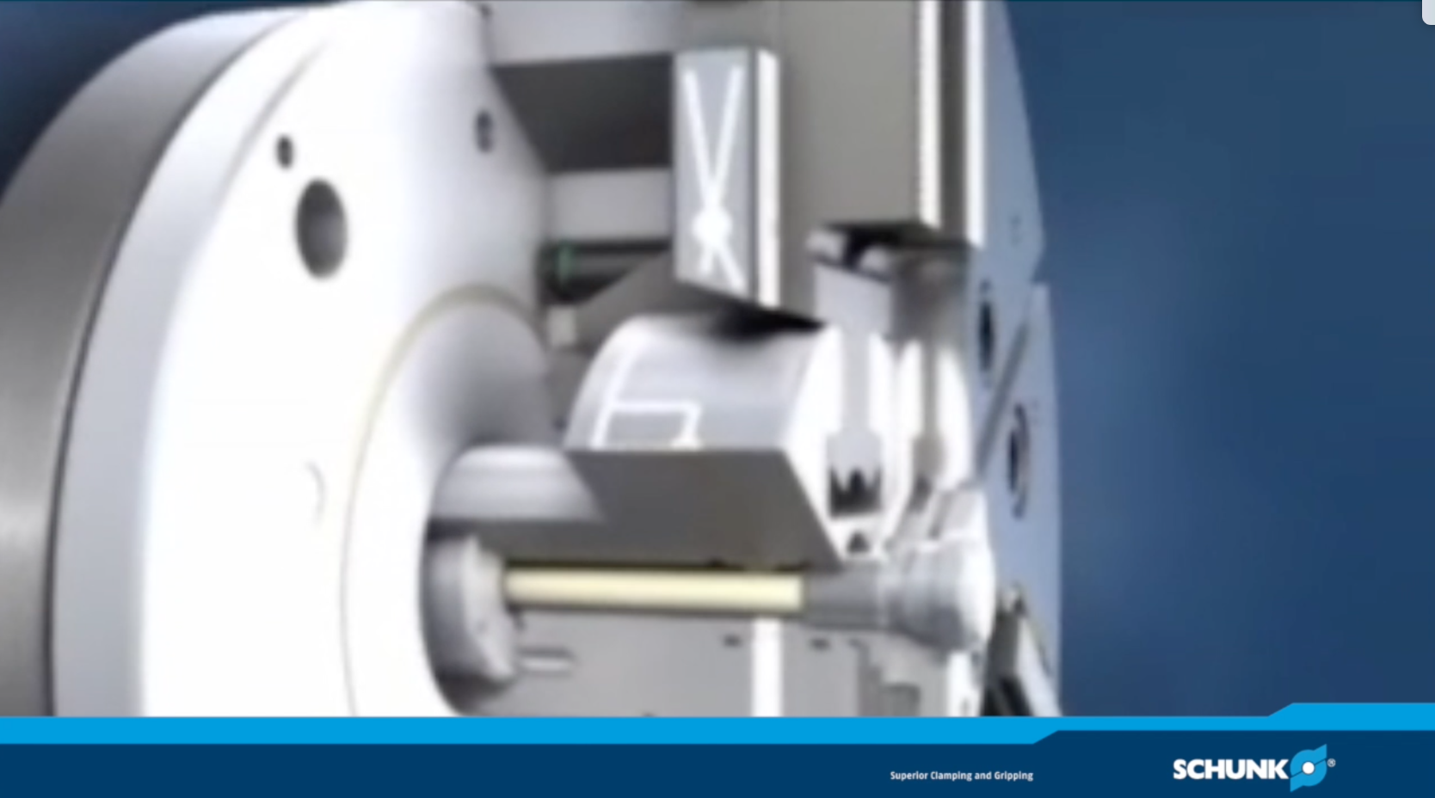
ROTA NCO

Slide 10
Variants ROTA NCO
Technical Data | Max. RPM [min⁻¹] | Max. Clamping force [kN] | Max. actuating force [kN] | Stroke/jaw [mm] | Piston stroke [mm]
ROTA NCO 165 | 6000 | 72 | 30 | 6.4 | 24
ROTA NCO 210 | 5000 | 95 | 42 | 9 | 27
ROTA NCO 260 | 4500 | 150 | 62 | 10 | 30
ROTA NCO 315 | 3600 | 190 | 90 | 13 | 40
ROTA NCO 400 | 2500 | 270 | 120 | 15 | 45
ROTA NCO 500 | 2000 | 330 | 140 | 15 | 45
ROTA NCO 630 | 1600 | 330 | 140 | 15 | 45
ROTA NCO 800 | 1000 | 330 | 140 | 16 | 50
ROTA NCO 1000 | 700 | 410 | 180 | 16 | 50

Slide 11



SCHUNK Services
Engineering
Dimensioning of special plates designed to the manufacturing specifications
Development of special solutions together with the customer
FEM analysis for critical components
Testing
Endurance tests with all new developments
Abrasion checking
Measurement of accuracy
Service
Initial operation of customer´s solution
Inspection and maintenance
Repairs

