Slide 1
Short presentation
TCU

Slide 2
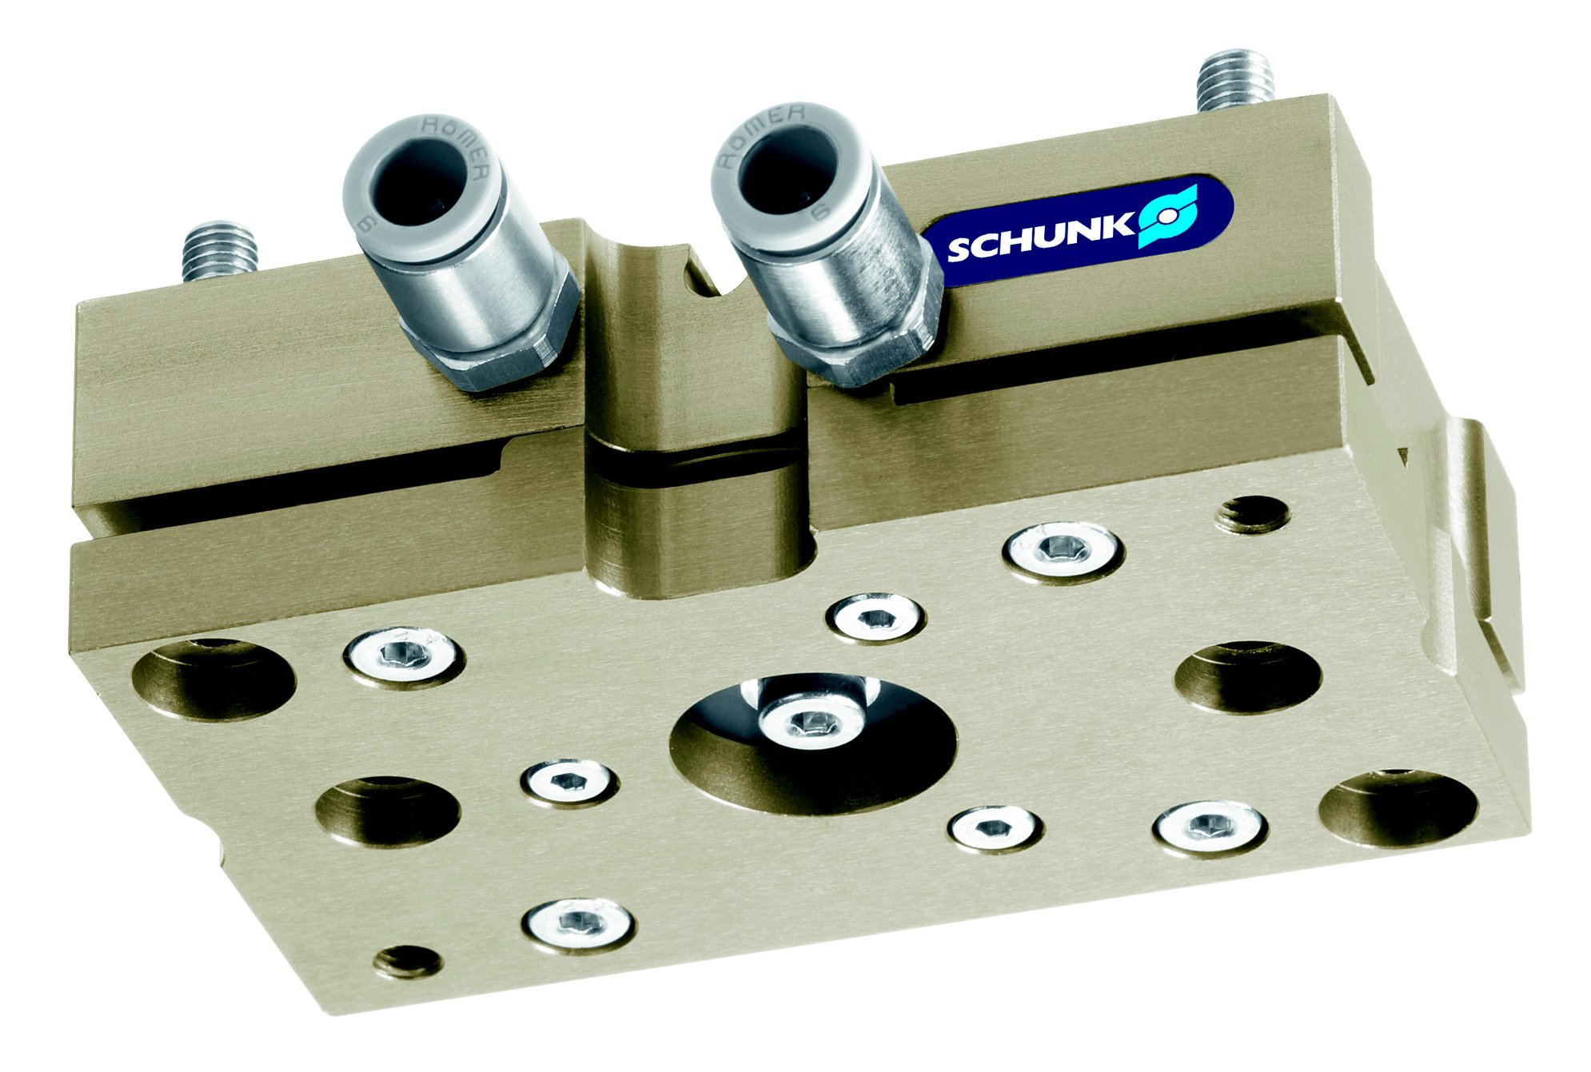
TCU
#1: Compact tolerance compensation unit with few interfering contours
Unique selling points:
Compensation of workpiece tolerances and position inaccuracies
Direct assembly of parallel and centric gripper
Compact Design
Further product features:
See MPG-plus basic version
Further product features:
Pneumatic locking
Monitoring of locking

Slide 3
TCU
#1: Compact tolerance compensation unit with few interfering contours
Customer value/selling points:
Reduces risk of jamming, required assembly forces are reduced
No additional adapter plates required
Low height and weight
Long life of elastomers, if the unit is locked during the process
Safe processes and shorter cycle times

Slide 4
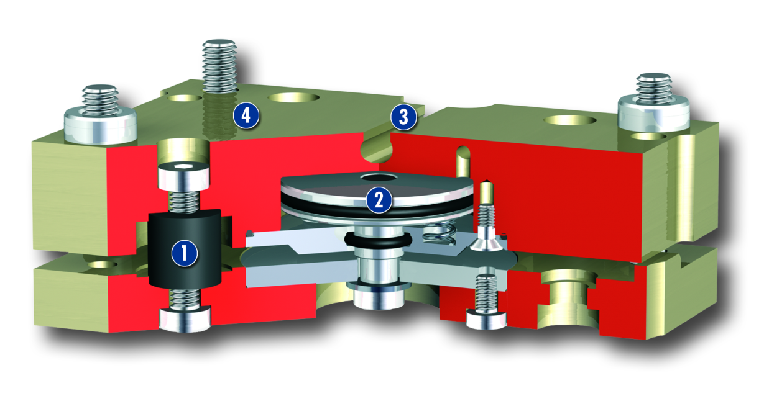
TCU
#1: Compact tolerance compensation unit with few interfering contours
  Basic technical functions:
  Sizes: 050, 064, 080, 100, 160, 200
  Weight: up to 24 kg
  Handling weight: 3 to 60 kg
  Deflection: 1 to 3°
  Moment load Mx: 10 to 160 Nm
  Moment load My: 25 to 160 Nm
  Moment load Mz: 30 to 140 Nm
Elastomere
Pneumatic locking
Slot for magnetic proxy-switches
Mounting interface

Slide 5


