Slide 1

Product presentation
FT
6-axis force/torque sensors

Slide 2
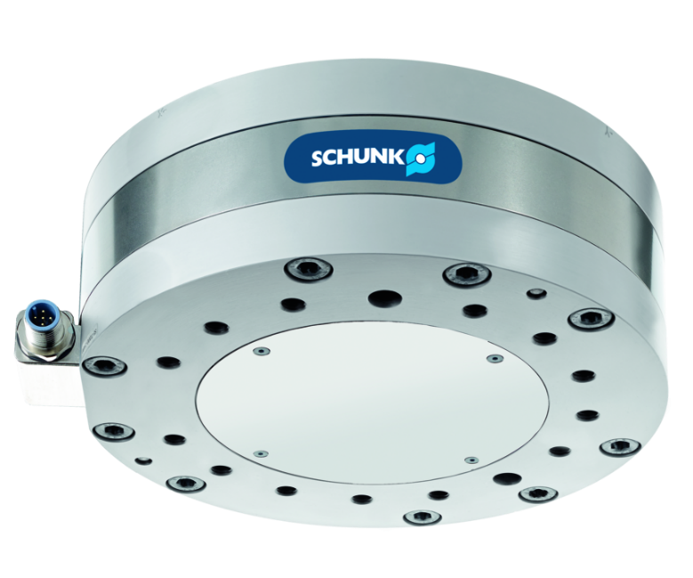
6-axis force/torque sensors
Rigid 6-axis force/torque sensor for precision measuring in all six degrees of freedom
Force/torque sensor for simple applications. Real-time measurement/data output for highly dynamic closed-loop control concepts.
Measurement range from 8 to 40,000 N

Slide 3

Robust. Flexible. Precise.

Slide 4
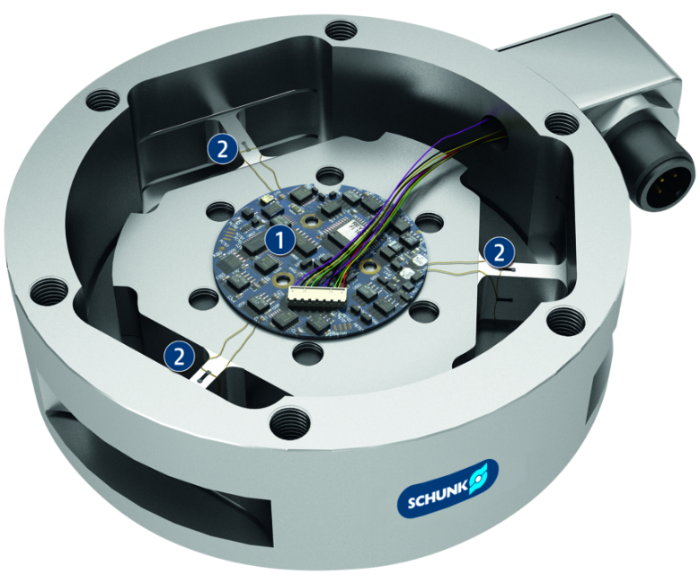
Principle of function
Functional description
The strain gauges (DMS) of the 6-axis force/torque sensors measure the strain applied in all six degrees of freedom (Fx, Fy, Fz, Mx, My and Mz). The DMS signals are amplified in the sensor.
1
Electronics
2
Resistance strain gauges

Slide 5
Advantages – Your benefits
Many sizes with different measuring ranges
The sensor measures in all six degrees of freedom forces as well as moments
Rotation and translation of the coordinates system in all three directions in space
Integrated temperature compensation to ensure the defined measuring accuracy
Easy integration into the process due to easy interface compatibility
Robust design due to a higher overload range for a long service life
IP protection class IP60, 65, 68 available as an option

Slide 6
Technical data
Technical data overview
Series | Size | Range of measurement Fx, Fy | Range of measurement Fz | Range of measurement Mx, My | Range of measurement Mz | Weight | Diameter | Height
 |  | [N] | [N] | [Nm] | [Nm] | [kg] | [mm] | [mm]
FT | Nano17 | 12 .. 50 | 70 | 0.12 .. 0.5 | 0.12 .. 0.5 | 0.0091 | 17 | 14.5
FT | Nano17-Titan | 8 .. 32 | 56.4 | 0.05 .. 0.2 | 0.05 .. 0.2 | 0.01 | 17 | 14.5
FT | Nano25 | 125 .. 250 | 1000 | 3 .. 6 | 3 .. 3.4 | 0.063 | 25 | 21.6
FT | Nano43 | 9 .. 36 | 36 | 0.13 .. 0.5 | 0.13 .. 0.5 | 0.039 | 43 | 11.5
FT | Mini40 | 20 .. 80 | 240 | 1 .. 4 | 1 .. 4 | 0.049 | 40 | 14
FT | Mini43LP | 62 .. 250 | 250 | 0.75 .. 3 | 1.25 .. 5 | 0.05 | 43 | 7.9
FT | Mini45 | 145 .. 580 | 1160 | 5 .. 20 | 5 .. 20 | 0.091 | 45 | 15.7
FT | Mini58 | 700 .. 2800 | 6800 | 30 .. 120 | 30 .. 120 | 0.345 | 58 | 30
FT | Mini85 | 475 .. 1900 | 3800 | 20 .. 80 | 20 .. 80 | 0.635 | 85 | 29.8

Slide 7
Technical data
Technical data overview
Series | Size | Range of measurement Fx, Fy | Range of measurement Fz | Range of measurement Mx, My | Range of measurement Mz | Weight | Diameter | Height
 |  | [N] | [N] | [Nm] | [Nm] | [kg] | [mm] | [mm]
FT | Gamma | 32 .. 130 | 400 | 2.5 .. 10 | 2.5 .. 10 | 0.255 | 75.4 | 33.3
FT | Delta | 165 .. 660 | 1980 | 15 .. 60 | 15 .. 60 | 0.913 | 94.5 | 33.3
FT | Theta | 1000 .. 2500 | 6250 | 120 .. 400 | 120 .. 400 | 4.99 | 155 | 61.1
FT | Omega85 | 475 .. 1900 | 3800 | 20 .. 80 | 20 .. 80 | 0.658 | 85 | 33.4
FT | Omega160 | 1000 .. 2500 | 6250 | 120 .. 400 | 120 .. 400 | 2.72 | 156.5 | 55.9
FT | Omega191 | 1800 .. 7200 | 18000 | 350 .. 1400 | 350 .. 1400 | 9.41 | 190 | 64
FT | Omega250 | 4000 .. 16000 | 32000 | 500 .. 2000 | 500 .. 2000 | 31.8 | 295 | 94.9
FT | Omega331 | 10000 .. 40000 | 88000 | 1500 .. 6000 | 1500 .. 6000 | 47 | 330 | 107

