Slide 1

Product presentation
MWS
Miniature change system

Slide 2
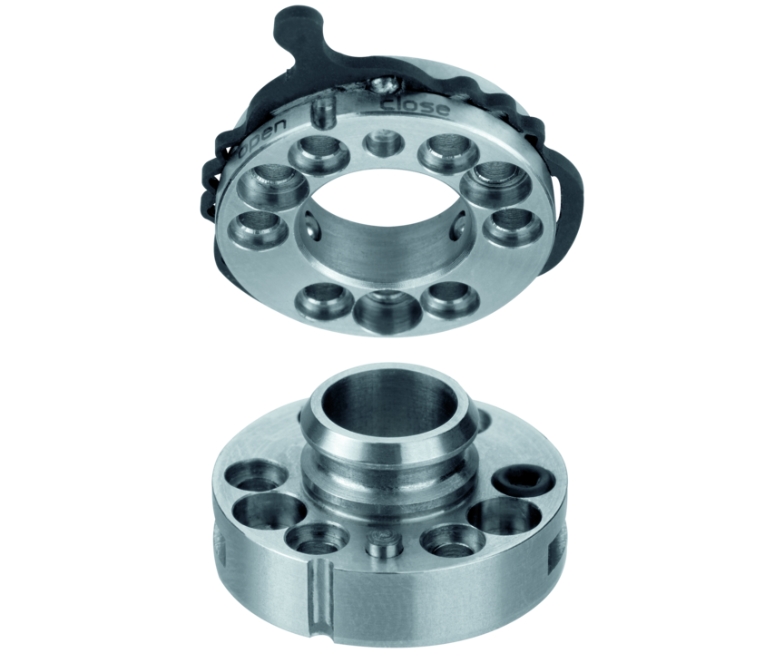
Miniature change system
Manual tool change system with integrated air feed-through and optional electric feed-through

Slide 3

Modular. Compact. Flexible.

Slide 4
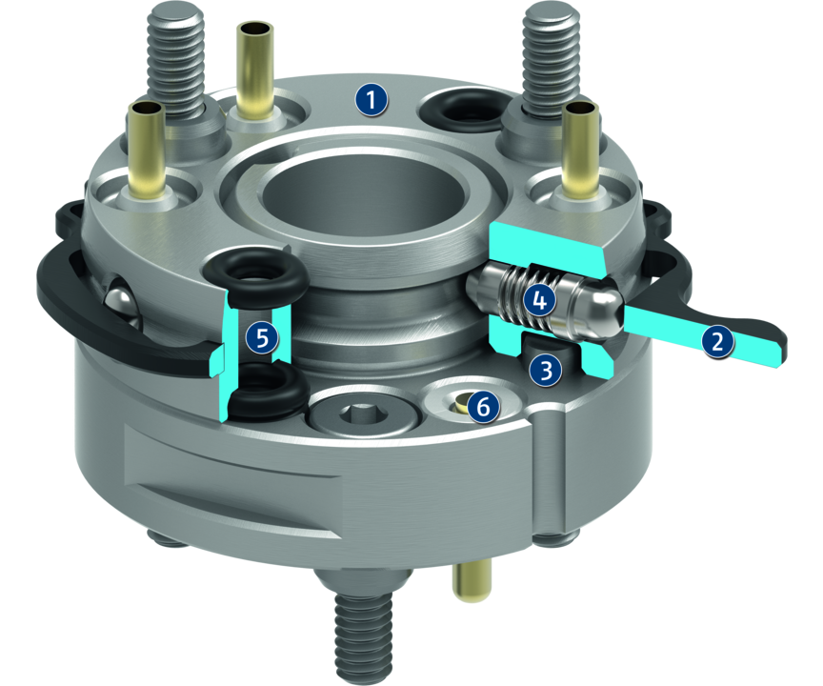
Principle of function
Functional description
The miniature change system (MWS) consists of a miniature change master (MWK) and a miniature change adapter (MWA). A form-fit connection is established between the miniature change master (MWK) and the miniature change adapter (MWA) by actuating the locking ring. An integrated pneumatic feed-through safely provides the tool with electricity.
1
Screw surface
2
Drive ring
3
Anti-twist protection
4
Locking mechanism
5
Pneumatic feed-through
6
Electric feed-through

Slide 5
Advantages – Your benefits
Extremely flat design for less interfering contours
Easy handling without additional tools quickly and easily removable at any time
Center bore for feed-through of parts, camera, laser beams, etc.
Integrated feed-through for six pneumatic or four electrical signals
Suitable storage rack to ensure the optimum adaption to each application
ISO mounting pattern for simple assembly; in compliance with DIN 32565 level 4

Slide 6
Technical data
Technical data overview
Size | Recommended handling weight | Weight | Min./max. distance when locking | No. of fluid feed-throughs | Number of electrical feed-throughs
 | [kg] | [g] | [mm]
20 | 0.5 | 7 .. 9 | 0.25 | 2 | 4
30 | 1 | 12 .. 16 | 0.25 | 2 | 4 .. 6

