Slide 1

Product presentation
FUS
Insertion unit

Slide 2
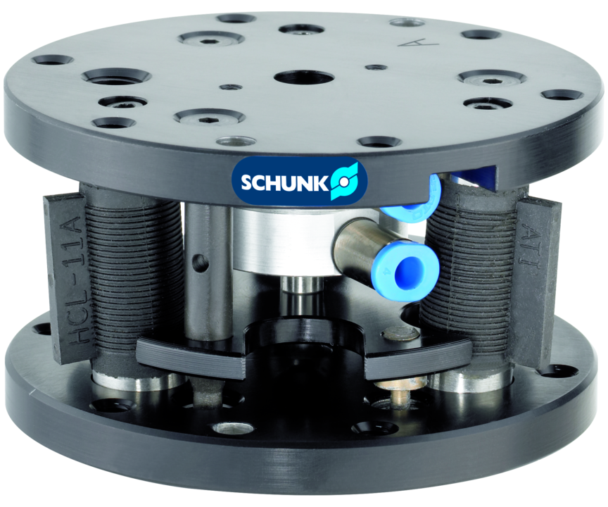
Insertion unit
symmetrical insertion unit with centric locking and monitoring
With pneumatic, centric locking for reset to the defined zero position.
Up to 5° rotary compensation angle

Slide 3

Compliant. Precise. Reliable.

Slide 4
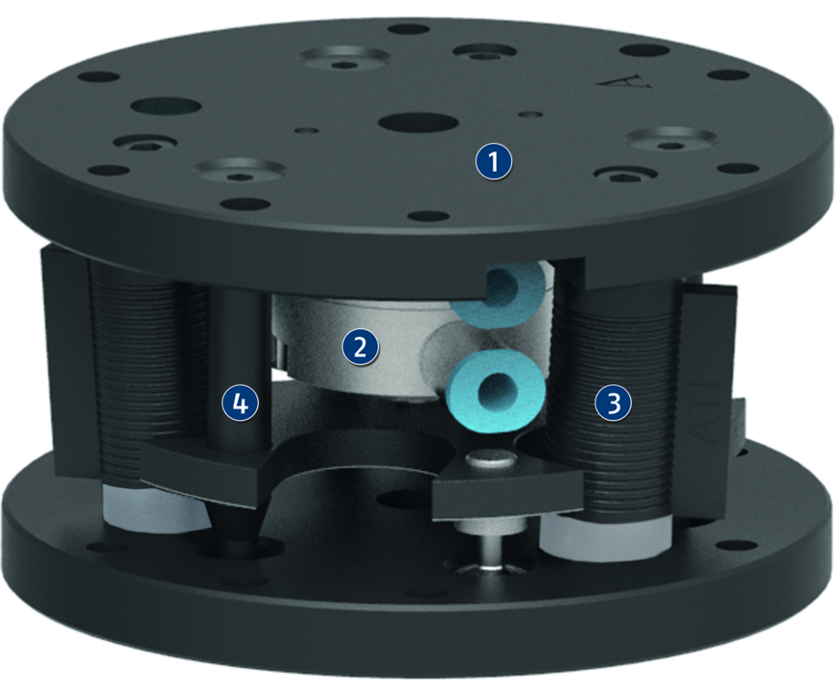
Principle of function
Functional description
The FUS’ function is based on the interaction between the two base plates, which are connected to each other by a set of three or six flexible elastomer elements. As a result, the FUS can compensate tolerances in the X and Y directions, allowing the correction of angle errors and causing a rotational compensation.
The FUS offers pneumatic locking to allow the compensation unit to be set to rigid. As a result, it is possible to prevent the tool or the gripper vibrating during movement of the robot arm or the linear axis. This increases the application’s repeat accuracy and extends the service life of the elastomer elements.
1
Adapter flange
2
Pneumatic locking
3
Elastomers
4
Overload pin

Slide 5
Advantages – Your benefits
Pneumatic, centric locking puts the unit back to a defined zero position and protects the elastomers
Layered elastomer construction soft and flexible when aligning, rigid when pressing in
Compensates alignment errors thereby reducing the danger of jamming

Slide 6
Technical data
Technical data overview
Size | Locking | Weight
 |  | [kg]
1 | mit Verriegelung | 0.18
001-30 | ohne Verriegelung | 0.05
100 | mit Verriegelung | 0.31
200 | mit Verriegelung | 0.5
400 | mit Verriegelung | 1.6 .. 1.8

