Slide 1

Product presentation
FDB
Deburring spindle

Slide 2
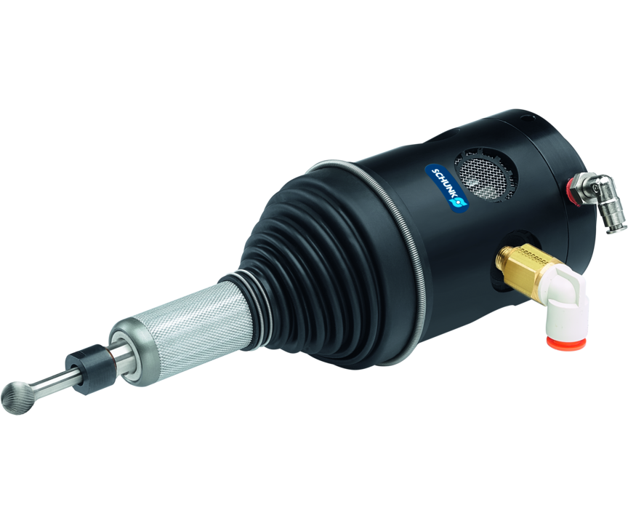
Deburring spindle
Flexible deburring spindle for use in robotic applications
Flexible and robot-controlled deburring of different workpiece contours.
Up to 65,000 RPM

Slide 3

Compliant. Robust. Precise.

Slide 4
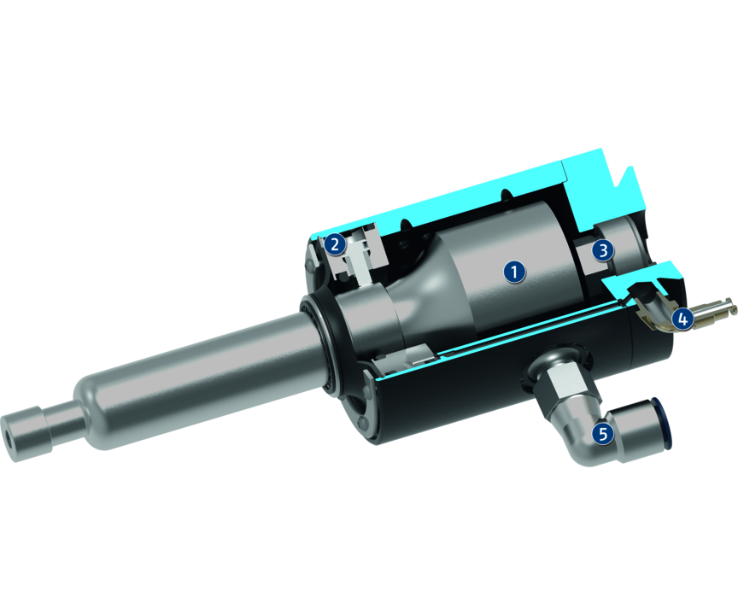
Principle of function
Functional description
The unit is driven by a pneumatic spindle with a speed of rotation depending on the unit size. The spindle is swivel mounted for being able to compensate the tolerances of the whole machining contour.
The force (rigidity) is needed for moving (oscillating) the spindle. It is controlled by a second air connection. Depending on the pressure, force is applied on the milling cut surface.
1
Pneumatic spindle
2
Ring cylinder
3
Bearing
4
Air connection
5
Air connection

Slide 5
Advantages – Your benefits
Flexible high-frequency spindle for maximum flexibility when deburring
Pneumatically adjustable rigidity of the cutting spindle via compressed air for clean chamfer edges in every installation position
High speeds for high feed rates
Flexible use on the robot arm or as a stationary unit
Axis locking function available to restrict the compensation path on the X-axis.

Slide 6
Technical data
Technical data overview
Size | Power | Max. compensation X | Max. compensation Y | Recommended compensation path | Idle speed | Weight
 | [W] | [mm] | [mm] | [mm] | [1/min] | [kg]
150 | 150 | 5 | 5 | 2.5 | 65000 | 1.11
300 | 300 | 7.5 | 7.5 | 3.8 | 30000 | 1.15
340 | 340 | 5.5 .. 7.5 | 0 .. 7.5 | 2.8 .. 3.8 | 40000 | 1.13 .. 1.15
900 | 900 | 9 | 9 | 4.5 | 25000 | 3.4
1040 | 1040 | 9 | 9 | 4.5 | 40000 | 4.53

