Slide 1

Product presentation
CWS
Compact change system

Slide 2
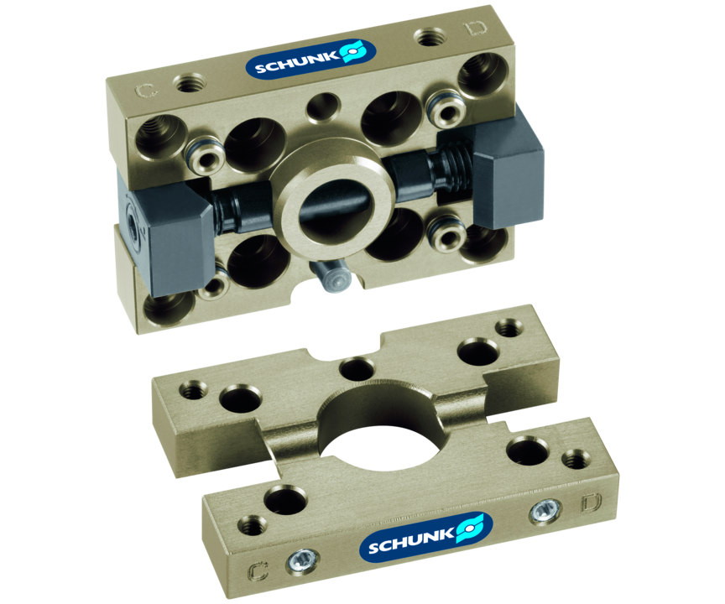
Compact change system
Compact, manual change system with integrated air feed-throughs for the most important SCHUNK gripping and compensation modules.

Slide 3

Compact. Flat. Productive.

Slide 4
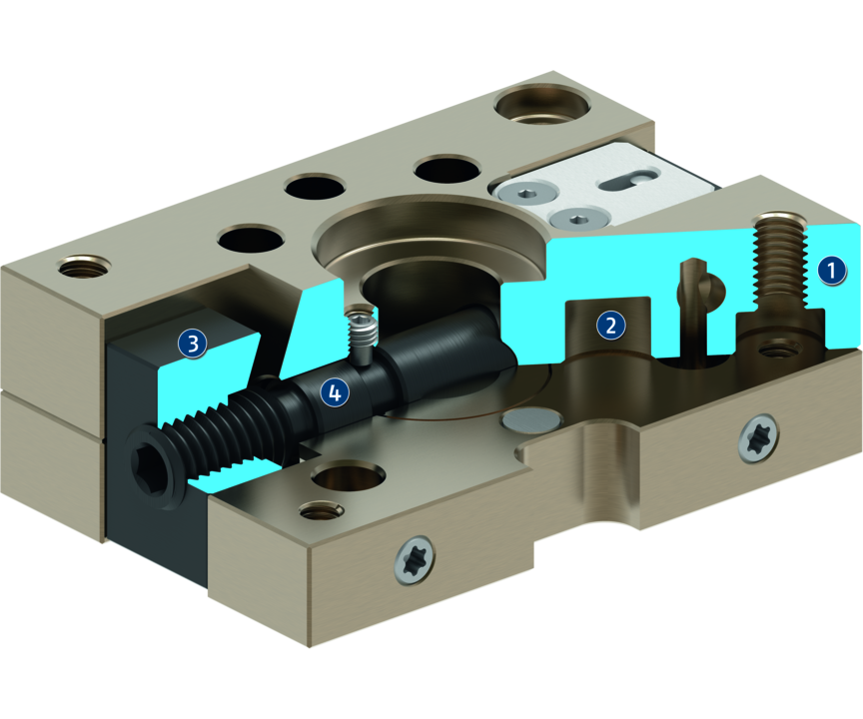
Principle of function
Functional description
The compact change system (CWS) consists of a change head (CWK) and a change adapter (CWA). A form-fit connection is established between the CWK and the CWA with two clamping jaws connected via a threaded spindle. The gripper is safely supplied with pneumatic power by up to four integrated pneumatic feed-throughs.
1
Housing
2
Air feed-through
3
Clamping jaw
4
Drive spindle

Slide 5
Advantages – Your benefits
High productivity through fast manual gripper change, especially with small and medium-sized lot sizes
Flat and weight-optimized through direct assembly of the gripper onto the change system without adapter plate
Series with five unit sizes for optimal size selection and a broad application range
Integrated pneumatic feed-through for safe energy supply of grippers
ISO mounting pattern for easy assembly to most types of robots without needing additional adapter plates

Slide 6
Technical data
Technical data overview
Size | Recommended handling weight | Weight
 | [kg] | [kg]
50 | 10 | 0.02 .. 0.05
64 | 16 | 0.032 .. 0.075
80 | 20 | 0.045 .. 0.115
100 | 24 | 0.07 .. 0.185
125 | 28 | 0.125 .. 0.32

