Slide 1

Product presentation
DDF-SE
Stationary rotary feed-through

Slide 2
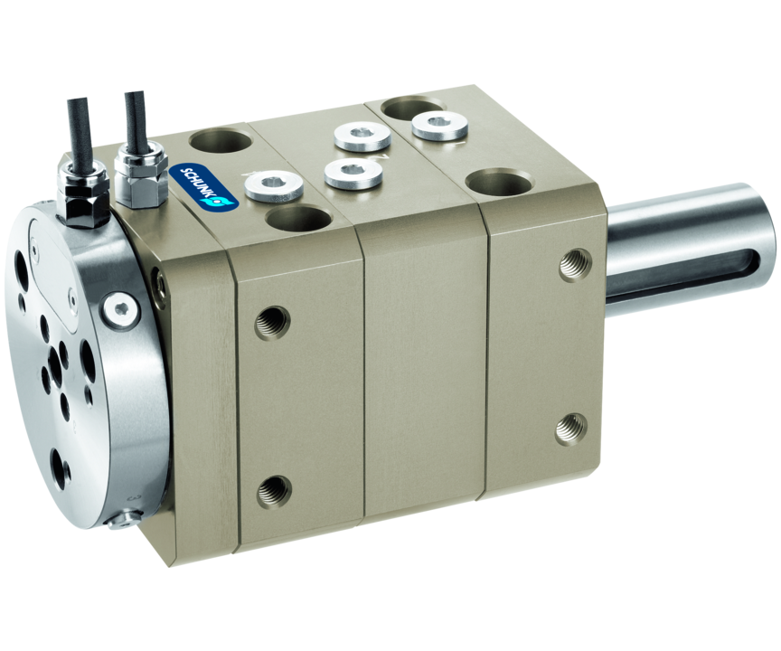
Stationary rotary feed-through
For feeding through electric signals and pneumatics for use on robots even when they are endlessly rotating.

Slide 3

Robust. Reliable. Flexible.

Slide 4
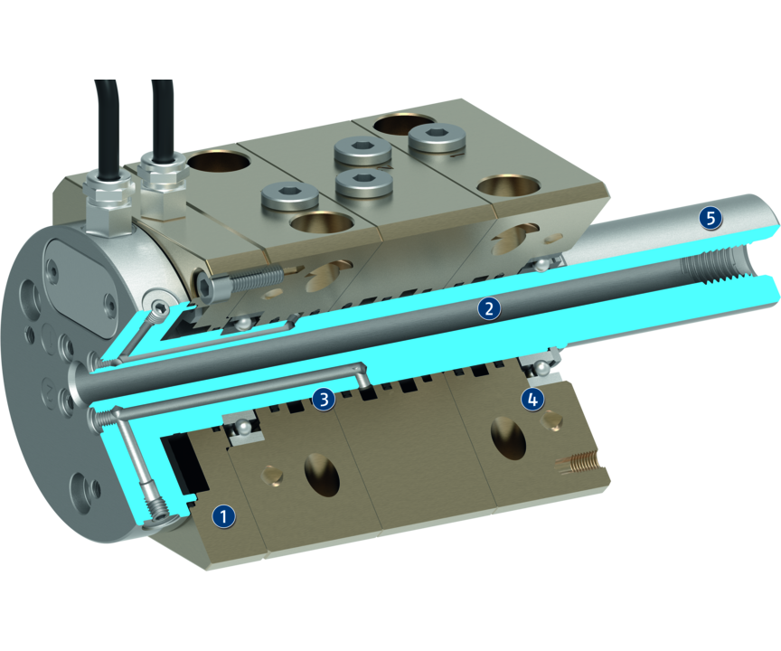
Principle of function
Functional description
The DDF-SE allows rotary movements of your tool of more than 360° without hoses and cables twisting around the axis. Integrated slip ring contacts supply the tool with energy, even at higher speeds (500 RPM).
Electrics and up to six pneumatic lines are fed through. The drive motor is flange-mounted with a standard shaft end with keyway. In order to minimize the axial offset between the motor and DDF-SE, a coupling should be provided.
1
Slip ring
2
Center bore
3
Air feed-through
4
Ball bearings
5
Steel shaft with keyway

Slide 5
Advantages – Your benefits
Combined air and electric feed-through for extensive supply to your gripper system/tool
Standardized shaft end for easy gear assembly
Revolutions up to 500 RPM ensures a reliable supply of pneumatic and electrical power for your gripping system, even with fast rotations of up to 500 RPM
Center bore available for simple feeding through of cables

Slide 6
Technical data
Technical data overview
Size | Max. drive speed | Continuous torque | Starting torque | Angle of rotation | No. of fluid feed-throughs | Max. pressure per connection | Number of electrical feed-throughs | Weight
 | [1/min] | [Nm] | [Nm] | [°] |  | [bar] |  | [kg]
80 | 500 | 4 | 6 | 360 | 4 | 10 | 6 | 3.3
120 | 300 | 13 | 20 | 360 | 6 | 10 | 8 | 9

