Slide 1

Product presentation
AGE-XY
Compensation unit XY

Slide 2
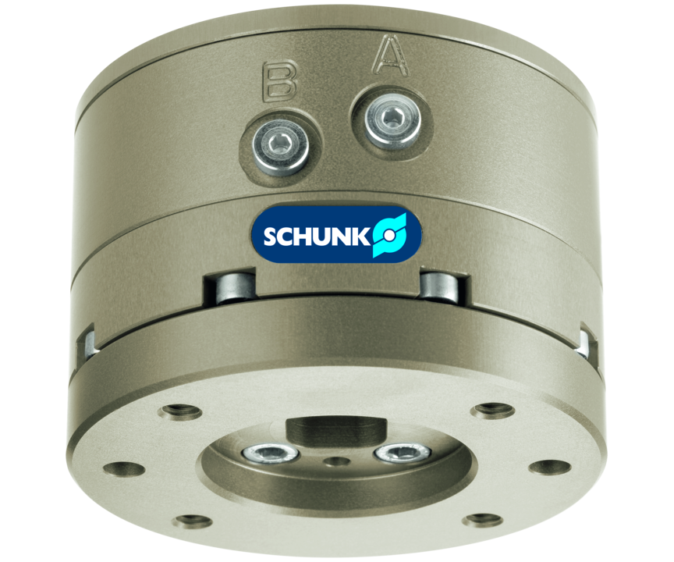
Compensation unit XY
Compensation unit with X-Y lateral compliance
The first precise compensation unit with position memory can be used in the assembly and handling area.
Up to 4 mm compensation stroke in XY

Slide 3

Compact. Smooth. Robust.

Slide 4
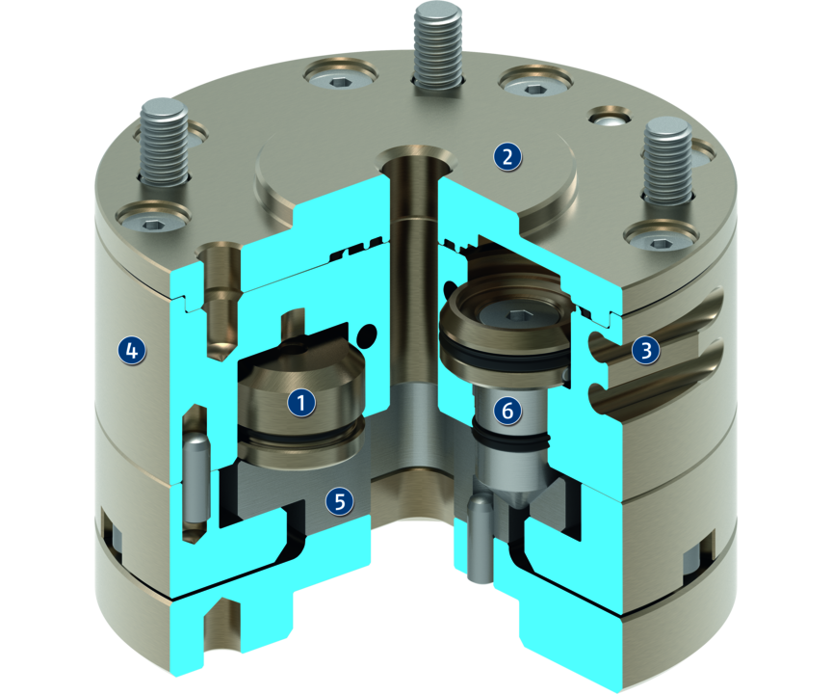
Principle of function
Functional description
The compensation unit AGE-XY allows the release of the linear movement in the X- and Y-axis by robots or handling units. After the compensation process, the workpiece can be centrically aligned again.
1
Position memory
2
Direct assembly
3
Monitoring
4
Housing
5
Compensation body
6
Centrical locking

Slide 5
Advantages – Your benefits
ISO mounting pattern for easy assembly to most types of robots without needing additional adapter plates
Robust sliding guide for high moment load at minimum space
Centrical locking for centering the unit in a defined position
Pneumatic position storage for eccentric locking in a deflected position

Slide 6
Technical data
Technical data overview
Size | Compensation XY | Deflection rotatory | Recommended handling weight, vertical | Recommended handling weight, horizontal | Locking force | Weight
 | [mm] | [°] | [kg] | [kg] | [N] | [kg]
50 | 2.5 | 12 | 6 | 4 | 235 | 0.46 .. 0.47
63 | 3 | 12 | 9 | 6 | 370 | 0.83 .. 0.85
80 | 4 | 16 | 15 | 10 | 580 | 1.49 .. 1.5

