Slide 1

Product presentation
AGE-S
Compensation unit XYZ

Slide 2
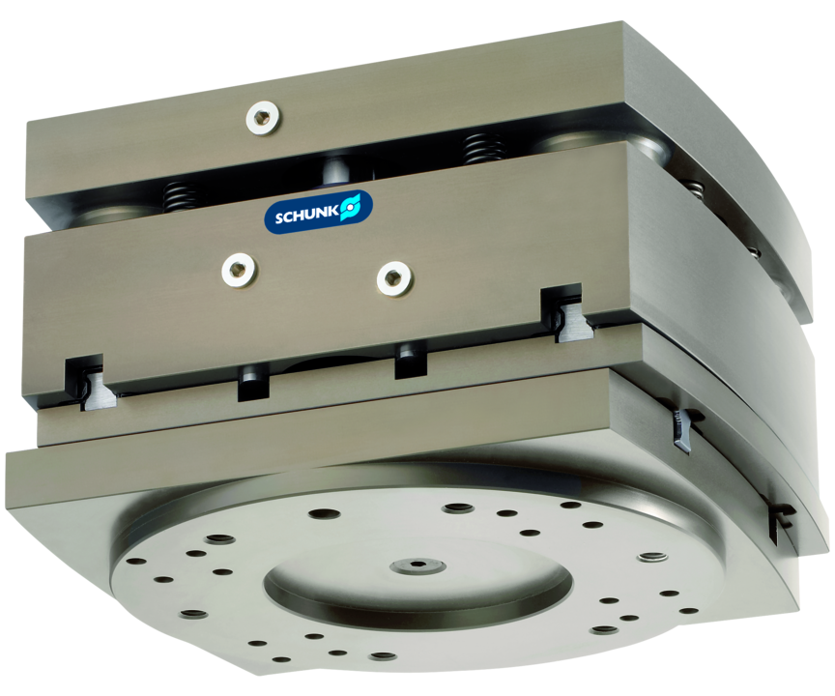
Compensation unit XYZ
Compensation unit compensating in XY- and Z-direction
For the medium and heavy load range with compensation options in X, Y and Z direction.
Up to 12 mm compensation path

Slide 3

Modular. Precise. Robust.

Slide 4
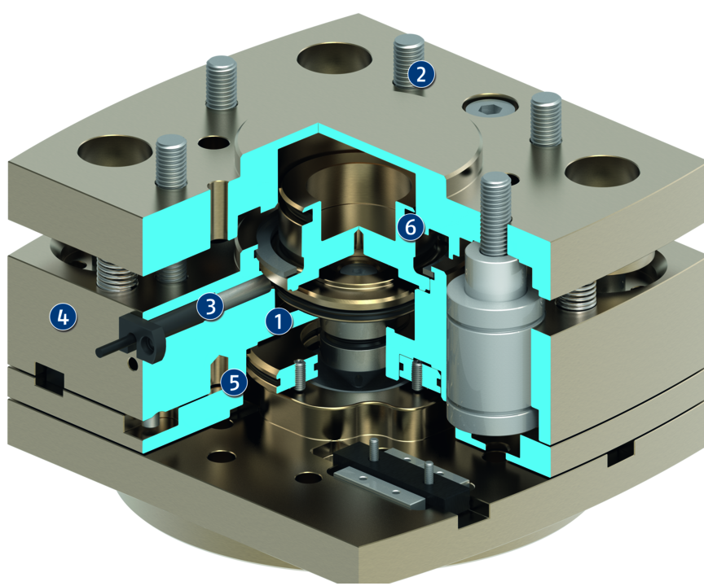
Principle of function
Functional description
The compensation unit AGE-S extends the AGE series (AGE-XY/AGE-Z/AGE-F) for the medium and heavy load range, and provides perfect compensation in all automation tasks. Robust and high-precision linear guidances with excellent guiding stability permit maximum handling weights at maximum compensation paths.
During handling in XY- as well as Z-direction, the unit can be made rigid using the integrated pneumatic lock and eccentrically locked using the position memory in XY-direction.
1
Position memory
2
Direct assembly
3
Monitoring
4
Housing
5
Compensation body
6
Centrical locking

Slide 5
Advantages – Your benefits
ISO mounting pattern for easy assembly to most types of robots without needing additional adapter plates
Three compensation directions in one unit compact design for minimum installation height
Centrical locking for fixing the unit rigidly in a defined, centric position
Pneumatic position storage for eccentric locking in a deflected position

Slide 6
Technical data
Technical data overview
Size | Compensation XY | Recommended handling weight, vertical | Recommended handling weight, horizontal | Locking force | Weight
 | [mm] | [kg] | [kg] | [N] | [kg]
100 | 4 | 9 | 5.5 | 800 | 2.6 .. 3.6
125 | 7 | 18 | 11 | 1100 | 5.3 .. 7.4
160 | 10 | 60 | 40 | 1800 | 10.5 .. 14.5
200 | 12 | 160 | 100 | 2700 | 21 .. 29.5

