Slide 1

Product presentation
AGE-F
Compensation unit AGE-F

Slide 2
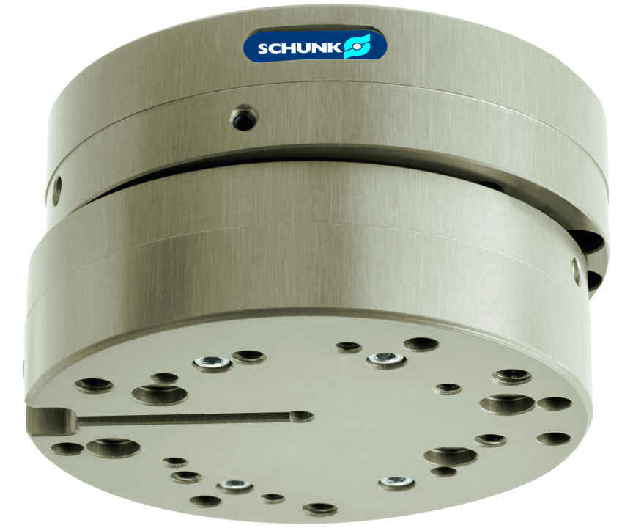
Compensation unit AGE-F
Compensation unit with X-Y lateral compliance and integrated spring return
With adjustable spring reset and compensation stroke
Up to 32 kg handling weight

Slide 3

Flat. Flexible. Compact.

Slide 4
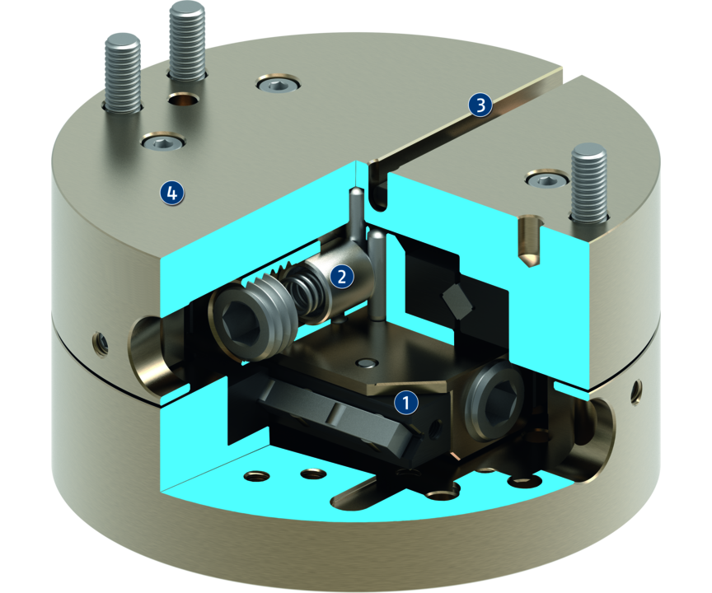
Principle of function
Functional description
The compensation unit AGE-F enables the activation of the linear movement in the X and Y axis of the robots or handling units. For example, this allows axis offset of workpieces to be compensated and centrically aligned again.
1
Linear guide
2
Spring-actuated reset
3
Slot for magnetic switch
4
Housing

Slide 5
Advantages – Your benefits
Spring reset in three different spring strengths. for a defined, centric position at a repeat accuracy of 0.02 mm
Direct assembly of grippers no need for additional adapter plates
Cross roller guides for smooth compensation at low compensation forces
Adjustable compensation stroke for minimizing interfering contours

Slide 6
Technical data
Technical data overview
Size | Compensation XY | Weight
 | [mm] | [kg]
31 | 1.5 | 0.123
40 | 2 | 0.23
63 | 4 | 0.78
80 | 5 | 3.13

