Slide 1

Product presentation
SFL
Vane swivel unit

Slide 2
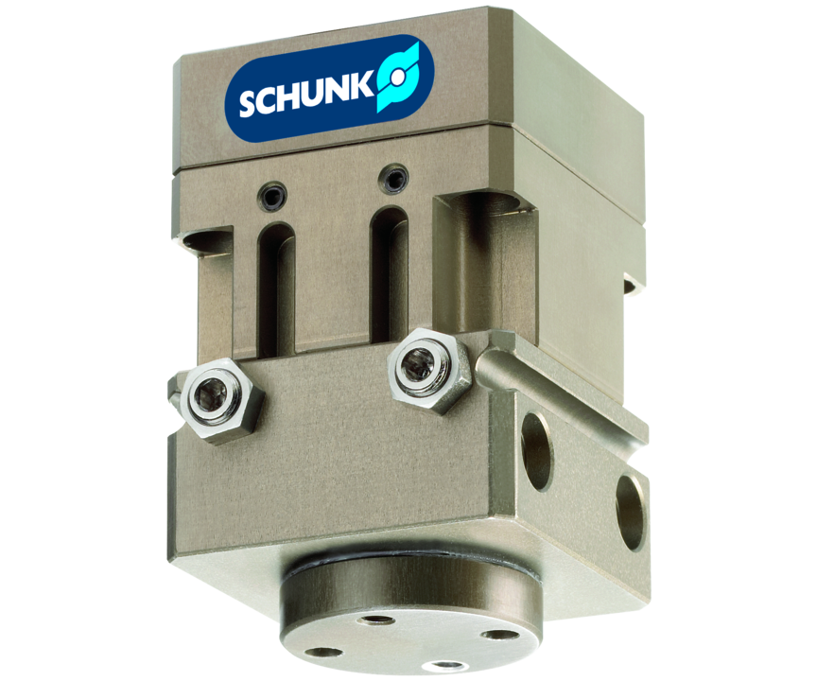
Vane swivel unit
Miniature vane swivel unit for light swiveling tasks up to 180°

Slide 3

Flexible. Freely adjustable swivel angle.

Slide 4
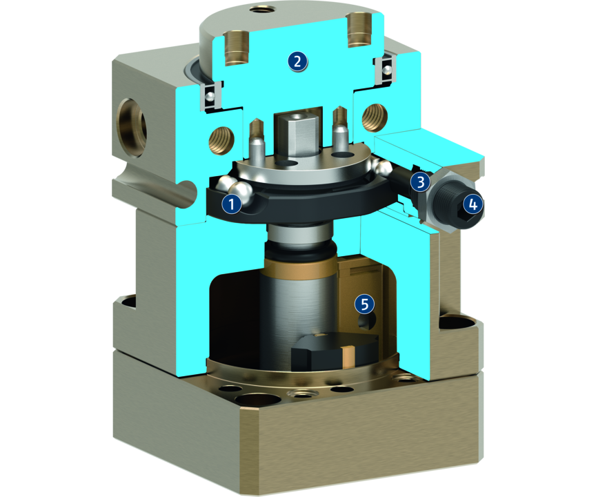
Principle of function
Functional description
The drive is pneumatic and based on the rotor principle.
The complete module can be supplied via a central, base-side connection using the direct connection.
1
Pre-adjustment of rotating angle
2
Rotary table
3
Fine adjustment of the angle of rotation
4
End position damping
5
Vane swivel unit

Slide 5
Advantages – Your benefits
Compact design due to the almost cube shaped design several modules can be mounted in parallel
Flexible adjustment of the swivel angle from 0 -180° this results in a versatile range of applications
Fine adjustment of the angle of rotation for sensitive adjustment of end positions
Powerful for even greater masses and inertias due to the variant with hydraulic shock absorbers
High life time and excellent synchronization due to machining of the running surfaces

Slide 6
Technical data
Technical data overview
Size | Angle of rotation | Torque | Weight | Repeat accuracy
 | [°] | [Nm] | [kg] | [°]
25 | 90 .. 180 | 0.1 | 0.09 | 0.05
40 | 90 .. 180 | 0.5 | 0.24 | 0.05
64 | 90 .. 180 | 3.6 | 0.71 | 0.05

