Slide 1

Product presentation
GFS
Swivel finger

Slide 2
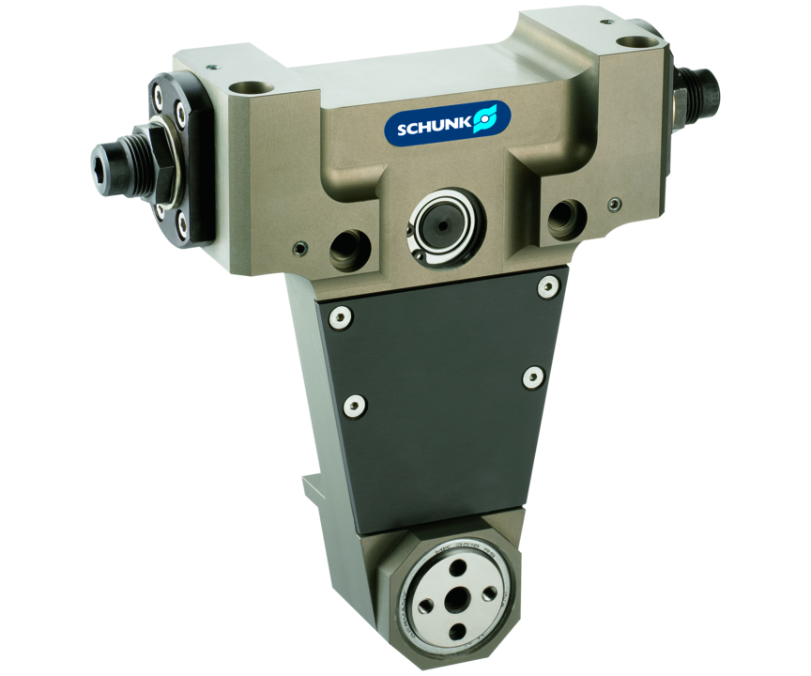
Swivel finger
Rotary finger for turning workpieces that are held by a gripper or can also be used as a special swivel unit

Slide 3

Productive. Flexible. Compact.

Slide 4
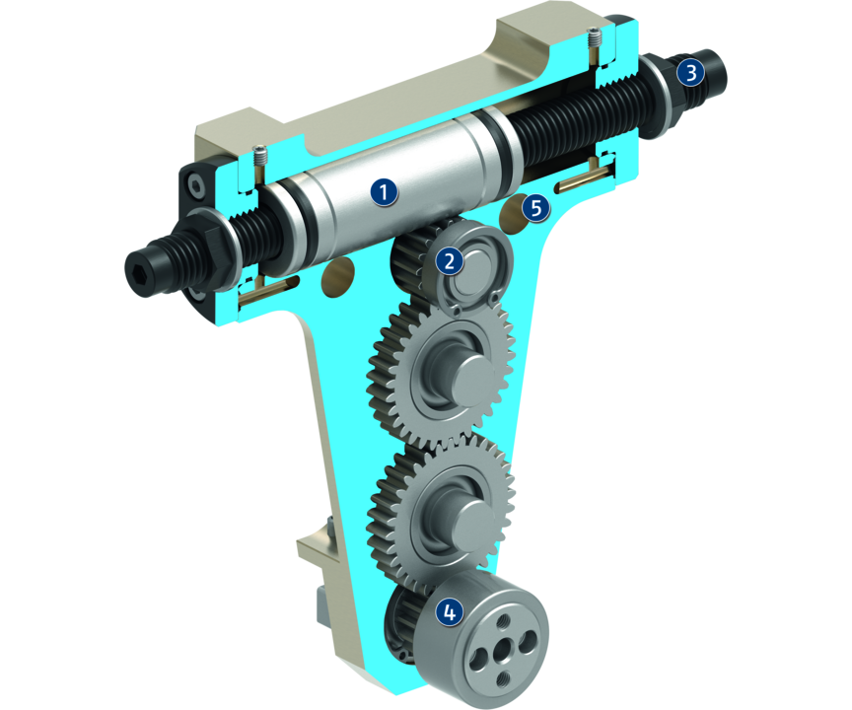
Principle of function
Functional description
The piston, subjected to compressed air on both sides, moves in a straight line. With its serrations, it turns the first gear. The rotary movement is transferred to the output flange by means of further gears.
1
Drive
2
Kinematics
3
Damping
4
Rotary flange
5
Centering and mounting possibilities

Slide 5
Advantages – Your benefits
Integrated hydraulic end position dampers for fast swiveling cycles
scope-free end positions for highest positioning accuracy
Counter-bearing without drive or damping as a cost-efficient version of the second bearing position

Slide 6
Technical data
Technical data overview
Size | Angle of rotation | Torque | Weight | Repeat accuracy
 | [°] | [Nm] | [kg] | [°]
16 | 90 .. 180 | 0.64 | 0.55 .. 0.69 | 0.07
25 | 90 .. 180 | 2.35 | 1.25 .. 1.6 | 0.07
32 | 90 .. 180 | 5 | 2.4 .. 3 | 0.07
40 | 90 .. 180 | 10 | 4 .. 5 | 0.07

